Slide 1
CA Real Estate Practice Excellence
Values, Attitudes, and Habits for Success
Guiding First-Generation Wealth Creators Through Integrity and Excellence

Slide 2
What This Training Covers
5 Core Values for ethical real estate practice
3 Essential Attitudes that build client trust
5 Professional Habits that transform delivery
Networking Framework for one-stop shop services
Daily Reflection Ritual for continuous growth

Slide 3
Five Core Values
The Foundation of Ethical Real Estate Practice

Slide 4
1. Integrity and Transparency
Why It Matters: Verifying title deeds protects clients from future disputes and hidden claims on their property.
In Practice: Explain in simple terms: "This check ensures no one else has a claim on your property—it protects your dream."
✓ Transparency is not abstract—it's the difference between safeguarding success and risking ruin.

Slide 5
2. Client-Centric Service
The Challenge: Clients dazzled by quick profits may want to skip documentation or ignore compliance.
Your Response: "Your success is remarkable. Let's ensure it lasts by keeping records clean—so tomorrow you can borrow, expand, or sell without hurdles."
✓ Listen, acknowledge aspirations, then guide toward structured growth.

Slide 6
3. Ethical Responsibility
The Pressure: Developers suggest under-reporting transaction values to save tax.
Hold the Line: "This shortcut may look profitable today, but it blocks loans, attracts penalties, and damages reputation."
✓ Teaching clients long-term discipline protects compliance AND the relationship.

Slide 7
4. Continuous Learning
Learn On Two Fronts:
Technical: New regulations like GST rule shifts
Communicative: How to explain them clearly
✓ Example: Create "before and after" charts to show GST impact—this makes you indispensable.

Slide 8
5. Social Responsibility
Broader Perspective: Clients may not consider zoning or environmental impact.
Your Stewardship Role: "If this land is reserved for agriculture, building here could harm the community and invite penalties."
✓ Become a steward of both financial and social good.

Slide 9
Three Essential Attitudes
Building Trust Through Empathy, Education, and Vision

Slide 10
1. Empathy and Patience
The Scenario: Client arrives with crumpled receipts and no balance sheet.
Your Attitude: "You've worked hard to earn this. Let's organize it together."
Patience builds trust
Over time, clients learn to value structure

Slide 11
2. Educator's Mindset
Transform Confusion into Clarity
Example—Why Stamp Duty Varies:
"Just like bus fares differ from city to city, stamp duty changes depending on where you buy property."
✓ Use relatable analogies to make technical concepts accessible.

Slide 12
3. Resilience & Strategic Vision
Resilience: Clients change plans mid-deal. Adapt without losing professionalism.
Strategic Vision: Help clients see beyond immediate profits.
Example: "If you reinvest part of this gain into structured assets, you'll secure your children's future."

Slide 13
Five Professional Habits
Daily Practices That Transform Client Relationships

Slide 14
1. Simplified Communication
Not This: "Capital gains tax implications..."
Say This: "Out of your profit, here's how much you'll keep after government rules."
Clients understand and act confidently
Clarity eliminates decision paralysis

Slide 15
2. Hand-Holding in Documentation
When clients hesitate to sign: Walk them through each clause patiently.
Highlight risks and protections
Provide simple templates for record-keeping
Build client discipline over time

Slide 16
3. Scenario-Based Guidance
Common Question: "What happens if property prices fall?"
Your Practice: Run regular "what-if" scenarios.
Helps visualize risks and opportunities
Builds foresight in present-focused clients

Slide 17
4. Regular Check-Ins & 5. Sensitive Networking
Regular Check-Ins: Quarterly reviews help unorganized clients stay aligned and build financial discipline.
Sensitive Networking: Preparing clients before introductions builds confidence.
Example: "The banker may ask for documents—don't worry, I'll help you organize them."

Slide 18
Networking for One-Stop Shop Services
Building Your Professional Ecosystem

Slide 19
The CA as the Central Hub
Hospital Model: Primary doctor diagnoses; specialists handle specific needs.
Your Role: Central advisor who refers to vetted professionals while ensuring accountability.
Architects (plan sanction)
Environmental consultants (pollution control)
Lawyers (title, contracts)
Bankers (financing)

Slide 20
Building Your Network: Key Steps
Identify complementary experts
Curate, don't collect—choose those who share your values
Formalize relationships with clear expectations
Educate clients about each professional's role
Vet service providers before including them

Slide 21
Ensuring Honest Services
Client fear: "Will I be cheated by unknown professionals?"
Your credibility extends to network if:
You conduct due diligence on service providers
You communicate shared values of protection, not exploitation
You gather feedback after each referral
You present network as a curated circle

Slide 22
Daily Reflection Ritual (10 minutes)
Gratitude: One moment where empathy helped a client
Regulatory Review: One law explained in simple terms
Scenario Thinking: One "what-if" case for low-literacy clients
Commitment: One communication habit to practice tomorrow
✓ From Compliance Expert → Educator, Mentor, Protector

Slide 23
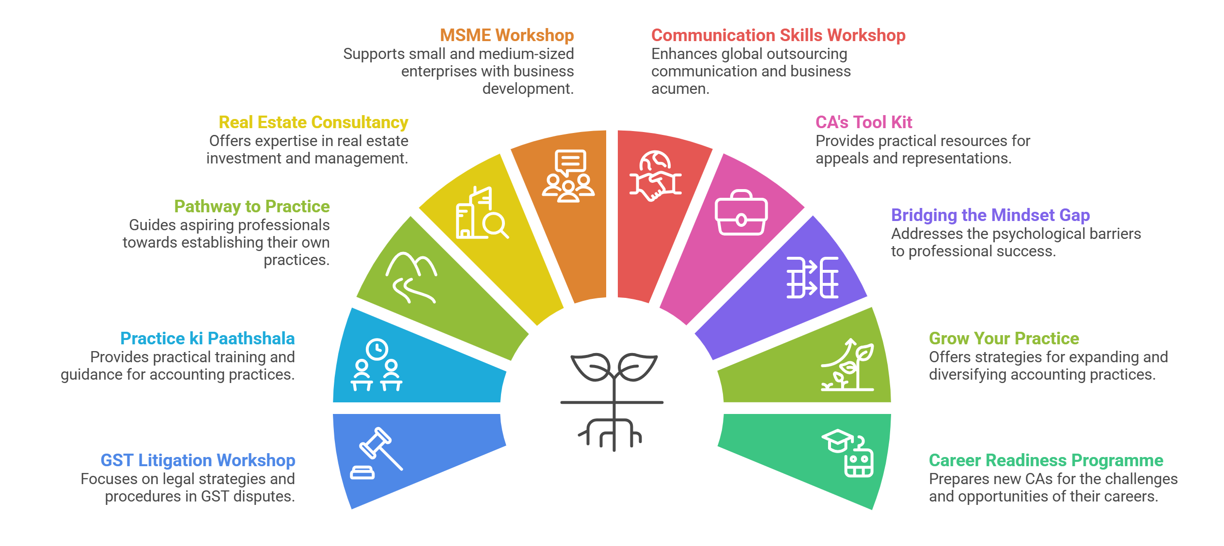
New Horizons for Growth

Slide 24
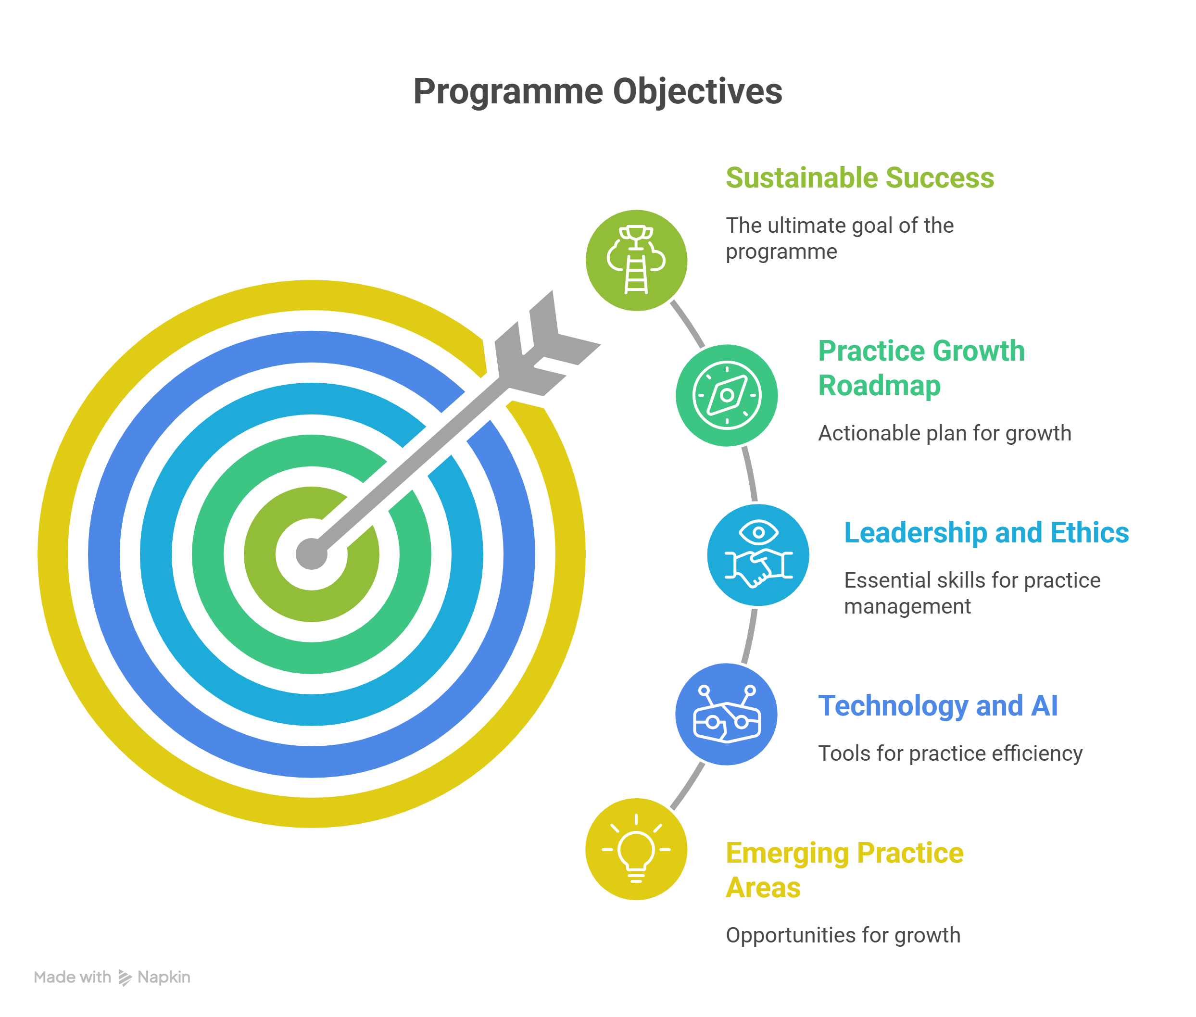
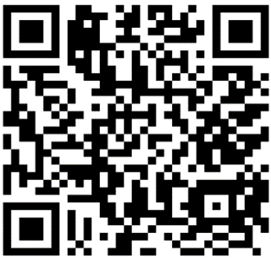
GROW YOUR PRACTICE- TWO DAYS WORKSHOP 2026
A transformative webinar initiative aimed at helping Chartered Accountants expand, strengthen, and future-proof their professional practices. These sessions are designed to equip members with cutting-edge strategies, practical tools, and actionable insights to navigate the rapidly evolving business landscape with confidence.
For Programme Details
kindly scan :

Slide 25
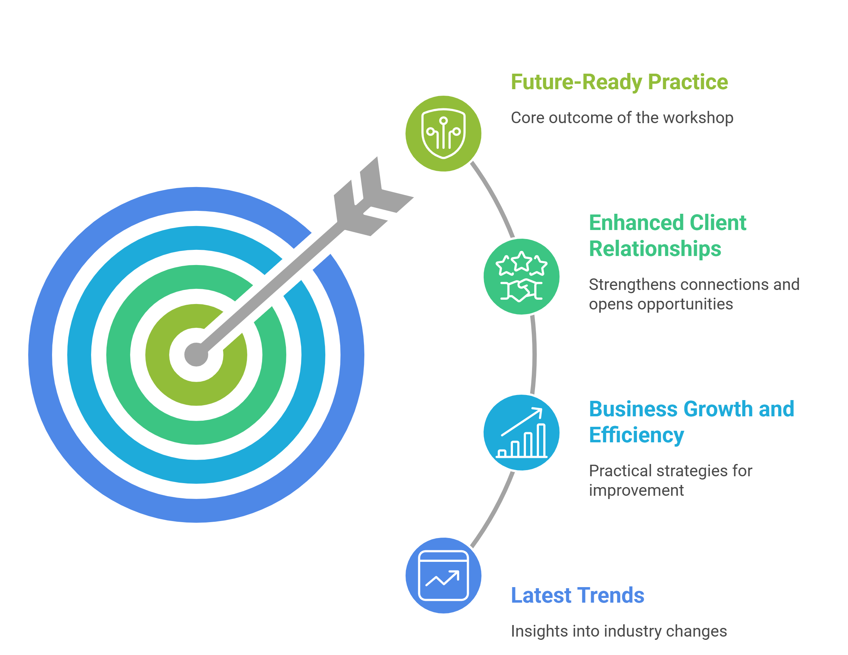
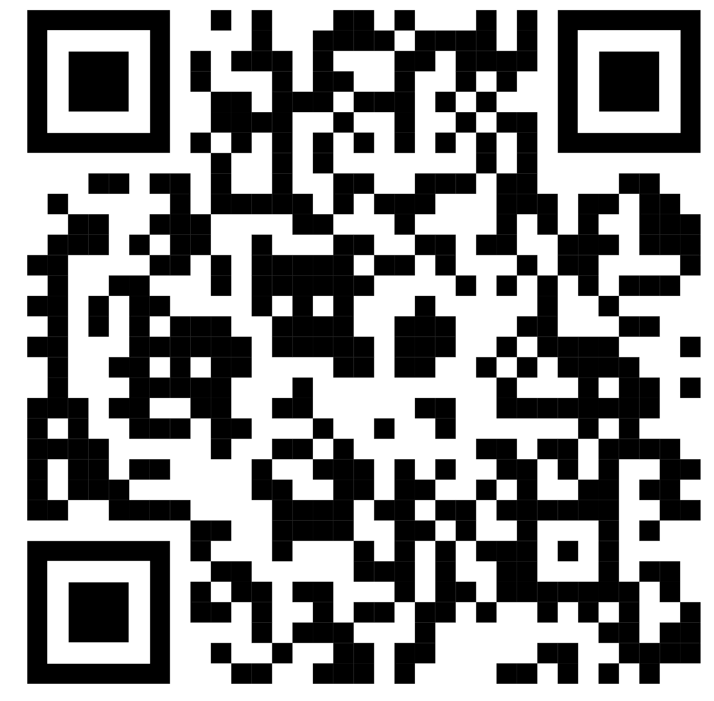
REIMAGINING THE CA PROFESSION: EMERGING PRACTICE OPPORTUNITIES IN A GLOBALISED ECONOMY – ONE DAY WORKSHOP
A one-day workshop designed as an annual thought-leadership platform to empower Small & Medium Practitioners to evolve beyond compliance-driven roles into future-ready, high-value advisory and entrepreneurial practices. Anchored in innovation, ethics, and professional excellence, the program aims to inspire strategic thinking, enhance practice capabilities, and enable meaningful professional impact in a rapidly transforming business landscape.
For Programme Details
kindly scan :

Slide 26
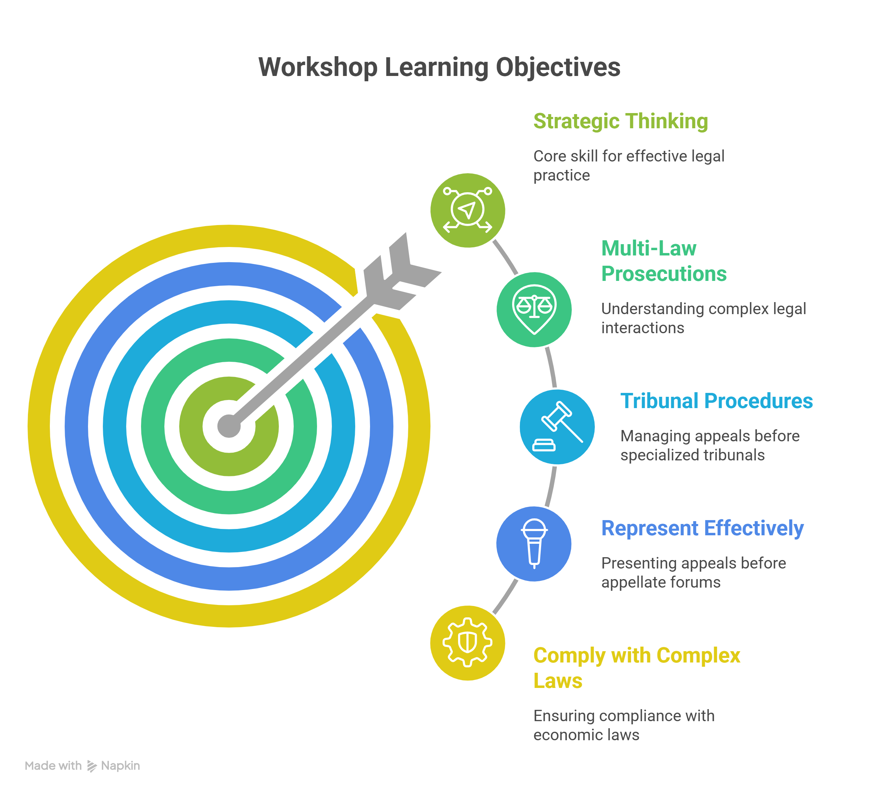

CA’S TOOLKIT: PRACTICAL GUIDE TO APPEALS & REPRESENTATIONS
The 2-day workshop on “CA’s Toolkit: Practical Guide to Appeals & Representations” is designed to empower members with the practical knowledge and skills needed for effective drafting, representation, and handling of tax and legal proceedings. The sessions bridge theoretical understanding with real-world applications, ensuring participants gain hands-on expertise across Direct and Indirect Tax laws, including allied legislations.
For Programme Structure
kindly scan :

Slide 27
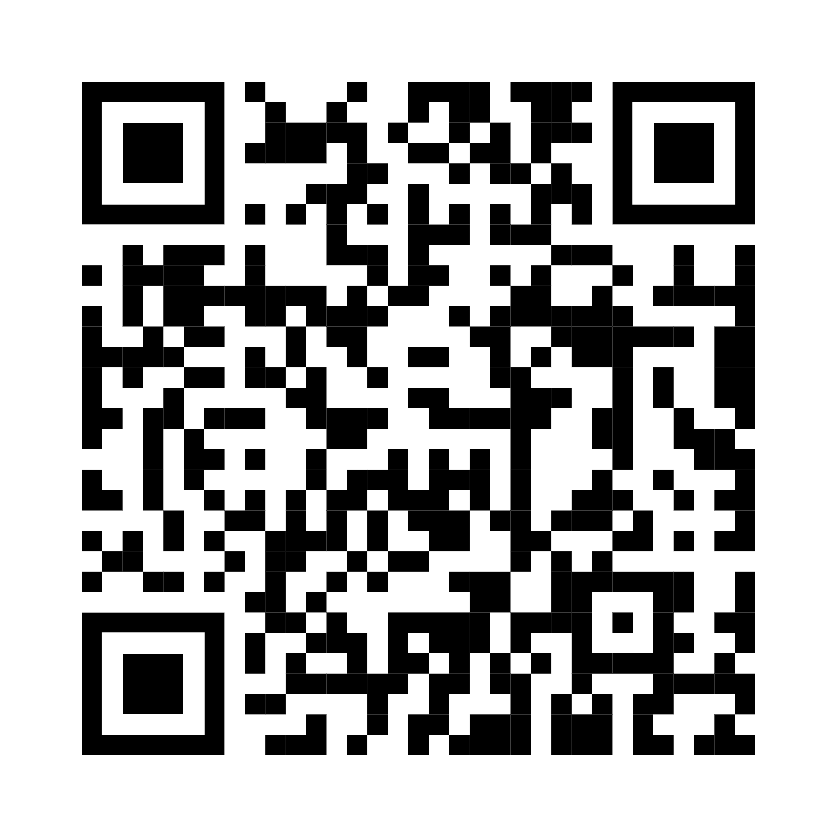
PRACTICE KI PATHSHAALA - A FLAGSHIP PROGRAMME
Practice ki Paathshala is a flagship initiative of the Committee for Members in Practice (CMP), ICAI, redesigned as a 4-day residential and non-residential refresher programme for Chartered Accountants seeking to elevate and future-proof their practice. Hosted at the Centre of Excellence (COE), Hyderabad, the programme offers a holistic blend of practice management, technology adoption, leadership development, and personal growth, delivered through expert-led sessions and interactive workshops.
For Programme Structure
kindly scan :

Slide 28
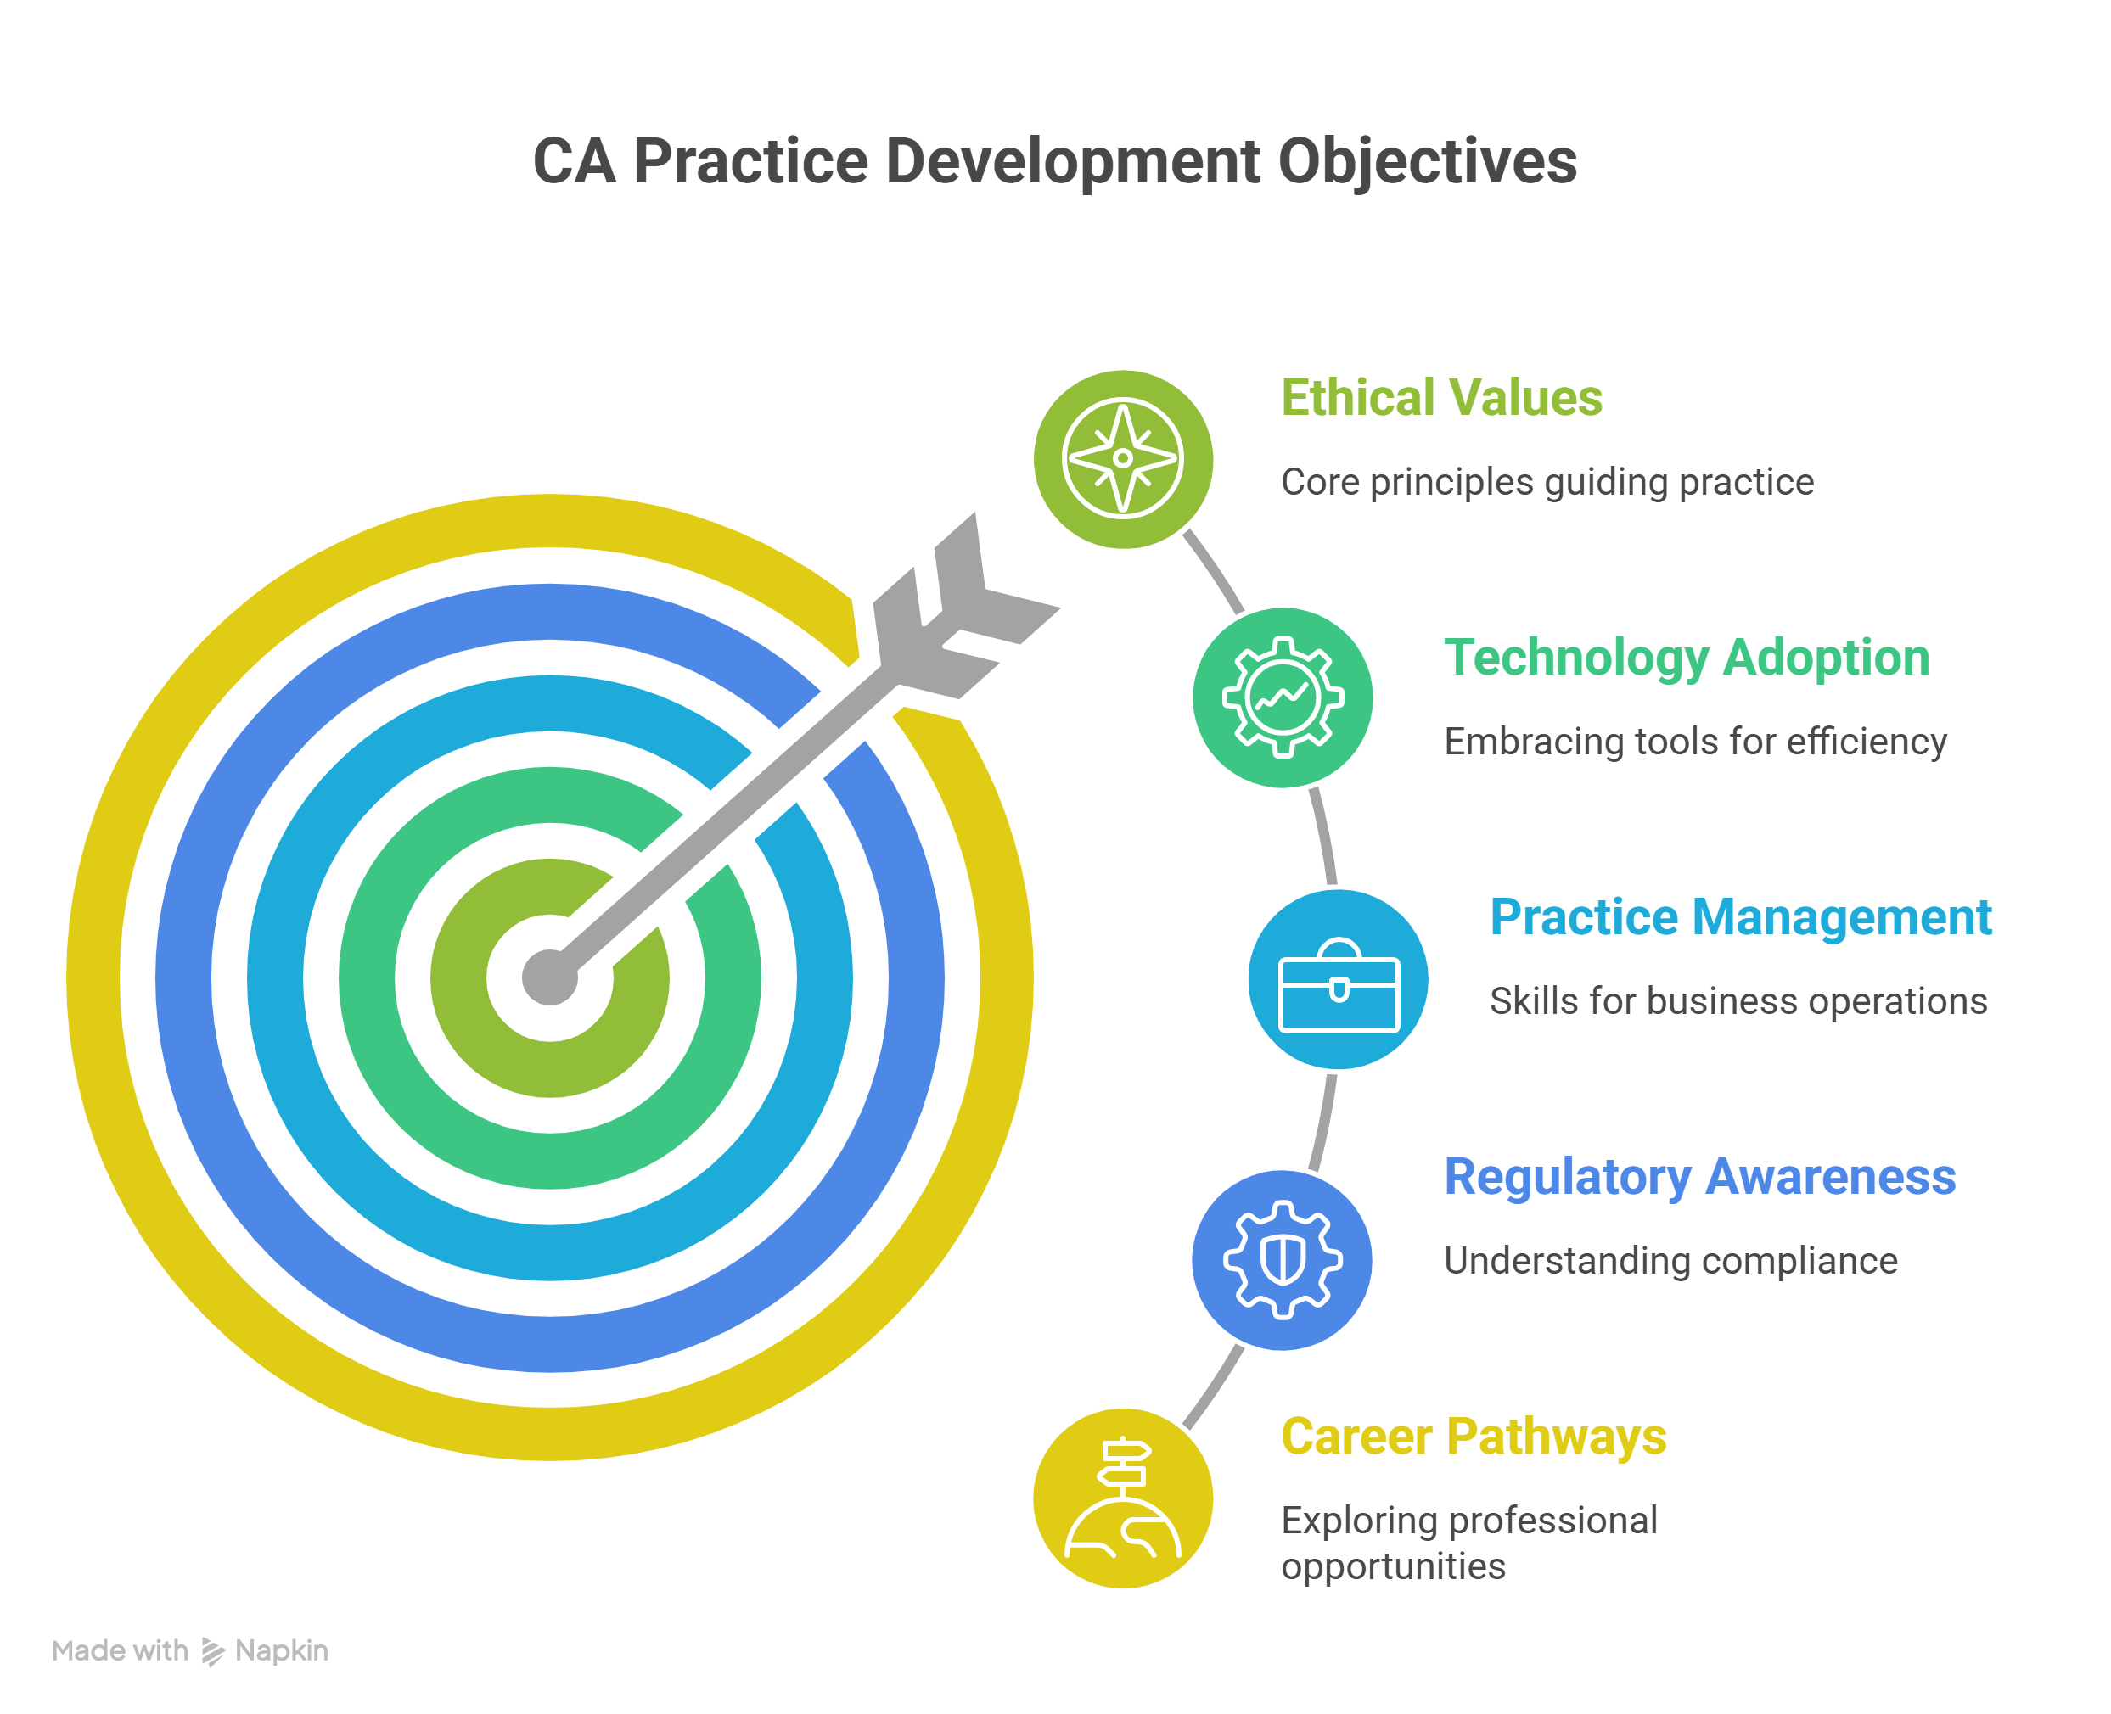

PATHWAY TO PRACTICE: 7 DAYS RESIDENTIAL TRAINING PROGRAMME FOR COP APPLICANTS - REVAMPED
Pathway to Practice is a 7-day residential programme by the Institute of Chartered Accountants of India (ICAI), designed for first-time Certificate of Practice (COP) applicants. It offers an immersive learning experience through expert sessions, workshops, and practical training on setting up and managing a CA practice. Covering practice management, compliance, client engagement, technology, ethics, and emerging opportunities, the programme builds a strong foundation for a future-ready professional journey.
For Programme Structure
kindly scan :

Slide 29
Thank You!
Your role in guiding first-generation wealth creators is transformational.
Material prepared using AI · Vetted by faculty CCM Madhukar N Hiregange

