Slide 1
TYPES OF REDEVELOPMENT PROJECTS AND DEVELOPMENT CONTROL REGULATIONS

Slide 2
OVERVIEW OF
DCPR 2034
MUMBAI
‹#›

Slide 3

Overview of DCPR 2034
How Much
How High
WHERE to Build
What USER
WHERE not to Build
Payment to Government
What are Regulations ?
‹#›

Slide 4
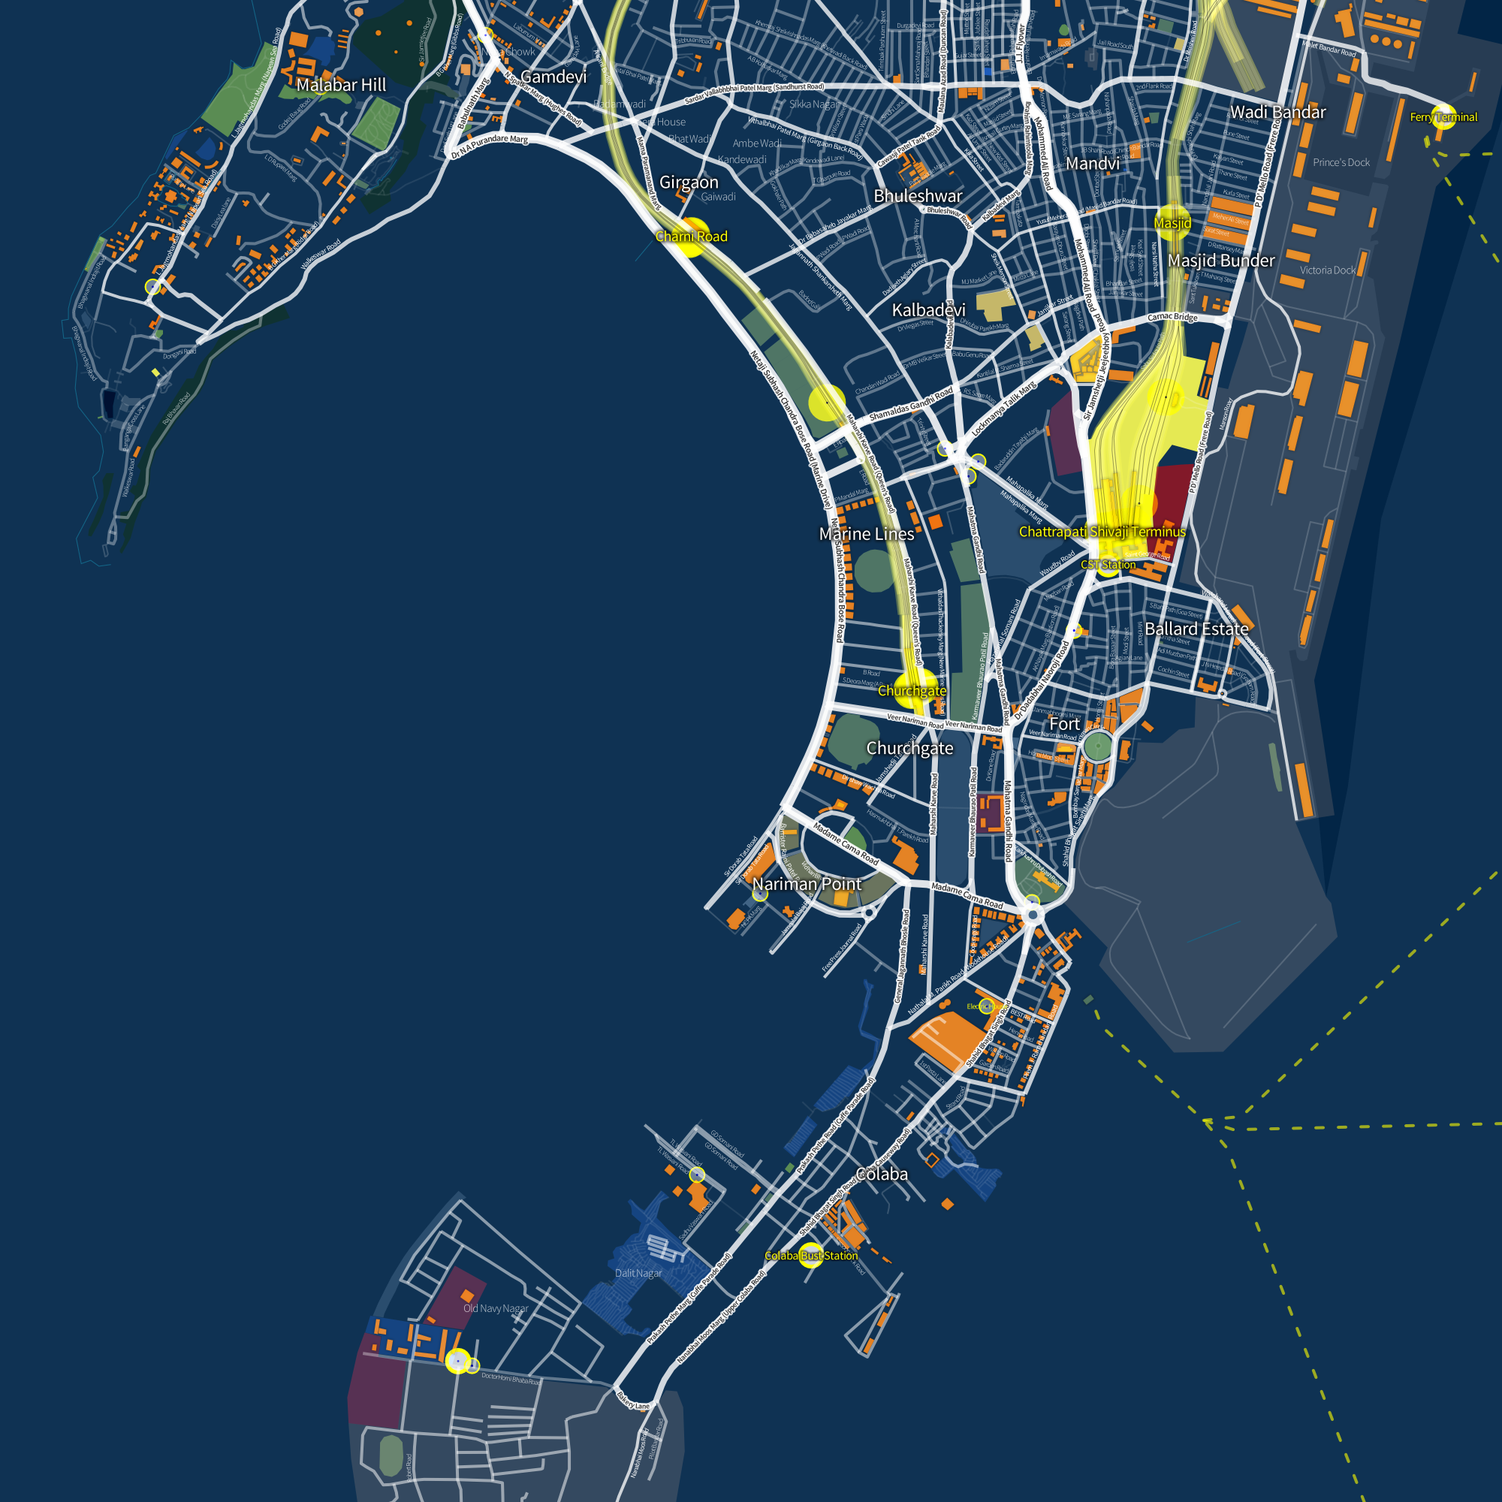
Overview of DCPR 2034
Planned Development
Regularised Growth
Responsibility Takers
Futuristic Planning
Context & Rule Sensitivity
Why are Regulations Important to Mumbai ?
‹#›

Slide 5
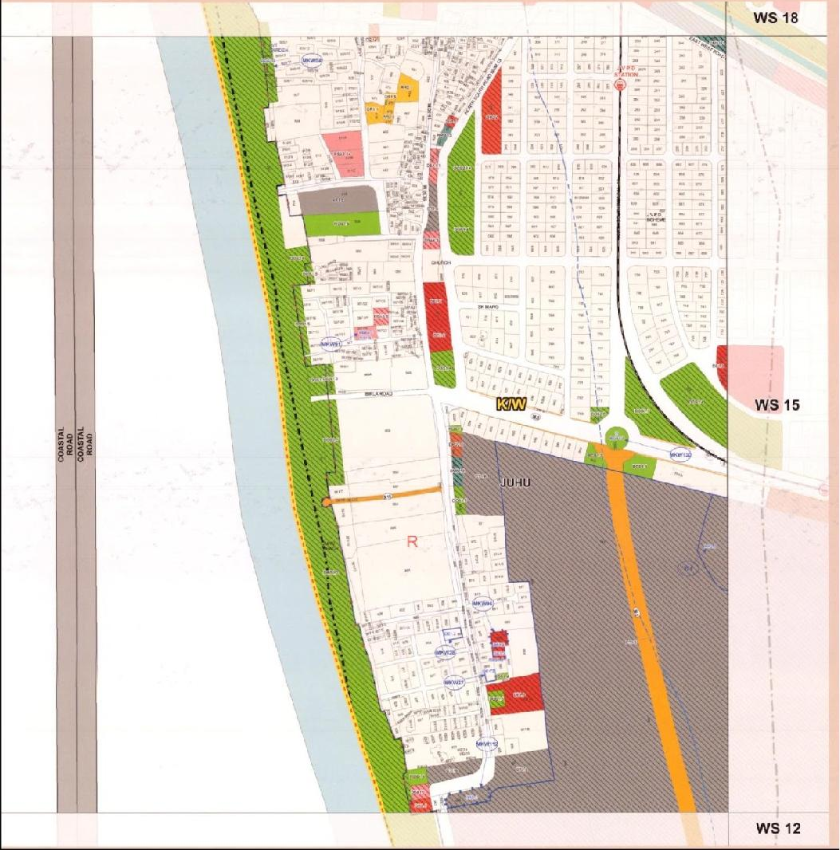
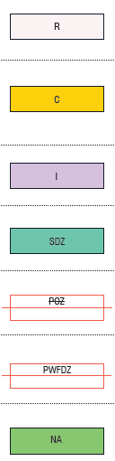

Overview of DCPR 2034 – Land use and Zones as per DP 2034
Residential zone (R-zone)
Commercial (C-zone)
Industrial (I-zone)
Special development zone
Port’s operational zone
Port’s water front develpment zone
Natural areas/zones
Green zones
‹#›

Slide 6
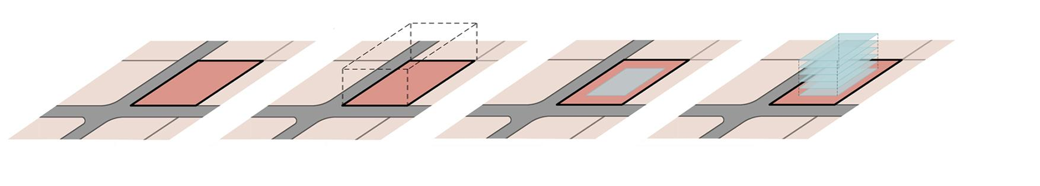
Overview of DCPR 2034 – F.S.I
WHAT IS F.S.I ?
FLOOR SPACE INDEX
The quotient of the ratio of the total covered area on all floors (excepting areas specifically exempted under these Regulations), to the area of the plot, viz.:
Floor Space Index (FSI) = Total covered area on all floors
Plot area
USABLE LAND AREA
left after leaving side open spaces
PLOT
Area: x m²
PLOT UNDER CONSIDERATION
AREA = X m²
Let’s consider Building on this Plot.
Net usable area after setbacks
AREA = Y m²
Building – Multiple floor plates of Y
TOTAL AREA = (6 Floors x Y) m²
= 6Y m²
Floor Space Index (FSI) = 6Yxxxx
X
‹#›

Slide 7
Overview of DCPR 2034 – T.D.R
WHAT IS T.D.R ?
TRANSFERABLE DEVELOPMENT RIGHTS
It is a compensation in the form of FSI or Development rights which shall entitle the owner for construction of BUA. It is issued in a certificate called DRC (Development Right Certificate)
TDR utilized on Plot B against reservation
Reservation
PLOT A (Having Reservation)
(Plan)
PLOT B
(Section)
‹#›

Slide 8

Overview of DCPR 2034 – F.S.I Calculation
HOW IS F.S.I CALCULATED?
General Calculations
Basic FSI
+
Premium FSI
+
T.D.R FSI
+
Fungible FSI
‹#›

Slide 9
Overview of DCPR 2034 - FSI Calculation – Mumbai Island City
BUA
equal to
PLOT AREA
FSI = 1.33
BUA equal to
A particular amount
of the
PLOT AREA
may be purchased
from the govt
(a)
(b)
(c)
(a+b+c)
BASIC FSI
PREMIUM FSI
T.D.R FSI
TOTAL FSI
FUNGIBLE FSI
TOTAL POTENTIAL
1.33
0.5 – 0.84
0.5 – 0.83
Q
Q x 0.35
Q x 1.35
Admissible TDR
as per
ROAD WIDTH
Additional
FSI (Premium)
0.0
0.5
0.62
0.73
0.84
T.D.R
Permissible
0.0
0.17
0.45
0.64
0.83
ROAD WIDTH
< 9m
9m – 12m
12m – 18m
18m – 27m
> 27m
35% of
TOTAL FSI
CALCULATED
‹#›

Slide 10
Overview of DCPR 2034 - FSI Calculation – Mumbai Island City
Consider a plot of land admeasuring 2,000 sq.mts abutting 27.45 m road
In coefficient
In sq mts
(a)
(b)
(c)
(a+b+c)
BASIC FSI
PREMIUM FSI
T.D.R FSI
TOTAL FSI
FUNGIBLE FSI
TOTAL POTENTIAL
1.33
0.84
0.83
3.0
3.0 x 0.35
3.0 + (3.0 x 0.35)
= 3.0 x (1.35)
2,660
1,680
1,660
6,000
6,000 x 0.35 = 2,100
= 6,000 + 2,100
8,100 sq mts
‹#›

Slide 11
Overview of DCPR 2034 - FSI Calculation – Mumbai Suburban
BUA
equal to
PLOT AREA
FSI = 1
BUA equal to
1/2 PLOT AREA
may be purchased
from the govt
FSI = 0.5
(a)
(b)
(c)
(a+b+c)
BASIC FSI
PREMIUM FSI
T.D.R FSI
TOTAL FSI
FUNGIBLE FSI
TOTAL POTENTIAL
1.0
0.5
0.5 – 1.0
Q
Q x 1.35
Q x 1.35
Admissible TDR
as per
ROAD WIDTH
ROAD WIDTH
< 9m
9m – 12m
12m – 18m
18m – 27m
> 27m
T.D.R Permissible
0.0
0.5
0.7
0.9
1.0
35% of
TOTAL FSI
Proposed
‹#›

Slide 12
Overview of DCPR 2034 - FSI Calculation – Mumbai Suburban
Consider a plot of land admeasuring 2,000 sq.mts abutting 27.45 m road
In coefficient
In sq.mts
(a)
(b)
(c)
(a+b+c)
BASIC FSI
PREMIUM FSI
T.D.R FSI
TOTAL FSI
FUNGIBLE FSI
TOTAL POTENTIAL
1.0
0.5
1.0
2.5
2.5 x 0.35
2.5 + (2.5 x 0.35)
= 2.5 x (1.35)
2,000
1,000
2,000
5,000
5,000 x 0.35 = 1,750
= 5,000 + 1,750
6,750 sq mts
‹#›

Slide 13
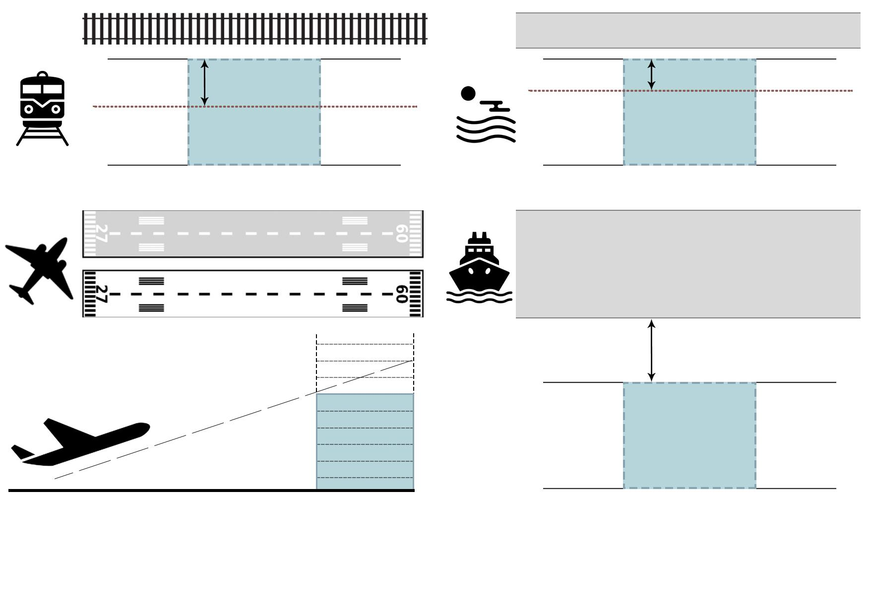
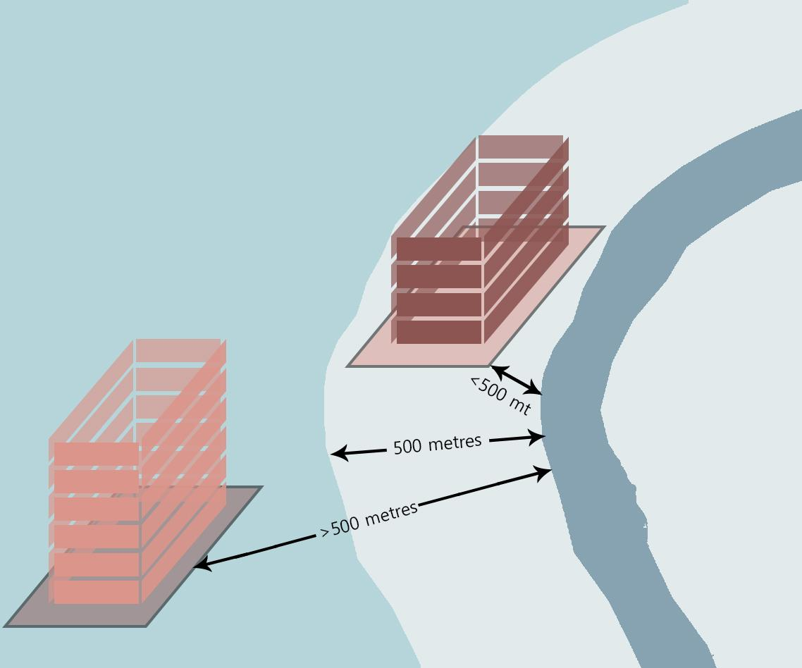
Overview of DCPR 2034 – Site Constraints
RAILWAY LINES
6m BUFFER FROM NALLAH
NALLAH
6 M
30 M
30m BUFFER FROM RAIL LINE
CIVIL AVIATION AREA/ RUNWAY
BUILDING HT
< 4 habitable floors
BUILDING HT
-NO RESTRICTIONS-
Buffer from Defence Establishments (Navy)
AVIATION FUNNEL HEIGHT RESTRICTIONS
‹#›

Slide 14
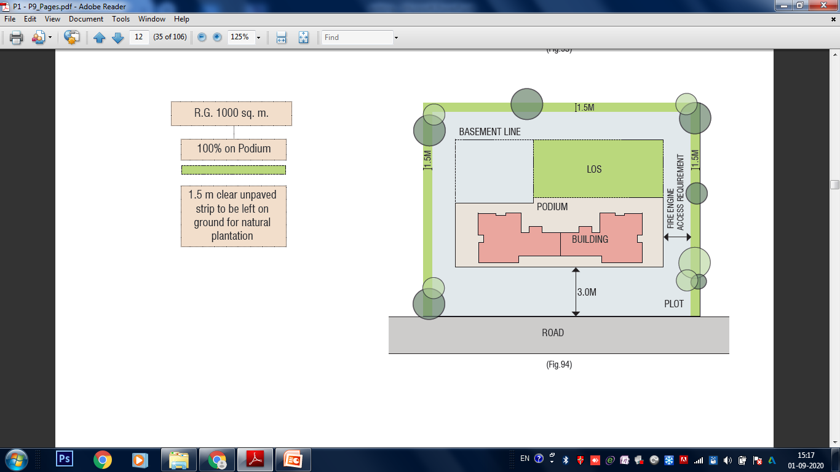
Overview of UDCPR 2034 – Planning Considerations
Following Regulations shall be considered while planning:
The Plot shall derive access from Min. 9.00 m wide road.
Layout Open space as per Reg.27 of DCPR 2034.
Side & Front open space as Reg.41 of DCPR 2034.
Height of the building as per Reg.19 & Reg.43 of DCPR 2034
Parking requirements as per Reg.44 of DCPR 2034.
CFO requirements as per Reg.47 of DCPR 2034.
SOS
FOS
PLOT AREA – 3000 SQ.MT
‹#›

Slide 15
Incentive FSI for Redevelopment Projects
DCPR 2034
‹#›

Slide 16
Incentive for Redevelopment Projects
ADVANTAGES OF REDEVELOPMENT
Replacing unsafe/old structures with well planned infrastructure, modern amenities, spacious common passages, staircases with modern and better elevation.
Redevelopment can be undertaken by society members in following ways :
Self-redevelopment
Development Manager Model
Developer
‹#›

Slide 17

Incentive FSI for Redevelopment Projects
Regulation (33) of DCPR 2034
33(5) Redevelopment in MHADA Layout
Benefit
Requirement
Provision
60 % of the FSI shall be used to rehabilitate existing tenements
Planning Authority shall be MHADA
Under existing housing Schemes of MHADA, Basic entitlement of 35% extra carpet area for existing tenants (minimum being 35 sq mt total carpet area)
For MHADA layout partially occupied by slum, Minimum carpet area of 27.88 sq mts to be given
MIG & LIG
3.0 FSI
> 4000 sq mts = 4.0
(18.0 m road)
Additional Entitlement of carpet area as per plot size
Additional 35% Fungible FSI over & above Permissible FSI
Incentive shall be as per Land Rate/Rate of Construction (LR/RC) Ratio
25% of normal premium for Staircase premium and Open space deficiency
‹#›

Slide 18

Incentive FSI for Redevelopment Projects
Regulation (33) of DCPR 2034
33(7) Redevelopment of Cessed Buildings in Island city
Benefit
Requirement
Provision
Minimum carpet area = 27.88 sq.mts , maximum carpet area = 120 sq.mts
If more than 120 then cost to be borne by tenant.
Corpus fund to be created as prescribed by MHADA
Rs 5,000/ sq.mt to be paid as development cess
Existing cessed/Corporation building prior to 30/09/1969
All tenants of old building will be re-accommodated in the redeveloped building
No new tenancy created after 13.6.1996 will be considered
3.0 F.S.I or Area required for rehabilitation of existing tenants plus incentive FSI, whichever is more.
Additional 35% Fungible FSI over & above Permissible FSI
10% of normal premium for Staircase premium and Open space deficiency
‹#›

Slide 19

Incentive FSI for Redevelopment Projects
Regulation (33) of DCPR 2034
33(7)(A)Redevelopment of Dilapidated / Unsafe tenant occupied Buildings in Suburbs
Benefit
Requirement
Provision
Occupier must get 5% of Additional Rehab Area
All tenants of old building will be re-accommodated in the redeveloped building
No new tenancy created after 13.6.1996 will be considered
20% can be used for non-residential use
Consent of atleast 51% members required
Minimum carpet area = 27.88 sq.mts , maximum carpet area = 120 sq.mts
If more than 120 then cost to be bared by tenant.
Corpus fund to be created
Rs 5,000/ sq.mt to be paid as development cess
50% incentive BUA of Proposed Rehab area
Additional 35% Fungible FSI over & above Permissible FSI
10% of normal premium for Staircase premium and Open space deficiency
‹#›

Slide 20

Incentive FSI for Redevelopment Projects
Regulation (33) of DCPR 2034
33(7)(B) Redevelopment of Housing Societies
Benefit
Requirement
Provision
Needs to be a registered society
Building to be 30 years of age or more
All existing members to be reaccommodated
Staircase/Lift lobby areas shall be exempted from FSI without charging premium to the extent of area already availed free of FSI by charging premium in the existing building
15 % of existing BUA or 10 sq.mt per member.
Additional 35% Fungible FSI over & above Permissible FSI
‹#›

Slide 21

Incentive FSI for Redevelopment Projects
Regulation (33) of DCPR 2034
33(9) Reconstruction or redevelopment of Cluster(s) of Buildings under Cluster Development Scheme(s)(CDS):
Benefit
Requirement
Provision
Min Plot area shall be 4,000 sq.mt in Island city and 6,000 sq.mt in Suburbs
Min Road width shall be 18.00 m
HPC shall consider proposals abutting 12.00m roads depending on availability of 18.00 m road within 500m.
Buildings at least 30 years of age and acquired by MHADA under MHAD Act ,1976
No new tenancy created after 13.6.1996 will be considered
Minimum carpet area to be proposed- 27.88 sq.m
Incentive shall be as per Land Rate/Rate of Construction (LR/RC) Ratio
Conditions for rehabilitation
Area for cluster development | Additional area
Above 4000 sq.mt up to 5000 sq.mt. | 10%
Above 5000 sq.mt up to 1 ha | 15%
Above 1 ha up to 2 ha | 20%
Above 2 ha up to 5 ha | 25%
Above 5 ha up to 10 ha | 30%
Above 10 ha | 35%
4.0 F.S.I or Area required for rehabilitation of existing tenants plus incentive FSI, whichever is more.
Additional 35% Fungible FSI over & above Permissible FSI
10% of normal premium for Staircase premium and Open space deficiency
‹#›

Slide 22

Incentive FSI for Redevelopment Projects
Regulation (33) of DCPR 2034
33(11) PTC – Permanent Transit Camp
Benefit
Requirement
Provision
Minimum 12.00 m road width is required.
This provision shall not apply on reserved plots or where permissible Zonal FSI is less than 1.00
Planning Authority shall be SRA
Zonal FSI – 1.00
Additional FSI as per 33(11) – 3.00
Carpet area provision –
Residential 27.88 sq mts
Commercial 20.9 sq mts
Area equal to BUA of PTC to be handed over shall be admissible as Incentive FSI for Sale
12m Road = 3.0 FSI
18m Road = 4.0 FSI
PTC of Plot A
SALE from Plot B
Additional 35% Fungible FSI over & above Permissible FSI
1.50
1.50
PTC
SALE
Clubbing & Shifting is Permitted
10% of normal premium for Staircase premium and Open space deficiency
‹#›

Slide 23
Incentive FSI for Redevelopment Projects
Regulation (33) of DCPR 2034
33(20)(B)Affordable housing (AH)/ Rehabilitation & resettlement (R& R)
Benefit
Requirement
Provision
Minimum 12.00 m road width is required.
This provision shall not apply on reserved plots or where permissible Zonal FSI is less than 1.00
Zonal FSI – 1.00
Additional FSI as per 33(20)(B) – 3.00
Carpet area provision –
Residential 27.88 sq mts
Commercial 20.9 sq mts
Area equal to BUA of PTC to be handed over shall be admissible as incentive
12m Road = 3.0 FSI
18m Road = 4.0 FSI
Additional 35% Fungible FSI over & above Permissible FSI
PAP of Plot A
SALE from Plot B
1.50
1.50
PAP
SALE
Clubbing & Shifting is Permitted
10% of normal premium for Staircase premium and Open space deficiency for 33(20)(B) component
‹#›

Slide 24
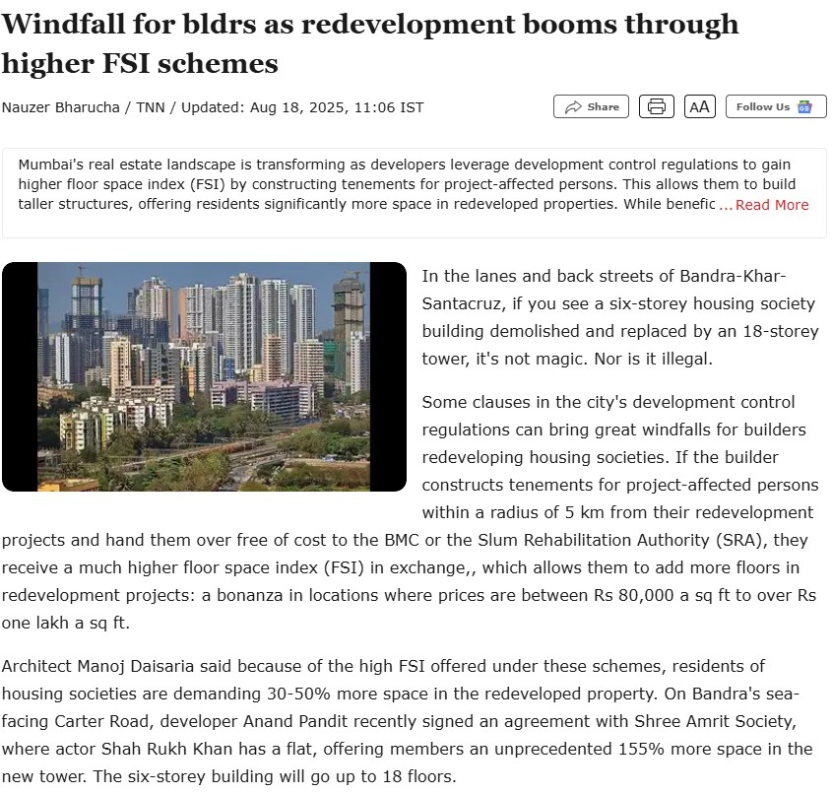
Incentive FSI for Redevelopment Projects
DCPR 2034 offers schemes & incentives making redevelopment projects viable, boosting the real estate market and attracting developers.
Positive aspects of redevelopment have been highlighted in the recent article of Times of India
‹#›

Slide 25

Incentive FSI for Redevelopment Projects
Regulation (33) of DCPR 2034
33(19)Additional FSI for commercial user development in central business District or Plots in Residential/Commercial zones
Benefit
Requirement
Provision
For entirely Commercial development
This provision shall not apply on reserved plots
Residential user permitted to the extent of 30% of permissible FSI as per 30(A).
Such 30% FSI for Residential user can be used to rehabilitate existing tenants.
12 m Road = 3.0 FSI
18 m Road = 4.0 FSI
27 m Road = 5.0 FSI
Additional 35% Fungible FSI over & above Permissible FSI
‹#›

Slide 26


Process of Approvals
Planning Authorities
BMC
SRA
MHADA
33(7), 33(7)(A), 33(7)(B), 33(9), 33(19), 33(20)(B)
33(11)
33(5)
‹#›

Slide 27




Process of Approvals
Kind of Approvals
Chief Fire Office (CFO)
EETC (Executive Engineer of Traffic Control)
Tree NOC
SWD/HE NOC
Metro NOC
Railway NOC
Civil Aviation NOC
HRC Approval
CRZ NOC
HPC Approval
MOEF Clearance
Municipal Commissioner/CEO/V.P. (in case of concessions)
Design Finalisation
Design to comply with DCPR 2034
Submission Drawings
Submit to Authority
I.O.D.
Commencement Certificate
Further Commencement Certificate
Occupation Certificate
‹#›

Slide 28
OVERVIEW OF
UDCPR 2020
Maharashtra State
‹#›

Slide 29
Overview of UDCPR 2020 - FSI Calculation – CONGESTED AREAS (For All Municipal Corporation & CIDCO)
BUA
equal to 1.50/2.00 x
Net PLOT AREA
FSI = 1.50/2.00
BUA equal to
0.30 x
PLOT AREA
may be purchased
from the govt
(a)
(b)
(c)
(a+b+c)
BASIC FSI
PREMIUM FSI
T.D.R FSI
TOTAL FSI
Ancillary FSI
TOTAL POTENTIAL
1.50/2.00
0.30
0.30 – 0.70
Q
Q x 0.60/0.80
Q x 1.60/1.80
Admissible TDR
as per
ROAD WIDTH
Basic fsi
1.50
2.00
2.00
2.00
T.D.R
Permissible
0.0
0.30
0.50
0.70
ROAD WIDTH
< 9m
9m – 18m
18m – 30m
> 30m
60%/80% of
TOTAL FSI
Proposed
‹#›

Slide 30
Overview of UDCPR 2020 - FSI Calculation – CONGESTED AREAS
Consider a plot of land for Residential development admeasuring 2,000 sq.mts abutting 30 m road
In coefficient
In sq mts
(a)
(b)
(c)
(a+b+c)
BASIC FSI
PREMIUM FSI
T.D.R FSI
TOTAL FSI
Ancillary FSI
TOTAL POTENTIAL
2.00
0.30
0.70
3.0
3.0 x 0.60
3.0 + (3.0 x 0.60)
= 3.0 x (1.60)
4,000
600
1,400
6,000
6,000 x 0.60 = 3,600
= 6,000 + 3,600
9,600 sq mts
‹#›

Slide 31
Overview of UDCPR 2020 - FSI Calculation – NON CONGESTED AREAS (For All Municipal Corporation & CIDCO)
BUA
equal to 1.10 x
NET PLOT AREA
FSI = 1.10
BUA equal to
0.50 PLOT AREA
may be purchased
from the govt
FSI = 0.5
(a)
(b)
(c)
(a+b+c)
BASIC FSI
PREMIUM FSI
T.D.R FSI
TOTAL FSI
ANCILLARY FSI
TOTAL POTENTIAL
1.10
0.5
0.4 – 1.40
Q
Q x 0.60/80
Q x 1.60/1.80
Admissible TDR
as per
ROAD WIDTH
ROAD WIDTH
< 9m
9m – 12m
12m – 15m
15m – 24m
24m – 30m
> 30m
T.D.R Permissible
0.0
0.40
0.65
0.90
1.15
1.40
60%/80% of
TOTAL FSI
Proposed
‹#›

Slide 32
Overview of UDCPR 2020 - FSI Calculation – NON CONGESTED AREAS
Consider a plot of land for Residential development admeasuring 2,000 sq.mts abutting 30 m road
In coefficient
In sq.mts
(a)
(b)
(c)
(a+b+c)
BASIC FSI
PREMIUM FSI
T.D.R FSI
TOTAL FSI
ANCILLARY FSI
TOTAL POTENTIAL
1.10
0.5
1.40
3.00
3.00 x 0.60
3.0 + (3.0 x 0.60)
= 3.0 x (1.60)
2,200
1,000
2,800
6,000
6,000 x 0.60 = 3,600
= 6,000 + 3600
9,600 sq.mts
‹#›

Slide 33
Incentive FSI for Redevelopment Projects
UDCPR 2020
‹#›

Slide 34
Incentive FSI for Redevelopment Projects
Chapter 7 of UDCPR 2020
7.4 Redevelopment in MHADA Layout
Benefit
Requirement
Provision
Under existing housing Schemes of MHADA, Basic entitlement of 35% extra carpet area for existing tenants (minimum being 35 sq.mt total carpet area)
For MHADA layout partially occupied by slum, Minimum carpet area of 27.88 sq.mts to be given
60 % of the FSI shall be used to house existing tenements
MIG & LIG
3.0 FSI or
as per Road width whichever is higher
Additional Entitlement of carpet area as per plot size
Additional 60% Ancillary FSI over & above Permissible FSI
Incentive shall be as per Land Rate/Rate of Construction (LR/RC) Ratio
‹#›

Slide 35
Incentive FSI for Redevelopment Projects
Chapter 7 of UDCPR 2020
7.6.1 Redevelopment of Multi-Dwelling Buildings of Co-Operative Housing Societies / Apartments
Benefit
Requirement
Provision
Should have been Declared Dangerous or Dilapidated or Unsafe/ Building Having Age More than 30years
Needs to be a registered society
Consent of at least 51% members
Minimum Carpet area = 27.87 sq.mt for Residential user
For Non-Residential User, Same as existing area
30 % of existing BUA or 15 sq mt per member.
Additional 60% Ancillary FSI over & above Permissible FSI
‹#›

Slide 36
Incentive FSI for Redevelopment Projects
Chapter 7 of UDCPR 2020
7.6.2 Redevelopment of Tenanted Buildings
Benefit
Requirement
Provision
Minimum carpet area = 27.88 sq. mts for residential users & for non-residential user area equivalent to existing
Should have been Declared Dangerous or Dilapidated or Unsafe/ Building Having Age More than 30years
Corpus Fund & Development CESS to be decided by the Authority that would take care of maintenance for 10 years
50% incentive BUA of existing tenant area
Additional 60% Ancillary FSI over & above Permissible FSI
‹#›

Slide 37
Incentive FSI for Redevelopment Projects
Chapter 14 of UDCPR 2020
14.8 Urban Renewal Scheme(URS):
Benefit
Requirement
Provision
Min Plot area shall be 10000 sq.mt in Non congested areas and 4000 sq.mt in Congested areas
Min Road width shall be 18.00 m
Buildings of at least 30 years of age
No new tenancy created after 02.12.2020 will be considered
Minimum carpet area to be provided 27.88 sq.m for slum area and 30 sq.mt for Non slum area.
Incentive shall be as per Land Rate/Rate of Construction (LR/RC) Ratio
Minimum 25% additional area over existing area shall be proposed for existing tenaments.
4.0 F.S.I or Area required for rehabilitation of existing tenants plus incentive FSI, whichever is more.
Additional 60% Ancillary FSI over & above Permissible FSI
‹#›

Slide 38
Thank you ….
‹#›
Disclaimer : This is for presentation purpose only, for exact interpretation original regulations is to be referred.

