Slide 1

Unlocking the Future

Slide 2
Contents
Contents
  GST Audit
  GST 2.0 Post 2 Months
  Landmark Judgements

Slide 3
GST : Environment before GST 2.0

Slide 4



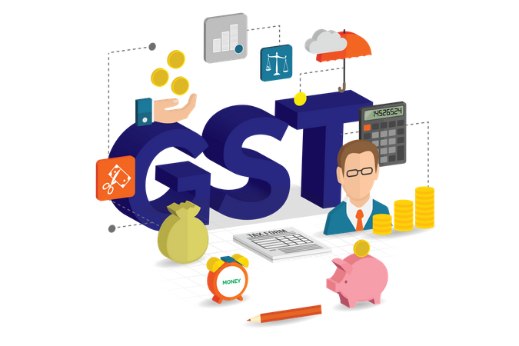

8 years of GST and current environment
Robust GST evolution
Engagement with industry
GST law has transformed significantly since its inception in July 2017, spurred by 56 GST Council meetings and the focus has been on procedural simplification, robust technology adoption and unambiguous legal provisions
Tax authorities have been very pro-active in reviewing policy measure and engage with industry to simplify the GST regime
Dispute resolution
True show of co-operative federalism
GST Appellate Tribunal (GSTAT) to be operational by end-September, with hearings from December, providing a robust mechanism for dispute resolution
The GST Council continues to exemplify the spirit of cooperative federalism, bringing together the Centre and States to make consensus-driven decisions that shape India’s indirect tax landscape

Slide 5
Genesis of GST 2.0
Compliance burden on Industry
Dispute resolution backlog
Multiple tax slabs leading to inverted duty structure
Significant time consumption in registration and refund processes
Promotion of consumption
Genesis of GST 2.0

Slide 6




Three Pillars of GST Reform - Structure, Rates, and Ease of Living
Honourable Prime Minister of India on 79th Independence day announced significant reforms in GST, focusing on 3 pillars: structural reforms, rate rationalization and ease of living
Structural Reforms
Rate Rationalization
Ease of doing Business
Resolving classification issues to streamline rate structures and minimize disputes.
Providing clarity on rates to build industry confidence and support better business planning
Inverted duty structure correction to align input and output tax rates
Reduction of taxes on common items and aspirational goods to enhance affordability, boost consumption
Move towards simple tax with 2 slabs.
Flexibility to rationalize GST rates owing to the end of compensation cess by 31st March 2026
Registration: seamless, technology-driven, and time-bound
Return: Implement pre-filled returns, thus reducing manual intervention and eliminating mismatches.
Refund: Faster and automated processing of refunds

Slide 7
Impact and Future Outlook

Slide 8
Impact of GST 2.0
Prices of Small cars, TVs, air conditioners, washing machines, etc. have been reduced
Simplification of registration process and quick processing of refund claims
I
N
D
I
V
I
D
U
A
L
S
06
01
B
U
S
I
N
E
S
S
Benefits for higher income group
Ease of doing business
Operationalization of GSTAT
Removal of the concept of intermediary
Many food items, including packaged snacks, UHT milk, and instant noodles, have been brought under the 5% or NIL GST slab.
05
02
Benefits for lower income group
Reducing litigation
Relief provided in respect of essential learning materials like pencils and exercise books, health insurance policies, gym, fitness centers, etc.
Relief to Middle Income Group
Technological advancement
04
03
Industry has to update their ERP systems for addressing the GST rate changes

Slide 9
Future Outlook
Unlocking working capital
01
Inverted duties
Unlocking of working capital measures, e.g., transfer of CGST credit among distinct persons
02
Addressing the inverted duty structure in a holistic manner
Seamless ITC availment
03
Audits and Assessments
Removing restrictions on input tax credits in some cases by relooking at restrictions in Section 17(5)
04
Ensuring uniformity in audits across central and state administration
GSTN 2.0
05
Enhancing technological infrastructure for data availability for pre-populating of GST returns, including B2C e-invoicing.

Slide 10
Key announcements/proposals of GST 2.0

Slide 11
A. Trade facilitation

Slide 12
Proposals under GST 2.0
GST 2.0
IMS Readiness
Inverted Duty Refunds
State Incentives
Advocacy & Representation
ITC reversals
Fast track Refunds

Slide 13

Export liberalization
Export liberalization
  ‘Intermediary’ dismantled: Omission of clause (b) of Section 13(8) of IGST Act – proxy relating to “Intermediary Services” has been deleted ensuring a huge relief to Indian exporters
  Place of supply for “intermediary services” will be determined by location of the recipient
  Industry has long grappled with tax uncertainty due to exports being taxed as “intermediary” leading to denial of refunds and tax demand on exports
  This helps eliminate the ambiguity, offering much-needed relief and stability
Business Impact
Aligns with global tax practices, making India more business-friendly destination for service exports
1
2
Smoother process for claiming export benefits
Reduce disputes and improves cash flow
TDS Obligations to be complied on supply of metal scrap
Landlords adjusted rent amounts among family members to remain below the GST threshold. Such practices will be curtailed
Impact of deletion of intermediary provisions on transactions under RCM to be evaluated
3
Boost global competitiveness of services industry
4

Slide 14
Post-supply discount
Post-supply discount
  Omission of Section 15(3)(b)(i) of CGST Act – removing requirement for discounts to be pre-documented in a supply agreement and specifically linking it with relevant invoices
  Amendment to section 15(3)(b) of CGST Act to provide that discount should be granted through a credit note issued under section 34 of CGST Act
  Amendment to section 34: To include a reference to Section 15(3)(b) to ensure reversal of ITC by recipient when the value of supply is reduced through a credit note
  Withdrawal of Circular No.212/6/2024-GST (which provided for submission of declaration/ CA certificate) and Circular to be issued clarifying nuances of post-supply discounts for trade facilitation
Business Impact
1
Allow businesses to offer discounts flexibly, based on actual sales performance or market conditions
2
Simplifies documentation and reduces compliance burden for both suppliers and recipients
TDS Obligations to be complied on supply of metal scrap
Huge benefit for traders and unlocking working capital challenges in supply chain, cutting across sectors
3
Landlords adjusted rent amounts among family members to remain below the GST threshold. Such practices will be curtailed
4
Brings clarity and consistency, reducing risk of litigation

Slide 15
Simplification of registration process
Simplification of registration requirement
  Reduced timeline for registration: Optional simplified GST registration scheme wherein registration shall be granted on an automated basis within three working days for low risk applicants and small businesses (tax liability not exceeding INR 2.5 lakh in a month)
  In-principle approval for a simplified GST registration mechanism for small suppliers making supplies through ECOs across multiple states
    Small suppliers may sell across multiple states via e-commerce platforms without requiring separate Principal Place of Business (PPOB)
Business Impact
1
Eases compliance and unlocks interstate growth for MSMEs and micro-entrepreneurs
2
This opens up new customer base, increases sales potential, and supports scalable growth
TDS Obligations to be complied on supply of metal scrap
3
Reduces paperwork, lowers legal risk and makes it easier for first-time entrepreneurs to enter market
4
Unlock working capital for the sellers and facilitates ease of doing business

Slide 16
GSTAT to be operational
Other proposals
  GSTAT will be operational by end of September 2025, with hearings commencing before December
  Council has set 30th June 2026 as limitation date for filing backlog appeals, ensuring clarity
  Principal Bench will serve as the National Appellate Authority for Advance Ruling, strengthening consistency in interpretation and enhancing taxpayer confidence in GST framework
Business Impact
1
Company to access readiness for filing appeals
2
TDS Obligations to be complied on supply of metal scrap
Business to assess and gear up for pre-deposit payments
3
Faster Dispute Resolution expected owing to higher count of benches
4
Improved ease of doing business

Slide 17
Impact of Anti-profiteering
Anti Profiteering provisions
  No formal anti-profiteering announced for rate reductions
  As a learning from the past, a trust-based compliance mechanism is expected for the industry to voluntarily pass on the benefits of rate cuts to the end consumers
  Both the Central Board of Indirect Taxes and Customs (CBIC) and State authorities are expected to actively engage with the industry to ensure that benefits from the latest rate rationalization are transmitted to end consumers
  Focus now shifts on the voluntary compliance on the businesses to pass on benefits of GST rate reduction specifically in the upcoming festive season in India
Business Impact
Need to adjust pricing structures
Inventory with old pricing (MRP) may require stickering to reflect new prices throughout supply chain
Regulatory and public expectations to pass on benefits to end consumers could impact margins if not managed strategically
1
2
TDS Obligations to be complied on supply of metal scrap
Accurate documentation and audit trails are essential to show that benefits are being transferred to consumers, when there is no official Government watchdog
Businesses may need to revise advertising, promotional materials, and consumer communication to highlight reduced prices
3
Landlords adjusted rent amounts among family members to remain below the GST threshold. Such practices will be curtailed
4

Slide 18
Compliance under Legal Metrology Act
Requirement from Legal Metrology perspective
  Manufacturer, packer, or importer of a pre-packaged commodity is legally authorized to declare and revise the Maximum Retail Price (MRP)
  Where revised prices are lower than the price marked on the package, retailer shall not charge any price in excess of the revised price, irrespective of the month in which the commodity was pre-packed
  In case of upward revision of MRP, the original MRP shall continue to be displayed and the revised MRP shall not overwrite on it
Business Impact
Businesses to ensure necessary intimations are made to the relevant authorities in relation to change in MRP
Companies may consider affixing stickers to declare the revised lower MRP.
1
2
Companies can consider intimating the consumers regarding rate change by way of advertisements and display on company website
Landlords adjusted rent amounts among family members to remain below the GST threshold. Such practices will be curtailed
3

Slide 19
GST 2.0
Fast Track Refund
  Risk-based provisional sanction of refund w.r.t. zero-rated supplies :
  From November 2025, 90% provisional refunds within 7 days of acknowledgment of application basis risk evaluation except specified persons
    Person not undergone Aadhaar authentication
    Person supplying goods in nature of areca nuts, pan masala, tobacco and essential oils
  Provisional refund shall not be granted only in exceptional circumstances
  Risk-based provisional sanction of refunds w.r.t. IDS:
  Currently, refund on provisional basis is allowed only w.r.t zero-rated supplies. Post amendment, the same will also be allowed in cases arising out of IDS
    As an interim measure of trade facilitation, in case of refund applications filed on account of IDS, on or after 01.10.2025, 90% of the refund amount so claimed may be sanctioned on provisional basis in similar manner as zero-rated supplies

Slide 20
B. Rate rationalization measures

Slide 21
Sectoral recommendations – Consumer Sector
Food Sector
Consumer Electronics and common use items
GST on packaged food items reduced from 12% to 5%
GST on ice-creams, biscuits, pastries and cakes, chocolates reduced from 18% to 5%
GST rates on air conditioners, televisions more than 32 inches, dishwashers, projectors, monitors to be reduced from 28% to 18%
GST rate on all imported dutiable articles (except drugs and medicines) intended for personal use - reduced from 28% to 18%
Stationery products proposed to be exempted from GST, currently taxed at 12% and Sport items and toys taxed at 5%, currently attract 12%
Handicraft, Leather, Footwear and Apparel
Other services
Footwear of sale value not exceeding INR 2500 per pair to be moved from 12% to 5% slab. Footwear of sale value exceeding INR 2500 per pair will continue to be at 18%
Apparel of sale value not exceeding INR 2500 per piece shall be taxable at 5%. Apparel of sale value exceeding INR 2500 per piece will attract 18% as against 12%
Transportation of passengers and goods to be taxed at 18% with ITC as against 12% (retaining 5% without ITC)
Supply of renting of any motor vehicle (with operator) designed to carry passengers and supply of renting of goods carriage (with operator) where cost of fuel is included in consideration to be taxed at 18% as against 12%
Business Impact
Rate rationalization across segments fuels consumer demand, more specifically the common man
Reduced GST rate expected to positively impact consumption resulting in positive economic growth
Expected to result in accumulation of input tax credit for businesses

Slide 22
Sectoral recommendations - Others
Banking, financial services and insurance (BFSI) sector
Travel and tourism Sector
  c
Prospectively, export status for intermediary services to overseas clients
Individual health insurance policies exempted including family floater plans, senior citizen and the reinsurance services thereof.
Individual life insurance policies exempted including term, ULIP, and endowment plans and reinsurance services thereof
Need to reassess pricing strategies and document compliance to deal with regulatory scrutiny due to exemptions
Other than economy flights to become expensive as GST increased from 12% to 18%
GST on “Hotel Accommodation” services with a value up to Rs. 7,500 per unit per day reduced from 12% to 5%
Hotels to reevaluate their pricing and cost frameworks due to withdrawal of ITC benefits
Beauty and Fitness Sector
Special Goods/ Services
Reduction of GST from 18% to 5% on beauty and physical well-being services including services of gyms, salons, barbers, yoga centres
However, ITC restriction will need to be factored in by the service suppliers
Special 40% GST rate is proposed for sin goods, including tobacco, carbonated/ aerated drinks and related products, replacing the earlier slab structure
Also includes specified actionable claims like betting, casinos, gambling, horse racing, lottery, online money gaming
Clarity required on liquidation of compensation cess balances

Slide 23
Sectoral recommendations - Others
Automotive Sector
Energy Sector
Rate rationalization for small segments should fuel consumer demand; HSN classification disputes on parts and components are likely to reduce with uniform 18% rate
Mid, large and SUV segments taxed at 40%. With discontinuation of compensation cess, there is need for mechanism to transition accumulated compensation cess
Industry to proactively assess impact on working capital requirements on unsold inventory throughout supply chain
Increase GST rate on coal from 5% to 18% to remove inverted duty structures and align with compensation cess withdrawal
Industry to seek clarity on treatment of accumulated cess balances post its removal
Cutting GST on solar, wind, and photovoltaic equipment from 12% to 5% will lower project costs and accelerate adoption
Reducing GST on ammonia from 18% to 5% will support green hydrogen, fertilizers, and chemical sectors
E-commerce sector
Pharma and life sciences Sector
Local delivery services to be notified under 9(5) of the CGST Act in cases the person is not liable for registration and is supplying such services through e-commerce operator
Local delivery services provided by and through ECO to be excluded from scope of GTA services
Definition of Local delivery services is awaited
‘Nil’ rates on 36 lifesaving drugs, including those used for treatment of cancer, rare diseases and severe chronic diseases
Medical apparatus/ equipment and devices used for medical, surgical, dental or veterinary usage reduced from 18%/ 12% to 5%
Reforms such as 90% provisional refunds for claims arising from the inverted duty structure, reducing the GST rate on job work services for pharma sector are welcomed.

Slide 24
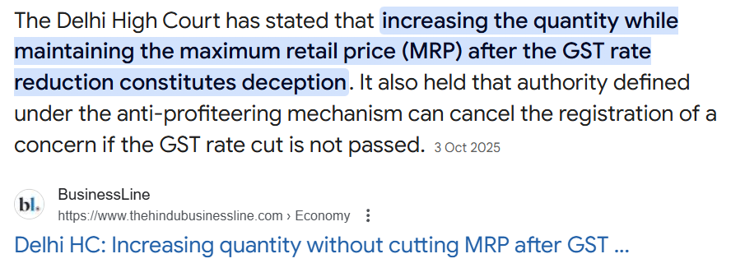
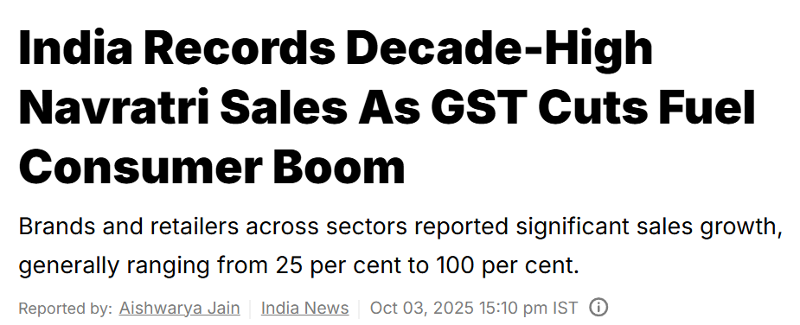
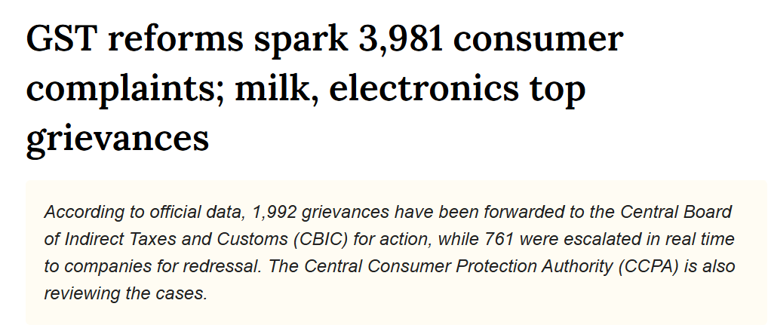
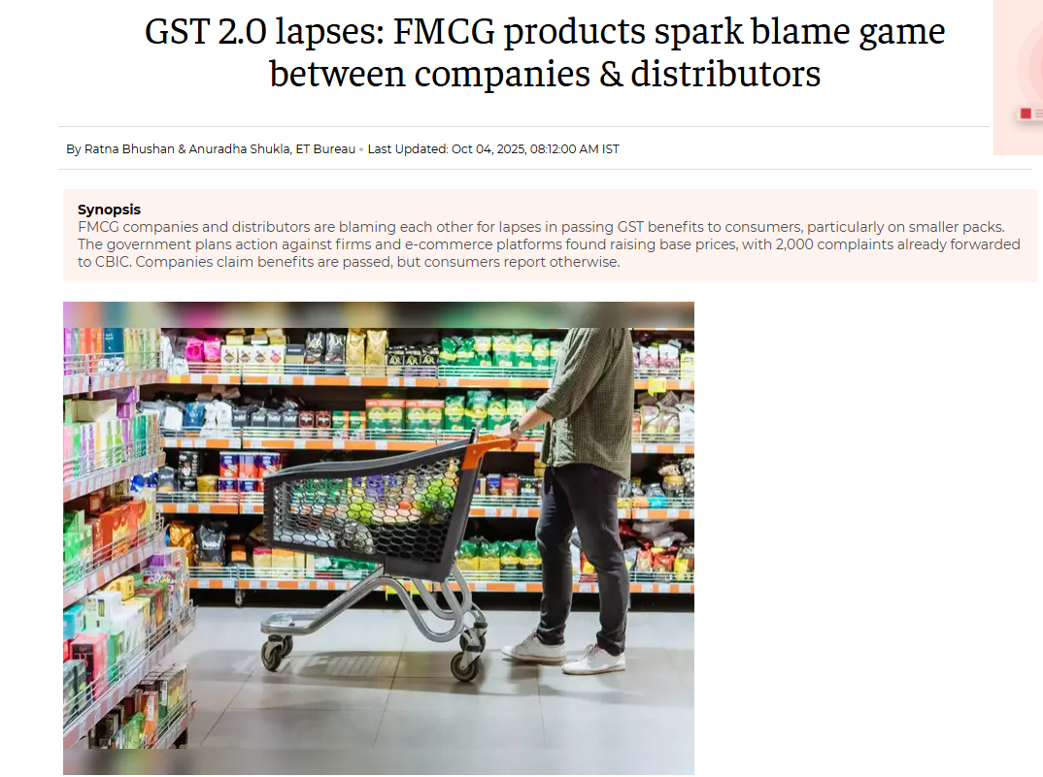
Sectoral Impact
MRP Products: Increase of quantity instead of decrease in MRP
Consumer Durables
FMCG Sector
Anti Profiteering

Slide 25

GST AUDIT

Slide 26
Purpose of GST Audit
Verification of accuracy
of taxes paid
Eligibility of ITC Availed
Identifying the reasons for reconciliation difference between different statutory records
Purpose
Adherence with the compliance prescribed under GST Law
Qualification of the
benefits availed

Slide 27
Parameters of Selection of GST Audit
Mismatch in GST Returns
Significant variation
Parameters of
Selection of case
Niche integrity of the Industry
Based on AI fetched reports
Recommended by external agencies
Targeted audits based on past audits

Slide 28
Guiding Principles of Audit
Adherence to risk factors developed through a targeting strategy
Consistency with Departmental Circulars and using professional methodology
Chalk out a sound pre-audit plan and conduct the audit accordingly
Emphasize a systematic, flexible and penetrative audit
Regular review of the audit plan and progress and modification of the audit program
Concentrate on scrutiny of returns and records.
Identify the veracity of turnover declared, taxes paid, refund, input tax credit (ITC)
Record the proceedings of audit and findings thereof.
Provide a fair opportunity to the auditee to be heard
Carry out audit while adhering to high professional standards
Implement a feedback mechanism for measuring the taxpayer‘s experience

Slide 29
Process of GST Audit
Audit by Tax Authorities
#1
#3
#5
#7
Selection of the Auditee
Devising Audit Plan
Discussion on issues identified and calling out additional details/documents
Providing an opportunity of hearing to the taxpayer
Desk Review based on details available
On-premise visits
Preparing preliminary observations
Issuance of Final Audit Report
#8
#4
#2
#6

Slide 30
Process of GST Audit
Special Audit u/s 66
Steps 1 and Steps 2
Same as audit by authorities
Step 3
Direction to the person to get his records examined and audited by a chartered accountant or a cost accountant as may be nominated by the Commissioner.
Step 4
Submission of report by CA to the Commissioner
Step 5 and Step 6
  Providing an opportunity of hearing to taxpayer
  Issuance of SCN

Slide 31
Timelines of the GST audit
Last dates for issuing notices under Section 73 and 74 of the Central Goods and Services Tax Act, 2017
SCN under Section 73
Order under Section 73
SCN under Section 74
Order under Section 74
FY 2017-18 | 30th September 2023 | 31st December 2023 | 05th August 2024 | 05th February 2025
FY 2018-19 | 31st January 2024 | 30th April 2024 | 30th June 2025 | 31st December 2025
FY 2019-20 | 31st May 2024 | 31st August 2024 | 30th September 2025 | 31st March 2026
FY 2020-21 | 30th November 2024 | 28th February 2025 | 28th August 2026 | 28th February 2027
FY 2021-22 | 30th September 2025 | 31st December 2025 | 30th June 2027 | 31st December 2027
FY 2022-23 | 30th September 2026 | 31st December 2026 | 30th June 2028 | 31st December 2028
FY 2023-24 | 30th September 2027 | 31st December 2027 | 30th June 2029 | 31st December 2029

Slide 32
Handling GST Audit by the Auditee
Pre-readiness for the audit
Collating all the details such as financial statements, GST returns, reply to notices submitted, etc.
Review of documentation in order to pre-empt the issues that could arise in GST Audit
Keeping the critical pointers in mind before initiation of the audit
Preparation at the time of receipt of notice
Analyze the GST Audit requirements as stated in notice
Assistance in collation of the documents.
Submission of documents before the GST authorities
Visiting tax office
Visiting the GST authorities to explain the details/documents submitted
Explaining the business operations to the GST authorities along with tax positions adopted
Preparing the responses to the queries raised by GST authorities
Representation
Representation during the course of premise visit by the GST authorities
Liaisoning for PAR and/or FAR
Liaisoning with GST audit authorities for obtaining the preliminary audit observations/final audit observations
Way Forward
Carrying out PPR review of the issues highlighted in PAR/FAR
Discussing the way forward in respect of the issues highlighted

Slide 33
How to pre-ready before the Audit
GST Reconciliations
1 vs 3B
2A vs 3B
9 vs 1/3B
Annual tax comparisons
Any other reconciliations
Collation of documents
Sales Invoice
Trial Balance
Purchase Invoices
Asset register
Workings of ITC reversal
Reporting in Other Statute
Reconciliation with Form 26AS
Reconciliation with ITR
Reconciliation with TP report
Reconciliation with other statutory submissions
Assignment of Resources
Assigning appropriate resources as the audit may be conducted for 5 years in one go.
Evaluating the issues
It is always recommended to evaluate all the collated documents and reconciliations to identify if there are mis-matches or non availability of documents.

Slide 34
Recent changes to enhance reconciliations during audits
GSTR-9 and GSTR-9C
IMS
Keeping the credit notes pending
Non rejection of BoE filed for Import of Goods
GSTIN change in BoE through IMS
Optional functionality of providing Remarks
Change in format of GSTR-2B
Option to declare the ‘Amount of ITC to be reduced’

Slide 35

Landmark Judgements

Slide 36
Sikkim HC | Refund of Unutilised ITC on Business Closure denied
Facts of the case
Observations by Division Bench of
High Court
Operations discontinued in Sikkim due to lack of orders from customers.
All assets were sold and the taxpayer claimed refund of unutilized ITC under Section 49(6) of the CGST Act on the ground of closure of business
Refund was rejected by the Assistant Commissioner and upheld by the Appellate Authority, stating that closure of business is not a valid ground under Section 54(3) for refund of unutilized ITC.
SICPA challenged the rejection in the Writ Petition and Sikkim HC in single Judge decision allowed the refund holding that there is no express prohibition in the CGST Act against refund on business closure.
Aggrieved by the order of single bench revenue challenged it against the Divisional bench of Sikkim HC.
Issue: Whether a registered person is entitled to encash unutilised ITC lying in the electronic credit ledger upon closure of business under Section 49(6) read with Section 54(3) of the CGST Act.
The Division Bench of High Court held that Section 49(6) does not independently confer the right to claim a refund.
Any refund under Section 49(6) must strictly follow the procedure laid down in Section 54.
Section 54(3) allows refund of unutilized Input Tax Credit only in two specific cases: zero-rated supplies made without payment of tax, and inverted duty structure
The Court clarified that closure or discontinuance of business does not fall in any of these two categories.
Granting refund on account of business closure would amount to judicial rewriting of the statute, which is not permissible under law.
The Court reaffirmed that refund is a statutory right and not a constitutional entitlement, and the legislature has full authority to define the circumstances under which refund may be granted.

Slide 37


Supreme Court | Right to rectify return beyond prescribed timelines
Facts
Aberdare Technologies (P.) Ltd. filed its GSTR-1 and GSTR-3B returns within the prescribed time (this case is prior to the roll out of GSTR-1A). However, later on discovered clerical and arithmetical errors in the returns and requested the tax authorities to allow rectification.
The request was denied by the department.
The assessee approached the Bombay High Court, which allowed the rectification on the ground that there was no revenue loss to the department.
The Central Board of Indirect Taxes and Customs (CBIC) challenged the High Court’s decision by filing a Special Leave Petition (SLP) before the Supreme Court.
Issues
Whether an assessee has the right to rectify clerical or arithmetical errors in GST returns beyond the prescribed timelines, especially when there is no revenue loss to the department.
Observations
The Supreme Court dismissed the SLP filed by the CBIC, upholding the High Court’s decision.
The Supreme Court held that:
The right to correct clerical or arithmetical mistakes is intrinsic to the right to conduct business and should not be denied without valid justification.
Software limitations cannot be a valid reason to deny such rectifications, as systems should facilitate compliance.
The Court urged the CBIC to re-examine the timelines and provisions for correcting bona fide errors, especially when denial of Input Tax Credit (ITC) leads to double taxation for the purchaser.
The Court found no reason to interfere with the High Court’s order and dismissed the petition.

Slide 38
Allahabad HC | Denial of ITC on the ground that supplier has failed to deposit tax with the government
Issues
Whether a bona fide purchaser who has paid GST through proper tax invoices and banking channels can be denied Input Tax Credit solely because the supplier failed to deposit the tax with the government.
Facts
R.T. Infotech, a registered supplier and authorized user of mobile recharge services from Bharti Airtel Ltd., claimed Input Tax Credit (ITC) in respect of the services received from Bharti Airtel.
The GST component (CGST and SGST) was duly paid by the petitioner to Bharti Airtel through RTGS (banking channel).
The tax authorities denied the ITC claim on the ground that the supplier (Bharti Airtel Ltd.) had not deposited the collected tax with the government.
The petitioner argued that it had fulfilled all obligations and that action should be taken against the defaulting supplier, however, the Authorities disallowed the ITC. Appellate authorities also confirmed the demand.
Observations
The High Court held that the purchaser had fulfilled all statutory obligations by:
Purchasing goods through valid tax invoices.
Making payments via banking channels.
The Court emphasized that the purchaser cannot be penalized for the supplier’s failure to deposit tax or file returns.
It is the responsibility of the tax authorities to take action against the defaulting supplier and not to deny ITC to the compliant purchaser.
The Court relied on the Supreme Court’s decision in Asstt. Commissioner of State Tax v. Suncraft Energy (P.) Ltd. and the Madras High Court’s ruling in D.Y. Beathel Enterprises v. State Tax Officer.

Slide 39
Bombay HC | Blocking of Input Tax Credit in the Electronic Credit Ledger when no credit is available in the ledger on the date of the blocking order
Facts
Observations
Whether Rule 86-A of the CGST Rules, 2017 permits the blocking of Input Tax Credit in the Electronic Credit Ledger when no credit is available in the ledger on the date of the blocking order.
The authorities invoked Rule 86-A of the CGST Rules, 2017 to block ITC in the petitioner’s E-Credit Ledger.
At the time of the blocking order, the petitioner’s Electronic Credit Ledger had a “Nil” balance.
The petitioner argued that Rule 86-A could not be invoked to block ITC when no credit was available in the ledger on the date of the order.
The Revenue contended that Rule 86-A should be interpreted to allow blocking of ITC even if the credit was not available at the time, to prevent fraudulent availment and utilisation of ITC.
The Bombay High Court held that Rule 86-A can only be invoked to block ITC that is actually available in the Electronic Credit Ledger at the time of the blocking order.
The Court rejected the concept of “negative blocking” (i.e., blocking future ITC not yet credited).
It emphasized that taxing statutes must be strictly interpreted, and no presumed legislative intent can override the plain language of the rule.
The Court followed the rulings of the Gujarat, Delhi, and Telangana High Courts, which had similarly held that Rule 86-A does not permit blocking of non-existent or future ITC.
The impugned order was quashed, and the blocked ITC was directed to be restored within 15 days.

Slide 40
Punjab & Haryana HC | Computation of limitation period for filing an appeal under Section 107
Issue in Hand: Whether the time spent by the petitioner in pursuing a rectification application under Section 161 of the HGST/CGST Act should be excluded while computing the limitation period for filing an appeal under Section 107.
Facts
Observations
M/s Arvind Fashion Ltd., engaged in retail and warehousing of garments and accessories, was issued a show cause notice for discrepancies in ITC claims and tax on “other expenses” based on consolidated financials.
The petitioner filed a rectification application under Section 161, citing errors in the original order.
This rectification application was rejected without notice or hearing.
The petitioner then filed an appeal.
The AA dismissed the appeal on the ground of time barred. However, the time taken by authorities for processing the rectification application was not excluded
The High Court held that the rectification application was filed within the prescribed time and the appeal was filed immediately after its rejection.
It would be anomalous to require simultaneous filing of an appeal and a rectification application, as a successful rectification would render the appeal unnecessary.
The appellate authority erred in not excluding the time spent on the rectification application while computing the limitation period.
The Court set aside the appellate order and remitted the matter to the appellate authority for a decision on merits.

Slide 41
Madras HC | Issuance of single SCN and assessment order covering multiple financial years
Facts
The petitioner, challenged a single show cause notice and assessment order issued by the tax department covering six financial years (2017–18 to 2022–23) on the ground that this has violated the provisions of Sections 73 and 74 of the CGST Act.
The petitioner contended that each financial year is treated as a separate unit under the GST law, with distinct limitation periods and procedural requirements.
The respondent argued that the term "any period" allowed for clubbing multiple years into a single notice and order.
Issues
Whether the issuance of a single show cause notice and assessment order covering multiple financial years is permissible under Sections 73 and 74 of the CGST/TNGST Act, 2017.
Observations
The Court held that the GST Act treats each financial year as a separate tax period, with specific limitation periods.
Issuing a composite show cause notice for multiple years violates the statutory scheme and deprives the assessee of the opportunity to provide year-specific rebuttals.
The Court emphasized that:
  Show cause notices must be issued separately for each financial year.
  Clubbing multiple years frustrates the limitation scheme and constitutes a jurisdictional over reach.
  The impugned order was passed without authority of law and is void ab initio.
The Court quashed the impugned order and allowed the writ petition, reiterating that such bunching of notices is impermissible in law.

Slide 42
Bombay at Goa HC | Transfer of unutilized ITC between companies located in different States pursuant to an amalgamation
Facts
Observations
The petitioner was formed after amalgamation.
The amalgamation was approved by the NCLT with effect from 01.04.2019.
The Goa-based transferor company had
unutilized Input Tax Credit (ITC) in its electronic credit ledger (IGST, CGST, and SGST).
The petitioner attempted to transfer this ITC using Form GST ITC-02, but the GST portal rejected the request, citing that the transferor and transferee must be in the same State/Union Territory.
The petitioner challenged this restriction, arguing that neither Section 18(3) of the CGST Act nor Rule 41 of the CGST Rules imposes such a condition.
The Court held that:
Section 18(3) and Rule 41 do not impose any restriction on inter-State transfer of ITC.
The GST law permits transfer of unutilized ITC when there is a change in the constitution of a registered person due to amalgamation, regardless of State boundaries.
The GST portal’s technical limitation cannot override statutory rights.
However, the Court acknowledged that allowing SGST transfer from Goa to MH would result in a financial loss to Goa.
The petitioner voluntarily gave up the claim for SGST transfer.
The Court directed the authorities to allow the transfer of IGST and CGST amounts by physical mode for now and urged the GST Council and GSTN to update the system to accommodate such inter-State ITC transfers in future.

Slide 43
Supreme Court | Compliance and reporting mechanism for overseas OIDAR service providers supplying services to Indian recipients
Issue
Facts
A writ petition was filed to sought multiple directions to the GST authorities regarding the regulation and compliance mechanisms for foreign suppliers of Online Information and Database Access or Retrieval (OIDAR) services.
Specific reliefs sought included:
Mechanism to track GST paid on OIDAR services used by Non-NTORs under reverse charge.
Introduction of a new return form or modification of GSTR-5A to reflect revenue from Non-NTORs.
Mechanism to verify total receipts earned by foreign OIDAR providers from India.
Requirement for overseas service providers to establish a fixed establishment in India or allow access to their accounting records.
Implementation of compliance mechanisms similar to those applicable to domestic service providers.
Disclosure of data on the number of foreign OIDAR providers operating in India.
Whether the Supreme Court should issue directions to the GST authorities to establish a comprehensive compliance and reporting mechanism for overseas OIDAR service providers supplying services to Indian recipients.
Observations
The Supreme Court did not issue any direct directions to the GST authorities, instead, it permitted the petitioner to submit a representation to the GST Council, including a copy of the writ petition and its prayers.
The Court directed the GST Council to consider the representation expeditiously and in accordance with law.

Slide 44
Gujarat HC | Refund of unutilized Input Tax Credit of Compensation Cess paid
Facts
Observations
01
02
The petitioner is engaged in supplies to Special Economic Zones (SEZs) and exports outside India.
To generate electricity for manufacturing, the petitioner purchased coal (with payment of compensation cess) and used it in its captive power plant.
The petitioner availed Input Tax Credit (ITC) on the cess paid on coal.
The finished goods manufactured were exported as zero-rated supplies with payment of IGST but without payment of Compensation Cess.
The petitioner filed a refund application, being the unutilized ITC of cess proportionate to the zero-rated supplies.
The refund was rejected on the ground that refund of cess credit is not admissible when exports are made with payment of IGST.
The appellate authority upheld the rejection
The High Court held that the issue was no longer res integra in light of its earlier decision in the case of Patson Papers (P.) Ltd., where it was held that refund of unutilized ITC of Compensation Cess is permissible even when exports are made with payment of IGST.
The Court found that the facts in the present case were identical to those in Patson Papers.
It ruled that the petitioner was entitled to a refund of unutilized ITC of Compensation Cess paid on coal used in the manufacture of exported goods.
The Court quashed the impugned orders and directed the department to process and sanction the refund claim

