Slide 1

Demystifying Sustainability, SSE & Social Audits
CA Priti Paras Savla
Central Council Member, The Institute of Chartered Accountants of India
Chairperson, Sustainability Reporting Standards Board
Director, Institute of Social Auditors of India

Slide 2
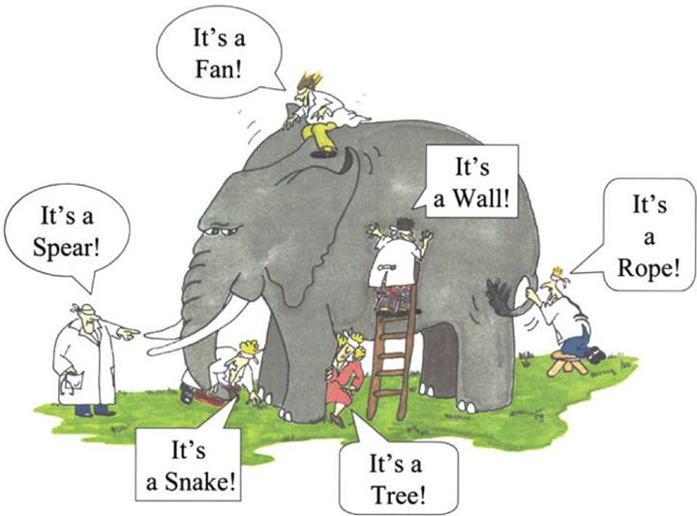
What is Sustainability (1/2)

Slide 3

Growing importance of Sustainability
Sustainability is a concept which lays down that responsible business practices weren’t just good for the environment or society but also for business.
98%
83%
75%
Board commitment towards Sustainability
Growing
ESG Funds
of investors surveyed evaluate nonfinancial disclosures, either formally or informally
of investors surveyed consider formal frameworks to be necessary in assessing long–term value
of investors surveyed would find value in assurance of the robustness of an organization’s planning
for climate risks
Climate Risk in Investments
Growing
Disclosures
Demand for nonfinancial information on the rise
Increasing and more stringent regulation
Changing consumer behaviour
Global accords more prominent than ever
Notes:
Source: Bata India Annual Report: FY-2018-19

Slide 4



Benefits of integrating Sustainability in business
Achieving a sustainable economy
Living within environmental limits
Ensuring a strong, healthy & just society
Promoting good governance
Creating shared value and fostering innovation
Risk management and future ready
Reduced costs by eliminating inefficiencies and optimizing resource use
Enhanced stakeholder engagement and trust, and reduce possibilities of conflict
Contribution to Sustainable Development
Competitive advantage
Access to international funding, markets & listings
Better positioning to respond to local & global regulatory compliances
Retain and attract employees
Achieving significant cost reduction
“Since 1994, Dow has invested nearly $2 billion in improving resource efficiency and has saved $9.8 billion from reduced energy and wastewater consumption in manufacturing. In 2013, GE had reduced greenhouse gas emissions by 32% and water use by 45% compared to 2004 and 2006 baselines, respectively, resulting in $300 million in savings”
~Harvard Business Review

Slide 5



Decoding Sustainability/ ESG
What does ESG mean for an Organisation?
Its commitment to
Decoding ‘E’:
Environment
Decoding ‘S’:
Social
Decoding ‘G’:
Governance
Refers to how an organisation operates within the physical, natural environment.
Includes investors examining a company’s natural resource usage, and the impact of its operations and value chain on the environment.
Refers to how businesses impact their stakeholders – customers, employees and the communities in which they operate.
Includes corporate governance and business integrity.
Corporate governance describes how the company governs itself with policies and controls to achieve compliance and transparency.
Business integrity refers to ethical business practices.
Accountability at the highest level
Reduce environmental footprint
Fulfil social responsibilities
Climate Change
Renewable Energy
Water Stress
Waste Management
Sustainable Sourcing
Occupational Health & Safety
Labour Relations
Human Rights
Employee Wellbeing
Community Engagement
Anti-corruption and Anti-bribery
Whistle Blower
Business Ethics
Board Diversity
Ownership
Strong business growth
Notes:
Source: Bata India Annual Report: FY-2018-19

Slide 6


SUSTAINABILITY REPORTING - Pillars OF change
Regulators
Disclosure Requirements and Frameworks
Promote and Propagate Sustainable Finance
Accountancy Profession
Support , Prepare and Implementation
Assurance
Corporates
Adopting Sustainability Reporting
Enhance Stakeholder‘s Trust, Confidence and Experience

Slide 7

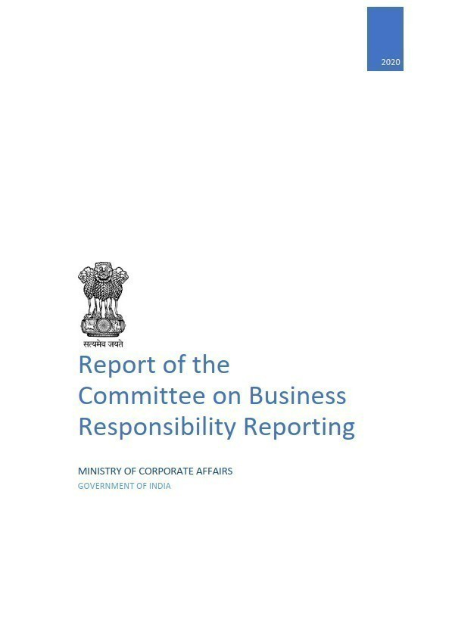
Changing regulatory landscape on ESG disclosure in India
Business Responsibility Reporting (BRR)
National Voluntary Guidelines (NVGs) drawn by the MCA;
Mandate was extended to top 100 listed companies by market cap
Business Responsibility & Sustainability Reporting
The Ministry of Corporate Affairs upgraded its National Voluntary Guidelines in the form of ‘National Guidelines on Responsible Business Conduct’ (NGRBC) in 2018.
The Institute of Chartered Accountants of India (ICAI) - Sustainability Reporting Standards Board (SRSB)
SRSB of ICAI has the mission to take appropriate measures to increase awareness and implement measures towards responsible business conduct.
It has taken In the initiative of finalising BRSR formats for both listed and unlisted companies.
2012
2020
Developed for the top 1000 companies listed in India
May be extended to several unlisted companies that meet specified thresholds of turnover and/or paid-up capital.
The adoption of Comprehensive BRSR would be mandatory for such companies.
MCA appointed Committee has proposed revised BRR formats
2015
Sustainability Report
BSE signed pact with GRI to extent BRR from top 100 to top 500 listed companies:
Globally organizations are disclosing non-financial performance using different standards
Integrated Reporting <IR>
SEBI issued circular advising top 500 listed companies to adopt IR on a voluntary basis from FY 2017-18
Globally organizations integrating non-financial aspects with the business strategy
Section 135 of Companies Act
Every company having net worth of INR 500 crore or more, or turnover of INR 1000 crore or more or a net profit of INR 5 crore or more, to:
spend at least 2% of their average net profits made in the preceding three years on CSR
set up a CSR Committee
A report within the company’s annual report on CSR activities
2017
BRR – increased coverage
Applicability extended to include top 1000 listed companies as per SEBI’s listing regulations
2019

Slide 8
Changing regulations in India
Shift towards non-financial disclosures
With Sustainability reporting gaining traction in India, SEBI defined Sustainability disclosures in a standardised manner for listed companies basis which Business Responsibility and Sustainability (BRSR) guidelines were issued
SEBI introduced Business Responsibility Report (BRR) in 2011
ICAI’s BRSR Scoring Methodology
Scope of BRR was expanded in 2020 to introduce BRSR
Applicable to the Top 1,000 listed companies from FY23
Maturity stage | BRSR Score (% of Total Score)
Formative | Up to 25%
Emerging | > 25% and Up to 50%
Established | > 50% and Up to 75%
Leading | > 75%
BRR was mandated for top listed companies
100 in 2012
500 in 2015
1,000 in 2019
Principle | Essential Indicators | Leadership Indicators
Ethics | 6 | 5
Sustainable life-cycle | 6 | 6
Employees | 10 | 7
Stakeholders | 1 | 2
Human Rights | 7 | 2
Environment | 8 | 6
Public policy | 2 | 2
Social development | 6 | 2
Consumers | 3 | 6
Maximum Score: 300
Essential | 225
Leadership | 75
Principle
Indicators
Questions
Disclosure
Notes:
Source: Bata India Annual Report: FY-2018-19

Slide 9
Business Responsibility and Sustainability Report explained
The objective of this section is to obtain basic information about the company – size, location, products, number of employees, CSR activities, etc. The proposed formats include additional disclosures on proximity of a company’s operations to environmentally sensitive sites such as protected areas, water-stressed zones, etc.
General Disclosures
Business Responsibility and Sustainability Report (BRSR)
In this section, the company is required to disclose information on policies and processes relating to the NGRBC Principles concerning leadership, governance, and stakeholder engagement. Wherever relevant, companies have been asked to provide links to their websites where these policies are available.
Management Disclosures
Responses to Section C indicate how a company is performing in respect of 9 Principles and Core Element of the NGRBCs. This section requires companies to demonstrate their intent and commitment to responsible business conduct through actions and outcomes. The questions have been divided into two types:
Essential (Mandatory)
Leadership (Voluntary)
Principle-wise Disclosures
Notes:
Source: Bata India Annual Report: FY-2018-19

Slide 10


Snapshot of BRSR principles
P3: Employee Wellbeing and Engagement
P1: Ethical Business Practices
P2: Product Stewardship
P4:Stakeholder Engagement
ESG Implementation Program Management
A 100% Compliant Company
Robust Governance Framework
Established framework for product stewardship
Enhanced mechanisms for ensuring supply chain sustainability
Healthy Environment
Developed Workforce
Safe Workplace
Human Capital Development throughout Value chain
Greater investor confidence
Enhanced brand reputation & attractiveness
P5: Human Rights
P6 : Environmental Stewardship
P7: Public Policy Advocacy
P8: Inclusive and Equitable Growth
P9: Customer Focus
ESG Implementation Program Management
Enhanced Human Rights and Ethics policies and processes.
Association with Global coalition (UNGC 10, IFC Performance Standards, etc.)
Environmentally compliant company
Carbon and water neutrality
Established processes for waste & biodiversity management
Robust public advocacy on global matters.
Enhanced engagement with local communities
Enhanced brand reputation & attractiveness
Enhanced customer engagement and product information disclosure.
SOPs/ policies for cyber security & data privacy for customers
Sustainable product labelling
Notes:
Source: Bata India Annual Report: FY-2018-19

Slide 11
Coverage of BRSR principles
Ethical governance
Businesses should conduct and govern themselves with integrity, and in a manner that is Ethical, Transparent, and Accountable
Process of identification of key stakeholders
Stakeholder engagement
Stakeholder consultation for ESG decisions
Stakeholder grievances redressal
Principle 1
Investments in specific technologies to improve the environmental and social impacts of products and processes
Sustainable Sourcing of Products
Product reclamation details
EPR Applicability
Life cycle assessments for products
Sustainable Product Packaging
Product stewardship
Businesses should provide goods and services in a manner that is sustainable and safe
Principle 2
Employee well-being measures and retirement benefits
Accessibility of workplaces
Policies for equal opportunities, processes for grievance redressal
Employee retention and return to work rates
Employee training and development assistance
Workplace health and safety
Value chain assessment
Employee well being and engagement
Businesses should respect and promote the well-being of all employees, including those in their value chains
Principle 3
Stakeholder engagement
Businesses should respect the interests of and be responsive to all its stakeholders
Process of identification of key stakeholders
Stakeholder engagement
Stakeholder consultation for ESG decisions
Stakeholder grievances redressal
Principle 4

Slide 12
Coverage of BRSR principles
Training on human rights issues and policies
Minimum employee wages
Remuneration of the Board
Responsible person/committee for human rights
Complaints receive and redressal system for employees
Human rights assessments and due-diligence
Assessment of value chain partners
Human rights
Businesses should respect and promote human rights
Principle 5
Environmental stewardship
Businesses should respect and make efforts to protect and restore the environment
Energy usage, consumption, and GHG emissions
Water Management
Waste management practices
Location in ecologically sensitive areas
Value chain assessments for environmental impact
R&D and Innovation details for environmental upgradation
Principle 6
Public policy advocacy
Businesses, when engaging in influencing public and regulatory policy, should do so in a manner that is responsible and transparent
Affiliations with trade and industry associations
Actions on anti-competitive conduct by the entity
Public policy positions advocated by the entity
Principle 7
Social Impact Assessments
CSR expenditure and beneficiary details
Ongoing Rehabilitation and Resettlements (R&R)
Mechanisms to receive and redress grievances of the community
Local sourcing
Benefits of usage of traditional knowledge
Inclusive and equitable growth
Businesses should promote inclusive growth and equitable development
Principle 8
Customer feedback and grievance redressal mechanisms
Turnover from products with responsible labelling
Product recalls based on safety issues
Frameworks and policies on cyber security and data privacy
Customer information channels
Data breaches details
Customer focus
Businesses should engage with and provide value to their consumers in a responsible manner
Principle 9

Slide 13
Highlights of the BRSR
1
Impact Investing
Benchmarking Global
Reporting Standards
Training and
Awareness
Assessment
Disclosures
Essential and Leadership Indicators
2
3
4
5
The listed companies while preparing sustainability reports, can now cross-reference such reporting with internationally accepted disclosure parameters as set out under GRI, SASB, TCFD, etc.
Furthermore, in case the data sought under BRSR format is already available under the annual report; the Regulatory Authority to avoid dual reporting, allows entities to cross reference such disclosure data
New format lays emphasis on the importance of imparting adequate awareness and training sessions on aspects such as employee health & safety measures, anti-corruption issues and upskilling the workforce.
Accordingly, companies are required to disclose details of such training initiatives
With the primary objective to create awareness around sustainability, the new disclosure requirements will enable companies to connect with the stakeholders and promote impact investments
With a key focus on environmental and social aspects, new format seeks disclosures w.r.t. any Environmental or Social Impact Assessments carried out by the listed entities in compliance with relevant laws.
Revised framework promotes adaptation of Key Performance Indicators (KPIs) model and although voluntary, the Regulatory Authority encourages listed companies to report on leadership indicators as well.
Notes:
Source: Bata India Annual Report: FY-2018-19

Slide 14

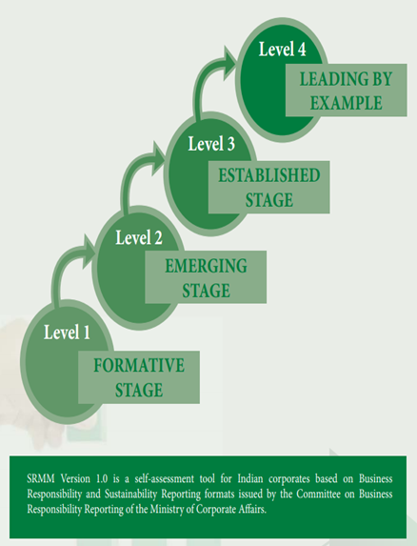
Sustainability Reporting Maturity Model (SRMM) Version 2.0 – Developed by ICAI
First ever maturity model based on scoring of Business Responsibility and Sustainability Reporting (BRSR) formats.
Level 1, Level 2 and Level 3 and Level 4 of Sustainability Maturity of corporates defined based on total range of scores as per BRSR scoring
Innovative solution which offers possibility for each corporate complying with BRSR to individually assess its position vis a vis various sustainability reporting maturity levels
Allow the rating agencies and assurance provider to compare sustainable nature of Indian companies with international companies.
Corporates can self- evaluate their current level of maturity, identify areas where more focus is required, develop a road map for upgrading to a higher level of maturity.

Slide 15
Sustainability Reporting Maturity Model (SRMM) Version 2.0
SRMM V 2.0 is a more refined and comprehensive scoring mechanism based on SEBI Circular of May 2021
SRMM V 2.0 further aligns the Indian Corporate Sustainability Reporting with International Standards
Along with SRMM V 2.0, a SDG ,WEF and GRI mapping vis a vis BRSR has been annexed to enable appropriate scoring evaluation by Corporates to match International Standards.
SRMM V 2.0 enables top 1000 listed entities to identify areas of improvement in their mandatory BRSR Reporting and enable optimizing and growing on the maturity scale.

Slide 16
Sustainability Reporting Maturity Model (SRMM)
Level | Level 1 | Level 2 | Level 3 | Level 4
Stage | Formative Stage | Emerging Stage | Established Stage | Leading by Example
BRSR Score | Up to 75 | 76-150 | 151-225 | 226-300
Explanation | The organisations are at the initial level of reporting and are in the process of identifying the need and responsibility of BRSR. | The organisations realize the value of BRSR and responds to it by setting up robust mechanism for reporting, etc. | The organisations have established formal functions/ policies/ systems for BRSR. | The organisations strive for more than compliance and work towards being a market leader.
 | Try to establish policies/systems for data collection and disclosures. | The functions/ policies/ systems for such reporting are still to be formalised/ focussed. The organisation is working towards establishing/ enhancing internal controls, data collection and disclosures. | Involved in compliance functions, etc., and focus increasing on qualitative aspects. | Strategically differentiating by enhancing disclosures vis a vis innovative methods/ techniques employed.

Slide 17

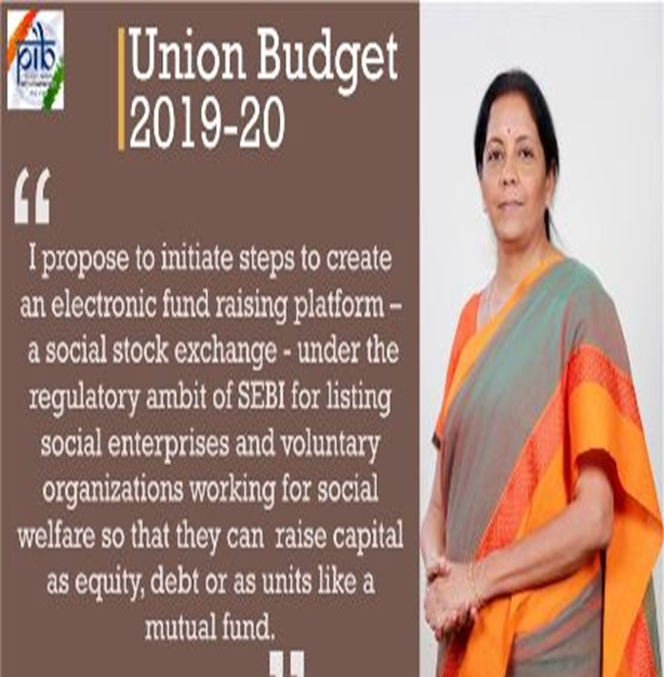

SOCIAL STOCK EXCHANGE
Social Stock Exchange (SSE) is a platform which allows investors to buy shares in social enterprises vetted by an official exchange. SSE will function as a common platform where social enterprises can raise funds from the public.
The Union Budget 2019 had proposed setting up of first of its kind SSE in India.
SEBI’s Working Group (WG) Report on SSE, released on June 01, 2020, had provided a form and content to the Hon’ble Finance Minister’s vision. Recommendations outlined modalities for creating a SSE that will serve as a platform for fundraising and, also incorporate procedures by which social impact of NPOs and FPEs will be measured and reported.

Slide 18
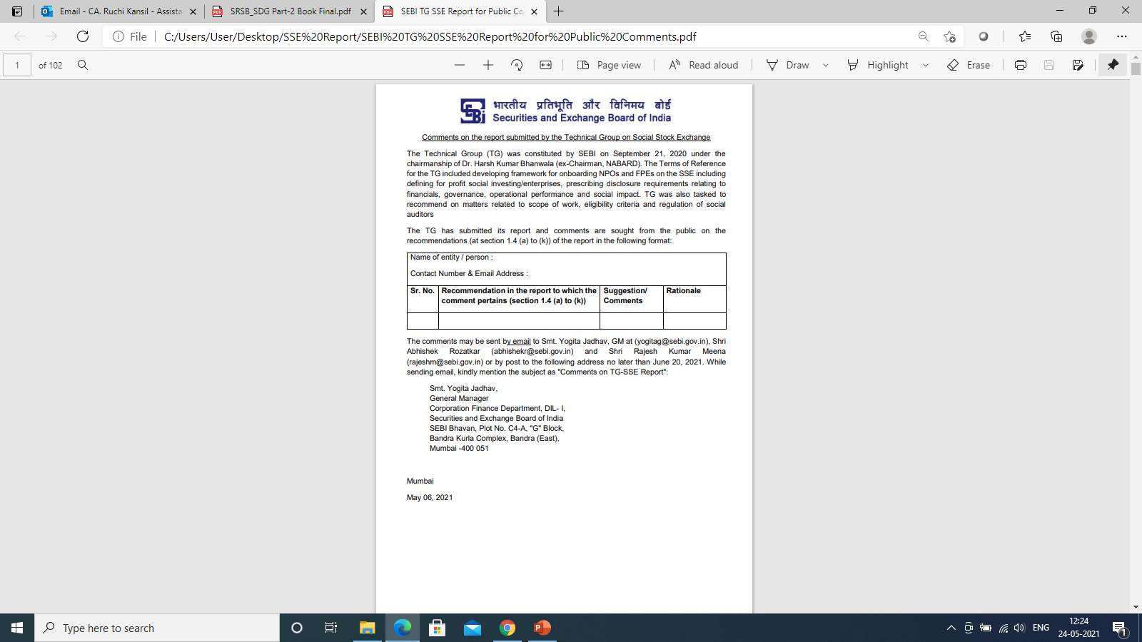










TECHNICAL GROUP ON social stock exchange
SEBI had constituted Technical Group (TG) on SSE on September 21, 2020, and ICAI was given representation for developing framework for on boarding Non-Profit Organisations (NPOs) and For-Profit Social Enterprises (FPEs) on the SSE.
Technical Group has submitted its report in May 2021 and comments were sought from the public on the recommendations. SRSB has submitted comments on the same.
SEBI had released Framework for Social Stock Exchange (SSE) in September 2021, wherein SSE will be separate segment of the existing stock exchanges to facilitate fund raising by social enterprises in the Securities Market.

Slide 19
SEBI Notification - SOCIAL STOCK EXCHANGE
Vide Notification dated July 25, 2022, “Securities and Exchange Board of India (Issue of Capital and Disclosure Requirements) (Third Amendment) Regulations, 2022”, has been issued in The Gazette of India regarding formation of Social Stock Exchange.
“Social Stock Exchange” has been defined as “A separate segment of a recognized stock exchange having nationwide trading terminals permitted to register Not for Profit Organizations and/ or list the securities issued by Not-for-Profit Organizations in accordance with provisions of these regulations.”
“Social Enterprise” means either a Not for Profit Organization or a For Profit Social Enterprise that meets the eligibility criteria specified in this Chapter.

Slide 20
16 thematic areas as notified by sebi
Eradicating hunger, poverty, malnutrition and inequality
Promoting health care including mental healthcare, sanitation and making available safe drinking water
Promoting education, employability and livelihoods
Promoting gender equality, empowerment of women and LGBTQIA+ communities
Ensuring environmental sustainability, addressing climate change including mitigation and adaptation, forest and wildlife conservation
Protection of national heritage, art and culture
Training to promote rural sports, nationally recognised sports, Paralympic sports and Olympic sports
Supporting incubators of Social Enterprises

Slide 21
16 thematic areas as notified by sebi
Supporting other platforms that strengthen the non-profit ecosystem in fundraising and capacity building
Promoting livelihoods for rural and urban poor including enhancing income of small and marginal farmers and workers in the non-farm sector
Slum area development, affordable housing and other interventions to build sustainable and resilient cities
Disaster management, including relief, rehabilitation and reconstruction activities
Promotion of financial inclusion
Facilitating access to land and property assets for disadvantaged communities;
Bridging the digital divide in internet and mobile phone access, addressing issues of misinformation and data protection
Promoting welfare of migrants and displaced persons

Slide 22
FRAMEWORK FOR SOCIAL STOCK EXCHANGE
Minimum Requirements to be met by NPOs for registration with SSE
Broad Parameter | Details
Entity is registered as an NPO | Entities must be registered in India as one of the below: A charitable trust registered under the public trust statue of the relevant state; A charitable trust registered under the Societies Registration Act, 1860 A charitable trust registered under the Indian Trusts Act, 1882 A company incorporated under section 8 of the Companies Act, 2013
Ownership and control | Disclose if NPO is owned and/or controlled by government or private
Exemption under Income Tax Act | Registration Certificate under section 12A/12AA/12AB to be valid for at least the next 12 months. Does not have a notice or ongoing scrutiny by Income Tax.
Registration with Income Tax as an NPO | Valid IT PAN
Age of the NPO | Minimum 3 years

Slide 23
FRAMEWORK FOR SOCIAL STOCK EXCHANGE
Minimum Requirements to be met by NPOs for registration with SSE
Broad Parameter | Details
Deduction under Income Tax Act, 1960 | Entity to ensure whether tax deduction is available or not to investors. Valid 80G registration required under Income Tax Act, 1961.
Eligible to be Social Enterprise | As per requirements with Regulation 292E of ICDR Regulations
Annual Spending in the past financial year | Must be at least Rs. 50 lakhs
Funding in the past financial year | Must be at least Rs. 10 lakhs

Slide 24
FRAMEWORK FOR SOCIAL STOCK EXCHANGE
Minimum Requirements to be met by NPOs for registration with SSE
Broad Parameter | Details
Primary Goals | Social Intent & Impact
Activity | Any one of 16 thematic areas targeting underserved or less priviledged population or regions
Minimum qualifying % | 67% of activities for target population based on Revenue/ Expenditure/ Customer Base
Ineligible | Corporate Foundations, Political & Religious organizations/activities, Professional or Trade associations, Infrastructure or housing Companies (except affordable housing)

Slide 25


Fund raising by social enterprises
Not for Profit Organization may raise funds on a Social Stock Exchange through:
Issuance of Zero Coupon Zero Principal Instruments to institutional investors and/ or non-institutional investors in accordance with the applicable provisions of this Chapter;
Donations through Mutual Fund schemes as specified by the Board;
Any other means as specified by the Board from time to time.
For Profit Social Enterprise may raise funds through:
Issuance of equity shares on the main board, SME platform or innovators growth platform or equity shares issued to an Alternative Investment Fund including a Social Impact Fund;
Issuance of debt securities;
Any other means as specified by the Board from time to time

Slide 26
FRAMEWORK FOR SOCIAL STOCK EXCHANGE
Minimum Initial Disclosure Requirement for NPOs raising funds through issuance of Zero Coupon Zero Principal Instruments
SSE shall mandate the structure of fund raising document and host such requirements on website.
SSE shall ensure that documents contain the following minimum disclosures:
- Vision - Finance
- Target Segment - Compliance
- Strategy - Credibility
- Governance - Social Impact
- Management - Risks
- Operation

Slide 27
FRAMEWORK FOR SOCIAL STOCK EXCHANGE
Annual Disclosure by NPOs on SSE
I. Disclosure on General Aspects:
Name of the organization (legal and popular name)
Location of headquarters and location of operations
Vision / Mission / Purpose
Organizational goals, activities, products and services
Outreach of organization (Type and number of direct, indirect and institutional beneficiaries / stakeholders reached)
Scale of operations Details of top donors or investors of organisation (Including Employee and Volunteer strength)
Details of top donors or investors of organisation - List of Top 5 donors or investors (budget wise)
Details of top 5 programs in disclosure period - List of Top 5 interventions/programs (budget wise)

Slide 28
FRAMEWORK FOR SOCIAL STOCK EXCHANGE
Annual Disclosure by NPOs on SSE
II. Disclosures on Governance aspects:
Ownership and legal form
Governance Structure (outlines board and management committee structures, mandates, membership, charters, policies and internal controls)
Details of governing body including names of the members of the body
Executives with key responsibilities
Number of meetings by governing body and other committees formed by them along with attendance and the process of performance review
Organisation level potential risks and mitigation plan
Reporting of related party transactions
Mechanisms for advice and concerns about ethics, along with conflict of interest and communicating other critical concerns

Slide 29
FRAMEWORK FOR SOCIAL STOCK EXCHANGE
Annual Disclosure by NPOs on SSE
II. Disclosures on Governance aspects (Contd.):
Remuneration Policies
Stakeholder grievance, process of grievance redressal and number of grievance received and resolved
Compliance management process and statement of compliance from senior decision maker
Organisation registration certificate and other licenses and certifications (12A, 80G, FCRA, GST, etc.)
III. Disclosures on Financial aspects:
Financial Statement (Balance Sheet, Income statement and Cash Statement). Also program wise fund utilization for the year
Auditors report and auditor details

Slide 30
FRAMEWORK FOR SOCIAL STOCK EXCHANGE
Disclosure of Annual Impact Report by Social Enterprises
All Social Enterprises(SEs) will have to provide duly audited Annual Impact Report (AIR) to SSE within 90 days from the end of Financial Year.
AIR shall capture the qualitative and quantitative aspects of the social impact generated by the entity.
AIR should at a minimum, cover the aspects –
Strategic Intent and Planning
Approach
Impact Score Card
Statement of utilisation of funds
Listed NPO shall submit statement of utilisation of funds to SSE within 45 days from the end of quarter

Slide 31
Institute of Social Auditors of India
Self - Regulatory OrganiZation (SRO) for Social Stock Exchange
Institute of Social Auditors of India (ISAI) - Self-Regulatory Organisation (SRO) for Social Stock Exchange to enrol and regulate Social Auditors (SAs), has been formed by ICAI, with the main objective of establishing itself as a leading institution for regulation and development of Social Auditors in an independent and transparent manner, sub-serving the public interest.
The functions of SRO include -
Empanelment, registration of SAs
Laying down standards of professional conduct, suspension/ cancellation of membership of SAs
Framing the Social Audit Standard covering aspects such as scope, engagement acceptance, basic principles, audit procedures, assurance report, documentation etc.
Prescribing a separate Code of Conduct for SAs.

Slide 32

SOCIAL Audit standards
“Social Auditor” has been defined as an individual registered with a self-regulatory organization under the Institute of Chartered Accountants of India or such other agency, as may be specified by the Board, who has qualified a certification program conducted by National Institute of Securities Market and holds a valid certificate.
ICAI had been entrusted with development of Social Audit Standards covering aspects such as scope, engagement acceptance, basic principles, audit procedures, assurance report, documentation etc.
SRSB of ICAI has developed Compendium of Social Audit Standards consisting of Framework for the Social Audit Standards, Preface to the Social Audit Standards and Social Audit Standards (SAS) on all the sixteen thematic areas and sub-areas for taxonomic classification of social objectives covering various related areas of audit of social impact, for example, poverty, nutrition, climate change, etc.

Slide 33









Social Audit Standards
Social Audit Standards | SDGs
SAS 100: Eradicating hunger, poverty, malnutrition and inequality | SDG 1 – No Poverty SDG 2 – Zero Hunger
SAS 200: Promoting health care including mental healthcare, sanitation and making available safe drinking water | SDG 3 – Good Health and Well-being
SAS 300: Promoting education, employability and livelihoods | SDG 4 – Quality Education SDG 8 – Decent Work and Economic Growth
SAS 400: Promoting gender equality, empowerment of women and LGBTQIA+ communities | SDG 5 – Gender Equality
SAS 500: Ensuring environmental sustainability, addressing climate change including mitigation and adaptation, forest and wildlife conservation | SDG 13 – Climate Action SDG 7 – Affordable and Clean Energy SDG 14 – Life Below Water

Slide 34





Social Audit Standards
Social Audit Standards | SDGs
SAS 600: Protection of national heritage, art and culture | SDG 11 – Sustainable Cities and Communities
SAS 700: Training to promote rural sports, nationally recognised sports, Paralympic sports and Olympic sports | SDG 10 – Reduced Inequalities
SAS 800: Supporting incubators of Social Enterprises | SDG 9 – Industry, Innovation and Infrastructure
SAS 900: Supporting other platforms that strengthen the non-profit ecosystem in fundraising and capacity building | SDG 9 – Industry, Innovation and Infrastructure
SAS 1000: Promoting livelihoods for rural and urban poor including enhancing income of small and marginal farmers and workers in the non-farm sector | SDG 8 - Decent Work and Economic Growth SDG 10 – Reduced Inequalities
SAS 1100: Slum area development, affordable housing and other interventions to build sustainable and resilient cities | SDG 6 – Clean Water and Sanitation SDG 15 – Life on Land

Slide 35


Social Audit Standards
Social Audit Standards | SDGs
SAS 1200: Disaster management, including relief, rehabilitation and reconstruction activities | SDG 11 - Sustainable Cities and Communities
SAS 1300: Promotion of financial inclusion | SDG 10 - Reduced Inequalities SDG 17 – Partnerships for the Goals
SAS 1400: Facilitating access to land and property assets for disadvantaged communities | SDG 10 - Reduced Inequalities
SAS 1500: Bridging the digital divide in internet and mobile phone access, addressing issues of misinformation and data protection | SDG 16 – Peace, Justice and Strong Institutions
SAS 1600: Promoting welfare of migrants and displaced persons | SDG 10 - Reduced Inequalities

Slide 36

THANK YOU
CA Priti Savla
9321426883
priti@psaindia.net

