Slide 1

WORKSHOP ON THE INCOME TAX ACT, 2025
ORGANISED BY DIRECT TAX COMMITTEE
HOSTED BY VASAI BRANCH (WIRC)
TOPIC:
FORM 26 VIS-À-VIS 3CA/CB/CD- DIFFERENCE IN REPORTING REQUIREMENT
SUNDAY 10th MAY, 2026
PRESENTED BY CA. RASHID SIDDIQUI
CA Rashid H Siddiqui & Co
Chartered accountants

Slide 2
Disclaimer
The material contained in the ensuing slides is for general information, compilation and the views of the speaker and is purely for general discussion at the seminar and it should not be construed and binding either on the part of the Speaker or the Institute/ Study Circle. It is not intended to be legal advice on any particular matter. Since the features of the website are dynamic in nature, it is advised in your own interest to refer to Government publications including the Income Tax Act and Rules before arriving to any final conclusion. Members are requested to refer to the Act , Laws, Rules and Decisions of the various courts of law from time to time depending on a particular case to case as may be applicable to them.
CA Rashid H Siddiqui & Co
Chartered accountants

Slide 3
AGENDA
Transition from Income-tax Act, 1961 to Income-tax Act, 2025 and Rules, 2026.
Applicability of Tax Audit under Section 63 vis-à-vis erstwhile provisions.
Shift from Forms 3CA/3CB/3CD to Single Form 26.
Structure and key components of Form 26.
Key reporting changes and clause-level differences.
Audit approach: Categorisation, quantification, and system-driven reporting.
Compliance framework: Documentation, timelines, and penalties.
Practical challenges and implementation considerations.
CA Rashid H Siddiqui & Co
Chartered accountants

Slide 4
The Journey of Income-tax Act, 2025
(Timeline)
CA Rashid H Siddiqui & Co
Chartered accountants

Slide 5
12 August 2025:
The Bill was successfully passed by the Rajya Sabha.
11 August 2025:
The revised Income tax (No. 2) Bill, 2025 was introduced and passed by the Lok Sabha.
21 August 2025:
The Bill received the official assent of the Hon’ble President of India, formally enacting it as the Income-tax Act, 2025.
CA Rashid H Siddiqui & Co
Chartered accountants

Slide 6
The Journey of Income-tax Rules, 2026
(Timeline)
CA Rashid H Siddiqui & Co
Chartered accountants

Slide 7
22 February 2026:
The framework was kept open for a 15-day public discussion period allowing tax professionals, CAs, and industry bodies to submit their feedback via the e-filing portal.
8 February 2026:
The CBDT released the draft Income Tax Rules, 2026, and draft statutory forms for public consultation.
20 March 2026:
After incorporating stakeholder feedback, the CBDT officially notified the Income-tax Rules, 2026.
CA Rashid H Siddiqui & Co
Chartered accountants

Slide 8
Key Changes in Income Tax Act,1961
vs
Income Tax Act, 2025
CA Rashid H Siddiqui & Co
Chartered accountants

Slide 9
PARAMETERS | INCOME TAX ACT 1961 | INCOME TAX ACT 2025
Sections | 819 | 536
Schedules | 14 | 16
Rules | 511 | 333
Forms | 399 | 190
CA Rashid H Siddiqui & Co
Chartered accountants

Slide 10
APPLICABILITY OF INCOME TAX ACT, 2025
CA Rashid H Siddiqui & Co
Chartered accountants

Slide 11
The provisions of the New Act will apply from the Tax Year 2026-27 onwards.
Current Status (FY 2025-26): For the current financial year, tax filings will still follow the existing IT Act, 1961, though they incorporate the revised tax slabs and rebates introduced in Budget 2025.
New "Tax Year" Concept: The confusing dual concept of "Previous Year (PY)" and "Assessment Year (AY)" has been merged into a single Tax Year.
CA Rashid H Siddiqui & Co
Chartered accountants

Slide 12
QUICK QUIZ
CA Rashid H Siddiqui & Co
Chartered accountants

Slide 13
Q1. What is Form 26 under the Income-tax Act, 2025?
A
Tax Audit Report
B
Annual Information Statment
ANS: A. Tax Audit Report
CA Rashid H Siddiqui & Co
Chartered accountants

Slide 14
Q2. How is the tax audit report structured under the new law?
A
Multiple Form (3CA/3CB + 3CD)
B
Single Integrated Form 26
ANS: B. Single Integrated Form 26
CA Rashid H Siddiqui & Co
Chartered accountants

Slide 15
Q3. What is the due date linkage for filing Form 26 under the new law?
A
Same as ITR due date
B.
One month prior to ITR due date
ANS: B. One month prior to ITR due date
CA Rashid H Siddiqui & Co
Chartered accountants

Slide 16
Q4. In Form 26, audit observations must be:
A
Only Descriptive (Free Text)
B
Categorised and quantified
ANS: B. Categorised and quantified
CA Rashid H Siddiqui & Co
Chartered accountants

Slide 17
Q5. Which of the following is a new requirement for auditors in Form 26?
Reporting server location of books of accounts
Only reporting profit and loss figures
A
B
ANS: A. Reporting server location of books of accounts
CA Rashid H Siddiqui & Co
Chartered accountants

Slide 18
Q6. Under Form 26, reporting of TDS/TCS requires disclosure of:
Only total tax deducted/collected
Transactions reported and not reported in returns
A
B
ANS: B. Transactions reported and not reported in returns
CA Rashid H Siddiqui & Co
Chartered accountants

Slide 19

CA Rashid H Siddiqui & Co
Chartered accountants

Slide 20
FORM 26
(Prescribed under Rule 47 of Income Tax Rules, 2026)
(Form 3CA/CB & CD under Income Tax Act, 1961)
CA Rashid H Siddiqui & Co
Chartered accountants

Slide 21
APPLICABILITY OF TAX AUDIT
CA Rashid H Siddiqui & Co
Chartered accountants

Slide 22
TAX AUDIT
Category | Section 44AB (1961 Act) | Section 63 (2025 Act) | Change
Business (Normal) | Sales, Turnover or Gross receipts > ₹1 crore | Sales, Turnover or Gross receipts > ₹1 crore | No change
Business (High Digital) | Sales, Turnover or Gross receipts > ₹10 crore (if cash ≤ 5%) | Sales, Turnover or Gross receipts > ₹10 crore (if cash ≤ 5%) | No change
Profession | Gross receipts > ₹50 lakh | Gross receipts > ₹50 lakh | No change
CA Rashid H Siddiqui & Co
Chartered accountants

Slide 23
Section 58 of the Income Tax Act 2025
(Old 44AD,44ADA & 44AE)
Applicability:
Assessee declares profit below 6%/8% AND total income exceeds basic exemption limit (₹ 2,50,000 under Old Tax Regime) (₹ 4,00,000 under New Tax Regime)
CA Rashid H Siddiqui & Co
Chartered accountants

Slide 24
Governing Provisions and Rules
(Old vs. New)
CA Rashid H Siddiqui & Co
Chartered accountants

Slide 25
Governing Provisions and Rules
(Old vs. New)
Parameter | Form 3CA/3CB/3CD | Form 26
Governing Section | Section 44AB – Income-tax Act, 1961 | Section 63 – Income-tax Act, 2025
Prescribed Under | Income-tax Rules, 1962 (Rule 6G) | Income-tax Rules, 2026 (Rule 47)
Effective Till | AY 2026-27 (PY 2025-26) | Tax Year 2026-27 onwards
Category | Two separate Audit Reports + One Statement | Single Integrated Report with 4 Parts
Due Date for filing | 30th September or 31st October (If Transfer Pricing Applicable) | 30th September or 31st October (If Transfer Pricing Applicable)
CA Rashid H Siddiqui & Co
Chartered accountants

Slide 26
Clause Count
Metric | Form 3CD (Old) | Form 26
Number of Clauses | 44 Clauses | 53 Clauses (+ Extensive Schedules)
Schedules | Minimal (mostly inline data) | Multiple dedicated Schedules (GST, ICDS, Quantitative, Unquoted Shares, etc.)
CA Rashid H Siddiqui & Co
Chartered accountants

Slide 27
Structural Differences and
Fundamental Changes
CA Rashid H Siddiqui & Co
Chartered accountants

Slide 28
Structural Differences
Aspect | Form 3CD (old) | Form 26 (New)
Format Style | Clause-based narrative | Data-structured schedules
Focus | Book–tax differences | Full compliance ecosystem
Digital system disclosure | Not required | Mandatory software & cloud details
ICDS reporting | Limited | Dedicated ICDS schedules
International taxation | Minimal | Integrated TP & BEPS-style reporting
CA Rashid H Siddiqui & Co
Chartered accountants

Slide 29
Structural Differences
Aspect | Form 3CD (old) | Form 26 (New)
TDS/TCS | Summary-based | Transaction analytics format
Indirect tax linkage | Not integrated | GST registration & expenses mapping
Financial transaction reporting | Select clauses | Detailed loan, cash, SFT tracking
Auditor qualification tagging | General remarks | Clause-specific tagging (1-53)
CA Rashid H Siddiqui & Co
Chartered accountants

Slide 30
Old Structure (Act 1961): Three Separate Forms
Form | Purpose
Form 3CA | Audit Report for persons already audited under any other law (e.g., Companies Act)
Form 3CB | Audit Report for persons not audited under any other law
Form 3CD | Annexure — Statement of Particulars (44 Clauses) attached to either 3CA or 3CB
So a tax auditor would file either 3CA +3CD or 3CB + 3CD.
CA Rashid H Siddiqui & Co
Chartered accountants

Slide 31
New Structure (Act 2025): Single Integrated Form 26
Form 26 has 4 Parts:
Part | Purpose | Old Equivalent
Part A | General Information (Assessee Details) | (New/Expanded)
Part B | Statement of Particulars (53 Clauses + Schedules) | Form 3CD (but restructured)
Part C | Audit Report where accounts audited under any other law | Form 3CA
Part D | Audit Report where accounts not audited under any other law | Form 3CB
CA Rashid H Siddiqui & Co
Chartered accountants

Slide 32
Key Reporting Equivalents
Form 3CD vs. Form 26
CA Rashid H Siddiqui & Co
Chartered accountants

Slide 33
Reporting Requirement / Particulars | Form 3CD (Previous Format) | Form 26 (Part A & B)
Identity & Basic Details | Clauses 1–8 | Clause 1-8 (Part A)
Nature of Business | Clause 10 | Clause 12
Books of Account | Clause 11 | Clauses 13–14
Method of Accounting & Inventory | Clause 13 -14 | Clauses 15–16
Depreciation | Clauses 18 | Clause 36 & Detailed Schedules
Disallowances | Clause 26 | 27 Series of Clauses
MSME Interest | Clause 22 | Clause 33
TDS/TCS Compliance | Clause 34 | Clauses 49, 50, & 51
Loans and Deposits (Sec 269SS/T) | Clauses 31, 31a, & 31b | Clause 45 (Consolidated)
Payment made to Specified Persons | Clause 23 | Clause 29 & 30
CA Rashid H Siddiqui & Co
Chartered accountants

Slide 34
COMPONENTS OF PART B OF FORM 26
CA Rashid H Siddiqui & Co
Chartered accountants

Slide 35
PART B (Form 26)
Part | Clauses Covered
A- General Information | Clause 9 to Clause 12
B- Particulars of books of account and method of accounting | Clause 13 to Clause 19
C - Particulars of receipt/income | Clause 20 to Clause 25
D - Particulars of expenses | Clause 26 to Clause 34
E- Particulars of Prior Period | Clause 35
F- Particulars of Losses, Depreciation, and Deductions | Clause 36 to Clause 39
G- International Taxation | Clause 40 to Clause 43
H- Other Key Parameters | Clause 44 to Clause 48
I- Particulars of TDS/TCS | Clause 49 to Clause 51
J - Particulars of indirect taxation | Clause 52
K - Quantitative Details | Clause 53
CA Rashid H Siddiqui & Co
Chartered accountants

Slide 36
KEY CHANGES AND COMPARISONS BETWEEN CLAUSES OF
FORM 3CD VS FORM 26 – PART B
CA Rashid H Siddiqui & Co
Chartered accountants

Slide 37
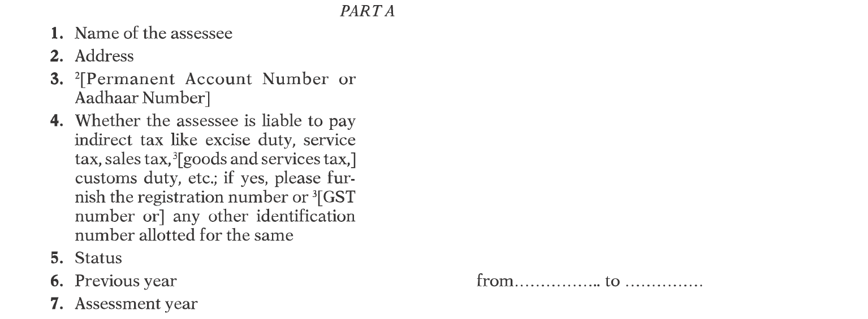
Form 3CD – PART A
CA Rashid H Siddiqui & Co
Chartered accountants

Slide 38
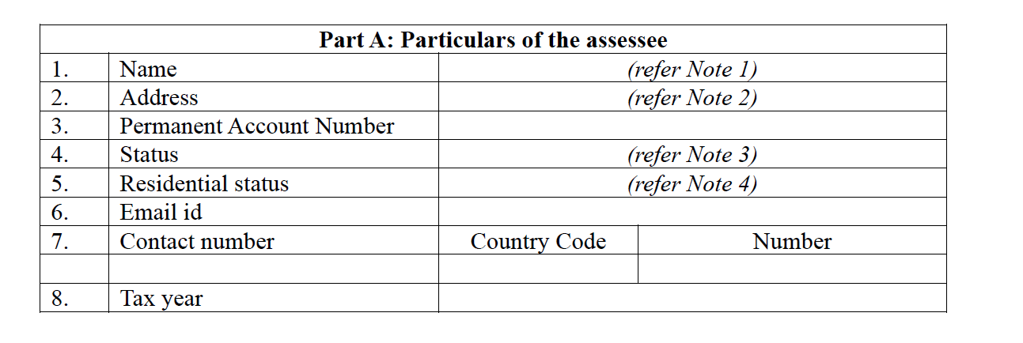
Form 26 – PART A
CA Rashid H Siddiqui & Co
Chartered accountants

Slide 39
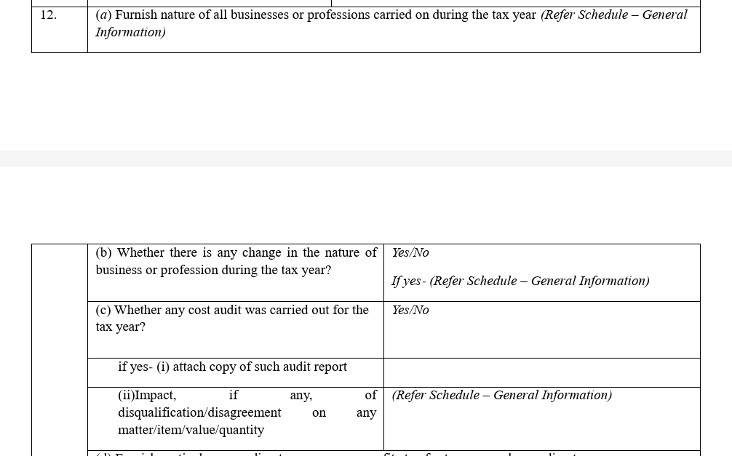
Form 26 – PART B
(Clause 12)
Clause 37 of Form 3CD
CA Rashid H Siddiqui & Co
Chartered accountants

Slide 40
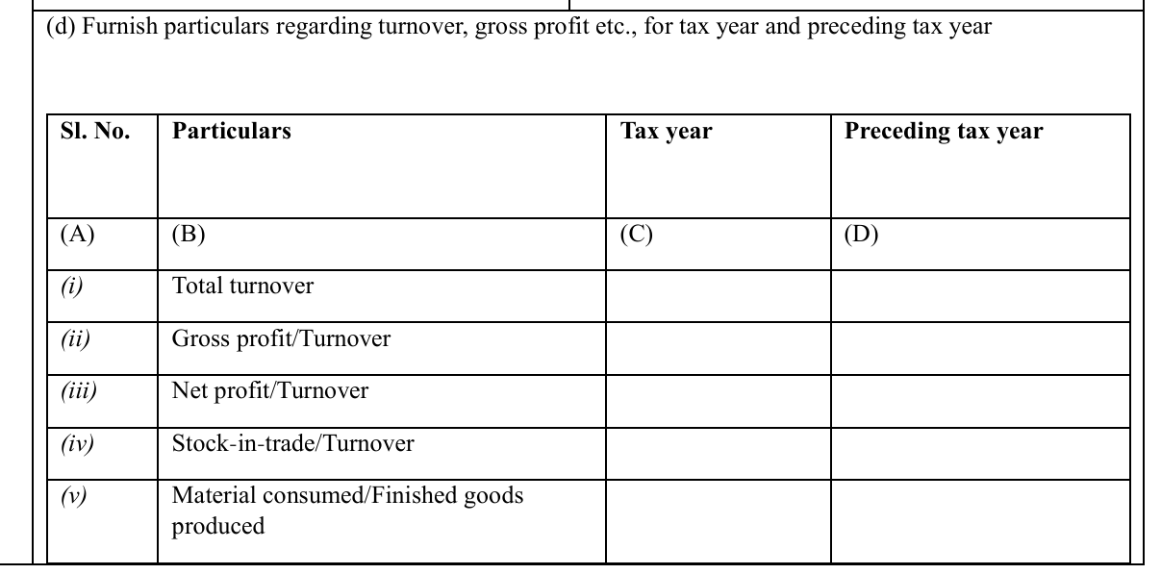
Form 26 – PART B
[Clause 12 (d)]
3CD Clause No 40
CA Rashid H Siddiqui & Co
Chartered accountants

Slide 41
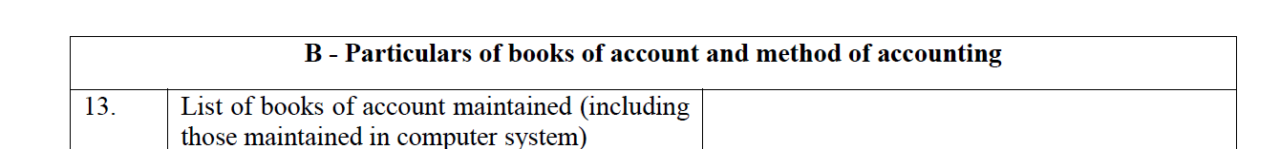
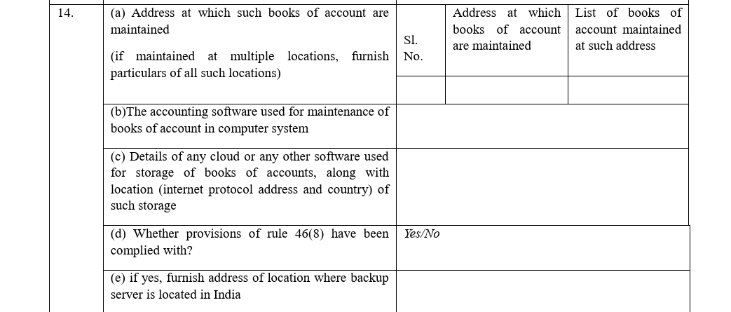
Form 26 – PART B
Books of Accounts
(Clause 13 & 14)
CA Rashid H Siddiqui & Co
Chartered accountants

Slide 42
Rule 46 (8) of Income Tax Rules 2026
Rule 46(8) of the Income-tax Rules 2026 introduces a formal and enforceable framework for digital record-keeping. In simple terms, it says that if you maintain books of account electronically shall remain accessible in India at all times, and back up of such books of accounts shall be kept every single day, and those backups must be stored on servers physically located in India.
CA Rashid H Siddiqui & Co
Chartered accountants

Slide 43
Rule 46 (8) of Income Tax Rules 2026
The rule covers two main categories of taxpayers:
Persons required to maintain books of account under Section 62 of the Income-tax Act – this includes most businesses, professionals, and entities with prescribed income or turnover thresholds.
Persons liable for tax audit under Section 63 – typically businesses with turnover above Rs. 1 crore and professionals above Rs. 50 lakh (subject to applicable thresholds).
CA Rashid H Siddiqui & Co
Chartered accountants

Slide 44
Practical Challenges
Multiple Locations – Books Maintained?
Work From Home / Remote Accounting?
Books maintained by a CA firm. What address to report?
Use of Accounting Software?
Cloud Accounting?
Data Stored Outside India?
Company takes backup on Google Drive. What address to give?
CA Rashid H Siddiqui & Co
Chartered accountants

Slide 45
Penalties
Non-compliance Type | Penalty Amount
Non-maintenance of books as prescribed under Rule 46(8) (Section 441 of Income Tax Act 2025) | Rs. 25,000
Incorrect certification in audit report (Section 463 of Income Tax Act 2025) | Rs. 10,000
CA Rashid H Siddiqui & Co
Chartered accountants

Slide 46
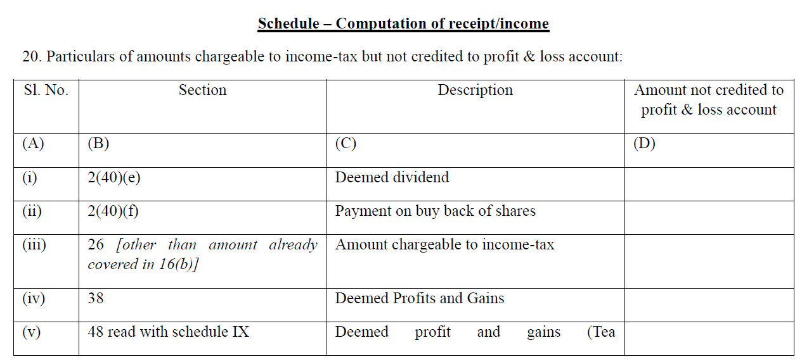
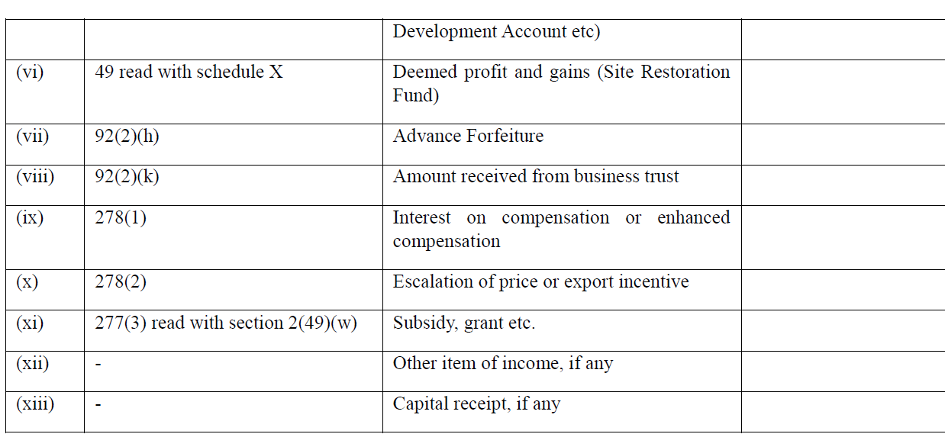
Clause 20 – PART B
Amount chargeable to Income Tax but not credited to Profit & Loss Account
CA Rashid H Siddiqui & Co
Chartered accountants

Slide 47
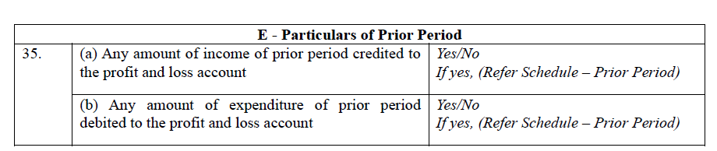
Form 3CD
(Clause 27b)
Particulars of Prior Period Items
These are now separately reported to prevent timing arbitrage, a common technique where income or expenses are shifted across years to minimize tax liability. By isolating prior period items, the form ensures year-wise income accuracy.
CA Rashid H Siddiqui & Co
Chartered accountants

Slide 48
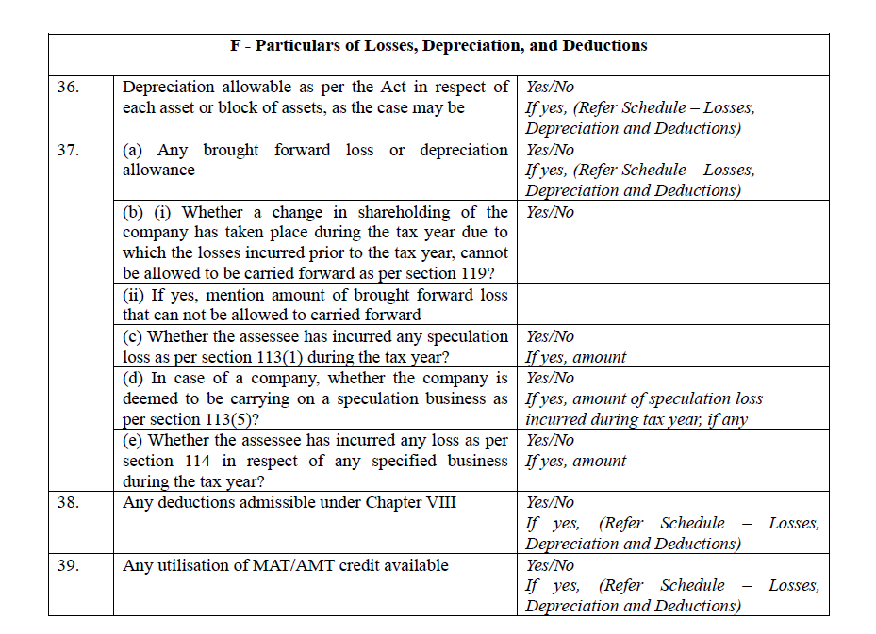
Form 26 – PART B
Losses, Depreciation and Deductions
(Clause 36-39)
CA Rashid H Siddiqui & Co
Chartered accountants

Slide 49
Particulars of Losses, Depreciation, and Deductions
Depreciation is now reported based on usage period, whether an asset was used for more than 180 days or 180 days or less in the tax year, rather than requiring asset-wise dates of “put to use.” This significantly simplifies reporting for businesses with large asset bases, Details of carry-forward losses, their origin year, and the nature of loss, Deductions claimed under Chapter VI-A equivalent provisions of the 2025 Act.
CA Rashid H Siddiqui & Co
Chartered accountants

Slide 50
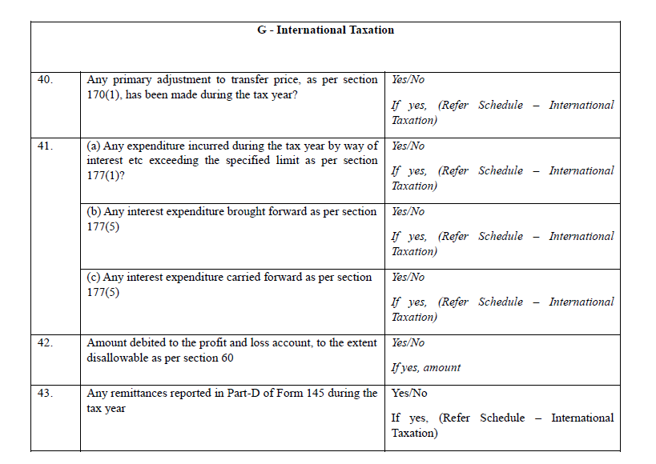
Form 26 – PART B
International Taxation
(Clause 40 - 43)
Form 3CD
(Clause 30A, 30B)
CA Rashid H Siddiqui & Co
Chartered accountants

Slide 51
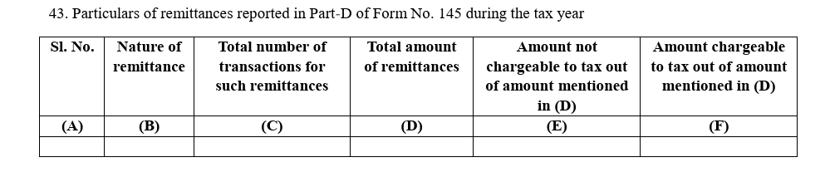
Form 26 – PART B
Foreign Remittance Reporting
Clause 43
Old Form 15CA
CA Rashid H Siddiqui & Co
Chartered accountants

Slide 52
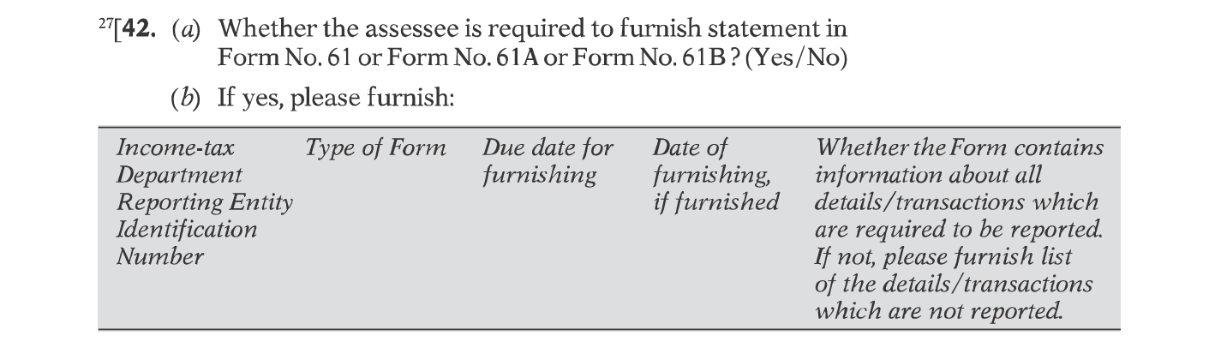
Form 3CD
SFT Details
(Clause 42)
CA Rashid H Siddiqui & Co
Chartered accountants

Slide 53
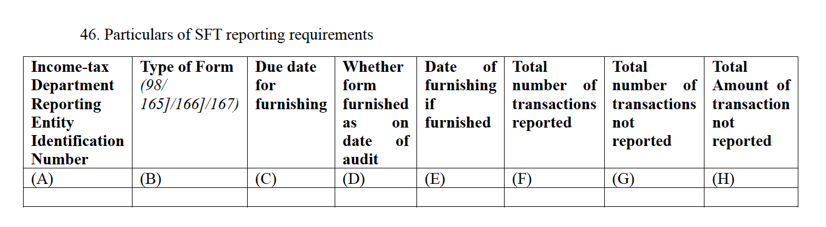
Form 26 – PART B
SFT Details
(Clause 46)
CA Rashid H Siddiqui & Co
Chartered accountants

Slide 54
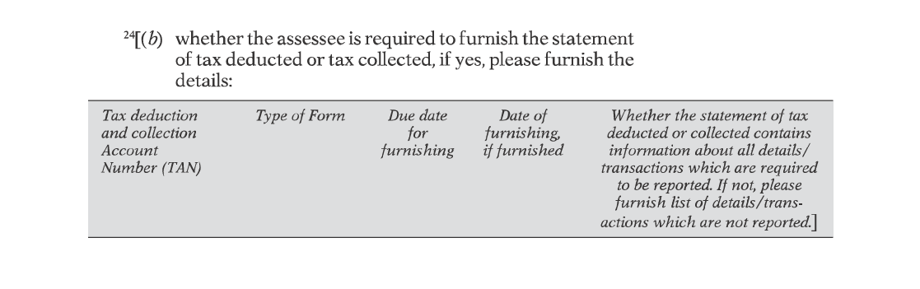
Form 3CD
TDS Reporting
Clause 34(b)
CA Rashid H Siddiqui & Co
Chartered accountants

Slide 55
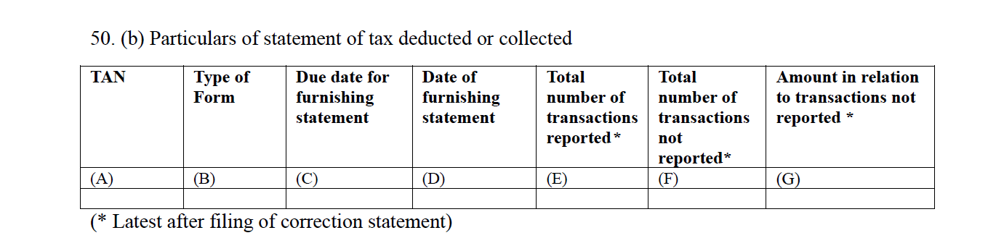
Form 26 – PART B
TDS Reporting
Clause 50(b)
CA Rashid H Siddiqui & Co
Chartered accountants

Slide 56
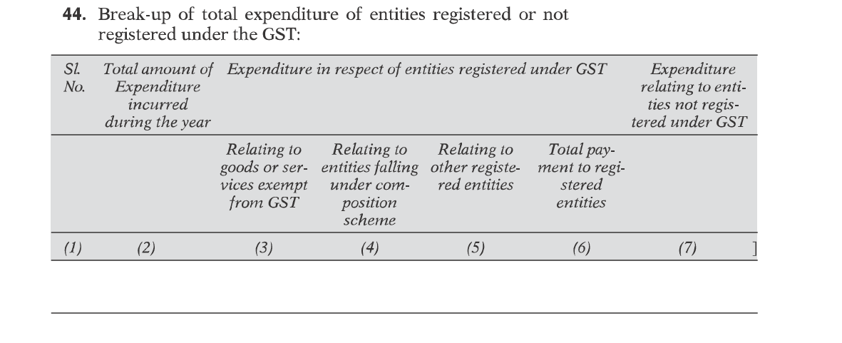
Form 3CD
GST Reporting
(Clause 44)
CA Rashid H Siddiqui & Co
Chartered accountants

Slide 57
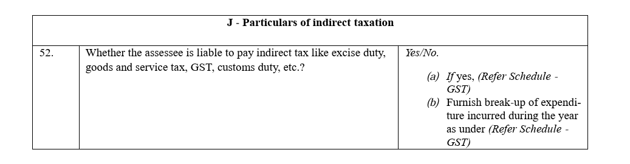
Form 26 – PART B
GST Reporting
(Clause 52)
CA Rashid H Siddiqui & Co
Chartered accountants

Slide 58
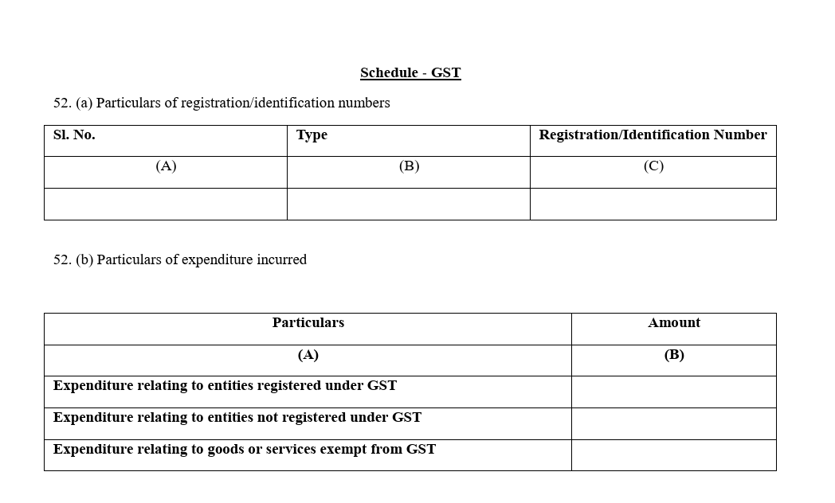
Form 26 – PART B
GST Reporting
(Schedule GST)
CA Rashid H Siddiqui & Co
Chartered accountants

Slide 59
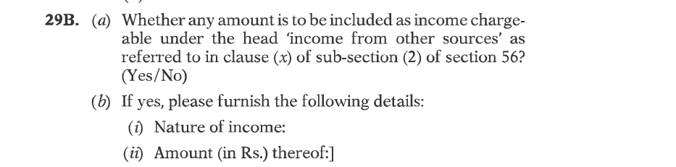
Form 3CD
Income from Other Sources
(Clause 29B)
CA Rashid H Siddiqui & Co
Chartered accountants

Slide 60
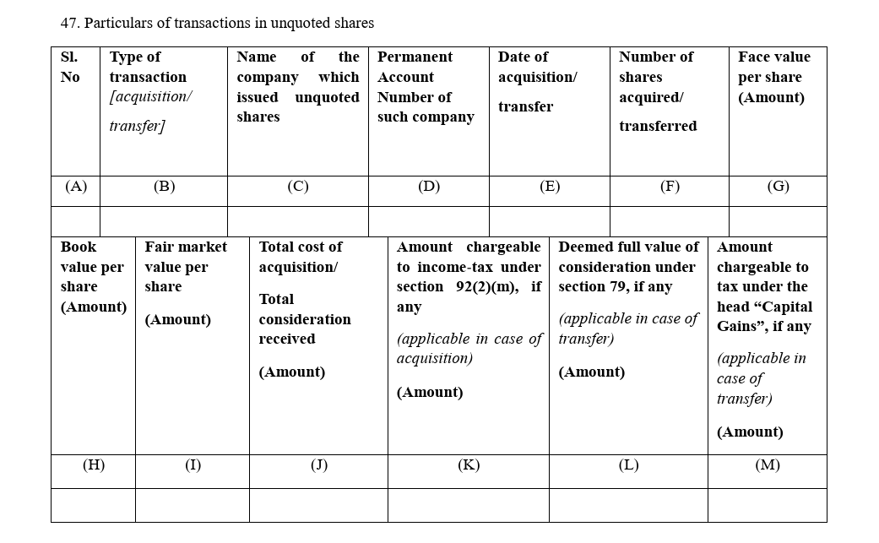
Form 26 – PART B
Income from Other Sources
(Clause 47)
CA Rashid H Siddiqui & Co
Chartered accountants

Slide 61
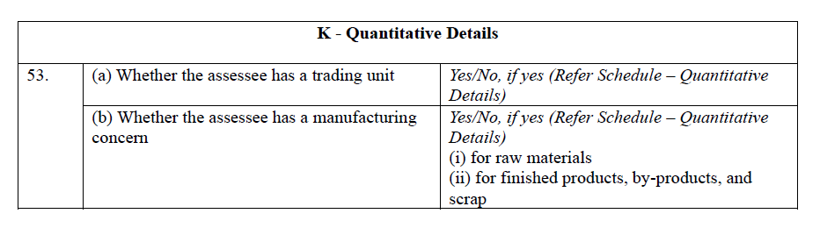
Form 3CD
(Clause 35)
Quantitative Details
Applicable to trading and manufacturing assessees
Opening stock, purchases, sales, closing stock, and yield/wastage for raw materials, finished goods, by-products, and scrap
Useful for detecting unaccounted production or suppressed sales
CA Rashid H Siddiqui & Co
Chartered accountants

Slide 62
PART “C” AND “D” OF
FORM 26
CA Rashid H Siddiqui & Co
Chartered accountants

Slide 63
PART C- AUDIT REPORT
(ACCOUNTS AUDITED UNDER ANY OTHER LAW)
CA Rashid H Siddiqui & Co
Chartered accountants

Slide 64
PART C- AUDIT REPORT
(ACCOUNTS AUDITED UNDER ANY OTHER LAW)
This part applies when an assessee’s books have already been audited under another law
For example: Companies audited under the Companies Act, 2013, or banks under the Banking Regulation Act.
KEY FEATURES
The statutory audit report is annexed to Form 26 and forms part of the tax audit documentation.
The tax auditor places reliance on the already-audited financial statements and links them to the tax audit.
CA Rashid H Siddiqui & Co
Chartered accountants

Slide 65
PART C- AUDIT REPORT
(ACCOUNTS AUDITED UNDER ANY OTHER LAW)
All audit observations, qualifications, adverse remarks, disclaimers, or emphasis of matters must be: Reported clause-wise
Mandatorily categorised as one of three types:
Test-check basis: auditor verified on a sample basis
2. Based on management representation: auditor relied on management’s assertions
3. Unable to verify: auditor could not obtain sufficient evidence
The impact of each observation on profit/loss or book profit must be quantified and reported.
This categorisation is a significant new requirement, it forces auditors to be transparent about the basis of their conclusions, reducing vague or blanket qualifications.
CA Rashid H Siddiqui & Co
Chartered accountants

Slide 66
PART D- AUDIT REPORT
(ACCOUNTS NOT AUDITED UNDER ANY OTHER LAW)
CA Rashid H Siddiqui & Co
Chartered accountants

Slide 67
PART D- AUDIT REPORT
(ACCOUNTS NOT AUDITED UNDER ANY OTHER LAW)
This part applies when there is no prior statutory audit for example, individual professionals, partnership firms, or proprietorships.
KEY FEATURES
The tax auditor conducts a fresh, independent audit specifically for Section 63 purposes.
The auditor expresses an opinion on whether the Profit & Loss Account / Income & Expenditure Account and Balance Sheet give a true and fair view.
All audit observations are reported along with their financial impact.
Parts A & B are read together with Part D to form the complete audit documentation.
CA Rashid H Siddiqui & Co
Chartered accountants

Slide 68

Quantification of Audit Qualifications
(The Biggest Risk Shift)
Form 3CB
Form 26
Auditors reported "observations" or "disclaimers" via free text in Form 3CA/3CB.
Part C & D of Form 26 require auditors to explicitly quantify the "Net Impact" of audit qualifications on the Profit/Loss.
CA Rashid H Siddiqui & Co
Chartered accountants

Slide 69
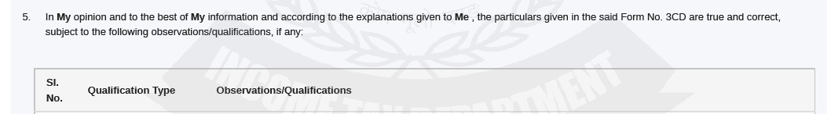
Under “Observations" or "disclaimers" via free text
(Form 3CA/3CB)
CA Rashid H Siddiqui & Co
Chartered accountants

Slide 70
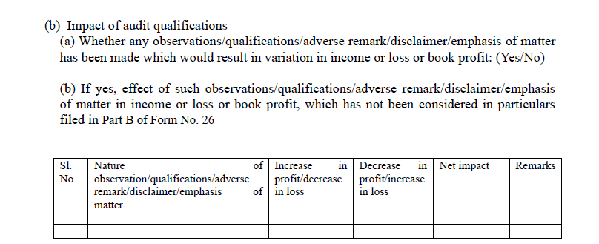
Under Part C and D, Auditor has to quantify the “Net Impact”
(Form 26)
CA Rashid H Siddiqui & Co
Chartered accountants

Slide 71
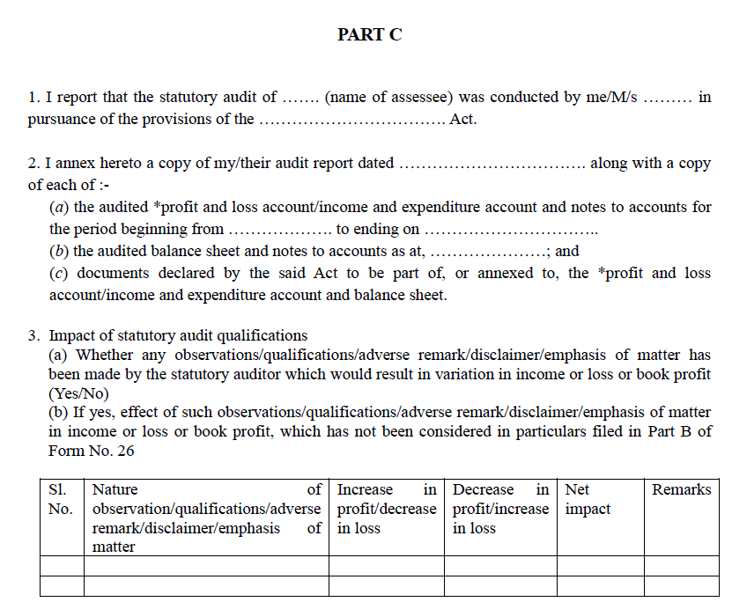
Part C of Form 26
CA Rashid H Siddiqui & Co
Chartered accountants

Slide 72
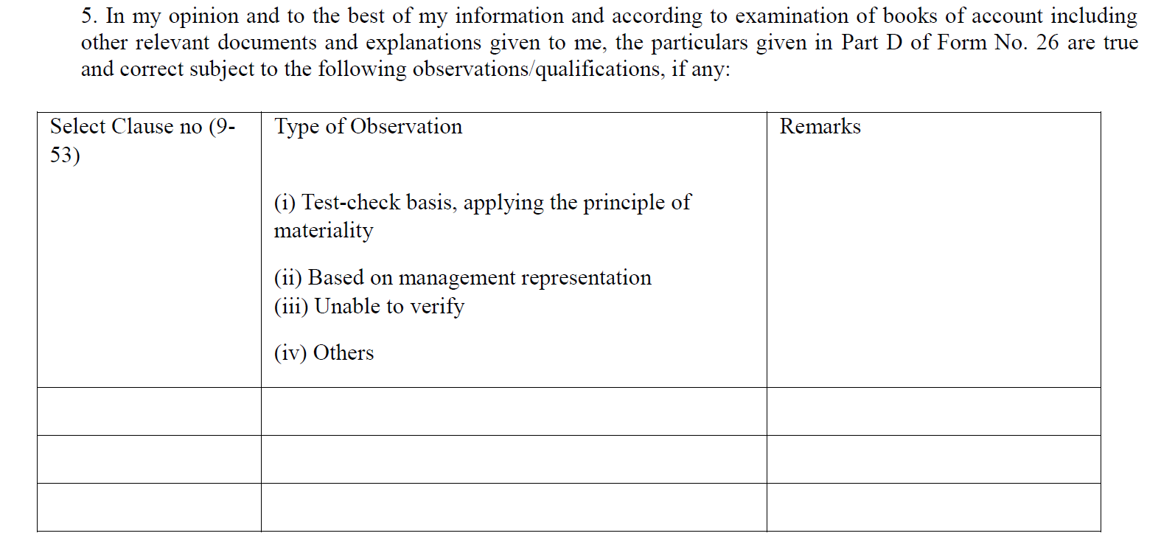
Tax Auditor Observations/ Qualifications
CA Rashid H Siddiqui & Co
Chartered accountants

Slide 73
QUICK QUIZ
CA Rashid H Siddiqui & Co
Chartered accountants

Slide 74
Q1. Form 26 under the Income-tax Act, 2025 is structured into how many parts?
A
2 Parts
B.
4 Parts
ANS: B. 4 Parts
CA Rashid H Siddiqui & Co
Chartered accountants

Slide 75
Q2. In Form 26, audit observations must include:
Only general remarks
Categorisation and financial
impact
A
B.
ANS: B. Categorisation and Financial Impact
CA Rashid H Siddiqui & Co
Chartered accountants

Slide 76
Q3. Form 26 replaces which earlier tax audit structure?
A
Form 3CA/3CB with 3CD
B.
Form 26AS
ANS: A. Form 3CA/3CB with 3CD
CA Rashid H Siddiqui & Co
Chartered accountants

Slide 77
Preliminary Documents Required For Filing Form 26
CA Rashid H Siddiqui & Co
Chartered accountants

Slide 78
Checklist for Form 26
Documents Required for Filing:
The following documents are typically needed:
1. Financial statements: Balance Sheet, P&L or I&E Account, and Notes to Accounts.
2. Audited financial statements under another law (for Part C cases).
3. Supporting workings for all particulars disclosed in Part A & B.
4. TDS/TCS records: returns, challans, certificates, and reconciliations.
5. GST records: returns (GSTR-1, GSTR-3B), ITC reconciliations, and notices if any.
6. Quantitative and inventory records: stock registers, purchase and sales records.
7. Transfer pricing documentation for international transactions.
8. Form 145 data for foreign remittances.
9. MAT computation and credit utilization schedules.
10. Depreciation schedules with usage period classification.
CA Rashid H Siddiqui & Co
Chartered accountants

Slide 79
Fee for Non-Filing/Delayed Filing of
Form 26
(Section 428 of Income Tax Act, 2025)
(Section 271B of Income Tax Act,1961)
CA Rashid H Siddiqui & Co
Chartered accountants

Slide 80
Fee for Non-Filing of Form 26
(Section 428 of Income Tax Act, 2025)
Under Section 428(c) of the Income-tax Act, 2025, if a person fails to get his accounts audited and fails to furnish the report as required under Section 63, he shall be liable to pay fee based on the duration of the delay:
₹ 75,000: For a delay of up to one month.
₹ 1,50,000: For a delay extending beyond one month.
CA Rashid H Siddiqui & Co
Chartered accountants

Slide 81
Key Challenges for Auditors under Form 26
CA Rashid H Siddiqui & Co
Chartered accountants

Slide 82
Key Challenges for Auditors under Form 26
Increased Accountability through Quantification
Auditors now need to quantify the financial impact of every qualification or observation. This is a major shift from descriptive reporting in Form 3CD and increases professional risk and responsibility.
2. Mandatory Categorisation of Observations
Each audit remark must be classified as test-check, management representation, or unable to
verify, which demands clearer judgement and reduces flexibility in reporting.
3. Extensive Data Reconciliation
Integration with TDS, GST, SFT, and AIS (Form 168) requires auditors to ensure complete
consistency across multiple systems, making reconciliation more time-consuming and complex.
CA Rashid H Siddiqui & Co
Chartered accountants

Slide 83
Key Challenges for Auditors under Form 26
4. Detailed and Structured Reporting
The Yes/No based reporting with detailed schedules leaves little room for omission, increasing
the need for thorough documentation and accuracy.
5. Technology and System-Level Disclosures
New requirements like reporting server location, IP address, and data backup in India introduce
IT-related verification challenges, which were not part of traditional tax audits.
6. Higher Documentation Burden
Auditors must maintain robust working papers and evidence to support every disclosure,
especially where reliance is placed on management representation.
CA Rashid H Siddiqui & Co
Chartered accountants

Slide 84
Key Challenges for Auditors under Form 26
7. Alignment with ITR and Risk of Mismatch
Since Form 26 is closely aligned with ITR, any inconsistency may lead to automated scrutiny,
adjustments, or litigation, increasing pressure on accuracy.
8. Time and Compliance Pressure
With more detailed reporting and stricter validation, audit timelines may become tighter,
especially during peak filing periods.
CA Rashid H Siddiqui & Co
Chartered accountants

Slide 85
FAQs
(Income Tax India)
CA Rashid H Siddiqui & Co
Chartered accountants

Slide 86
Form No. 26 – Frequently Asked Questions (FAQs)
What is Form No. 26?
Form No. 26 is the prescribed Report of Audit of Accounts and Statement of Particulars required to be furnished under Section 63 of the Income-tax Act, 2025, in accordance with Rule 47 of the Income-tax Rules, 2026.
From which tax year is Form No. 26 applicable ?
Form No. 26 is applicable for tax years commencing on or after 1st April, 2026.
CA Rashid H Siddiqui & Co
Chartered accountants

Slide 87
Who is required to furnish Form No. 26?
Form No. 26 is required to be furnished by a person carrying on business or profession whose accounts are required to be audited under Section 63 of the Income-tax Act, 2025. This includes: (a) Business cases where total sales, turnover or gross receipts exceed ₹1 crore (threshold increases to ₹10 crore where cash receipts and cash payments each do not exceed 5% of total receipts and payments respectively); (b) Profession cases where gross receipts exceed ₹50 lakh; (c) Presumptive taxation cases under sections 58(2) or 61(2) (Table: Sl. Nos. 4 and 5) where income declared is lower than the deemed income.
(d) Presumptive Taxation cases: When a taxpayer opts out of a presumptive scheme in any of the five consecutive years (the "lock-in period"), and their income exceeds the basic exemption limit.
CA Rashid H Siddiqui & Co
Chartered accountants

Slide 88
Is furnishing of Form No. 26 compulsory?
Yes. Furnishing of Form No. 26 is mandatory for all persons carrying on business or profession who fulfil the conditions specified in Section 63 of the Income-tax Act, 2025.
What is the due date for furnishing Form No. 26?
Form No. 26 is required to be furnished annually, by the specified date, which is one month prior to the due date for furnishing the return of income under Section 263(1) of the Income-tax Act, 2025. Accordingly, where due date for furnishing return of income under section 263(1) is 31 October / 30 November, Form No. 26 shall be filed on or before 30 September / 31 October, respectively.
CA Rashid H Siddiqui & Co
Chartered accountants

Slide 89
What is the structure of Form No. 26?
Form No. 26 consists of the following parts:
Part A – Particulars of the Assessee
Part B – Statement of Particulars required under Section 63
Part C – Audit Report where accounts are audited under any other law
(corresponding to erstwhile Form 3CA)
Part D – Audit Report where accounts are not audited under any other law
(corresponding to erstwhile Form 3CB)
CA Rashid H Siddiqui & Co
Chartered accountants

Slide 90
When is Part C of Form No. 26 applicable?
Part C of Form No. 26 is applicable where the assessee’s accounts have been audited under any other law. In such cases, the tax auditor relies on the statutory audit and reports the particulars required under Section 63.
When is Part D of Form No. 26 applicable?
Part D of Form No. 26 is applicable where the assessee’s accounts are not audited under any other law. An Accountant as defined under Section 515(3)(b) conducts the audit specifically for the purposes of Section 63.
CA Rashid H Siddiqui & Co
Chartered accountants

Slide 91
Whether Forms 3CA and 3CB (including Annexure in Form 3CD) prescribed under the
Income-tax Act, 1961 continue to apply?
Forms 3CA, 3CB and 3CD continue for tax audits for previous years relevant to assessment years up to 2026-27. However, from tax year 2026-27, tax audit has to be furnished in Form No. 26.
Whether section references in Form No. 26 correspond to the Income-tax Act, 1961?
No. All references in Form No. 26 correspond exclusively to the Income-tax Act, 2025 and the Income-tax Rules, 2026.
CA Rashid H Siddiqui & Co
Chartered accountants

Slide 92
Who is authorised to sign Form No. 26?
Form No. 26 must be signed by an Accountant as defined under Section 515(3)(b) of the Income-tax Act, 2025.
Is UDIN mandatory for Form No. 26?
Yes. and must be generated by the signing Accountant and quoted in Form No. 26. UDIN (Unique Document Identification Number) is mandatory
Whether FRN is required to be mentioned in Form No. 26?
Yes. Where the audit is conducted in the name of a firm, the Firm Registration Number (FRN) is required to be mentioned.
CA Rashid H Siddiqui & Co
Chartered accountants

Slide 93
What is the process flow of filing Form No. 26?
1. The assessee engages an Accountant as defined under Section 515(3)(b).
2. The Accountant fills Form No. 26 on the e-filing portal with Membership Number and
FRN, where applicable.
3. UDIN is generated and quoted.
4. The form is digitally signed using the Accountant’s DSC and uploaded.
5. The assessee electronically accepts Form No. 26 to complete filing.
CA Rashid H Siddiqui & Co
Chartered accountants

Slide 94
Whether reporting is required even where the answer to a clause is “No”?
Yes. Each clause in Part B requires a mandatory Yes/No response to ensure completeness and uniformity.
Whether disclosure of accounting software and electronic storage is mandatory?
Yes. Under Rule 46, where the books of account or other documents are maintained electronically, they shall mandatorily remain accessible in India at all times, and a daily backup shall be maintained in India-located servers. In consonance with this Rule, Form No. 26 requires the IP address and country of location of server on which such accounting information is maintained, as well as the address of the India-located backup server to be furnished by the auditor.
CA Rashid H Siddiqui & Co
Chartered accountants

Slide 95
How does Yes/No based reporting with schedules protect taxpayers?
This approach ensures completeness, enables automated validation and reduces subjective interpretation, enhancing certainty and transparency.
Whether Clause 36 relating to depreciation and brought forward losses has undergone any change?
Clause 36 corresponds to Clause 18 of the erstwhile Form 3CD. A material change relates to explicit segregation between assets used for less than 180 days and 180 days or more without requirement of specific dates. This would lead to substantial reduction in compliance burden.
CA Rashid H Siddiqui & Co
Chartered accountants

Slide 96
Whether Clause 43 relating to Form 15CA remittances represents a change?
Yes. Clause 43 is restricted to remittances actually reported in Part-D of Form No. 145 during the tax year and is integrated into international taxation reporting, thereby narrowing scope and avoiding duplication.
Whether Clause 53 relating to quantitative details has changed?
Yes. Clause 53 introduces a structural change. Quantitative reporting is required only where the assessee has a trading unit or manufacturing concern and is furnished through a dedicated schedule segregating raw materials, finished goods, by-products and scrap.
CA Rashid H Siddiqui & Co
Chartered accountants

Slide 97
What is the objective of separating Part B from Part C / Part D?
To clearly distinguish factual disclosures from audit opinion, reduce overlap and enhance accountability.
Whether Part B applies irrespective of Part C or Part D?
Yes. Part B applies uniformly in all cases.
CA Rashid H Siddiqui & Co
Chartered accountants

Slide 98
What would be the alignment between the return of income and Form No. 26?
An endeavour has been made to align the data required in Form No. 26 with that in the ITR Form, so that, going forward, the taxpayer/department can populate the data provided in Form No. 26 in the ITR. This would also reduce mismatches between the ITR and Form No. 26 which could potentially trigger adjustments under section 270(1), consequently also reducing rectifications, appeals, grievances, etc.
What is the new reporting requirement regarding statement of tax deducted or tax collected?
The auditor will have to provide the total number of transactions reported and those not reported in the TDS/TCS return, as it stands after the latest correction statement. Further, the total amount in relation to transactions not reported in the TDS/TCS return, will also have to be furnished.
CA Rashid H Siddiqui & Co
Chartered accountants

Slide 99
Conclusion
Form 26 is a major upgrade from Form 3CD. It moves from basic reporting to a more structured, transparent, and technology-driven system. With one single form, clear Yes/No reporting, and better linkage with ITR, TDS, GST, and AIS, it reduces errors and mismatches. It also makes auditors more accountable by requiring proper classification and quantification of observations.
Form 3CD was about reporting facts, while Form 26 is about reporting with clarity, accuracy, and responsibility.
CA Rashid H Siddiqui & Co
Chartered accountants

Slide 100

CA Rashid H Siddiqui & Co
Chartered accountants

Slide 101

CA Rashid H Siddiqui & Co
Chartered accountants

Slide 102

CONTACT DETAILS
CA Rashid H Siddiqui
Mobile No: 9920510708
Email ID: rashid1009@Hotmail.com
Office Address: 205, Heena Arcade, Off SV Road, Jogeshwari West, Mumbai 400102
CA Rashid H Siddiqui & Co
Chartered accountants

