Slide 1
Growing
Accounts outsourcing
Kethaan Parakh

Slide 2
Problem
People
Knowledge
Government

Slide 3



People

Slide 4
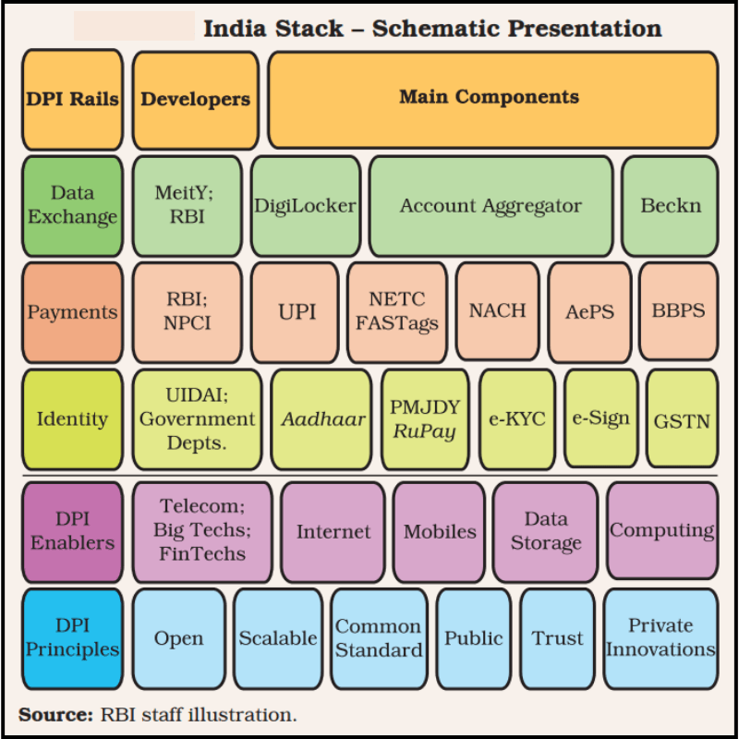
Government

Slide 5
Knowledge
Good At | Bad At

Slide 6
S
I
P
O
C

Slide 7
Person
GST
IT
Accounts
Payroll
Audit
Regulatory

Slide 8
Tax
GST
IT
Accounting
Accounting
Audit
Audit
Regulatory
Payroll

Slide 9
Just adding people is not going to help

Slide 10
Losing out on opportunities?

Slide 11
Lack of Visibility

Slide 12


Slide 13
Learning
Thinking in structured manner

Slide 14
Some skills required
Going into details
Mapping out the steps
Person allocation
Providing tools
Monitoring

Slide 15





Employees
Consultants
Management
Banks
Accountant
Vendors
Customers
Head-Office
Clearing Agent
Auditors

Slide 16
Solution: TRANSFORM YOUR ACCOUNTING DIVISION
People Dependant
Process Driven
AI Enabled

Slide 17

3-way match
Payments
Documentation
Procurement
Loan servicing
Contracts
Accounting
Tally
GST
Import Export

Slide 18






What we will have to do - Workflow
1

Slide 19

What we will have to do - Handholding
2

Slide 20


Slide 21

3
Time
Saving

Slide 22
Process
Tools
AI

Slide 23
Different Answers
Completeness of Info
Persons
GPT?

Slide 24
NUMBERS | TEXT

Slide 25


Slide 26
Impact
Frustration of providing the same document again
Uncertainty of GST Input Tax Credit (ITC)
Re-work caused by wrong TDS deductions
Fear of missing out transactions

Slide 27
AI driven accounting AI driven KYC Audit Trail

Slide 28
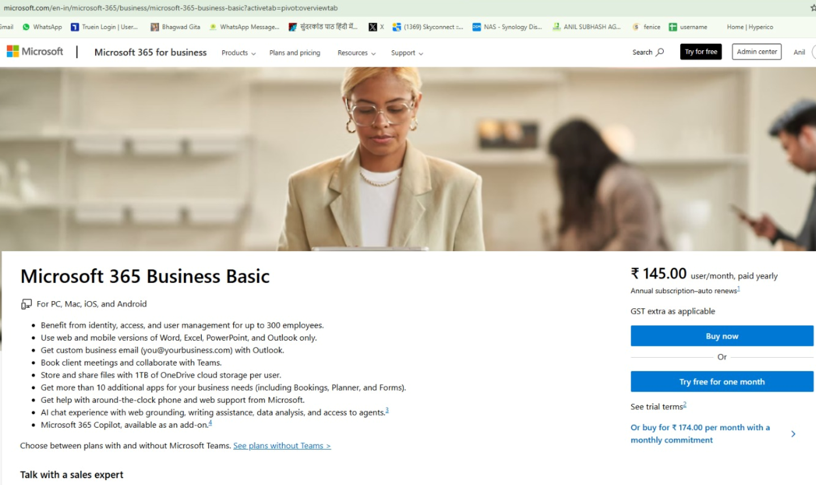

Slide 29
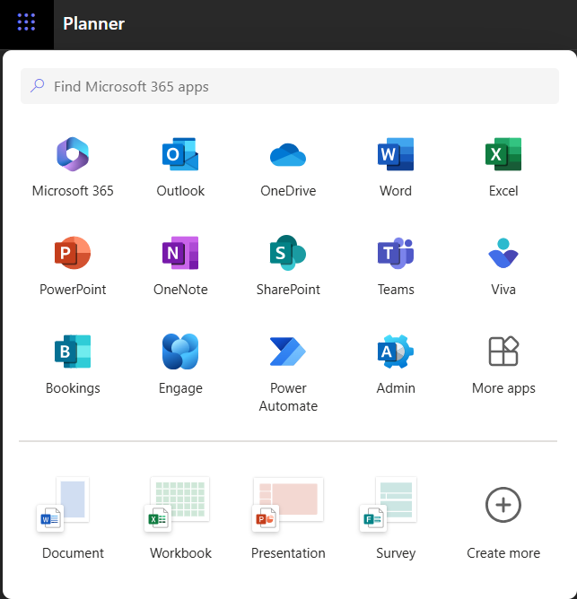

Slide 30
Any Questions?

