Slide 1
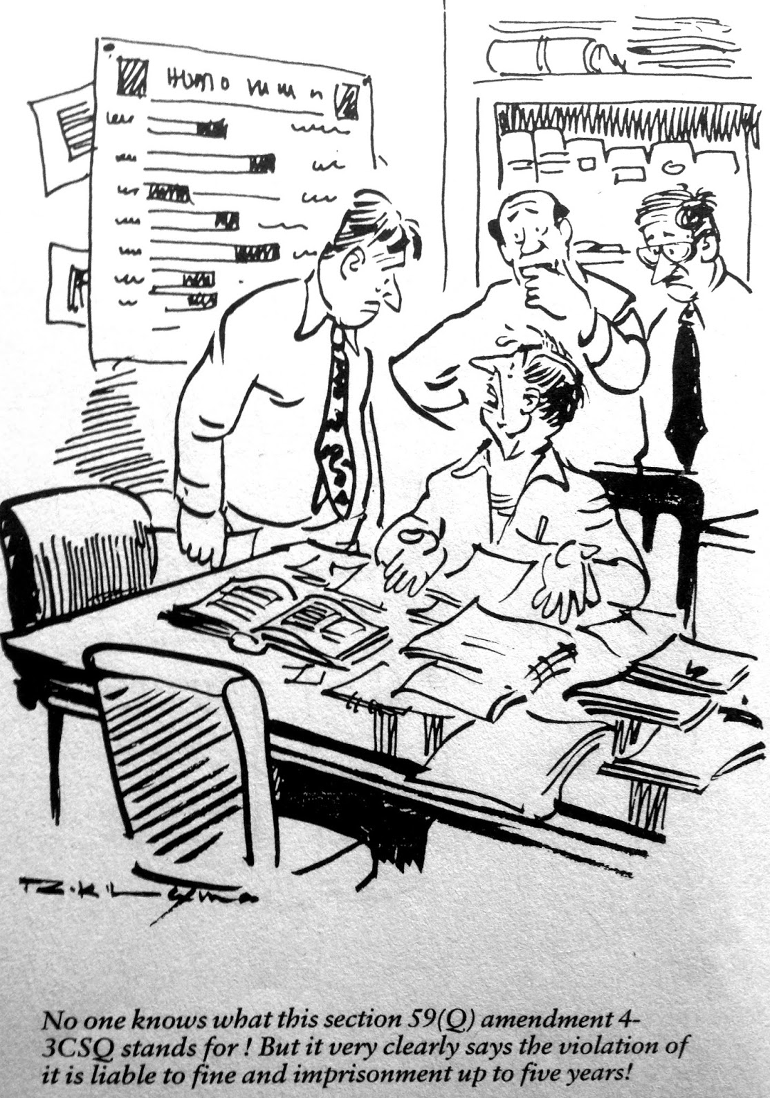
Amendments applicable for
A.Y. 2025-26
CA Mahendra Sanghvi

Slide 2
Coverage
Important amendments applicable for A.Y. 2025-26 – for preparing computation of income
Changes in Tax Audit Report (audit reports to be issued on and from 01/04/2025)
Changes in Income Tax Returns for A.Y. 2025-26
Financial Statement of Non Corporate Entities

Slide 3
Not Covering
Amendments relating to Trusts
Increase in rate of STT – F&O
International Financial Services Centre / Investment funds
Severegine Wealth Fund/ Pension Fund
Profits and Gains of business of operation of cruise ships in case of non-residents
Safe Harbour rules in relation to mining and selling of raw diamonds

Slide 4
Reference Material
Finance (No. 2) Act, 2024 (“FA 2024”)
Finance Act, 2025
Other Circulars, Notifications, Press Releases & Rules
Guidance Notes issued by ICAI

Slide 5
Rates of Tax

Slide 6
Personal Income Tax..
Change in slabs for new tax regime u/s.115BAC(1A)
Savings of ₹ 10,000/- + Surcharge + Cess (if total income > 12 Lakhs)
New Tax Regime is default tax regime
Rate of Tax | Slabs for A.Y. 2024-25 Total Income | Slabs for A.Y. 2025-26 Total Income
Nil | Upto Rs.3,00,000 | Upto Rs.3,00,000
5% | Rs.3,00,001 – Rs.6,00,000 | Rs.3,00,001 – Rs.7,00,000
10% | Rs.6,00,001 – Rs.9,00,000 | Rs.7,00,001 – Rs.10,00,000
15% | Rs.9,00,001 – Rs.12,00,000 | Rs.10,00,001 – Rs.12,00,000
20% | Rs.12,00,001 – Rs.15,00,000 | Rs.12,00,001 – Rs.15,00,000
30% | Above Rs.15,00,000 | Above Rs.15,00,000

Slide 7
Rates of Tax
No changes in AMT, Mat, Education Cess and Surcharge rates
No changes in rates of Firm, LLP, Domestic Companies
In case of Foreign Companies – tax rates reduced from 40% to 35%

Slide 8
Rebate u/s.87A Controversy
Particulars | Ms. Monisha Sarabhai | Ms. Maya Sarabhai
Interest Income | 4,00,000 | 6,50,000
STCG 111A 20% | 1,90,000 | 5,00,00,000
Gross Total Income | 5,90,000 | 5,06,50,000
As Per Law
Tax Payable before rebate | (5000 + 38,000) = 43,000 | 1,00,17,500
Eligible Rebate u/s.87A | 25,000 | Nil
Tax Payable after rebate | 18,000 | 1,00,17,500
As Per Utility | As Per Utility
Eligible Rebate u/s.87A | 5,000 | 17,500
Tax Payable after rebate | 38,000 | 1,00,00,000

Slide 9
…Rebate u/s.87A Controversy …
Chamber of Tax Consultants vs. Director General of Income Tax (systems) [2025] 170 taxmann.com 707 (Bombay)/[2025] 303 Taxman 451 (Bombay)/[2025] 473 ITR 85 (Bombay)[24-01-2025]
Judgment of CIT (A), Pune in case of Beena Manishbhai Fofaria dated 22/11/2024 is in favour
CPC is allowing to make claim but raising demand in 143(1) intimation
Clarified in Finance Bill Speech of 2025 – No rebate u/s.87A on special rates income
FA 2025 has added proviso to section 87A w.e.f. 01/04/2026- Provided further that the deduction under the first proviso, shall not exceed the amount of income-tax payable as per the rates provided in sub-section (1A) of section 115BAC

Slide 10
Individual Taxation
Standard deduction u/s.16(ia) against Salary income is increased from ₹ 50,000/- to ₹ 75,000/- (only in case of new tax regime)
Deduction in respect of family pension u/s.57(iia) is increased from ₹ 15,000/- to ₹ 25,000/- (only in case of new tax regime) (cannot exceed 1/3rd of income)
National Pension Scheme
Employer can contribute upto 14% of Basic +DA (increased from 10%)
Employee gets deduction u/s.80CCD(2), higher deduction of 14% is available only in case employee is opting for NTR
Employer will get higher deduction u/s.36(1)(iva) irrespective of regime opted by employee
Provisions of Section 17(2)(vii) and 17(2)(viia) – wherein aggregate contribution by employer for PF, NPS and supperannuation fund > Rs.7,50,000 in a year

Slide 11
Procedure to Opt in /Opt out…
Particulars | New Tax Regime | Old Tax Regime
Having income under head Profits and Gains of Business or Profession (ITR 3 & 4) | Default Regime | To file form 10 IEA – before the due date u/s.139(1) If already filed in AY 24-25, then do not file If filed in AY 24-25 after the due date u/s.139(1)
Not having income under head Profits and Gains of Business or Profession (ITR 1 & 2) | Default Regime | In return of income filed u/s.139(1)
Notes:
Need to be careful in case of assessee having speculation income, partners in firm having only share of profit

Slide 12
House Property Income
Section 23(2) – Provided that ALV of the house shall be taken as NIL in cases wherein it is used for own residence or cannot actually be occupied by the owner by reason of the fact that owing to his employment, business or profession carried on at any other place, he has to reside at that other place in a building not belonging to him
With a view to simplifying the provisions FA 2025 substituted S.23(2) w.e.f. 01.04.2025 - The annual value of the property consisting of a house or any part thereof shall be taken as nil, if the owner occupies it for his own residence or cannot actually occupy it due to any reason
There is no amendment in section 23(4) – which allows benefit of SLP zero for two houses.

Slide 13
Letting out of residential house
Letting out of property – business income or house property income????
FA 2024 added explanation to section 28 – explanation 3 It is hereby clarified that any income from letting out of a residential house or a part of the house by the owner shall not be chargeable under the head “Profits and gains of business or profession” and shall be chargeable under the head “Income from house property”.
Memorandum explanting provisions : Section 28 of the Act specifies kinds of income that shall be chargeable to income-tax under the head ‘Profits and gains of business or profession’. It has been observed that some taxpayers are reporting their rental income generated by letting out of the house property, under the head ‘Profits and gains of business or profession’ in place of the head ‘Income from house property’. Accordingly, they are reducing their tax liability substantially by showing house property income under the wrong head of income
Commercial premises are not covered by amendment.
Systematic activity of letting out residential property alongwith other services – like guest house or booking.com?

Slide 14
Section 37 – Disallowance of Settlement amounts
Section 37 – General allowance
Explanation 1 - provides that any expenditure incurred by an assessee for any purpose which is an offence or which is prohibited by law is disallowable
Explanation 3 - provides what is included in “expenditure incurred by an assessee for any purpose which is an offence or which is prohibited by law”
Clause (iv) added to said “to settle proceedings initiated in relation to contravention under such law as may be notified by the Central Government in the Official Gazette in this behalf”
What if not guilty but paying?
GST amnesty scheme??
Earlier ruling in case of Deputy Commissioner of Income tax, Circle 3(3)(1), Mumbai vs. Anil Dhirajlal Ambani [2018] 93 taxmann.com 492 (Mumbai)/[2018] 66 ITR(T) 606 (Mumbai)/[2018] 171 ITD 144 (Mumbai)[23-03-2018] - assessee paid consent/settlement charges to SEBI under SEBI's Guidelines regarding consent terms without admitting guilt, it would be an business expenditure
Meaning of term in relation to

Slide 15
Remuneration to Partners – S 40(b)(v)
Provides for maximum remuneration that can be paid to working partners and other conditions
Increase in the limits
Deduction in hands of firm towards remuneration to partners can increase by ₹2,70,000/-
In case of loss or NIL book profit | : | NIL
In case the book profit for the year is upto Rs.3,00,000/- | : | Amount of book profit
In case the book profit for the year exceeds 3,00,000/-: On the first Rs.6,00,000/- of the book profit On the balance book profit | : : | Rs. 3,00,000/- or 90% of the book profit whichever is higher. 60% of the book profit

Slide 16
Remuneration to Partners – S 40(b)(v)
Earlier amendment was by The Finance (No.2) Act, 2009
Finance Bill was introduced on 23/07/2024 and received assent of Loksabha on 07/08/2024
Practical difficulty in implementation in AY 2025-26??
The amendment is clause 40(b) is w.e.f. 01/04/2025 but remuneration is subject to following conditions:
is authorised by, and is in accordance with, the terms of the partnership deed and
relates to any period falling after the date of such partnership deed
No clarification

Slide 17
Capital Gains
What has changed?
Increase in rates of tax
Reduction in period of holding for asset to be classified as long term capital gain in certain cases. Now only two holding period (earlier three)
Increase in yearly exemption limit in case of LTCG
Removal of indexation benefit
Why Change?
Rationalisation and simplification of taxation of capital gains
Effective Date ?
23rd of July, 2024 (Date of the budget)

Slide 18
Capital Gains
Period of Holding :
Rates of Tax:
Type of Capital Asset | Short Term | Long Term
Listed Securities | Upto 12 months | More than 12 months
Other Capital assets | Upto 24 months | More than 24 months
Type of Capital Asset | Short Term/Long Term | Section | On and from 23/07/2024
Listed Securities | Short Term | 111A | 20%
Listed Securities | Long Term | 112A | 12.5%
Other capital asset (except covered by Section 50AA) | Long Term | 112(1)(c) | 12.5%
Other capital asset (except covered by Section 50AA) | Short Term |  | Applicable rate
Assets covered by section 50AA | Short Term |  | Applicable rate

Slide 19
Name of Capital Asset | Nature of Capital Gain | Relevant Provision | Period of Holding |  | Rate of Tax
 |  |  | Old provision i.e., Before 23rd July, 2024 | New provision i.e., After 23rd July, 2024 | Old provision i.e., Before 23rd July, 2024 | New provision i.e., After 23rd July, 2024
Listed Equity Shares (STT paid)* | LT | 112A | > 12 months | > 12 months | 10% (without indexation) | 12.5% (without indexation)
 | ST | 111A | < 12 months | < 12 months | 15.00% | 20.00%
Listed Equity Shares (STT not paid) | LT | 112 | > 12 months | > 12 months | 10% (without indexation) | 12.5% (without indexation)
 |  |  |  |  | 20% (with indexation) | 12.5% (without indexation)
 | ST | Rates as per First Schedule of FA (No. 2) 2024 | < 12 months | < 12 months | applicable rate | applicable rate
Unlisted Equity Shares | LT | 112 | > 24 months | > 24 months | 20% (with indexation) | 12.5% (without indexation)
 | ST | Rates as per First Schedule of FA (No. 2) 2024 | < 24 months | < 24 months | applicable rate | applicable rate

Slide 20
Name of Capital Asset | Nature of Capital Gain | Relevant Provision | Period of Holding |  | Rate of Tax
 |  |  | Old provision i.e., Before 23rd July, 2024 | New provision i.e., After 23rd July, 2024 | Old provision i.e., Before 23rd July, 2024 | New provision i.e., After 23rd July, 2024
Units of Equity Oriented MFs (Listed)* | LT | 112A | > 12 months | > 12 months | 10% (without indexation) | 12.5% (without indexation)
 | ST | 111A | < 12 months | < 12 months | 15.00% | 20.00%
Units of Debt Oriented MFs** (> 65% in debt or Fund of such funds) | Always ST | 50AA (Rates as per First Schedule of FA (No. 2) 2024) | -- | -- | applicable rate | applicable rate
Listed Bonds/Debentures (other than Capital index bonds and Sovereign Gold Bonds) | LT | 112 (without indexation) | > 12 months | > 12 months | 20% (without indexation) | 12.5% (without indexation)
 | ST | Rates as per First Schedule of FA (No. 2) 2024 | < 12 months | < 12 months | applicable rate | applicable rate

Slide 21
Name of Capital Asset | Nature of Capital Gain | Relevant Provision | Period of Holding |  | Rate of Tax
 |  |  | Old provision i.e., Before 23rd July, 2024 | New provision i.e., After 23rd July, 2024 | Old provision i.e., Before 23rd July, 2024 | New provision i.e., After 23rd July, 2024
Unlisted Bonds/Debentures/Debt- Oriented FOFs | LT | 50AA (Rates as per First Schedule of FA (No. 2) 2024) | > 36 months | NA | 20% (without indexation) | applicable rate
 | ST | 50AA (Rates as per First Schedule of FA (No. 2) 2024) | < 36 months | NA | applicable rate | applicable rate
Market Linked Debentures | ST | 50AA (Rates as per First Schedule of FA (No. 2) 2024) | NA | NA | applicable rate | applicable rate
Listed Units of Business Trust (InVITs and REITs)* | LT | 112A | > 36 months | > 12 months | 10% (without indexation) | 12.5% (without indexation)
 | ST | 111A | < 36 months | < 12 months | 15.00% | 20.00%

Slide 22
Name of Capital Asset | Nature of Capital Gain | Relevant Provision | Period of Holding |  | Rate of Tax
 |  |  | Old provision i.e., Before 23rd July, 2024 | New provision i.e., After 23rd July, 2024 | Old provision i.e., Before 23rd July, 2024 | New provision i.e., After 23rd July, 2024
Immovable Properties | LT | 112 | > 24 months | > 24 months | 20% (with indexation) | 12.5% (without indexation)
 | ST | Rates as per First Schedule of FA (No. 2) 2024 | < 24 months | < 24 months | applicable rate | applicable rate
Physical Gold | LT | 112 | > 36 months | > 24 months | 20% (with indexation) | 12.5% (without indexation)
 | ST | Rates as per First Schedule of FA (No. 2) 2024 | < 36 months | < 24 months | applicable rate | applicable rate
Foreign Equity | LT | 112 | > 24 months | > 24 months | 20% (with indexation) | 12.5% (without indexation)
 | ST | Rates as per First Schedule of FA (No. 2) 2024 | < 24 months | < 24 months | applicable rate | applicable rate

Slide 23
Section 50AA Deemed Short Term
Section 50AA was inserted by FA 2023
FA 2024 increased scope: Transfer of following capital assets post 23/07/2024 shall be deemed to Short Term irrespective period of holding:
Market Linked Debenture
Units of Specified Mutual Fund* (Debt Mutual Fund purchased on or after 01/04/2023)
Unlisted Debentures
Unlisted Bonds
* Definition of specified mutual fund is amended for A.Y. 2026-27 (by FA 2024)
For A.Y. 2025-26 – not invested more than 35% of its total proceeds in equity shares of domestic companies
For A.Y. 2026-27 –invests more than 65% of its total proceeds in debt or money market instrument or specified mutual fund.
ETF’s, Gold Mutual Fund, Gold ETF’s etc from A.Y. 2026-27 will be excluded from Section 50AA
Upto 22/07/2024 LTCG taxed at 20% without indexation and STCG at slab rates – Not deemed STCG – applicable rates

Slide 24
Section 112 – Tax on LTCG
Section 112 (1)- provides option to pay tax @ 10 % without indexation or 20% with indexation in case of listed shares /listed securities /listed bonds /listed debentures and STT is not levied – said option not available for transfer on or after 23/07/2024.

Slide 25
Section 112A – Tax on LTCG
The yearly limit of ₹ 1,25,000/- is applicable for aggregate LTCG which arises during the year
Can assessee choose to claim said yearly exemption against LTCG Post 23/07/2024 (ignoring LTCG for period 01/04/2024 to 22/07/2024)?
Can assessee choose to set off of loss incurred in earlier year/s or prior to 23/07/2024 against LTCG Post 23/07/2024(ignoring LTCG for period 01/04/2024 to 22/07/2024)?
Can assessee choose to adjust basic exemption limit against LTCG Post 23/07/2024 (ignoring LTCG for period 01/04/2024 to 22/07/2024)?
Can assessee choose to claim exemption u/s.54F against LTCG Post 23/07/2024 (ignoring LTCG for period 01/04/2024 to 22/07/2024)?

Slide 26
Section 112A – Tax on LTCG
 | Particulars | ₹ | Rate of tax
A | LTCG upto 22/07/2024 | 50,00,000 | 10%
B | LTCL upto 22/07/2024 | (30,00,000) | 10%
C | Brought Forward LTCL of | (10,00,000)
D | LTCG on or after 23/07/2024 | 1,00,00,000 | 12.5%
E | LTCL on or after 23/07/2024 | (2,00,000) | 12.5%
F | Other Income | Nil
Option I
Tax U/s 112A @ 12.5% On Ltcg Rs. 83,75,000 [1,00,00,000 -2,00,000 -,10,00,000-3,00,000- 1,25,000) |  | 10,46,875
Tax U/s 112A @ 10% On Ltcg Rs. 20,00,000 (A-B) |  | 2,00,000
 |  | 12,46,875
Option II
Tax U/s 112A @ 12.5% On Ltcg Rs. 53,75,000 [1,00,00,000 -2,00,000 -,10,00,000-30,00,000- 3,00,000- 1,25,000) |  | 6,71,875
Tax U/s 112A @ 10% On Ltcg Rs. 50,00,000 |  | 5,00,000
 |  | 11,71,875

Slide 27
Section 48– Removal of Indexation Benefit (exception)
Indexation benefit (cost of acquisition and cost of improvement) will not be applicable for capital asset transferred on or after 23/07/2024.
Exception : Indexation benefit can be claimed at the option of the “A”, if following conditions are satisfied:
Transferor is resident individual or resident HUF
Capital asset transferred is land or building or both (residential /commercial /nature of use is irrelevant)
The asset is transferred on or after 23/07/2024
The asset is acquired before 23/07/2024
However, one can not claim loss. Loss is not allowed to set off or carried forward.

Slide 28
Section 48– Removal of Indexation Benefit
Particulars | I | II | III | IV | V
Date of Sale | 22/07/2024 | 23/07/2024 | 23/07/2024 | 23/07/2026 | 23/07/2026
Date of Purchase | 01/04/1996 | 01/04/1996 | 01/04/1981 | 22/07/2024 | 23/07/2024
Sale Consideration | 1,50,00,000 | 1,50,00,000 | 1,50,00,000 | 1,50,00,000 | 1,50,00,000
Cost of Acquisition (higher of cost or value as on 01.04.2001) | 10,00,000 | 10,00,000 | 40,00,000 | 1,00,00,000 CII FY 24-25 363 And of FY 26-27 assuming 480) | 1,22,00,000 CII FY 24-25 363 And of FY 26-27 assuming 480)
Indexed cost of acquisition | 36,30,000 | 36,30,000 | 1,45,20,000 | 1,32,23,140 | 1,32,23,140
Cost of Improvement | 5,00,000 (FY 2010-11 -167) | 5,00,000 (FY 2010-11 -167) | 5,00,000 (FY 2010-11 -167) | -- | --
Indexed cost of improvement | 8,35,000 | 8,35,000 | 8,35,000 | -- | --
LTCG 20% - with Indexation | 1,05,35,000 | 1,05,35,000 | (3,55,000) | 17,76,860 | --
LTCG 12.5% - without Indexation | NA | 1,35,00,000 | 1,01,65,000 | 50,00,000 | 50,00,000
Tax @ 20% | 21,07,000 | 21,07,000 | Nil (Ignore Loss) | 3,55,372 | NA
Tax @ 12.5% | NA | 16,87,500 | 12,70,625 | 6,25,000 | 3,50,000

Slide 29
Period of Holding
Exception to the General rule of period of holding :
Slum sale covered under provisions of section 50B of the Act (36 months)
Securities listed on foreign stock exchanges – these are not listed securities as per S.2(42A)-their period of holding will be 24 months
For capital asset converted into Stock in Trade on or before 23/07/2024 – period of holding shall continue to be as per old provisions even if stock is sold on or after 23/07/2024

Slide 30
Share offered for sale under IPO/FPO
Explanation (a)(iii) to section 55(2)(ac) is amended retrospectively w.e.f. AY 2018-19
To cover cases wherein shares not listed on 31/01/2018 but are listed subsequent to the date of transfer (i.e. sale of unlisted equity shares under IPO/FPO)
FMV as on 31/03/2018 shall be:
CII for FY 17-18 i.e. 272
__________________________________
CII for the year in which asset was held by assessee
(in case shares held prior to it 01/04/2001 CII of FY 2001-02)
Cost of acquisition

Slide 31
Buy Back of Shares …
Buy Back – Company purchasing its own shares from shareholders for a consideration
Under Companies Act – buy back is linked to reserves like dividends
In hands of share holder – it is similar to sale of shares
Prior to 2013, buy back was taxable in hands to shareholders as Capital Gains
Shareholders in Singapore of Mauritius – Capital Gains not taxable
MEMO to FA 2013 – Unlisted Companies, as part of tax avoidance scheme, are resorting to buy-back of shares instead of payment of dividends in order to avoid payment of tax by way of DDT particularly where the capital gains arising to the shareholders are either not chargeable to tax or are taxable at a lower rate.
Section 115QA – tax on buy back in hands of company @ 20%(+surcharge +cess)
From 2013, Companies were paying buy back tax and in hands to share holder it was exempt u/s.10(34A)
FA 2019- Provisions of buy back tax made applicable to listed shares (similar to unlisted shares)

Slide 32
…Buy Back of Shares…
FA 2020 changed dividend taxation – dividend become taxable in hands of shareholder and dividend distribution tax was scraped
Dividend is taxed based on slab rates whereas buy back being taxed at fixed rate of 20%
MEMO to FA 2024 - References have been received stating that pay-outs on buy-back of shares should be taxed in hands of recipients, in line with similar regime in place for taxation of dividend.
Both dividend as well as buy-back are methods for the company to distribute accumulated reserves and thus ought to be treated similarly. In addition, there is extinguishment of rights for the shareholders who are tendering their shares in the buy-back by domestic company, to the extent of shares bought back by such company from shareholders. The cost of acquisition of such shares also needs to be accounted for in some manner

Slide 33
…Buy Back of Shares…
Amendment w.e.f 01/10/2024
New section 2(22)(f) introduced - any payment by a company on purchase of its own shares from a shareholder in accordance with the provisions of section 68 of the Companies Act, 2013
Section 2(22)(iv) deleted – as per said section buy back was excluded from dividend
Section 10 (34A) – exemption not available for buy back of shares on or after 01/10/2024
Section 46A is amended whereby consideration received by shareholder on buy back of shares is deemed to be NIL
Proviso is inserted to Section 57 - no deduction shall be allowed in case of dividend income of the nature referred to in sub-clause (f) of clause (22) of section 2 – interest expenditure upto 20% of dividend income shall not be allowed as deduction
Section 115QA –no tax for buy back on or after 01/10/2024
TDS Provisions u/s.194 amended to include dividend paid to resident shareholders
TDS will be deducted u/s.195 for dividend paid to non resident shareholders.

Slide 34
…Buy Back of Shares…
Company is having accumulated profits or not is irrelevant
If in hands of shareholder said shares were held as stock in trade?
Buy back u/s.230 to 232 of the Companies Act- approved by NCLT?
Buy back of preference shares governed by section 55 of Companies Act?
Various judicial decisions have held them to be in nature of dividend.
For shareholder being Company, deduction u/s.80M can be claimed
Surcharge on buy back tax was capped at 12% , whereas surcharge on dividend income is capped at 15%
Dividend taxed as slab rates and capital loss set off @ 12.5%
If no capital gain in subsequent eight years?
Grandfathering benefit ? (deemed consideration is Nil)
Capital asset converted to stock in trade prior to 01/10/2024 and buy back after 01/10/2024
Under DTAA will buy back be covered under dividend?
Provisions of section 56(2)(x) will get attracted if buy back is made at price below value as per rule 11UA?

Slide 35
Reporting of Foreign Assets in ITR - Penalty
Resident assessee’s having foreign assets are required to report details of said assets in Sch FA in ITR and details of Foreign income is schedule FSA
Black Money Act - Section 42 non furnishing of return and 43 failure to report /inaccurate reporting of Foreign Income /Foreign assets attracts penalty of Rs. 10 Lakhs –regardless of value of foreign asset
Penalty is not leviable - in respect of an asset, being one or more bank accounts having an aggregate balance which does not exceed a value equivalent to ₹ 5 Lakhs at any time during the previous year
This penalty is applicable for each year of default
Suggestion received that amount of Rs. 5 Lakhs is low and in many cases penalty is levied wherein asset value is lower than penalty amount
Section 42 and 43 of Black Money Act is amended w.e.f. 01/10/2024 – not applicable in respect of an asset or assets (other than immovable property) where aggerate value of such asset or assets does not exceed ₹ 20 Lakhs.
Penalty is leviable even if assessee proves that he was prevented by resealable cause ? (Judgments on both sides)
No relief from Prosecution section 49 & 50
Reporting in Sch FA is for period 01/01/2024 to 31/12/2024 and in ₹

Slide 36
Credit for TDS /TCS in hands of employees
FA 2024 substituted section 192(2B) w.e.f. 01/10/2024
Prior to substitution employer was allowed to consider – any other income reported by employee and its corresponding TDS and loss only under head income from house property
W.e.f. 01/10/2024 – employer is allowed to consider – any TDS (earlier only TDS in respect of other income reported was allowed to consider) eg. TDS u/s.194N cash withdrawals and any TCS (TCS on overseas tour package, LRS, Motor Car etc)
Accordingly rule 26B (statement of particulars of income under heads of income other than “Salaries” or details of tax deducted at source or collected at source” is substituted w.e.f. 15/10/2024 and new Form no. 12BAA – ‘statement showing particulars for purpose of sub-section (2B) of section 192’ is inserted w.e.f. 15/10/2024.
Documents to be taken by employer to allow such claim?

Slide 37
TDS Rates
Section | Nature of payment | Rate upto 30/09/24 | Rate on and from 01/10/24
194DA | Payment in respect of life insurance policy | 5% | 2%
194F | Payments on account of repurchase of units by Mutual Fund or Unit Trust of India | 20% | Omitted
194H | Commission or brokerage | 5% | 2%
194IB | Payment of rent by certain individuals or Hindu undivided family. | 5% | 2%
194M | Payment of certain sums by certain individuals or Hindu undivided family – payment for carrying out work, commission or brokerage, professional fees | 5% | 2%
194O | Payment of certain sums by e-commerce operator to e-commerce participant | 1% | 0.1%
Notes:
Rate of TDS u/s.194D in respect of insurance commission was proposed to reduce from 5% to 2%, however, Finance Bill did not include said amendement

Slide 38
TDS rate change
Mr. Wasooli (TO from business > 1Crore) has paid following commission for FY 2024-25, wants to know rate at which TDS is required to be deducted :
Name of broker | Amount of Brokerage | Date of credit | Date of Payment | Rate of TDS
Gopal | 1,00,000 | 31/03/25 | 30/09/24 | 5%
Laxman | 50,000 | 31/03/25 | 31/03/25 | 2%
Madhav | 25,000 | 30/09/24 15,000 31/03/25 10,000 | Not Paid | 2%
Lucky | 10,000 | 30/09/24 | 30/09/24 | Nil

Slide 39
Section 198 – Foreign Taxes…
Section 198 – Tax deducted at source is Income
The following TDS/taxes are not covered u/s. 198 –
-Tax paid by employer u/s. 192(1A) on non-monetary perquisite for which exemption is available u/s. 10(10CC)
-TDS u/s. 194N
-TDS under the GST Law
- Foreign Taxes???
MEMO: Some assessee’s are not including taxes withheld outside India for the purpose calculating their total income which was leading to under reporting of total income as only their net income was being offered for taxation. However, they are claiming credit for taxes withhold abroad resulting in double deduction on account of income not being included in total income but credit for foreign taxes withheld was being taken.

Slide 40
…Section 198 – Foreign Taxes
Section 198 is amended w.e.f. 01/04/2025 - All sums deducted in accordance with the foregoing provisions of this Chapter and income-tax paid outside India, by way of deduction, in respect of which an assessee is allowed a credit against the tax payable under this Act shall, for the purpose of computing the income of an assessee, be deemed to be income received
Raj, resident Indian is having following income for AY 2025-26
Tax credit available u/s.90, 90A, 91 (tax credit is not available for state taxes)
Judgments allowing as well not allowing deduction for foreign taxes paid for which credit is not allowed
Nature of Income | Amount of Income | TDS | Foreign credit allowed as per DTAA
Interest on FD (India) | 10,00,000 | 1,00,000
Dividend from Amazon USA (Equivalent rupees) | 50,000 | 5,000 | 3,500

Slide 41
…TDS other amendments…
TDS on Immovable Property (other than agricultural land) – 194IA – Limit of Rs.50 Lakhs, quo payment made by each buyer or quo total consideration of property
Say Gopaal, Laxman, Madhav and Lucky have sold residential property in Goa for total consideration of 1 Crore to Mr. wasooli, wherein all are having equal share.
Ahmedabad – Trib in Bhikhabhai Hirabhai Patel vs DCIT [2023] 155 taxmann.com 87 had held that obligation under s.194IA of the Act is fastened on the transferee qua each transferor and where the consideration paid to any transferor is less than Rs.50 Lakhs, the provisions of Section 194IA of the Act would not apply.
Appropriate Authority and Commissioner of Income-tax vs. Smt. Varshaben Bharatbhai Shah [2001] 115 Taxman 483 (SC)/[2001] 248 ITR 342 (SC)/[2001] 166 CTR 373 (SC)[13-03-2001] - This left the Court in no doubt at all that what was to be transferred was the said immovable property and that the consideration for such transfer was the sum of Rs. 47 lakhs. It was of no consequence that the second and third respondents owned the said immovable property as tenants-in-common or that this was how they had shown their ownership in their income-tax returns. The High Court was, therefore, in error in concluding that what had been sold by the second and third respondents to the first respondent was their equal share in the said immovable property, that the apparent consideration was less than Rs. 25 lakhs and that, therefore, the provisions of Chapter XX-C would not apply.

Slide 42
…TDS other amendments…
MEMO: If buyer is paying less than 50 Lakhs, no tax is being deducted, even if value of the immovable property /stamp duty value exceeds 50 Lakh. This is against intention of legislature
S. 194IA is amended w.e.f. 01/10/2024 to state that TDS provisions applicable if aggregate amount paid or payable by all the transferees to all the transferor exceeds Rs.50 Lakhs
Same analogy for payment of rent u/s.194I??
CBDT Circular 715 dated 08/08/1995 – clarifies – Threshold limit u/s.194I will apply to each of the payee/co-owner separately.

Slide 43
Other amendments
Section 56(2)(viib) – where a company, not being a company in which the public are substantially interested, receives, in any previous year, from any person, any consideration for issue of shares that exceeds the face value of such shares, the aggregate consideration received for such shares as exceeds the fair market value of the shares:
"Provided also that the provisions of this clause shall not apply on or after the 1st day of April, 2025.".

Slide 44
Changes in TAR…
NOTIFICATION G.S.R. 207(E) [NO. 23/2025/F. NO. 370142/10/2025-TPL], DATED 28-03-2025 – amended Form 3CD
Clause no | Clause | Remarks
12 | Whether the profit and loss account includes any profits and gains assessable on presumptive basis, if yes, indicate the amount and the relevant section (44AD,44ADA,44AE,44AF,44B,44BB,44BBA,44BBB, 44BBC Chapter XII-G, First Schedule or any other relevant section.) | Added section 44BBC- Special provision for computing profits and gains of business of operation of cruise ships in case of non-residents.
19 | Amount debited to the profit and loss account and amounts admissible under sections 33AB, 33ABA, 35(1)(i), 35(1)(ii), 35(1)(iia), 35(1)(iii)(i), 35(1)(vi), 35(2AA), 35(2AB), 35ABA, 35ABB, 35AD, 35CCA, 35CCC, 35CCD, 35D, 35DD, 35DDA, 35E, any other relevant section. | Omitted clause 32AC - Investment in new plant or machinery, 32AD- Investment in new plant or machinery in notified backward areas in certain States, 35AC Investment in new plant or machinery and 35CCB Expenditure by way of payment to associations and institutions for carrying out programmes of conservation of natural resources.

Slide 45
…Changes in TAR…
Clause no | Clause | Remarks
21 | Please furnish the details of amounts debited to the profit and loss account, being in the nature of capital, personal, advertisement expenditure etc Expenditure incurred to settle proceedings initiated in relation to contravention under such law as notified by the Central Government in the Official Gazette in this behalf | Added
22 | Amount of interest inadmissible under section 23 of the Micro, Small and Medium Enterprises Development Act, 2006 (MSMED Act); or Total amount required to be paid to a micro or small enterprise, as referred to in section 15 of the MSMED Act, during the previous year; Of amount referred to in (ii) above, amount – (a) paid up to time given under section 15 of the MSMED Act; (b) not paid up to time given under section 15 of the MSMED Act and inadmissible for the previous year. | Said clause is substituted Added Removed: or any other amount not allowable under clause (h) of section 43B of the Income-tax Act, 1961

Slide 46
…Changes in TAR…
Clause no | Clause | Remarks
28 | Whether during the previous year the assessee has received any property, being share of a company not being a company in which the public are substantially interested, without consideration or for inadequate consideration as referred to in section 56(2)(viia), if yes, please furnish the details of the same. | Omitted
29 | Whether during the previous year the assessee received any consideration for issue of shares which exceeds the fair market value of the shares as referred to in section 56(2)(viib), if yes, please furnish the details of the same. | Omitted
31(a) and (b) | (ii) Amount of each loan or deposit taken or accepted and code of the nature of such amount, as given in Note 1; [Dropdown to be provided]; | 31(a) – acceptance of loan or deposit 31(b) –acceptance of specified sum Old: (ii) amount of loan or deposit taken or accepted;
31(c) | Amount of each repayment of loan or deposit or any specified advance and code of the nature of such amount, as given in Note 1; [Dropdown to be provided]‖; | Old: amount of the repayment;

Slide 47
…Changes in TAR…
Note 1. – The code for the nature of amount/ receipt/ repayment is as below –
No | Nature of amount or receipt or repayment | Code
1 | Cash payment | A
2 | Cash receipt | B
3 | Payment through non account payee cheque | C
4 | Receipt through non account payee cheque | D
5 | Transfer of asset | E
6 | Transfer of liability | F
7 | Conversion of assets | G
8 | Conversion of liabilities | H
9 | Journal entry [Debit] | I
10 | Journal entry [Credit] | J
11 | Any other mode [Debit] | K
12 | Any other mode [Credit] | L

Slide 48
…Changes in TAR
Clause no | Clause | Remarks
36(b) | Whether the assessee has received any amount for buyback of shares as referred to in sub-clause (f) of clause (22) of section 2? (Yes/No) If yes, please furnish the following details: Amount received (in Rs.) Cost of acquisition of shares bought back | New Clause added
Utility for TAR is not yet available

Slide 49
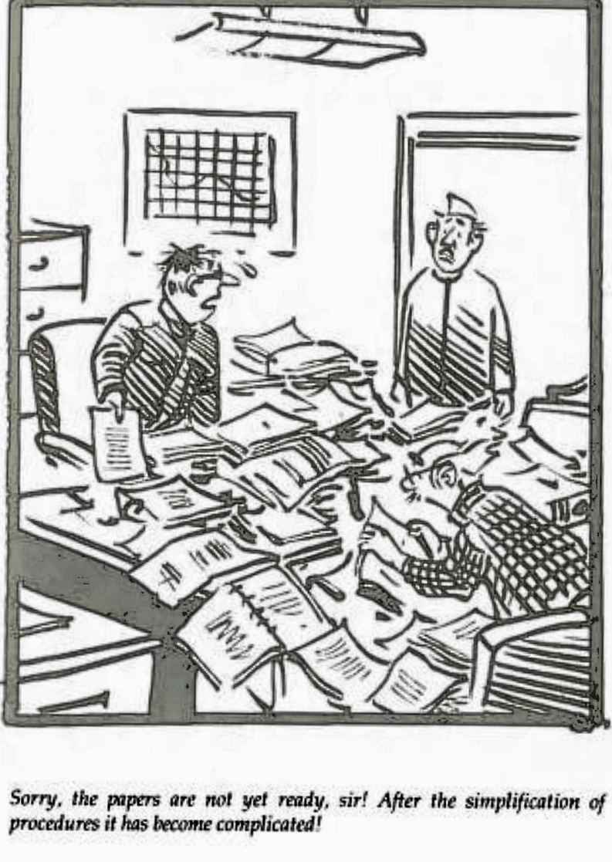
Changes in ITR…
Delay in notifying ITR’s for A.Y. 2025-26
Circular no 06/2025 dated 27/05/2025: Extended due date from 31/07/2025 to 15/09/2025 - Reason: ITR’s have gone structural and content revisions aimed at simplifying compliance, enhancing transparency and enabling accurate reporting. Additional time required to system developments, integration and testing. TDS credits reflected in June, limiting effective window for return filing.
Excel utilities for ITR 1 and ITR 4 are released on 29/05/2025
ITR1 and ITR4 – Earlier this forms could not be selected if assessee has capital gains. For A.Y. 2025-26 ITR1 can be filled even if assessee has LTCG under Section 112A. Said LTCG should not exceed ₹1,25,000 and there is no brought forward or carry forward of capital loss.

Slide 50
…Changes in ITR…
Reference of the Aadhaar Enrolment ID is removed. This is in line with amendment made to Section 139AA by FA 2024 w.e.f. 01/10/2024.
Section under which TDS is deducted to be mentioned in Sch TDS (tax payments)
Changes due to changes in Capital Gains
Changes due to change in buy back taxation – in Sch OS – row added to show “dividend income u/s.2(22)(f)’ and in Sch CG row added eg “Capital Loss on buy back of shares on or after 01st October 2024 [ Short Term 20% or 30% or applicable rate] (can be claimed only if respective Dividend income u/s 2(22)(f) is offered)
Sch AL - Assets and Liabilities at the end of the year (applicable in a case where total income exceeds ₹ 1 Crore.) Earlier limit was Rs.50 Lakhs.
For deduction claimed u/s.80U and 80DD – to mention acknowledgment no of Form 10IA filed.

Slide 51
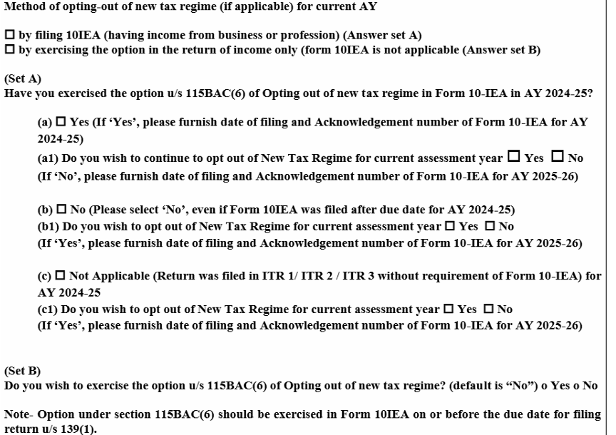
…Changes in ITR…
Changes in relation to tax regime (ITR 3)

Slide 52
…Changes in ITR
OLD Regime – ITR 1 & 4 Additional Details required
HRA u/s. 10(13A) | Place of Work, Actual HRA Received, Actual Rent Paid Basic Salary, Dearness Allowance, Metro/Non-Metro – System will calculate
Section 80C – LIC/PPF | Policy Number / Document Identity Number
Section 80D- Mediclaim | Name of the Insurer, Policy Number
Section 80DDB-Medical Treatment | Name of Specified Disease
Sectión - 80E, 80EE, 80EEA & 80EEB - Interest 24(b) – Housing Loan Interest | Name of the Bank /Institution Loan A/c Number Date Loan Sanction Total Amount of Loan Outstanding Loan (as on 31st March) Interest Amount etc

Slide 53
Financial Statement of Non Corporate Entities..
ICAI earlier released Technical Guide on “Revised Format of Financial Statements for Non-Corporate Entities (2022)”
Subsequently, ICAI has issued “Guidance note on Financial Statement of Non –Corporate Entities” – 08/08/2023
Enhance the quality, comparability and comprehensiveness of the financial reporting by these entities
This Guidance Note is effective for financial statements covering periods beginning on or after April 1, 2024.
The objective is to standardise the formats of financial statements and to enhance the quality and comprehensiveness of the financial reporting by these entities

Slide 54
.Financial Statement of Non Corporate Entities..
Who are covered?
Sole Proprietary Concern
HUF
Partnership Firms
Trust
AOP/BOI /Residential welfare association
Societies
Statutory Corporations, Autonomous bodies and Authorities
Any form of organisation that is engaged fully or partially in any Business or Professional activities
Who are not covered?
Companies incorporated under Companies Act
LLP incorporated under LLP Act
Concerns for which format is specifically prescribed like – Trust under Maharashtra Public Trust Act, Political Parties, Educational Institution etc

Slide 55
Financial Statement of Non Corporate Entities..
Is it mandatory to prepare financials statements of non –corporate entities in Vertical Format?
The Auditing and Assurance Standards Board of the Institute of Chartered Accountants of India (ICAI) has introduced an important amendment to the “Clarification Regarding Authority Attached to Documents Issued by the Institute.”
dated 19/08/2023 - While discharging his attest function, a member should examine whether the recommendations in a Guidance Note relating to an accounting matter have been followed or not. If the same have not been followed, the member should consider whether keeping in view the circumstances of the case, a disclosure in his report is necessary in accordance with Engagement Standards.

Slide 56
Financial Statement of Non Corporate Entities..
What are financial statements ?
Balance Sheet
Statement of Profit and Loss
Cash Flow Statement (where applicable) and
Those notes and other statements and explanatory material that are an integral part of the financial statements
Notes also include significant accounting policies as required by applicable Accounting Standards

Slide 57
Financial Statement of Non Corporate Entities..
Similar to Schedule III
To give comparative figures
Rounding off?
Owner’s Fund/Partner’s Fund – to bifurcate capital account, current account and reserves and surplus (capital reserves, revaluation reserves and other reserve –specify nature and purpose) and undistributed surplus i.e. balance in Statement of Profit and Loss - debit balance in profit & loss account to show as negative figure under head undistributed surplus…………. Even if resulting figure is negative to show under head Reserves and Surplus
Asset and liabilities to be classified – current or non current (considering concerns normal operating cycle/12 months)

Slide 58
Financial Statement of Non Corporate Entities..
Borrowings, provisions to classify – long term borrowings and short term borrowings, secured and unsecured etc, further to classified in
Term loans from Banks, from other parties,
Loans and advances from related parties
Terms of repayment of term loans and other loans shall be stated
Where loans have been guaranteed by partners/proprietor/owners or others, the aggregate amount of such loans under each head shall be disclosed.
Provisions for employee benefit needs to be shown separate
current maturities of Long term borrowings shall be disclosed separately
Trade Payables – to be classified as Dues to micro, small and medium enterprises & Other than micro, small and medium enterprises. Further to give ageing schedule

Slide 59
Financial Statement of Non Corporate Entities..
Additional disclosure trade payables
The principal amount and the interest due thereon (to be shown separately) remaining unpaid to any supplier at the end of each accounting year;
The amount of interest paid by the buyer in terms of section 16 of the Micro, Small and Medium Enterprises Development Act, 2006, along with the amount of the payment made to the supplier beyond the appointed day during each accounting year;
The amount of interest due and payable for the period of delay in making payment (which have been paid but beyond the appointed day during the year) but without adding the interest specified under the Micro, Small and Medium Enterprises Development Act, 2006;
The amount of interest accrued and remaining unpaid at the end of each accounting year; AND
The amount of further interest remaining due and payable even in the succeeding years, until such date when the interest dues above are actually paid to the small enterprise, for the purpose of disallowance of a deductible expenditure under section 23 of the Micro, Small and Medium Enterprises Development Act, 2006

Slide 60
Financial Statement of Non Corporate Entities..
Property, Plant and Equipment - Classification of assets ((Land, Building, plant & equipment, furniture and fixture, vehicles and office equipment and others)
Asset under lease to show separately
A reconciliation of the gross and net carrying amounts of each class of assets at the beginning and end of the reporting period showing additions, disposals acquisitions through business combinations…. other adjustments and the related depreciation and impairment losses/reversals shall be disclosed separately.
Intangible assets to classify separately
Trade receivable - Outstanding for a period less than 6 months and more than 6 months, secured considered goods, unsecured considered goods, doubtful
Inventories : classify – raw material, work in progress, finished goods, stock in trade, stores and spares, loose tools, others. Goods in transit to disclose separately

Slide 61
Financial Statement of Non Corporate Entities..
Revenue classification – Revenue from operations, other operating revenue and other income
Expense classification – specified expenses to disclose separately like Consumption of Stores and spare parts, power and fuel, rent etc and major expenses (like expenses higher of 1% of turnover or 1 lakh ) needs to be disclosed separately.
Raw material consumed (inventory at beginning, purchases during the year and inventory at end of year)
Changes in inventories of finished goods, work in progress and stock-in trade
Disclosure related to Contingent Liabilities (to the extent not provided for) to be classified as under- Claims against entity not acknowledged as debt; Guarantees; Other money for which the non-corporate entity is contingently liable.

Slide 62

Questions/Doubts

Slide 63
Thank You
“This Presentation is intended to provide certain general information existing as at the time of production. This Presentation does not purport to identify all the issues or developments. This presentation should neither be regarded as comprehensive nor sufficient for the purposes of decisionmaking. The presenter does not take any responsibility for accuracy of contents. The presenter does not undertake any legal liability for any of the contents in this presentation. The information provided is not, nor is it intended to be an advice on any matter and should not be relied on as such. Professional advice should be sought before taking action on any of the information contained in it. Without prior permission of the presenter, this document may not be quoted in whole or in part or otherwise.”

