Slide 1

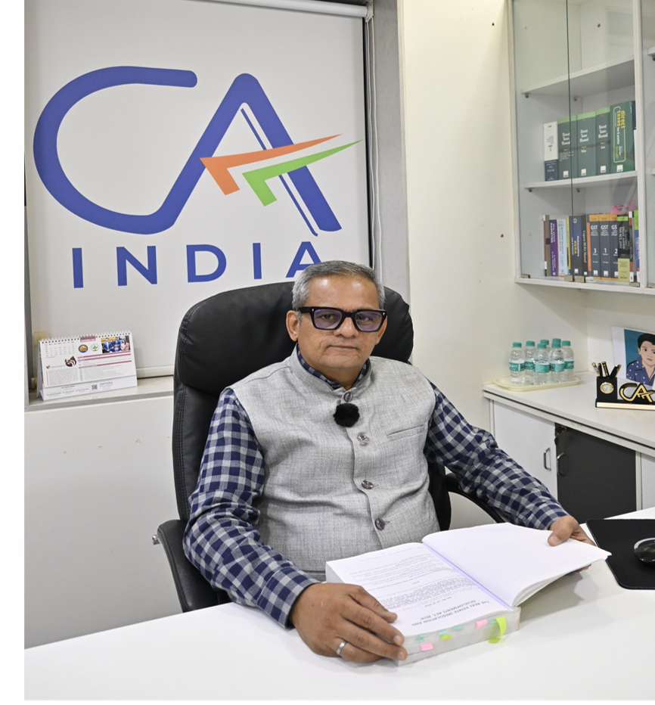
















Intensive Program - Real Estate Consultancy
Speaker - CA Ashwin Shah
Date - 27th June 2026
Vasai Branch of WIRC of ICAI

Slide 2
DISCLAIMER
  Intention is to provide easy understanding of the subject.
  The Presentation is based on RERA Laws and Rules as it stands on the date of the presentation.
  The possibility of human error may result technical inaccuracies, typographical or other errors.
  This document should not be construed as consultation for taking any tax/business decision based on this document.
  The Presenter are in no way responsible for any loss arising due to reliance placed on this document.
  All rights reserved. All contents created are owned by presenter or its affiliates for ease of understanding by the participants only. Unauthorized use is strictly prohibited.
  No part of this publication may be reproduced, distributed, or transmitted in any form or by any means, including photocopying, recording, or other electronic or mechanical methods, without the prior written permission of presenter.
  For view request of this presentation write at ashwin@caashwinshah.com

Slide 3

RERA - Why?
  Uniformity in Law
  Standardization of Disclosure
  Buyers Beware – Transparency in information
  Unfair Trade Practices
  Regulation & Promotion
  Faster Adjudication Process
  West Bengal - Divergent stand Rejected

Slide 4
IBC - Why?
  Overriding Supreme Code
  Creditors Driven Resolution
  Buyers seat in COC
  Independent Personnel - RP
  Monitoring by NCLT & IBBI
  Fair Value through Resolution Plan

Slide 5
Stakeholders
Secured Creditor
Landowner
Developer
Allottee
Other Creditor
RERA
NCLT

Slide 6
IBC on Real Estate
Applicability of IBC
Home Buyers post Amendment 2020
Unsecured financial creditors
Can file application for CIRP u/s 7 by at least
100 creditor in class or 10% of creditor in class- whichever is less
Can be part of COC through AR ( RP for group)
Involvement in decision making process
Company and LLP are directly covered
Corporate Guarantor covered
Personal Guarantor having Proprietary concern Bankruptcy

Slide 7
Revocation Process - Maha Rera
Section 7
Section 8 - Handover/Assignment of Project
Initiation
Suo Moto
Complaint u/s 31
Recommendation of Competent Authority
Trigger Points
Promoter default in doing anything under RERA law
Promoter violates terms of competent authority
Involved in unfair trade practices or irregularities
Action Process
30 day's notice to promoter before revocation
Authority discretion to impose conditions without revocation
Guidance under Order 8/2019
Upon Revocation
debar promoter from accessing webpage
Facilitate remaining development work
Freezing of Bank Accounts
Protect interest of allottees as it may deem fit
Obligation of Authority on Lapse or Revocation
Option to consult State Government for completion of remaining development work
No direction u/s 8 before expiry of 60 days of decision of revocation
Association of Allottees to have first right of refusal
Unlike IBC , there are no detailed guidelines except Order 8/2019 for transfer of project and vesting of rights in the project
No explicit provisions of monitoring by Authority post assignment u/s 8
No separate wing set up to look after stalled/lapsed project

Slide 8

JUDICIAL JOURNEY
Pre RERA Hon’ble High Court, Bombay in Vaidehi Aakash matter concluded that:
  There is no privity of contract between society and new buyers.
  All monies are collected by old developer.
  Society is not promoter.
  New Buyer can have remedies against old developer but not the society.
Note : Vaidehi Aakash was reconfirmed by Hon’ble High Court, Bombay even post implementation of RERA.

Slide 9

JUDICIAL JOURNEY CONTD…
  Post RERA Hon’ble High Court, Bombay in WP 2157 vide its order dated 13th December 2023 in Kapil Kunj CHS & others Vs State of Maharashtra concluded that:
There is no privity of contract between society and new buyers.
Society is not Promoter.
New Buyer can have remedies against old developer but not the society.
Vaidehi Aakash & Goregaon Pearl still prevails in the State of Maharashtra, and it is binding on Maha Rera and Appellate Tribunal, Maha RERA

Slide 10

JUDICIAL JOURNEY CONTD…
  Post RERA Hon’ble High Court in Tuvin Construction matter in 2nd Appeal held that -
  New Developer or Society are not obliged to refund monies to allottee
  New Developer can continue the project registration without requirement of consent u/s 15 OR
  New Developer can altogether go for fresh registration
  Hon'ble Appellate Tribunal in Anamika CHS matter directed Maha Rera to frame SOP to cover situation of termination with following aspects to protect the interest of allottees
  Society/landowner to intimate such termination
  Maha RERA to invoke section 7 for revocation under Suo moto powers
  Maha RERA to offer first rights of refusal to association of allottees u/s 8 or else appoint developers as prescribed .

Slide 11
CIRP PROCESS
  Application u/s 7,9,10 can be filed for triggering insolvency
  Adjudicating Authority ( NCLT ) after hearing both the sides to decide on admission or not to insolvency process
  Appointment of IRP and declaration of moratorium upon commencement of ICD
  Powers of Board and management suspended
  Public Announcement in two newspaper
  Claim collating and preparation of claim register
  Appointment of AR for class of creditors
  COC Constitution & Appointment of RP

Slide 12
CIRP PROCESS....
  IRP and RP to continue affairs as going concern with sole authority
  Appointment of Valuers
  Information Memorandum
  Form G Expression of Interest for Resolution Plan
  Peridocis Returns with NCLT and IBBI
  Regular meeting of COC for appraisal
  Appointment of Forensic Auditor for PUFE transactions
  Sharing Memorandum of Information to prospective Resolution Applicant

Slide 13
CIRP PROCESS.....
  Calling Resolution Plan
  COC to decide and approve Resolution Plan
  Submission of Resolution Plan with NCLT for approval
  Upon approval of Resolution Plan, implementation committee to implement and initiate the process of transfer etc
  If no resolution plan received or if COC thinks so that CD to go for liquidation Application to NCLT for liquidation declaration
  Liquidator appointment upon commencement of LCD
  CIRP cost including IRP/RP cost shall have first priority in distribution

Slide 14

Change of Promoter - Modalities
Section 15 of RERDA 2016
Requires Prior Approval of RERA with 51% consent
Obligation of Old Developer continues
Project through SARFAESI /DRT
Obligation of Old Developer continues
Section 7 & 8 of RERDA 2016
Authority to decide terms of transfer
Insolvency Route - Resolution Plan
Resolution Plan
Reverse CIRP
Project as Going Concern
Liquidate

Slide 15

IBC REVERSE CIRP - CARVING OUT PROJECT
  IBC deals with corporate debtor in its entirety.
  However, there are judicial precedent wherein Resolution Plan qua project is permitted whereby feasible project can be completed in the interest of home buyers
  Issues under Reverse CIRP - Carving out the project
  Books and Records, Creditors stake in different business , Government dues etc

Slide 16
IBC PWIRP - ISSUES AND COMPLEXITY
  Project specific approach deviation from CD as single unit
  Regulation 36A(1A) of IBBI Insolvency Resolution process for CIRP Regulation introduced in Feb 2024 to all RP to invite resolution plan for specific asset or project of CD
  Default in some of the project
  Excluding viable project from CIRP
  Discussion paper of IBBI dt 7th Nov 2024 was later incorporated as amendment - Key Features
  Possession to Home Buyers during CIRP
  Inclusion of Land authorities in COC
  Mandatory Report on Development Rights - within 60 days of ICD
  Association of Home Buyers can submit Resolution Plan
  Formation of Monitoring Committee

Slide 17
IBC PWIRP - JUDICIAL RECOGNITION
  SC - India bulls ARC Vs Ram Kishore Arora & Ors
  Acknowledged importance of disruption of ongoing project
  Observed that CD wise resolution led to greater inconvenience
  Stalled project could go through going concern by IRP/RP
  NCLT Chennai Branch - N Kumar, RP Vs Sheltrex Developers Pvt Ltd
  Contradictory judgement that PWIRP cannot be applied uniformly
  Specific facts and circumstances requires attention
  Amitabh Kant Committee has firmly supported implementation of PWIRP
  NCLAT - Flat buyers Association Winter Hills Vs Umang Real tech Pvt Ltd
  Recognized shortcoming of traditional CIRP
  Home buyers being unsecured financial creditors at disadvantage to financial institution

Slide 18
IBC - PWIRP - JUDICIAL RECOGNITION
  Raheja Developers - 94 home buyers Raheja Shilas Low Rise matter
  Buyers after exhausting all remedies consumer forum etc. filed application u/s 7 of IBC
  CIRP commenced
  Developer challenged before NCLAT which stayed CIRP
  Directed IRP to assist existing management to secure Occupancy Certificate which tantamount to Reverse CIRP
  SC - Alpha Corp Dev Pvt Ltd Vs Greater Noida Ind Dev Authority (2026)
  PWIRP permitted
  NCLAT order set aside
  PWIRP or Reverse CIRP decision depends on facts matrix, NCLT or appellate authorities decision and terms of allowance

Slide 19
IBC - PWIRP - CHALLENGES
  Challenges for Stakeholders
  Financial segregation is difficult task
  Lack of specific guidelines under IBC
  Jurisdiction issues with RERA
  Planning and competent authorities treat CD as whole for levy of tax and charges
  Secured creditors conflict of interest
  Absences of statutory guidelines makes it difficult for NCLT and appellate authorities for adjudication
  PWIRP does not stops CIRP for CD for other businesses
  Difficulties in evaluating financial feasibility qua each project wherein common pool of debt mechanism is used
  Entity test cannot withstand in PWIRP or Reverse CIRP
  Person u/s 3(23) of IBC does not recognize real estate project

Slide 20
THANK YOU
FOR YOUR TIME AND ATTENTION

