Slide 1
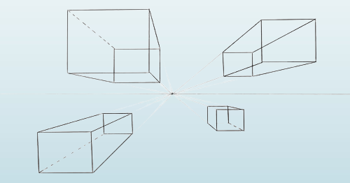
The Institute of Chartered Accountants of India
National Conference, Mumbai
Date: 12.10.2025
Karmayoga :
A Framework for Stress-free Working
SUNIL BAJPAI
Chief Commissioner of Income Tax
Notes:
Random Interaction
Gratitude
Efficiency and efficacy
योगः कर्मसु कौशलम

Slide 2
Sources of Stress
O
B S T A C L E
S
OUTCOME
Action
STRESS
PRESENT STATE
DESIRED STATE
STRESS
STRESS
STRESS

Slide 3




The Nature of Life
Opportunity to Perform Actions (Karma)
Obstacles in Actions (Problems)
Consequences of Actions
Notes:
Life is an opportunity to act
We need skills to overcome the obstacles
We need techniques to accept the outcomes

Slide 4




Sources of Problems
Physical
Body
Mental
Wealth (Tangible)
Acquisitions
Status (Intangible)
Relations
Goals
Environment
Notes:
Buying a Car
Minimalism
Happiness of a poor man

Slide 5

The Problems Trouble us
Our own problems
The problems of our near and dear ones
Notes:
We are surrounded by problems
Problem vs Trouble

Slide 6



Consequences of feeling Troubled
Health
Mental Disturbance (Quality of Life)
Productivity
Notes:
Psychosomatic Disorders

Slide 7
Can we see the “Invisible Labels”? A car ahead was moving like a turtle and not giving me way in spite of my continuous honking. I was on brink of losing my cool when I noticed the small sticker on the car’s rear . “Physically challenged; Please be patient.” And that changed everything. I immediately went calm & slowed down. In fact, I got a little protective of the car & the driver. I reached home a few minutes late, but it was ok. And then it struck me. Would I have been patient if there was no sticker? Why do we need stickers to be patient with people? Will we be more patient & kind with others if people had labels pasted on their foreheads? Labels like — “ Lost my job” , “Fighting cancer”, “Going through a bad divorce”, “Suffering Emotional abuse", "Lost a loved one”, “Feeling worthless”, “Financially broken”, ..and more like these. Everyone is fighting a battle we know nothing about. The least we can do is to be patient, kind & compassionate. Let us respect the Invisible Labels. Knowing each is carrying multiple ones.- That is why they say... Walk gently into others lives, all wounds are not always visible... !! (From Whatsapp with thanks)
Notes:
Seek audience reaction
Emphasize on the last line of the third para

Slide 8
How Problems cause Trouble
Problem
Trouble
(Perspective or Outlook)
(Internal)
(External)
Notes:
Reaction to the same situation
Road Rage
Counselling

Slide 9



Can we avoid the Troubles?
Dealing the problems with a proper perspective/attitude

Slide 10

Proper Perspective towards Problems
Proper Perspective towards the world
Notes:
Philosophy
Shad Darshan-Nyaya, Vaisheshika, Mimamsa, Vedanta, Yoga, Samkhya.

Slide 11


What is that Perspective?
YOGA

Slide 12
What is Yoga?
1. Bhagwad Gita: "Be equal minded in both success and failure. Such equanimity is called Yoga"
"Yoga is skill in action" "Know that which is called yoga to be separation from contact with suffering"
2. Yoga Sutras of Patanjali: yogas chitta vritti nirodhah – "Yoga is the calming down the fluctuations/patterns of mind“
3. Kaundinya’s Pancarthabhasya on the Pashupata-sutra: "In this system, yoga is the union of the self and the Lord"
4. Yogasataka a Jain work by Haribhadra Suri: "With conviction, the lords of Yogins have in our doctrine defined yoga as the concurrence (sambandhah) of the three [correct knowledge (sajjñana), correct doctrine (saddarsana) and correct conduct (saccaritra)]
5. Brahmasutra-bhasya of Adi Shankara: "It is said in the treatises on yoga: 'Yoga is the means of perceiving reality' (atha tattvadarsanabhyupāyo yogah)"
6. Malinivijayottara Tantra, one of the primary authorities in non-dual Kashmir Shaivism: "Yoga is said to be the oneness of one entity with another."
7. Mrgendratantravrtti, of the Shaiva Siddhanta scholar Narayanakantha: "To have self-mastery is to be a Yogin. The term Yogin means "one who is necessarily "conjoined with" the manifestation of his nature...the Siva-state (sivatvam)"
8. Saradatilaka of Lakshmanadesikendra, a Sakta Tantra work: "Yogic experts state that yoga is the oneness of the individual Self (jiva) with the atman. Others understand it to be the ascertainment of Siva and the Self as non-different. The scholars of the Agamas say that it is a Knowledge which is of the nature of Siva's Power. Other scholars say it is the knowledge of the primordial Self."
(Wikipedia)

Slide 13
We need a definition of Yoga which is-
Aligned with other definitions
Practical and Useful

Slide 14


Yoga - To perceive the whole universe as an Integrated machine
Video 1
Video 2
Video 3
Notes:
Inter Dependence - Classroom etc.
Exchange of Atoms
Exchange of bodies- 1 year
Effect of Ukraine and Gaza Wars
Survey Bhawantu Sukhinah
Overview effect
The butterfly effect

Slide 15

The effect of having the Yoga Perspective
Not being a doer
Not being an owner
Non discrimination
Gratefulness
Humility
Connectedness
Notes:
The Overview Effect
सर्वे भवन्तु सुखिन:

Slide 16
Hypothesis
Being connected is the key to happiness
Notes:
A short experiment
Observations on the experiment

Slide 17

Ways to enhance connectedness
To give
Time
Respect
Love
Care
Smile
Talk

Slide 18
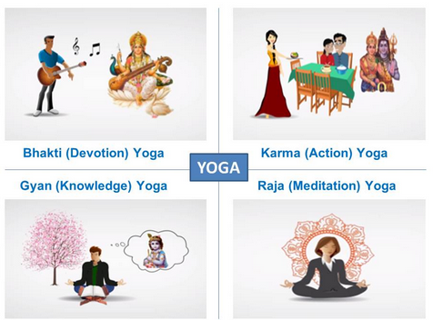
Means to attain a Yaugik state
Karma Yoga
Dhyan Yoga
Gyan Yoga
Bhakti Yoga
Notes:
Break

Slide 19
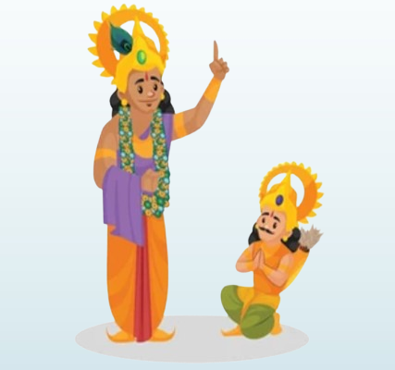

Bhagvadgita and Karma Yoga
The Context
Arjun’s Dilemma
Notes:
We are always engaged in some kind of war
What to do / Not to do

Slide 20
Krishna’s Message
नियत कर्मों को अवश्य करो,
कर्म अकर्म से बेहतर है।
कर्म किए बगैर तो, देखो,
शरीर निर्वाह असंभव है ॥3॰8॥
न हि कश्चित्क्षणमपि जातु तिष्ठत्यकर्मकृत्। कार्यते ह्यवशः कर्म सर्वः प्रकृतिजैर्गुणैः ।।3.5।।
न एक पल ऐसा होता है,
कि रह पाए बिना कर्म करे।
प्रकृतिजन्य गुणों के वश में,
पुरुष विवश होके कर्म करे ||3.5||
नियतं कुरु कर्म त्वं कर्म ज्यायो ह्यकर्मणः। शरीरयात्रापि च ते न प्रसिद्ध्येदकर्मणः ।।3.8।।
3.8 Do thou perform (thy) bounden duty, for action is superior to inaction and even the maintenance of the body would not be possible for thee by inaction.
3.5 Verily none can ever remain for even a moment without performing action; for everyone is made to act helplessly indeed by the alities born of Nature.

Slide 21
What about the sin that comes from killing one’s own kin?
कर्मण्येवाधिकारस्ते मा फलेषु कदाचन।
मा कर्मफलहेतुर्भूर्मा ते सङ्गोऽस्त्वकर्मणि ।।2.47।।
अधिकार कर्म करने का है,
कदापि नहीं कर्म के फल का ।
अकर्मण्यता से दूर रहो,
हेतु न मानो खुद को फल का ।।2.47।।
2.47 Thy right is to work only, but never with its fruits; let not the fruits of action be thy motive, nor let thy attachment be to inaction.
Notes:
Cricket
Y = f (x1, x2, x3………..xN)
What is so special in this ?

Slide 22
The Issues with Actions
The First Issue
Bondage of Action
Resolution
Detachment
आसक्ति त्याग कर्मफलों की,
निराश्रय सदा जो तृप्त रहे।
कर्मों में प्रवृत्त होकर भी,
कदापि वह कुछ भी नहीं करे ||4.20||
त्यक्त्वा कर्मफलासङ्गं नित्यतृप्तो निराश्रयः। कर्मण्यभिप्रवृत्तोऽपि नैव किञ्चित्करोत सः ।।4.20।।
4.20 Having abandoned attachment to the fruits of the action, ever content, depending on nothing, he does not do anything though engaged in activity.
Notes:
Opening a shop
Doing a job – Conduct Rules
The fundamental character of a man - Freedom

Slide 23
How can we act in a detached manner?
Attachment vs. Commitment (Sankalpa)
Advantages of detachment
Notes:
Commitment / purpose / calling
Father – Son vs Teacher – Student
Doctor operating on his Son

Slide 24
The issues with Actions
The Second Issue
Every action has attached Doshas
Resolution
Do your work as a Yagya
है मुक्त और आसक्ति-रहित,
ज्ञान में जो मन को लगाए।
करे यज्ञ के लिए आचरण,
कर्म सभी विलीन हो जाएँ ॥4॰23॥
गतसङ्गस्य मुक्तस्य ज्ञानावस्थितचेतसः। यज्ञायाचरतः कर्म समग्रं प्रविलीयते ।।4.23।।
ब्रह्म को समर्पित कर्म करे, जो बिन आसक्ति कर्मफल से। यों पाप नही लिपटें उससे, ज्यों नीर कमल के पत्ते से। ॥5॰10॥
ब्रह्मण्याधाय कर्माणि सङ्गं त्यक्त्वा करोति यः। लिप्यते न स पापेन पद्मपत्रमिवाम्भसा ।।5.10।।
4.23 To one who is devoid of attachment, who is liberated, whose mind is established in knowledge, who works for the sake of sacrifice (for the sake of God), the whole action is dissolved.
5.10 He who does actions, offering them to Brahman, and abandoning attachment, is not tainted by sin, just as a lotus-leaf is not tainted by water.
Notes:
Smoke
Building a temple
Ant
Second Law of Thermodynamics
Volunteering

Slide 25
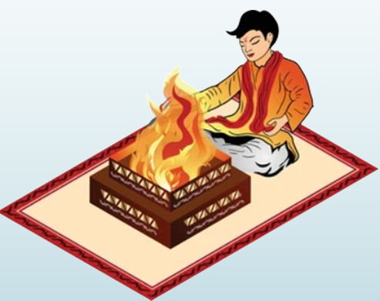
What is a Yagya?
A work done for a Devata
With a sense of Duty
Intention matters
Notes:
Teacher – Student
Officer – Public
Industrialist – Worker
Example – जल्लाद(executioner)
Accident Vs Murder
Mens rea

Slide 26
Ordinary Action vs Yagya
 | Ordinary Action
S. No. | Action | For whom | Purpose
1 | Teaching Students | Self | Salary
2 | Treating Patients | Self | Fees
3 | Fighting a court case | Self | Fees
4 | Doing a job | Self | Salary
5 | Studying | Self | A Job
6 | Doing Business | Self | Money
7 | Eating Food | Self | Taste
Yagya
Yaugik Action
For whom/
Devata
Yagyashesha
Teaching Students
Students
Salary
Treating Patients
Patients
Fees
Fighting a court case
The Client
Fees
Doing a job
The Employer
Salary
Studying
Parents/Society
A Job
Doing Business
Customers
Money
Eating Food
Society
Taste

Slide 27
The Perspective of a Yogi
Performing Actions as a ‘Nimitta’
मैं लोक-विनाशक महाकाल,
आया यहां संहार करने |
यहां, पक्ष-विपक्ष के योद्धा,
तुम न लड़ो तब भी ना बचने || 11.32 ||
इसलिए उठो यश-लाभ करो,
जीतो शत्रु, राज्य सुख पाओ |
मार चुका इनको पहले ही,
अर्जुन, तुम निमित्त बन जाओ || 11.33 ||
तस्मात्त्वमुत्तिष्ठ यशो लभस्व जित्वा शत्रून् भुङ्क्ष्व राज्यं समृद्धम्। मयैवैते निहताः पूर्वमेव निमित्तमात्रं भव सव्यसाचिन्।।11.33।।
11.32 The Blessed Lord said I am the full-grown world-destroying Time, now engaged in destroying the worlds. Even without thee, none of the warriors arrayed in the hostile armies shall live.
11.33 Therefore, stand up and obtain fame. Coner the enemies and enjoy the unrivalled kingdom. Verily by Me have they been already slain; be thou a mere instrument, O Arjuna.
कालोऽस्मि लोकक्षयकृत्प्रवृद्धो लोकान्समाहर्तुमिह प्रवृत्तः। ऋतेऽपि त्वां न भविष्यन्ति सर्वे येऽवस्थिताः प्रत्यनीकेषु योधाः।।11.32।।

Slide 28
The Motivation of a Yogi
Service to the God
जो करते हो जो खाते हो,
जो हवन करो या दान करो।
तप आदि, अर्जुन, कुछ भी करो,
सब मुझको अर्पित किए करो। ।।9.27।।
कर्म के फल और बंधन से,
इस तरह मुक्त हो जाओगे।
संन्यासयोग के योगी बन,
विमुक्त हो मुझको पाओगे ।।9.28।।
शुभाशुभफलैरेवं मोक्ष्यसे कर्मबन्धनैः। संन्यासयोगयुक्तात्मा विमुक्तो मामुपैष्यसि ।।9.28।।
यत्करोषि यदश्नासि यज्जुहोषि ददासि यत्। यत्तपस्यसि कौन्तेय तत्कुरुष्व मदर्पणम् ।।9.27।।
9.27 Whatever thou doest, whatever thou eatest, whatever thou offerest in sacrifice, whatever thou givest, whatever thou practisest as austerity, O Arjuna, do it as an offering unto Me.
9.28 Thus shalt thou be freed from the bonds of actions yielding good and evil fruits; with the mind steadfast in the Yoga of renunciation, and liberated, thou shalt come unto Me.
Notes:
Example – MLM
More Money for Self Vs More Money for Service
Example – Businessman
The inner fruit of service – A blind man, thorn
The bio-chemical effect
Why we don’t feel the joy in doing our work

Slide 29
SUMMARY The Four Step Process
It is not my problem
What action needs to be taken
Action with a Yaugik perspective
Detachment from the outcome
Notes:
The Yaugik perspective
The emotional reaction vs what needs to be done
Do as a Yagya
Accept the outcome as a divine will

Slide 30

II Thank You II
Feedback:
Whatsapp: 9313001238
E-mail: sbajpai.irs@gmail.com
Notes:
श्रेष्ठ पुरुष जो भी करते हैं....
Gratefulness / आभार
Feedback

