Slide 1

The AI Audit Journey: Charting the Future of Assurance
September 28, 2025
.

Slide 2

Setting the Stage
1
2
3
4
Evolution of Technology in Assurance
What CFOs and CEOs are saying about AI
Current state of Audit Landscape
AI Use Cases in Statutory Audit
5
6
7
8
Future Skills for Chartered Accountants
AI Use cases live demos
AI Implementation Framework
Future of AI in Audit Practice
The AI Audit Journey: Charting the future of Assurance

Slide 3

Evolution of Technology in Assurance

Slide 4
Evolution of Technology in Assurance
Desktop Computing
Mobile-First Workflows
Introduction of spreadsheet software and basic accounting systems revolutionized data processing and calculation accuracy.
Cloud-based platforms allowed auditors to access financial data remotely, improving efficiency and collaboration capabilities.
1990
2010
1980
2020
2000
Physical Ledgers
Internet & ERP Systems
AI & Agentic Systems
Manual bookkeeping, paper-based audit trails, and handwritten journal entries dominated financial record-keeping practices.
Enterprise resource planning systems enabled real-time data integration across business functions and departments.
Artificial intelligence now automates complex audit procedures, risk assessments, and generates intelligent insights for decision-making.
The AI Audit Journey: Charting the future of Assurance
The AI Audit Journey: Charting the future of Assurance

Slide 5
What CFOs and CEOs are saying about AI

Slide 6
What CFOs and CEOs are saying about AI
85%
71%
94%
CFOs See AI Value
Active AI Usage
Future Optimism
Recognize significant potential but only 39% have successfully implemented AI solutions across their organizations.
Companies currently using AI in finance operations to automate processes and enhance decision-making capabilities.
Believe generative AI will significantly benefit at least one activity area within the finance organization.
72%
67%
44%
Finance Teams Leveraging AI
AI for FP&A
Agentic AI by 2026
72% of finance teams now leveraging AI tools, a significant increase from 34% in 2024.
67% of finance leaders are using AI for Financial Planning & Analysis (FP&A) to navigate economic volatility.
44% of finance teams are projected to use agentic AI by 2026, marking a 600% increase from current levels.
49%
41%
AI in Business Strategy
Confident CFOs
49% of tech leaders have fully integrated AI into their core business strategy.
Only 41% of CFOs express confidence in their ability to navigate current economic challenges effectively.
Sources
International Accounting Bulletin - View Report
KPMG global AI in Finance - View Study
BCV AI and the Office of the CFO - View Study
Protiviti Global Finance Trends Survey 2025 - Read Report
Wolters Kluwer CCH Tagetik Survey 2025 - View Survey
CFO Connect State of AI in Finance 2025 - Explore Insights
PwC AI Predictions 2025 - View Report
The AI Audit Journey: Charting the future of Assurance

Slide 7
Current state of Audit Landscape

Slide 8

Current State of Indian Audit Landscape: Challenges & Opportunities
Volume & Complexity
Resource Constraints
Digital Transformation
Increasing client data volumes
Limited skilled professionals
Client systems modernisation
Complex regulatory requirements
Time-intensive manual processes
Electronic documentation
Multiple compliance frameworks
Rising client expectations
Real-time data availability

Slide 9
Current Landscape of AI in Finance Functions
Sources
World Economic Forum - Artificial Intelligence in Financial Services 2025
KPMG Global AI in Finance Report 2024
PwC 2025 AI Business Predictions
ISACA Auditing AI
Deloitte Generative AI in Finance reports
KPMG Study: AI Revolutionizes Financial Reporting
AI in Financial Reporting and Audit : Navigating the new era
Invoice processing automation: How can it cut processing time?
AI-driven operations forecasting in data-light environments
Accelerated AI Adoption
Enhanced Payment Automation
Latest 2024-2025 research indicates that 73% of financial reporting leaders expects the use of GenAI to become the norm in financial reporting. Adoption has significantly accelerated in the past six months, transforming finance operations across the board.
AI streamlines invoice processing, vendor payments, and approval workflows, reducing manual intervention by up to 80%. This leads to faster transaction times and fewer errors.
Predictive Cash Flow Forecasting
Proactive Fraud Detection
Machine learning algorithms analyze historical patterns, market data, and real-time inputs to predict future cash positions with improved accuracy, optimizing liquidity management.
Advanced analytics and behavioral AI identify suspicious transactions and anomalous patterns in real-time across financial systems, significantly minimizing fraud risks and losses.
Automated Regulatory Compliance
Key Technologies & Tools
AI-driven systems monitor regulatory changes, automate compliance checks, and generate audit trails, ensuring adherence to complex financial regulations like KYC and AML.
Implementation relies on cloud AI platforms (e.g., AWS SageMaker, Google Cloud AI), specialized fintech solutions, and Robotic Process Automation (RPA) integrated with advanced machine learning models.
Tangible ROI & Performance Metrics
Challenges to Implementation
Companies applying AI forecasting achieve 20–50% improvement in forecast accuracy and 10–15% reduction in operational costs.
Despite benefits, barriers include data quality issues, ethical concerns regarding algorithmic bias, talent gaps in AI expertise, and the complexity of integrating new AI solutions with legacy systems.
The AI Audit Journey: Charting the future of Assurance

Slide 10
AI Technology Fundamentals for Audit & Finance
Understanding the core AI technologies is crucial for appreciating their transformative potential in audit and finance. These advanced computational methods enable systems to perform tasks that typically require human intelligence, such as learning, problem-solving, and decision-making, offering unprecedented capabilities for efficiency, accuracy, and insight.
Machine Learning (ML)
Pattern recognition, predictive analytics, anomaly detection
Natural Language Processing (NLP)
Document analysis, contract review, regulatory text processing
Robotic Process Automation (RPA)
Task automation, data entry, workflow management
Computer Vision
Document scanning, image analysis, physical asset verification
Deep Learning
Complex pattern recognition, fraud detection, risk assessment
Generative AI
Report generation, memo writing, audit documentation

Slide 11
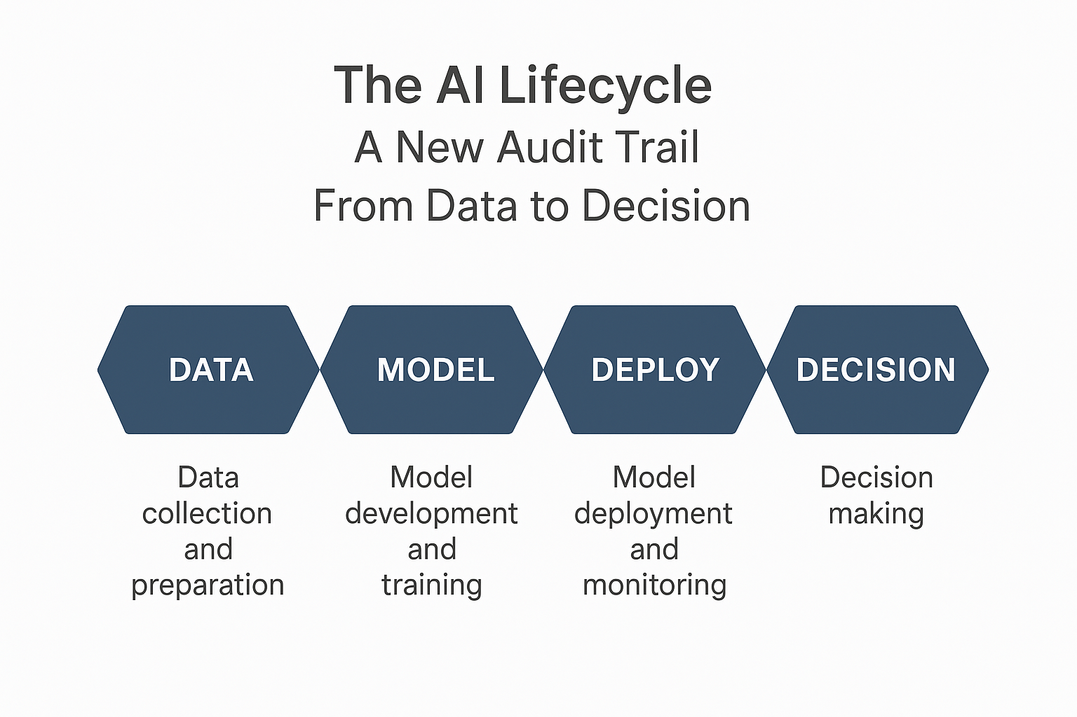
The AI Lifecycle: A New Audit Trail From Data to Decision
The traditional audit trail is linear, but the AI audit trail is a continuous loop. Each stage presents unique risks and requires specific audit procedures.

Slide 12
Analytics & AI Use Cases in Statutory Audit

Slide 13
AI Use Cases in Statutory Audit - Planning Phase
Automated engagement letter and proposal generation
AI-powered client acceptance and continuance assessments
Client industry benchmarking and trend analysis
Automated audit scoping based on client complexity
AI-driven preliminary analytical procedures
Automated materiality calculations and threshold setting
Sentiment analysis on business segments, employee segment & news segment
Intelligent audit team composition and scheduling
The AI Audit Journey: Charting the future of Assurance

Slide 14
AI Use Cases in Statutory Audit - Execution Phase
AI based automated reconciliations eg: Bank reconciliation, Intercompany etc.
Extracted key contract terms for performing agreement synopsis, IND AS 116 computation etc.
AI powered Overall analytical review with variance reasons
Journal entry testing and anomaly detection eg: pattern recognition in entries
Regression analysis – by using operational data
Process Mining – with AI element embedded in it
Automated Sampling for identifying Test of controls, Key item testing and anomalies
Invoice testing – OCR technology and auto-populates the workpaper
The AI Audit Journey: Charting the future of Assurance

Slide 15
AI Use Cases in Statutory Audit - Execution Phase
Data Extraction tools with pre-defined scripts.
Consolidated Overall Analytical review with Audit co-pilot
Correlation analysis – Revenue vs Debtors vs Bank Receipts
Extracting the details from the statutory challans and creating an automated workpaper
4 way match – Payroll register vs Attendance records vs Payment advice vs Financial statements
Gen AI assistant to answer the questions in the PowerBi dashboard
Vendor redistribution with optimized costing
Automated cut off testing procedures
The AI Audit Journey: Charting the future of Assurance

Slide 16
AI Use Cases in Statutory Audit - External Assurance
Identification of struck off parties and transactions
Identification of MSME and transactions
AI-powered related party transaction identification
Performing credit risk analysis using CIBIL scores
Reperformance of Foreign exchange gain/loss using RBI exchange rates
GST validation and input tax credit
PAN validation and identification of dummy employees
Validating the NAV for the Mutual fund caption
The AI Audit Journey: Charting the future of Assurance

Slide 17
AI Use Cases in Statutory Audit - Reporting
Automated audit opinion drafting assistance
Peer Benchmarking for audit report qualifications, ICFR reports and KAM
AI powered casting, cross-referencing and prior year figure comparison
Automated preparation of cash flow statements
AI-generated management letter points
AI powered insights generation on the financial statement closure process
Automated disclosure checklist validation
AI-generated consultation memos and recommendations
The AI Audit Journey: Charting the future of Assurance

Slide 18

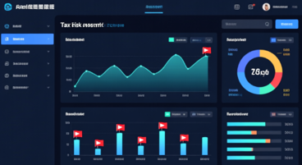

AI Applications in Tax Audit
Automated Data Analysis Return Scrutiny
AI cross-references tax returns with financial data
Identifies discrepancies and potential audit triggers
Automated calculation verification and compliance checks
Intelligent Risk Scoring Audit Selection
AI-driven taxpayer risk profiling and scoring
Predictive analytics for audit case selection
Behavioral pattern analysis for Fraud detection
Report Generation Documentation
Automated Audit Report generation with citation
Regulatory compliance documentation
Evidence trail and working paper preparation

Slide 19
AI impact on Audit Efficiency
Time Efficiency AI saves 4-12 hours per week, enabling focus on high-value advisory services
Quality Enhancement 100% population testing reduces sampling risk and improves audit quality significantly

Slide 20
Analytics & AI Use Cases in Statutory Audit – Live Demo

Slide 21
AI Implementation Framework

Slide 22
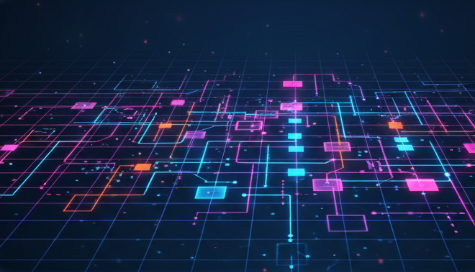










AI Implementation Framework
2
Data Readiness
Strategy & Vision
1
Ensure data quality, establish integration protocols, and create secure data pipelines for AI model training.
Define AI objectives, assess organizational readiness, and establish governance frameworks for successful implementation.
3
Model Selection
Choose appropriate AI tools, evaluate vendor solutions, and conduct pilot testing for specific use cases.
5
Monitoring & Feedback
Continuously assess performance, refine models, and gather user feedback to optimize AI system effectiveness.
4
Deployment
Roll out AI solutions systematically, train personnel, and integrate with existing audit and finance workflows.
The AI Audit Journey: Charting the future of Assurance
The AI Audit Journey: Charting the future of Assurance

Slide 23
AI Audit Implementation Journey
Assessment Phase Evaluate current audit processes, identify high impact use cases, and conduct readiness assessment for AI adaption
1
Pilot Implementation Start with low-risk areas like data validation, gradually expand to journal entry testing and risk assessment procedures
2
Training and charge Invest in comprehensive staff training, establish AI governance frameworks, and foster culture of continuous learning
3
Scale & Optimize Expand AI across all audit areas, measure ROI, refine algorithms, and develop new AI-enabled service offerings
4

Slide 24
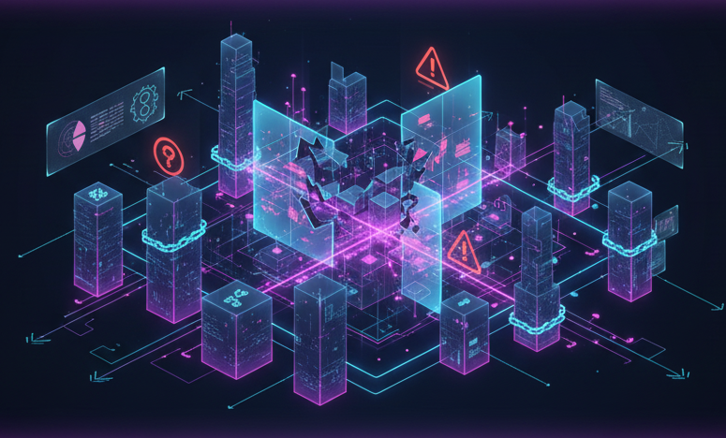
Navigating AI Implementation: Challenges
Top 5 Implementation Challenges
Data Quality
1
Poor data quality, including incompleteness, inconsistency, or inaccuracy, can severely hinder AI model performance and lead to unreliable audit outcomes.
Regulatory Compliance
2
Adhering to evolving regulations and ethical guidelines surrounding AI use in audit, especially concerning data privacy, security, and algorithmic transparency, poses a significant hurdle.
Skill Gaps
3
A shortage of audit professionals with sufficient AI literacy, data science skills, and technological expertise can impede effective implementation and utilization of AI tools.
Integration Complexity
4
Integrating new AI solutions with existing legacy systems and diverse data sources within the audit ecosystem can be complex, time-consuming, and resource-intensive.
Cost Considerations
5
The initial investment in AI infrastructure, software licenses, talent acquisition, and ongoing maintenance costs can be substantial, requiring careful financial planning and ROI justification.
The AI Audit Journey: Charting the future of Assurance

Slide 25





Navigating AI Implementation: Success Factors
Critical Success Factors
Leadership Commitment
Phased Approach
Strong executive sponsorship and a clear strategic vision are essential to drive AI adoption, allocate necessary resources, and overcome organizational resistance.
Starting with pilot projects and incremental rollouts allows firms to learn, adapt, and scale AI solutions effectively, minimizing disruption and maximizing success rates.
Staff Training
Vendor Partnerships
Investing in continuous training and upskilling programs for audit professionals ensures they are equipped with the knowledge and skills to work alongside and leverage AI technologies.
Collaborating with specialized AI vendors and technology providers can bring in external expertise, accelerate development, and provide access to cutting-edge tools and platforms.
Continuous Monitoring
Establishing robust monitoring frameworks to assess AI model performance, data integrity, and compliance ensures ongoing effectiveness and addresses any emerging issues proactively.
The AI Audit Journey: Charting the future of Assurance
The AI Audit Journey: Charting the future of Assurance

Slide 26
Navigating AI Implementation: Success Factors
Statistics on Implementation Timelines and Success Rates
Recent industry reports suggest that a typical AI implementation in a large audit firm can take anywhere from 12 to 24 months, depending on scope and complexity. Success rates vary, with firms reporting over 60% achieving significant ROI within two years, while others face challenges in scaling beyond pilot phases.
Best Practices from Leading Audit Firms
- Establishing dedicated AI innovation hubs or centers of excellence.
- Fostering a data-driven culture that prioritizes data governance and quality from the outset.
- Developing ethical AI guidelines and frameworks to ensure responsible use.
- Promoting cross-functional collaboration between audit, IT, and data science teams.
- Regularly evaluating AI tools and technologies to adapt to rapid advancements.
Sources:
Spaceo AI
KPMG Survey: AI Adoption Across US Finance Functions Reaches Highest Levels, with ROI Exceeding Expectations
The AI Audit Journey: Charting the future of Assurance
The AI Audit Journey: Charting the future of Assurance

Slide 27
Future of AI in Audit Practice

Slide 28
Future of AI in Audit Practice

Slide 29
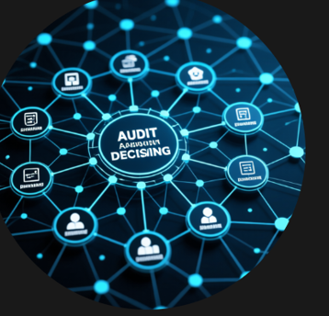
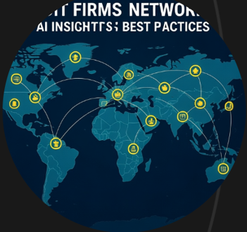
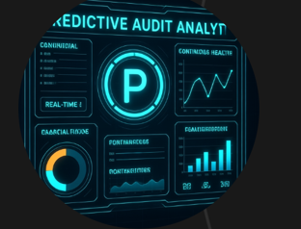
Future of AI in Audit Practice
Agentic AI Systems Autonomous AI Agents will handle end-to-end audit procedures, from risk assessment to report generation
Global audit networks AI powered audit ecosystems will enable real-time collaborations between firms, sharing insights, risk patterns
Continuous assurance Shift from periodic audits to continuous monitoring with AI providing real-time assurance on financial data integrity

Slide 30




The Future: Agentic AI in Statutory Audit
Multi-Agent Orchestration
Specialized AI agents will collaborate across different audit phases, sharing insights and coordinating complex procedures seamlessly.
Context-Aware Assistants
Advanced systems will provide real-time guidance, regulatory updates, and intelligent recommendations throughout audits.
Continuous Real-Time Audit
Human-led, AI-augmented processes will enable ongoing monitoring, reduce traditional audit cycles while enhancing assurance quality and stakeholder confidence.
The AI Audit Journey: Charting the future of Assurance

Slide 31
The Future: Global audit networks
Global Audit Networks
The establishment of interconnected AI systems across international audit firms will foster unparalleled standardization and collaborative intelligence, creating a truly global audit ecosystem.
Interconnected AI Infrastructure: Global audit networks will link disparate AI systems and data repositories from various firm offices and client locations, enabling unified data processing and analysis.
Standardized AI Protocols: The development and adoption of common AI protocols, data taxonomies, and auditing standards will ensure consistent audit quality and reporting across diverse global engagements.
Cross-Border Data Sharing: Secure and compliant mechanisms for sharing anonymized or aggregated audit data across borders will facilitate collaborative intelligence, allowing AI models to learn from a broader and richer dataset while adhering to data privacy regulations (e.g., GDPR, CCPA).
Unified Risk Databases & Benchmarking: Centralized repositories of global risk intelligence and industry benchmarks will provide auditors with deeper context and predictive insights, enhancing the ability to identify systemic risks and outliers.
Regulatory Harmonization: AI will play a crucial role in harmonizing compliance efforts across different regulatory frameworks, translating local requirements into a unified compliance posture for multinational clients.
Network Effects in Intelligence: Every audit performed within the global network will contribute to the collective intelligence of the AI systems, improving algorithms, risk models, and predictive capabilities for all participating firms.
The AI Audit Journey: Charting the future of Assurance

Slide 32
The Future: Continuous assurance
24/7 Monitoring Architecture: This involves the deployment of AI-powered sensors and direct data feeds integrated into client ERP systems, financial platforms, and operational databases, enabling continuous surveillance of transactions and controls.
Real-Time Anomaly Detection: AI algorithms will continuously analyze data streams to detect unusual patterns, anomalies, and potential control breakdowns as they occur, issuing immediate alerts to human auditors.
Proactive Risk Mitigation: Instead of identifying issues post-factum, continuous assurance allows for predictive risk modeling and proactive intervention, enabling clients to address financial irregularities or compliance breaches before they escalate.
New Service Models: This will give rise to new assurance service models, including "always-on" monitoring, real-time compliance reporting, and predictive analytics consultations, moving beyond traditional audit cycles.
Dynamic Audit Opinions: Audit opinions may evolve from annual statements to more dynamic, real-time dashboards or attestations that reflect the ongoing financial health and control effectiveness of an organization.
Technical Architecture:
Cloud-native platforms for scalability and data processing
Distributed ledger technology for immutable audit trails
Advanced cryptography for data security and privacy
Machine learning models for predictive analytics and anomaly detection
The AI Audit Journey: Charting the future of Assurance

Slide 33
Emerging AI Technologies Transforming Audit: 2025 & Beyond
Statistics on Expected Adoption and Investment
Industry forecasts project that by 2030, over 90% of large audit firms will have integrated at least 3 of these emerging AI technologies into their core operations. Investment in AI R&D for audit solutions is expected to grow by 46% CAGR, reaching an estimated $50 billion globally by 2030, driven by the demand for enhanced efficiency and deeper insights.
Preparing for the Future of AI-Augmented Auditing
Upskilling Talent
Data Governance & Ethics
Strategic Partnerships
Agile Infrastructure
Focus on developing advanced analytical skills, AI literacy, and data science expertise among audit professionals.
Establish robust frameworks for managing data quality, privacy, and ethical considerations surrounding autonomous AI decisions.
Collaborate with AI developers, academia, and fintech innovators to
co-create bespoke audit solutions.
Invest in flexible, cloud-native IT infrastructure capable of supporting advanced AI models and vast datasets.
Sources:
Mordor Intelligence (AI in Accounting Market)
Thomson Reuters (on large tax & accounting firms)
The AI Audit Journey: Charting the future of Assurance

Slide 34
Future Skills for Chartered Accountants

Slide 35
Future Skills for Chartered Accountants
Technical Proficiency Master AI Tools, data analytics, and emerging technology while maintaining core accounting expertise
Strategic thinking Develop ability to interpret AI insights and provide strategic advisory services beyond traditional compliance
Client advisory Transform from compliance-focused to strategic advisor role, leveraging AI for enhanced client value
Ethical Leadership Lead in AI Governance, ethics, and responsible implementation of AI in financial services

Slide 36

As we conclude, let's summarize the key insights from our journey into the future of AI audit. This isn't just a new service line; it's a fundamental transformation of the assurance profession.
AI Audit is not a destination, but a continuous journey. The AI landscape is constantly evolving, and so must our approach to audit. We cannot rely on a single, point-in-time check. Instead, we must embed a continuous process of monitoring and assurance into the AI lifecycle.
Proactive assurance is no longer optional. The risks associated with AI—from bias to model drift—are significant and can have severe financial, reputational, and ethical consequences. It is far more effective and valuable to identify and mitigate these risks during the design and development phases than to react to a public failure.
Embracing new skills and technologies is crucial. The auditor of the future will be a hybrid professional with expertise in traditional audit, data science, and ethics. Technology, particularly AI-enabled audit platforms, will be a key enabler, allowing us to perform deeper, more efficient audits.
The Opportunity: For assurance professionals, this journey is an opportunity to move from a compliance-focused role to a strategic advisor, helping organizations navigate a complex new world and build trust with their stakeholders.
Key Takeaways Charting the Path Forward

Slide 37
THANKS
AI will not replace auditors, but auditors who use AI will replace those who don’t. The future belongs to professionals who combine technical expertise with AI capabilities to deliver superior audit quality.

