Slide 1
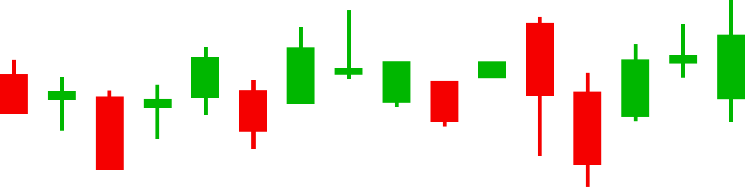


The Power Trio
Trends
Time frames
Support -Resistance
Speaker
Date
Keyur Furia
14-12-2025
ONE DAY SEMINAR ON CAPITAL MARKETS
Organised by Committee on Financial Markets and Investors’ Protection, ICAI
Hosted by Vasai Branch of WIRC of ICAI CAPITAL MARKET

Slide 2

Disclaimer
I am not SEBI Registered
The Content & Information provided is only for Educational & Informational purpose only.
It is not advice or recommendation. It does not gurantee as to its accuracy and completeness.
The user themselves will be solely responsible for any usage & actions.
Speaker or Organiser will not be responsible.
No representations can be made against Speaker & Organisers.
The Content & information should not be reproduced, copied, redistributed, transferred or sold without prior permissions & written consent of Speaker.
The disclaimer is mandatory to read, understand, agree and accept to access the content provided herewith.

Slide 3
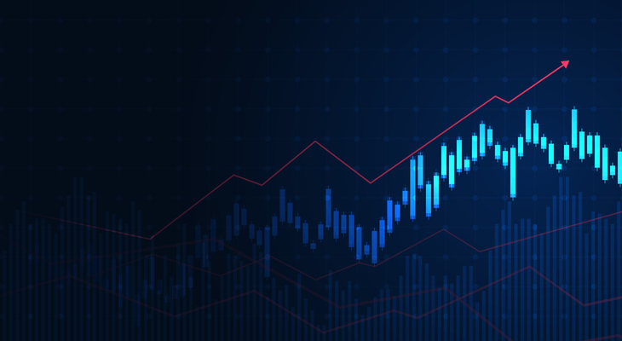
Introduction to Technical Analysis
Technical Analysis (TA) helps Investors to understand price movement based on historical data.
Three core pillars that guide every chart-based decision:
1. Time
2. Trend
3. Support & Resistance
Mastering these concepts enhances precision, risk control & confidence.

Slide 4

Why These Concepts Matter
Markets are dynamic, but price behaves in patterns
These tools help Investors:
1. Identify Directions
2. Proper Entries and Exits
3. Validate breakout & reversal signals
4. Manage risk effectively

Slide 5

Time - The Most Underestimated but most powerful concept in Techncal Analysis
Most investors and traders focus on price, indicators, or patterns…
But markets move in BOTH price and time.
If you understand when a move is likely to occur, your accuracy increases dramatically.
Time defines Market Phases
Accumulation
Mark up
Buyers accumulating stock quietly
uptrend starts after consolidation
Distribution
Mark down
Smart money or Big Players exit / profit booking done
Downtrend of stock begins

Slide 6
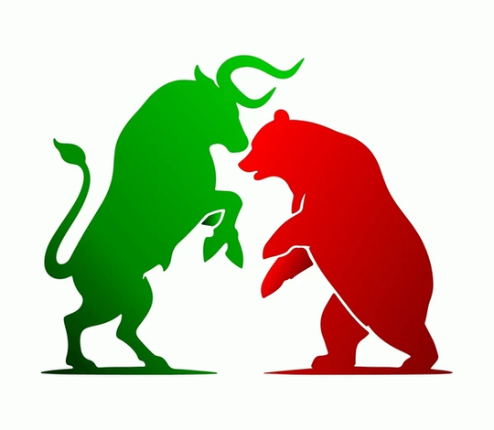
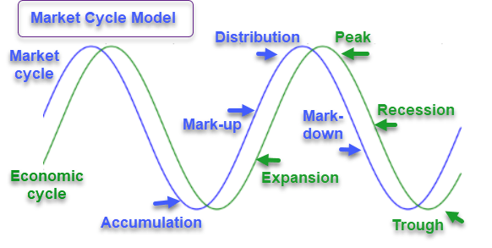


Time helps to identify Market cycles

Slide 7
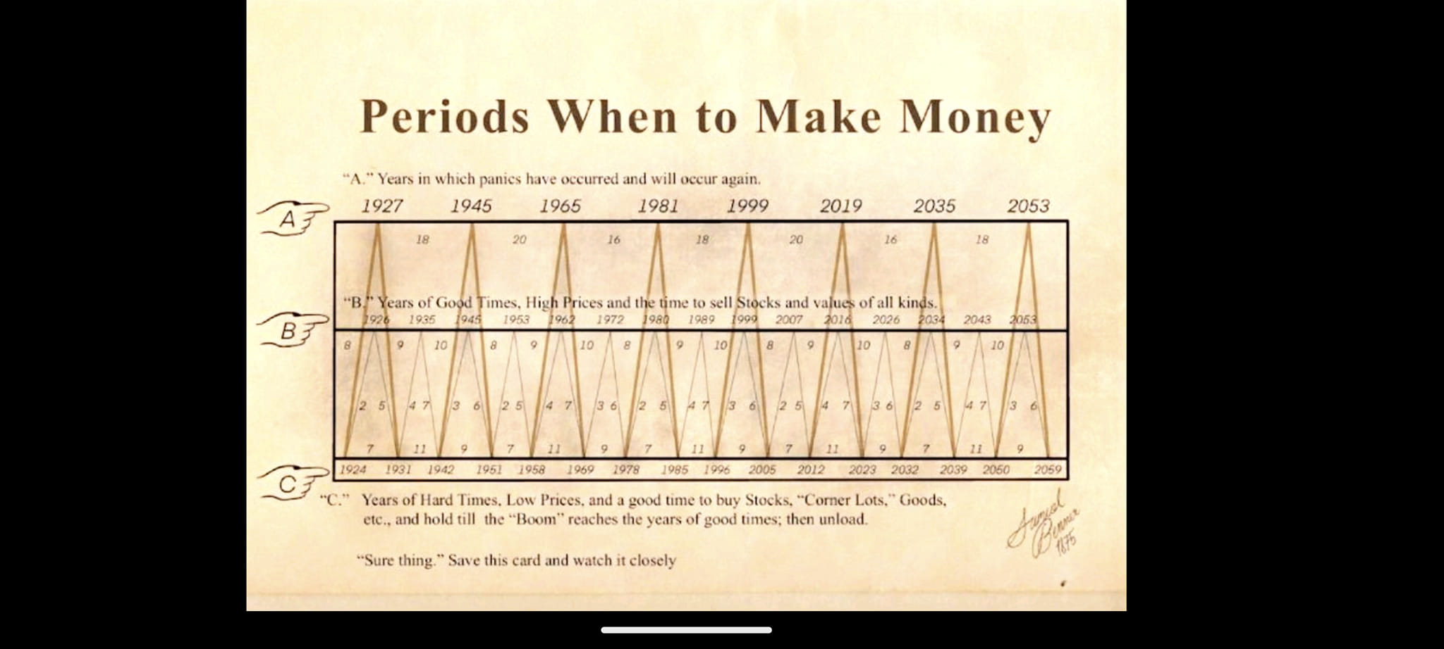
Time helps to identify Market cycles
Chart by Samuel Benner in 1875

Slide 8

Types of Timeframes
Long-Term:
Weekly, Monthly, Quaterly
Trend identification, major support/resistance
Medium Term:
Daily, weekly
Swing analysis, momentum study
Multi-Timeframe Analysis
Always analyze from Higher → Lower timeframe.
Higher timeframe = direction
Lower timeframe = entry trigger
Aligning both increases win-rate.

Slide 9
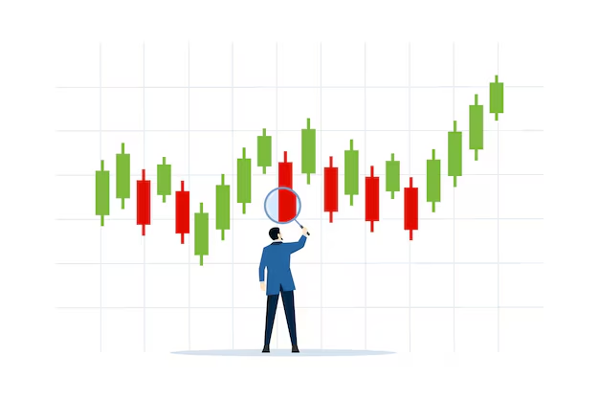
Trend - The Pulse of the Market
The Trend reveals the direction of the of price movement over a period of time in the market
Market moves in 3 ways
Uptrend - Buyers in control
Higher Highs (HH) & Higher Lows (HL)
Downtrend- Sellers in control
Lower Highs (LH) & Lower Lows (LL)
Sideways / Range bound - Neither dominant
Price consolidates in a range
How to Identify a Trend ?
Swing structure (HH, HL, LH, LL)
Trendlines
Moving averages
Market internal strength & volume

Slide 10

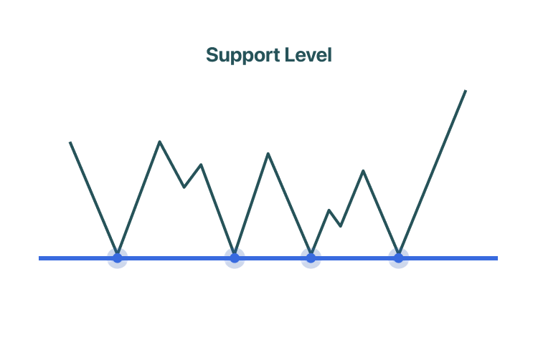
Support is a price zone where buying pressure exceeds selling pressure, causing price to pause, bounce, or reverse upward.
Think of it like a floor beneath the price.
Support forms due to human psychology + market structure:
A. Psychological Reasons
Traders remember previous reaction zones
Buyers see it as a “cheap price”
Sellers avoid selling at that zone
Big players accumulate silently
B. Market Mechanics
Limit-buy orders are stacked at certain prices
Profit-booking demand
Stop-loss clusters for short positions
Algorithms placing protective buy orders
Support

Slide 11

How to Identify Strong Support ?
A support zone is strong when:
✅ Price has reacted multiple times
✅ Reaction candles are strong (hammer, bullish engulfing)
✅ Comes with high volume
✅ Aligns with a higher timeframe level
✅ Confluence with indicators (MA, Fibo, trendline)
More confluences = stronger support.
Deep Dive into Support
How Price Behaves Around Support ?
Scenario A: Bounce
Price hits support → buyers defend → upmove begins
Ideal for trend continuation trades
Scenario B: Consolidation
Price stays at support for long
Indicates accumulation or weakening levels
Scenario C: Break of Support
When selling pressure becomes too high
Triggers stop-losses for longs
Creates fast downward moves

Slide 12

Support is a zone, not a guarantee.
Always begin with higher timeframe:
Monthly/Weekly: Major market floors
Daily: Reliable levels for swing
The Rule of Three:
A practical guideline:
Support tested 1 time – valid
Support tested 2 times – stronger
Support tested 3 times – weakening
Support tested 4+ times – high chance of break
Golden rules for Mastering Support:
⭐ Look for zone width, not a line
⭐ Use 2–3 confluence tools
⭐ Always wait for a reversal pattern
⭐ Respect the higher timeframe
⭐ Never buy just because “price is falling to support”
Patience + confirmation = profitable Investments
Deep Dive into Support

Slide 13
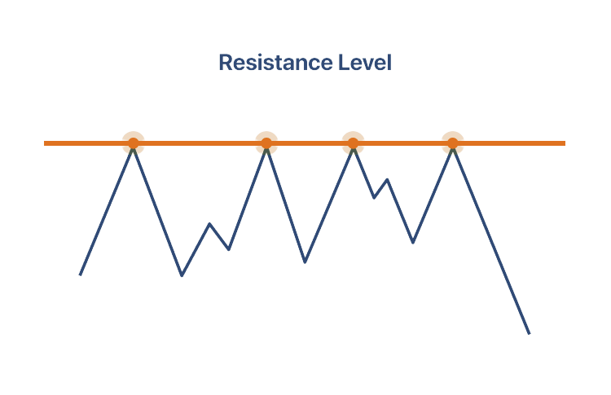
Resistance
Resistance is a price level where a stock tends to stop rising because selling pressure becomes stronger than buying pressure.
Investors expect many sellers to appear around this level, causing the price to struggle to break above it.
Why it matters ?
Helps identify potential sell or short points
Shows where upward momentum may slow or reverse
When resistance is broken, it can turn into new support,
often leading to a stronger upward move.
Simple example
If a stock keeps rising to around 400 but falls every time it hits that level, 400 is resistance.
Why Sellers Appear at Resistance
Profit-taking: Traders who bought at lower prices sell to lock in gains.
Previous buyers breaking even: Investors who bought earlier near the same price sell to recover losses.
Psychological numbers: Round numbers (like $100, $500, 20,000) often act as resistance.
Institutional algorithms: Many automated trading systems sell at known resistance zones.

Slide 14
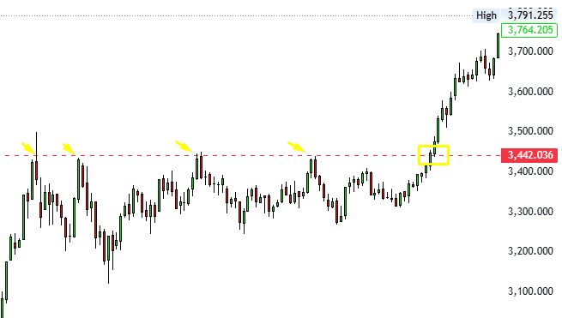
When Resistance Breaks
If buyers overpower sellers and price closes above resistance:
It can trigger a breakout.
The old resistance often becomes new support (called a “role reversal”).
Breakouts often lead to strong upward momentum because trapped sellers and momentum traders start buying.
How to Identify Strong Resistance
Resistance is stronger if:
The price rejects from that level multiple times
There’s high trading volume near the level
It aligns with other indicators (MA, Fibonacci, trendline)
It’s a round psychological number.

Slide 15
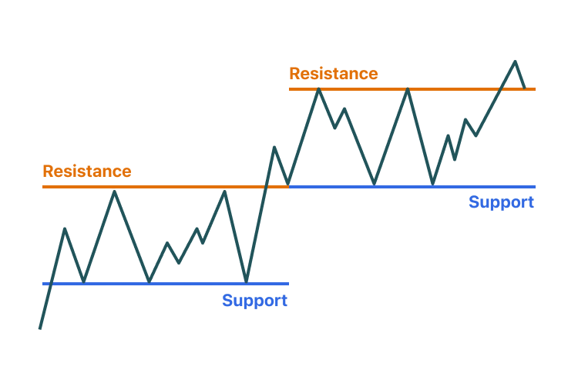
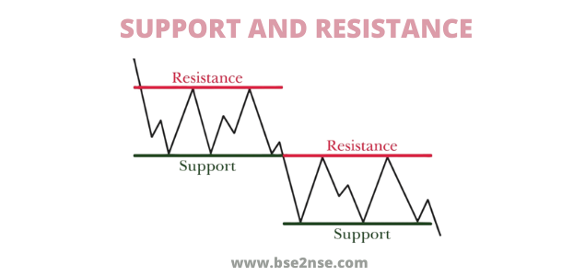
Support–Resistance Flip (Role Reversal)
1️⃣ Resistance becomes Support
When price breaks above a resistance level, that same level often becomes new support on a pullback.
Reason: Traders who missed the breakout buy the dip, and old sellers switch to buyers.
2️⃣ Support becomes Resistance
When price breaks below a support level, that level often becomes new resistance when price pulls back up.
Reason: Traders stuck in losing positions sell at break-even, and new sellers enter.
Why it happens
Market psychology + memory: buyers and sellers react to key levels the same way repeatedly.

Slide 16

How Time + Trend + SR Work Together
Check long-term trend – Market direction
Mark key support & resistance zones
Drop to smaller timeframe for precise entry
Enter on trend-following or breakout confirmation
Manage risk below support or above resistance
What Happens When All Three Align?
When Timeframe, Trend, and SR level all point to the same direction, you get:
✔ High probability setup
Because higher timeframe structure supports your trade.
✔ Low risk entry
Because SR gives a clear stop-loss zone.
✔ Clear target levels
Using the next SR zone.
✔ Strong confidence
Because you are trading with the market, not against it.

Slide 17
How Time + Trend + SR Work Together
Conclusion
Time Reveals Context:
Longer timeframes filter out noise and show where the market is in the broader cycle, helping investors understand true momentum and structure.
Trend Gives Direction:
Identifying major uptrends and downtrends guides investors toward high-probability opportunities and helps avoid capital-destroying phases.
Support & Resistance Guide Decisions:
Key price levels indicate where buying or selling pressure is likely to emerge, helping investors make disciplined entry, exit, and risk-management decisions.
Mastering These Fundamentals:
Combining time analysis, trend direction, and structural levels creates a consistent, repeatable framework—building the foundation for long-term, stable profitability.

Slide 18
Mastering These Fundamentals Builds the Foundation for Consistent Profitability
Mastering These Fundamentals Builds the Foundation for Consistent Profitability,Long-term consistency doesn’t come from predicting the future, but from recognizing high-probability conditions.
When investors combine:
Time analysis (context)
Trend alignment (direction)
Support & resistance structure (decision points)
…their decision-making becomes systematic, disciplined, and less vulnerable to emotional bias.
These principles form the backbone of a robust market framework—allowing investors to navigate volatility, manage risk intelligently, and compound returns over time.

Slide 19
Thank You
For your attention to this presentation.

