Slide 1
Faceless ASSESSMENT
Krupa R. Gandhi | November 16, 2025

Slide 2
Abbreviations
Ā | Assessee
AAS | Automated Allocation System
ACIT | Additional Commissioner of Income-tax
ADIT | Additional Director of Income-tax
AO | Assessing Officer
AR | Authorised Representative
Ast. CIT | Assistant Commissioner of Income-tax
Ast. DIT | Assistant Director of Income-tax
AU | Assessment Unit
CBDT | Central Board of Direct Taxes
CG | Central Government
CIT(A) | Commissioner (Appeals)
JCIT | Joint Commissioner of Income-tax
DDIT | Deputy Director of Income-tax
FA | Finance Act
FAS | Faceless Assessment Scheme
FAO | Faceless Assessing Officer
HC | High Court
ILDP | Income or Loss Determination Proposal
ITA | Income-Tax Authority
ITBA | Income Tax Business Application
ITO | Income Tax Officer
JAO | Jurisdictional Assessing Officer
JCIT | Joint Commissioner of Income-tax
JCIT(A) | Joint Commissioner of Income-tax (Appeals)
JDIT | Joint Director of Income-tax
LOA | Letter of Authority
NaFAC | National Faceless Assessment Centre
New Act | Income Tax Act, 2025
Old Act | Income Tax Act, 1961
Pr. CIT | Principal Commissioner of Income-tax
Pr. CCIT | Principal Chief Commissioner of Income-tax
Pr. DGIT | Principal Director General of Income-tax
RU | Review Unit
SC | Supreme Court
SCN | Show Cause Notice
SLP | Special Leave Petition
SOP | Standard Operating Procedure
TOLA | Taxation and Other Laws (Relaxation & Amendment of Certain Provisions) Act, 2020
TU | Technical Unit
VC | Video Conference
VU | Verification Unit

Slide 3
Evolution from “E-MAIL BASED PROCEEDINGS” to
“E-PROCEEDINGS ON ITBA PLATFORM” to “FACELESS REGIME”
CBDT migrates to e-Proceeding facility on ITBA platform in the 7 metro cities, giving taxpayers 'opt-out' choice
CBDT mandates e-Proceeding for all assessments during 2018-19 with certain exceptions search cases, international taxation cases, etc.
S. 143, 250 and 274 amended to expand scope of e-assessment, to make CIT(A) and penalty proceedings faceless
Faceless Assessments u/s 144B kicks in (later substituted by FA 2022 w.e.f 01.04.2022)
CG introduced Faceless Appeal Scheme, 2020,
Oct 2015
Feb 2018
Sep 2019
Aug 2020
Jan 2021
Dec 2021
CBDT took 1st step towards paperless assessment.
E-mail based communication scheme introduced for assessment in few metro cities
Sept 2017
Sub-sections (3A), 3(B) and 3(C) inserted u/s 143 to notify a new scheme of faceless and paperless assessment
Aug 2018
CG introduced e-Assessment Scheme, 2019
FA 2020
E-assessment Scheme renamed as Faceless Assessment Scheme, 2019
Sep 2020
CG introduced Faceless Penalty Scheme 2021 (later amended in May 2022)
April 2021
CBDT introduced Faceless Appeal Scheme, 2021

Slide 4
SCHEMES NOTIFIED under faceless regime [old act]
1
2
3
4
5
6
Faceless Assessment Scheme, 2021
Now codified u/s 144B for faceless assessments u/s
143(3), 144 & 147
Faceless Appeal Scheme, 2021
Disposal of appeals by CIT(A) [S. 250]
Faceless Penalty Scheme, 2021
Imposition of penalty
[S. 274]
e-Assessment of Income Escaping Assessment Scheme, 2022
Reassessment u/s 147, 148, 148A r.w. S. 151 & 151A
e-Settlement Scheme, 2021
Settlement of cases
[S. 245D]
e-Dispute Resolution Scheme, 2022
Dispute resolution in cases specified u/chp XIX-AA
[S. 245MA]
7
8
9
10
11
e-Advance Rulings Scheme, 2022
Faceless advance rulings
[S. 245R]
Faceless Inquiry or Valuation Scheme, 2022
Faceless inquiry or valuation
[S. 142B]
e-Verification Scheme, 2021
Faceless calling for information u/s 133 [S.135A]
e-Appeals Scheme, 2023
Faceless disposal of appeals by JCIT(A)
[S. 246A]
Faceless Jurisdiction of Income-tax Authorities Scheme, 2022
Jurisdiction of Income Tax authorities
[S. 130]

Slide 5










Schemes not yet notified under faceless regime [old act]
Faceless determination of arm’s length price [S. 92CA]
Faceless issuance of directions by the dispute resolution panel [S. 144C]
Faceless appeal to ITAT [S. 253]
Faceless disposal of appeals by Appellate Tribunal [S. 255]
Faceless revision of orders u/s 263 or 264 [S.264(A)]*
Faceless rectification, amendments and issuance of notice or intimation [S. 157A]*
Faceless effect of orders [S. 264B]*
Faceless collection and recovery of tax​ [S. 231]*
Faceless sanction for prosecution / compounding of offence [S. 279]*
Faceless approval or registration [S. 293D]*
* Time limit for issuing directios by CG for the purpose of giving effect to the schemes ended on 31.03.2022

Slide 6
Section 273 | faceless assessment
Overview of S. 273 of the Income Tax Act 2025
Scope
Applicability
Centre and Units
Irrespective of anything contrary contained in any other provisions of the Act, the assessment, re-assessment or re-computation u/s 270(1), 271 or 279 shall be made in a faceless manner as per procedure as may be prescribed.
Territorial area
Persons or class of persons
Incomes or class of incomes
Cases or class of cases
as may be specified.
National Faceless Assessment Centre
Assessment Units
Verification Units
Technical Units
Review Units
S. 273(3)
S. 273(2)
S. 273(1)
Notes:
Sec 273-corresponds to sec 144B of the old Act.
Sec 270(1)-Corresponds to sec 143(1)(a) of the old Act
Sec 271-Corresponds to sec 144 of the old Act
Sec 279-Corresponds to sec 147 of the old Act.

Slide 7
Section 273 | faceless assessment
Functions of Centre and Units
NaFAC
AU
VU
Facilitate conduct of faceless assessment proceedings.
Assign case to AU
Intimate Ā about completion of Assessment in a faceless manner.
Serve notice to Ā u/s 268(1) or 270(8).
Forward response of Ā to AU.
Conduct faceless assessment.
Analysis of material furnished for making assessment.
Identify issues and seek information
Determine any variation prejudicial to Ā
Such other functions.
Perform function of verification that includes enquiry, cross verification, examination of books of account, examination of witnesses and recording of statements.
Such other functions.
S. 273(3)(c)
S. 273(3)(a)
S. 273(3)(b)
Notes:
Sec 270(8)- Corresponds to sec 143(2) of the old Act
Sec 268(1)- Corresponds to sec 142(1) of the Old Act

Slide 8
Section 273 | faceless assessment
Functions of Centre and Units
TU
RU
Powers of units
Provide technical assistance
Assistance or advice on legal, accounting, forensic, information technology, valuation, transfer pricing, data analytics, management or any other technical matter
Review of any variation proposed by AU (if considered necessary by NaFAC).
Check whether relevant & material evidence brought on record
Check whether relevant points of facts and law incorporated
Check whether the issues requiring addition or disallowance have been incorporated.
Such other functions.
AU, VU, TU and RU AO
Powers shall be assigned by CBDT.
S. 273(5)
S. 273(3)(d)
S. 273(3)(e)

Slide 9
Section 273 | faceless assessment
Procedure for faceless assessment
As may be prescribed. [S. 273(1)]
S. 273(4): In accordance with the procedure as may be prescribed u/s 273(1):
VU, TU and RU shall facilitate conduct of faceless assessment.
AU shall make assessment of total income/loss by an order in writing after considering all material gathered and giving opportunity of being heard to the Ā.
Determine sum payable/refundable on the basis of assessment.
The New Act has not prescribed any procedure for conducting the assessment, re-assessment or re-computation proceedings in a faceless manner till date. However, a detailed procedure was prescribed u/s 144B of the Old Act.

Slide 10

Section 144B(1) | FACELESS ASSESSMENT PROCEDURE
S. 144B(1)(i)
S. 144B(1)(ii)
S. 144B(1)(iii):
NaFAC to assign the case selected for Faceless assessment to AU through AAS
NaFAC to intimate Ā that his assessment shall be completed u/s 144B
Notice u/s 143(2)/142(1) to be served through NaFAC and Ā to file response within the date specified in notice, and such response to be forwarded to AU
S. 144B(1)(iv): AU may request NaFAC for
Obtaining further information/ documents from Ā and/or other person
S. 144B(1)(iv)(c)
S. 144B(1)(iv)(a)
S. 144B(1)(iv)(b)
Conducting enquiry by VU
Seeking technical assistance from TU [arm’s length, property valuation, registration/ approval/ exemption withdrawal]
If no response
AU to serve SCN u/s 144 through NaFAC for best judgement assessment
S. 144B(1)(viii)
S. 144B(1)(ix)
NaFAC to intimate failure to AU
S. 144B(1)(v)
S. 144B(1)(vi)(a)
NaFAC obtains information/documents from the Ā and/or any other person within the prescribed time and transmits the response to the AU
NaFAC to assign request to VU through AAS
NaFAC to assign request to TU through AAS
S. 144B(1)(vi)(b)
S. 144B(1)(x)
S. 144B(1)(xi)
Ā to file response to NaFAC within specified time and the same to be forwarded to AU
NaFAC to intimate failure to AU
If no response
Report received from VU and TU by NaFAC to be forwarded to concerned AU
AU
S. 144B(1)(vii)
If response received

Slide 11
Section 144B(1) | FACELESS ASSESSMENT PROCEDURE
AU
S. 144B(1)(xii)
After considering all material available on record, AU to prepare ILDP
S. 144B(1)(xx)
AU to send draft order to NaFAC
CONT’D
Is Variation in ILDP prejudicial to Ā?
S. 144B(1)(xix)
AU may accept/ reject modifications proposed in review report and after recording reasons for rejection, prepare a draft order
Yes
No
AU to send copy of ILDP to NaFAC
S. 144B(1)(xii)(b)
S. 144B(1)(xii)(a)
Issue stating variations prejudicial through SCN through NaFAC
S. 144B(1)(xvi)(a)
Convey AU to prepare draft order in accordance with ILDP and AU shall prepare draft order; or
NaFAC to send such review report to the same AU, which had proposed the ILDP
S. 144B(1)(xvii)
Upon receipt of ILDP, based on CBDT guidelines, NaFAC can either
S. 144B(1)(xiii)
S. 144B(1)(xvi)
Ā to file response to NaFAC who shall forward to AU
If no response
If response received
S. 144B(1)(xvii)
RU to conduct review of ILDP and send review report to NaFAC
NaFAC to intimate failure to AU
S. 144B(1)(xv)
S. 144B(1)(xvi)(b)
S. 144B(1)(xiv)
Taking into consideration all relevant material, AU to prepare ILDP and send to NaFAC
Assign ILDP to RU through AAS

Slide 12

Section 144B(1) | FACELESS ASSESSMENT PROCEDURE
S. 144B(1)(xxiii):
Whether the draft order has been passed in case of an eligible Ā under 144C(1)?
NaFAC to convey AU to pass final assessment as per draft order. AU to pass final order and initiate penalty proceeding, if any and send to NaFAC
NaFAC to serve final assessment order and penalty, demand notice, refund notice to Ā
S. 144B(1)(xxi)
S. 144B(1)(xxii):
CONT’D
No
Yes
No
S. 144B(1)(xxi)
NaFAC to serve draft order on such Ā
Whether any variation proposed in the draft order is prejudicial to the interest of the eligible Ā?
S. 144B(1)(xxxii):
AU having regard to nature, complexity, volume, doubts about correctness, multiplicity in transaction in accounts, specialized nature of business activity and interest of revenue refer to NaFAC to invoke S. 142(2A)
Yes
S.144B(1)(xxv)/(xxvi)/(xxx):
S. 144B(1)(xxxi):
NaFAC to intimate AU to finalise assessment within time allowed u/s 144C(4), initiate penalty and send final assessment order, refund notice to NaFAC, which will further serve it to the Ā
NaFAC, after completion of assessment, transfer all electronic records to JAO
S. 144B(1)(xxiv)(a)
Ā to file acceptance to NaFAC
Yes
Where no objections received within time specified u/s 144C(2)
If eligible Ā accept Variations proposed in the draft order?
S. 144B(1)(xxiv)
NaFAC to intimate AU, forward DRP directions issued u/s 144C(5) to AU and AU to complete assessment in conformity with DRP directions within time limit u/s 144C(13), initiate penalty, if any and send a copy of final assessment order to NaFAC, which will further serve it to the Ā
S. 144B(1)(xxvii)/(xxviii)/(xxix)/(xxx)
S. 144B(1)(xxiv)(b)
Where Ā files objections with DRP and NaFAC within the period specified u/s 144C(2)
No
Notes:
144C(2)- time to file objections – 30 days from date of receipt of draft order
144C(4)- draft order to be passed within 1 month from the end of the month in which acceptance is recd or time to file objections expires.
144C(13)- AO to pass final order within 1 month from the end of the month in which DRP directions recd.

Slide 13
Section 273 | faceless assessment
Composition of Units
Assessment Unit
(a) ACIT / ADIT / JCIT / JDIT
(b) DCIT / DDIT / Ast. CIT / Ast. DIT / ITO
(c) Such other income-tax authority, ministerial staff, executive or consultant, as may be considered necessary by the Board.
Verification Unit
S. 273(6)
Technical Unit
Review Unit

Slide 14




Section 273 | faceless assessment
S. 273(7): Communication among the units/ Assessee/ Any other person
Assessment Unit
Verification Unit
Technical Unit
NaFAC
TAXPAYER
Review Unit
S. 273(8): S. 273(7) shall not apply to enquiry or verification conducted by VU in circumstances as specified by CBDT.

Slide 15
Section 273 | faceless assessment
S. 273(9), 273(10) and 273(11): Invoking the provisions of S. 268(5)
AU makes reference for invoking provisions of S. 268(5)
Pr. CCIT/ Pr. DGIT in-charge of NaFAC
Forward reference received from AU to Pr. CCIT/ Pr. DGIT having jurisdiction over the case.
S. 273(9)
S. 273(9)(a)
Transfer case to AO having jurisdiction over the case as per S. 273(12) for invoking S. 268(5).
S. 273(9)(b)/(10)
S. 268(5) should not be invoked
S. 268(5) should be invoked
Reference not forwarded.
S. 273(11)
AU shall proceed to complete assessment as per procedure laid down.
S. 273(11)
Notes:
Sec 268(5)- Corresponds to sec 142(2A)- special audit

Slide 16
Section 273 | faceless assessment
S. 273(12): Special power to Pr. CCIT/ Pr. DGIT (in charge of NaFAC) to transfer the case to jurisdictional AO with prior approval of CBDT.
S. 273(13): Definition of various terms
(a) Designated portal: Web portal designated by Pr. CCIT/ Pr. DGIT (in charge of NaFAC)
(b) Faceless assessment: Assessment proceedings conducted electronically in “E- Proceeding” facility of Assessee.
(c) Registered account: E-filing account of Assessee in the designated portal.

Slide 17
Section 273 v/s Section 144B
Structural Similarities
Broad Difference
Both provisions start with an overriding clause making faceless assessment a default scheme and not optional.
Both provisions empower CBDT to specify coverage by area, person, income or case.
Both provisions establish a central authority (NaFAC) and multiple functional units.
Both provisions prescribe exclusive electronic communication, except for specified enquiry/verification.
Both provisions allow for transfer of cases out of the faceless regime with prior approval of CBDT.
Absence of detailed procedure u/s 273:
S. 144B(1) and S. 144B(6) laid down a detailed procedure under 32 clauses and 11 clauses respectively for faceless assessment. However, S. 273 provides a more compact framework, empowering CBDT to prescribe the procedure for faceless assessment by rules.
Removal of certain definitions u/s 273.
Removal of Proviso to S. 144B(3)(iii) u/s 273(3):
[ Under above proviso- functions of VU can be performed by a VU any other faceless centre].

Slide 18
Faceless re-assessment proceedings
S. 151A (Old Act)
S. 151A of the Act provides for issuance of notice u/s 148 of the Act and conducting the entire re-assessment proceedings in a faceless manner.
[E-Assessment of Income Escaping Assessment Scheme 2022 vide notification no. 1466(E) dated March 29, 2022]
Omission of corresponding section
The New Act does not contain any corresponding section for conducting the re-assessment proceedings in a faceless manner.
However, S. 532 of the New Act empowers to CBDT to frame schemes.

Slide 19

Faceless re-assessment proceedings (CONT’D)
FACELESS AT WHAT STAGE(S)?
S. 148A Process and Issuance of Notice u/s 148
Issuance of Notice u/s 148 & Reassessment u/s 147
Only Reassessment u/s 147
S. 151A
of the Act
e-Assessment of Income Escaping Assessment Scheme, 2022
S. 144B of the Act
Scope of the Scheme
3. For the purpose of this Scheme,––
(a) assessment, reassessment or re-computation u/s 147 of the Act,
(b) issuance of notice u/s 148 of the Act,
shall be through automated allocation, in accordance with risk management strategy formulated by the Board as referred to in S. 148 for issuance of notice, and in a faceless manner, to the extent provided in section 144B of the Act with reference to making assessment or reassessment of total income or loss of Ā
Empowers CG to notify the scheme for re-assessment and procedures u/s 147, 148, 148A and 151
Faceless Assessment – Refer to only reassessment u/s 147

Slide 20



Litigation under Faceless Regime
Opportunity of Personal Hearing via VC
01
Opportunity of VC not granted
01
Opportunity of Personal Hearing via VC
01
02
Technical glitches in VC
Litigation under
Faceless Regime
02
Technical glitches in VC
02
Technical glitches in VC
03
Technical glitches on E-filing portal
03
Technical glitches in uploading response on portal
03
Technical glitches in uploading response on portal
04
Submissions not considered / non-application of mind
04
No SCN before Final Assessment Order
04
No SCN before Final Assessment Order
05
No SCN / Draft Assessment Order
Reply filed by Ā not considered before passing final order
05
Reply filed by Ā not considered before passing final order
05
Insufficient time provided to reply to SCN
06
Addition made beyond issue listed in SCN
06
Addition made beyond issue listed in SCN
07
Addition made beyond issue listed in SCN
06
08
JAO vs. FAO
07
Insufficient time provided to reply to SCN
07
Insufficient time provided to reply to SCN
Litigation under
Faceless Regime
09
Others
08
Others
08
Others
FACELESS ASSESSMENT KRUPA R. GANDHI | BANSI S. MEHTA & CO.
FACELESS ASSESSMENT KRUPA R. GANDHI | BANSI S. MEHTA & CO.
November 16, 2025
November 16, 2025
20
20
This Photo by Unknown Author is licensed under CC BY
This Photo by Unknown Author is licensed under CC BY
This Photo by Unknown Author is licensed under CC BY

Slide 21
Opportunity of VC not granted
Piramal Enterprises Ltd. vs. Addnl CIT [2021] 129 taxmann.com 18 (Bom HC)
Tyger Capital (P.) Ltd. vs. AU [2025] 177 taxmann.com 100 (Guj HC)
Siddharth Maneklal Patel vs. NeAC [2025] 179 taxmann.com 263 (Guj HC)
Principles of Natural Justice firmly run through the fabric of S. 144B(1).
Thus, when request for personal hearing was made but no opportunity was given, assessment was not made as per S. 144B and was to be set aside.
If Ā is not granted mandatory requirement of VC, it would amount to breach of principles of natural justice (Reliance placed on SOP dated August 03, 2022).
Order quashed and set aside.
Order was passed without providing opportunity for VC.
The impugned order passed was in clear breach and violation of natural justice.
D. B. Engineering Pvt. Ltd. v. NaFAC [2023] 147 taxmann.com 472 (Del HC)
Shiva Texyarn Ltd vs. AU [2025] 174 taxmann.com 850 (Mad. HC)
Wherever variation is proposed in the ILDP, the proposition that personal hearing if sought by the Ā, is required to be granted, is no longer res-integra.
Thus, where personal hearing was sought, assessment order passed without granting the same due to paucity of time, was to be set aside.
Personal hearing through VC was granted to Ā.
Ā was present at the time of VC, however, no one appeared for revenue.
Ā again requested for VC. However, order was passed without providing VC.
On appeal, order was quashed and set aside.

Slide 22






Technical glitches in vc
Rajdhani Textiles vs. NaFAC 2023] 156 taxmann.com 362 (Guj HC)
Dr. K. R. Shroff vs. Addnl CIT [2022] 444 ITR 354 (Guj HC)
VC scheduled twice but meeting could not be initiated owing to technical glitches
VC got abruptly terminated due to technical glitch and Ā was able to make only partial submissions
Atulbhai Kantilal Mehta vs, Addnl CIT [2023] 450 ITR 660 (Guj HC)
Fifth Field Rs. ACIT, NeAC [2022] 445 ITR 494 (Mad HC)
Leela Trade Link vs. NaFAC [2023] 156 taxmann.com 50 (Guj HC)
Due to technical glitches, hearing as scheduled could not be conducted.
Hyper-link for VC could not be opened
Ā used chat-box to communicate due to technical issues with audio and no VC was effectively conducted
The AO in all the above cases proceeded to pass final assessment order. Orders quashed and set aside since prescribed procedure u/s 144B not followed and no effective opportunity of personal hearing given.

Slide 23
Technical glitches on E-filing portal
Chandrasekaran Ragupati
vs. CBDT [2022] 138 taxmann.com 126 (Mad. HC)
SP Developers vs. Addnl CIT [2023] 149 taxmann.com 158 (Guj. HC)
Yogesh Bansal [2024] 159 taxmann.com 308 (Del. HC)
Ā could not upload documents and file reply to SCN due to technical glitches in the web portal. AO proceeded to pass final assessment order
AO directed to issue fresh notice and provide fresh opportunity to Ā to reply and file documents
Ā did not have access to notice u/s. 142(1) and speaking order disposing objections on the web portal. Ā received the assessment order by email.
Proceedings quashed / remanded from the stage of issue of notice.
Notice u/s. 143(2) was not served on Ā but directed to the email of erstwhile CA. The assessment order was not available on the portal.
AO directed to activate web portal so that Ā can upload replies to the notices issued.

Slide 24
Technical glitches on E-filing portal (CONT’D)
I Money Wallet Pvt. Ltd. v. NaFAC [2023] 146 taxmann.com 211 (Del HC)
Shri Venkatesh Refineries Ltd. v. DCIT [2023] 153 taxmann.com 289 (Bom HC)
Alleppey Sarvodaya Sangh [2025] 176 taxmann.com 996 (Kerala HC)
Ā failed to file response to SCN, due to a technical error in portal which showed that the response page had been closed
Revenue directed to open portal for Ā to file response since last date to pass assessment order was 30.09.2022
Ā sought adjournment request and then attempted to upload reply but portal window was closed
Since department neither accepted nor rejected request of Ā, it was directed to open window to enable Ā to upload documents
Some delay occurred w.r.t. a reply to notice but was submitted before passing the order.
AO order passed without considering the reply due to technical reason.
Matter remanded for fresh decision.

Slide 25
SUBMISSIONS NOT CONSIDERED / NON-APPLICATION OF MIND
Pankaj v. NeAC
[2022] 441 ITR 502 (Bom. HC)
Vijay Thakkar vs. NFAC [2025] 179 taxmann.com 201 (Guj. HC)
01
06
Raja Builders v. NaFAC
[2021] 280 Taxman 304 (Bom. HC)
Where Ā have submitted a detailed response, however the AO without considering the same, passes non-speaking order without application of mind, the order so passed needs to be set aside
Srigandha Souhardha Credit Co-op. Ltd. v. UOI [2023] 146 taxmann.com 167 (Kar. HC)
02
07
New Globe Logistik LLP vs. ACIT [2025] 177 taxmann.com 176 (Bom. HC)
Laxmanbhai Amarsingh Chavda vs. Assessment Unit [2025] 178 taxmann.com 284 (Guj. HC)
03
08
KBB Nuts (P.) Ltd. v. NaFAC
[2021] 435 ITR 622 (Del. HC)
Periyadurai Sadayappan vs. ITO [2025] 175 taxmann.com 1009 (Mad. HC)
04
09
Hasmukhbhai Girdharilal Chopra vs. NFAC [2025] 174 taxmann.com 379 (Guj. HC)
Rajkamal Agro Industries vs. NFAC [2025] 179 taxmann.com 621 (Guj. HC)
05
10

Slide 26
NO SCN / Draft Assessment Order
Barentz India (P.) Ltd vs. NaaFAC [2025] 179 taxmann.com 582 (Bom. HC)
Tulsidas Khimji (P.) Ltd. vs. ACIT [2025] 176 taxmann.com 696 (Bom. HC)
Toplight Corporate Management v. NaFAC [2021] 281 Taxman 451 (Del. HC)
Where AO passes the final assessment order without issuance of SCN/draft order, the order so passed needs to be quashed and set aside.
Magadh Sugar & Energy Ltd. v. AU [2023] 454 ITR 405 (Del. HC)
Saurabh Rohitbhai Modi HUF vs. NaFAC [2025] 171 taxmann.com 806 (Guj. HC)

Slide 27
Insufficient time provided to reply to scn
Where Ā was given 4 days (including Saturday and Sunday) to reply to SCN cum draft assessment order – order set aside and matter was remanded back as only 2 working days effectively provided
Urdu Education Society v. NaFAC [2022] 145 taxmann.com 11 (Bom HC)
Parag Kishorchandra Shah v. NaFAC [W.P. NO.11052 of 2021 (Bom HC)]
Where Ā was given 2 days to reply to SCN as assessment was getting time barred – order set aside and AO was to pay costs
Where AO issued SCN based on information that Ā had given huge unsecured loans and thereafter, made addition under section 69B, since insufficient time of just 1 day was granted to
Ā to respond to SCN, impugned order was in violation of principles of natural justice and matter was to be remanded back to pass fresh order
Magadh Sugar & Energy Ltd. v. AU [2023] 454 ITR 405 (Del. HC)
Vibgyor Vinimay (P.) Ltd. vs. NaFAC [2025] 175 taxmann.com 643 (Bombay HC)
Where Ā was given 5 days (including Saturday, Sunday and Holiday) to reply to SCN – order set aside and matter was remanded back as only 48 hours effectively provided
Green Valliey Industries v. AU [2023] 147 taxmann.com 295 (Cal HC)

Slide 28
Insufficient time provided to reply to scn (CONT’D)
Where Faceless Assessment Unit issued SCN granting merely four days to Ā to upload voluminous documents for compliance, since as per SOP under Faceless Assessment provisions, seven days' time from issue of SCN had been stipulated, there was violation of principles of natural justice and impugned assessment order was to be set aside.
Bijaya Kumar Panda vs. CBDT [2025] 176 taxmann.com 469 (Orissa HC)
Where Ā was given only 4 days to reply to SCN in reassessment, contrary to CBDT SOP mandating 7 days, there had been a flagrant violation of principles of natural justice and, thus, matter was to be remitted to Faceless AU for fresh adjudication
Ramshankar Mahapatra vs. CBDT [2025] 177 taxmann.com 329 (Orissa HC.)
Where department issued a second notice to Ā on 13-3-2025, seeking response by 17:00 hours of 15-3-2025 i.e. within two days, which was a very short time for filing response particularly as date of 14-3-2025 was declared as holiday on occasion of Holi festival, since no reasonable opportunity had been given to Ā, impugned assessment order passed was to be set aside
Magadh Sugar & Energy Ltd. v. AU [2023] 454 ITR 405 (Del. HC)
Magadh Sugar Ramesh Kumar Jain vs. CIT [2025] 176 taxmann.com 72 (Chhattisgarh HC)
Where a SCN was issued to Ā allowing only four effective days to respond, contrary to department’s SOP mandating seven days, SCN and impugned assessment order passed on basis of said SCN were to be quashed and set aside and matter remitted back to authority concerned to permit Ā to file a detailed response within a period of seven days
Sri Lakshmi Narasimha Swamy Vari Devasthanam vs. AU 2025] 176 taxmann.com 341 (Tel. HC)

Slide 29
Additions made beyond issues listed in scn
Acme Housing India (P.) Ltd. v. NaFAC [2023] 146 taxmann.com 286 (Bom HC)
Margita Infra v. NeAC [2023] 458 ITR 101 (Guj HC)
AO after passing draft assessment order raised a query by issuing notice u/s. 142. Since the draft assessment order was silent on the said query, final assessment order was to be quashed. The matter was remanded back to NaFAC for passing orders in compliance with S. 144B.
Where department made an addition fifty times more as compared to that proposed under SCN and rejected the books of account as well as failed to give VC opportunity, the assessment order and demand notice to be quashed and set aside giving the permission to the department to issue a fresh show cause notice
PCIT v. Woco Motherson Advanced Rubber Technologies Ltd [2018] 406 ITR 375 (Guj HC)
AO made disallowance additionally to what was proposed in the draft assessment order, disallowance so made was to be deleted

Slide 30
JAO v/s FAO
Important findings:
Hexaware Technologies Ltd. vs. ACIT[2024] 464 ITR 430 (Bom. HC)
No question of concurrent jurisdiction of both FAO and JAO for issuance of notice u/s 148.
The Scheme dated March 29, 2022 is mandatory and not optional.
The scheme provides issuance of notice through AAS.
Only FAO can issue 148 notice and not JAO.
Recent developments:
SLP filed by Revenue is pending before the Hon’ble Apex Court.
Everest Kanto Cylinder Ltd. [2024] 473 ITR 148 (Bom. HC) – Followed the decision of Hexaware Technologies Ltd. [2024] 464 ITR 430 (Bom. HC) and held the notices issued u/s 148A(b) and 148 as illegal and invalid.

Slide 31
JAO vs. fao (CONT’D)
Notices issued u/s 148A(b) and 148 by JAO are invalid and liable to be quashed.
01
ADIT (Int Tax) vs. Deepanjan Roy (Diary no. 33956/2025) (SC)
JD Printers (P.) Ltd. vs. ITO [2024]
166 taxmann.com 321 (Bombay HC)
06
02
Macleods Pharmaceuticals Ltd. vs. ACIT [2024]
166 taxmann.com 284 (Bombay HC)
Gurjinder Singh vs. CBDT [2025]
170 taxmann.com 747 (P & H HC)
07
03
Royal Bitumen (P.) Ltd. vs. ACIT
[2024] 164 taxmann.com 606 (Bombay HC)
Bhartiya Spinners vs. Union of India [2024]
166 taxmann.com 587 (P & H HC)
08
04
Sundaram Multi Pap Ltd. vs. ACIT [2024] 164 taxmann.com 608 (Bombay HC)
Ashwani Kumar Bhatia vs. UOI [2024] 169 taxmann.com 74 (Punjab & Haryana HC)
09
05
Venus Jewel vs. ACIT [2024]
164 taxmann.com 414 (Bombay HC)
Om Satya Overseas vs. Union of India [2025]
178 taxmann.com 137 (P & H HC)
10

Slide 32
others
Ā applied for VC and request was accepted. However, no VC link was provided to the Ā. In such a case, assessment order was set aside and remanded back.
Phari Projects (P.) Ltd. [2024] 165 taxmann.com 116 (Cal. HC)
2 SCN’s were issued to the Ā. However, it was not received by the Ā. AO passed the order in absence of any reply from Ā. On writ, the impugned order was quashed and set aside.
Sunil Kishanchand Andani vs. AU [2025] 170 taxmann.com 126 (Guj HC)
No notice was issued before making huge additions as no e-mail address was registered in PAN database. HC held that SOP issued by the CBDT to be followed and notice was to be served physically upon Ā
Fayeza Muffadal Contractor vs. NaFAC[2024] 296 Taxman 164 (Bom HC)
Notices issued u/s 143(2) by Addl. Commissioner, NaFAC instead of jurisdictional Assessing Officer to Ā under Central Charge were valid
Aadarsh Developers vs, DCIT[2024] 158 taxmann.com 81 (Kar HC)

Slide 33


Practical issues in faceless assessment

Slide 34

PRACTICAL ISSUES
01. DYNAMIC JURISDICTION
02. ADDITIONAL CLAIMS BEFORE AO
Against the faceless assessment order, the Ā can make rectification application u/s 154, application for stay of demand, etc. with the AO as records transferred by NaFAC to JAO
Ā can file limited replies on questions raised in scrutiny assessment. Usually, additional claims are also filed by the in the Ā in the same window
If Ā’s case is not picked up for scrutiny assessment, the Ā may be barred from making any fresh claims. Unlike physical scrutiny, difficult to put forward additional claim
Can the jurisdictional AO rectify mistakes apparent on records, which are made by the AO under NaFAC?
CBDT Circular No. 14 (XL-35), dated 11-4-1955: AO may grant reliefs/refunds suo moto or can do so on being pointed out by the Ā in the course of assessment proceedings
Two minds working on same issue may lead to absurdity. Also, probability of JAO rectifying mistake in order passed by NaFAC is questionable?

Slide 35
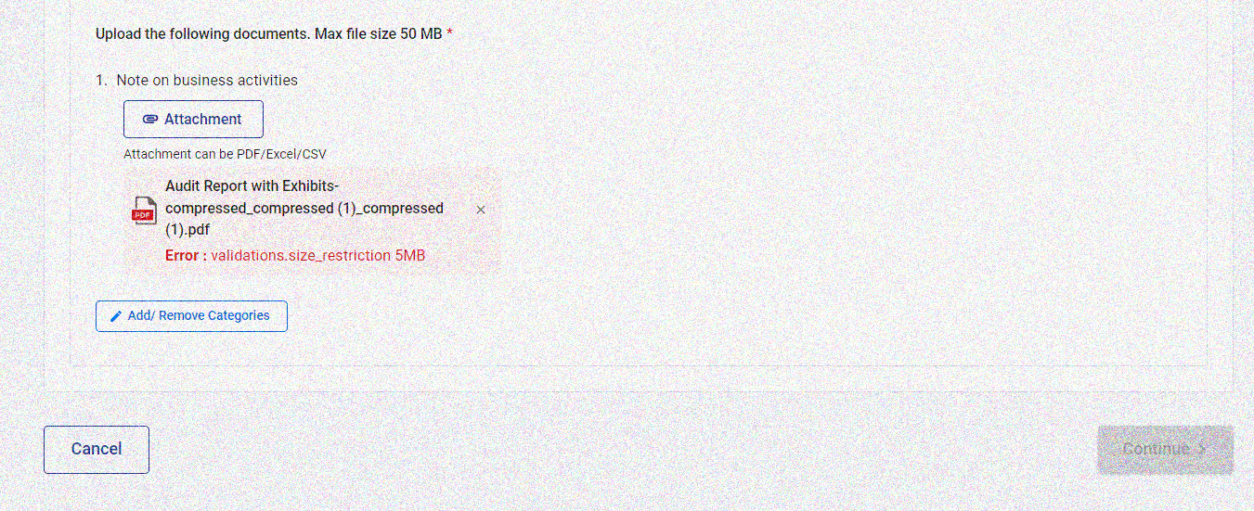
PRACTICAL ISSUES
03. RESTRICTIONS IN UPLOADING RESPONSE
Points to be noted:
Unable to upload big files
File unable to upload due to invalid name
Compressed files lead to poor quality
Individual file size <5mb and total size <50mb
If data size is large, upload data as partial response
File name should not contain space or special characters other than hyphen and underscore
Attachment can be PDF/ Excel / CSV
Scan clarity to be atl east 300 DPI

Slide 36
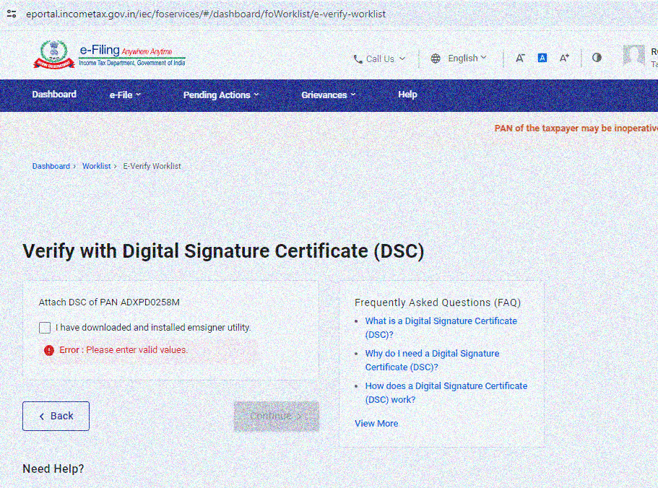
PRACTICAL ISSUES
04. ACCEPTING AS AR FOR VC
Due to technical glitches, AR may not be able to accept VC request and upload copy of LOA
LOA may be submitted along with the screenshot of the error as partial response to the last hearing notice
Specifically mention that the AR tried to accept the LOA from his portal but due to technical glitches, same is being submitted as partial response

Slide 37
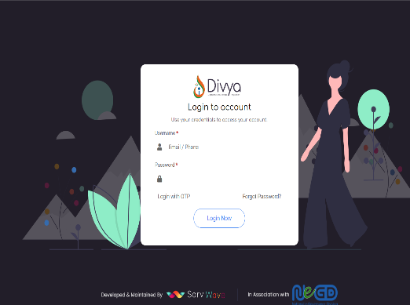
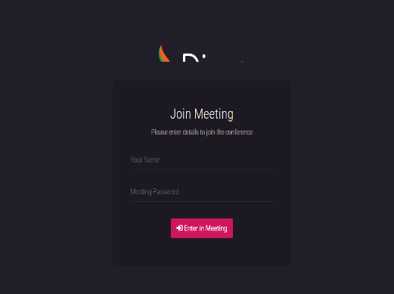
PRACTICAL ISSUES
05. DIFFICULTIES IN LOGGING INTO PORTAL FOR VC

Slide 38


PRACTICAL ISSUES
06. Order passed without giving VC
In many cases even though Ā requested for VC, orders are passed without giving VC opportunity
13. Audibility
The opposite person is not audible due to technical
glitches at either end
07. Recording
VC recording not provided
12. Link provided not working
08. Preferred dates
At times, the link provided for VC does not work. Shows ‘Invalid
User’ or ‘Invalid Password’
Preferred dates for VC not given in most of the cases
09. Time provided for VC
11. Technical glitches
Only 15 minutes time provided to present the case in most of the cases
Difficult to present the screen
10. Interfaces
Different interfaces thereby causing problem to login

Slide 39
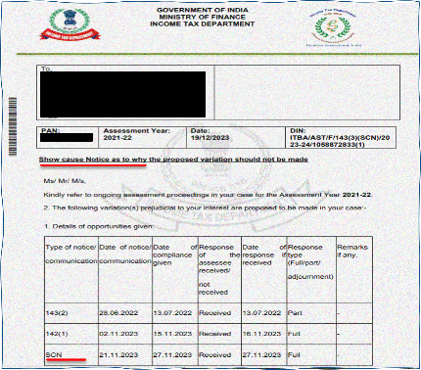
PRACTICAL ISSUES
14. RECEIPT OF MORE THAN ONE SCN
Points to be noted:
As per S. 144B(1)(xii), the AU shall after taking into account all the relevant material on record, prepare a SCN for proposed variation and serve it on the Ā through NaFAC.
If after issue of 1st SCN, Ā has not furnished any further material, can the AU issue further SCN?
Can Ā challenge the jurisdictional validity of the other SCNs issued?
Whilst the Ā should respond to other SCN, one may state that the reply is ‘without prejudice to challenging the legal validity of the said notice’

Slide 40


Slide 41
THANK YOU!
The views expressed in this presentation are personal views of the presenter. This Presentation is intended to provide certain general information and should not be construed as professional advice. This presentation should neither be regarded as comprehensive nor sufficient for the purposes of decision making. The presenter does not take any responsibility for accuracy of contents. The presenter does not undertake any legal liability for any of the contents in this presentation. Without prior permission of the presenter, this document may not be quoted in whole or in part or otherwise.

