Slide 1
Subject-Review Procedures and Reporting by Peer Reviewer and importance of AQMM in Peer Review One day training programme organized by PEER REVIEW BOARD and hosted by VASAI BRANCH of WIRC of ICAI- 15/03/2026, SUNDAY Speaker- CA. Ramlaxman Nolakha – Disclaimer note- PPT for reference of speaker only please refer- ICAI, PRB website, publications, for all purposes.

Slide 2
“Invest in books, seminar,
good clothing and other things that will increase your confidence and sense of worth..”

Slide 3
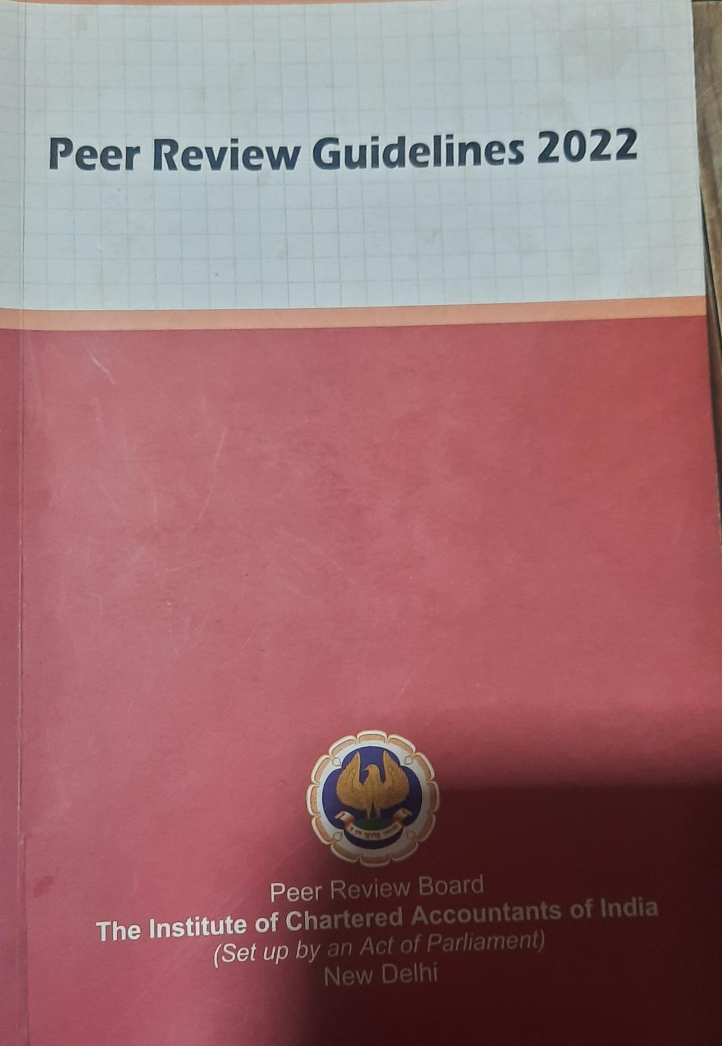
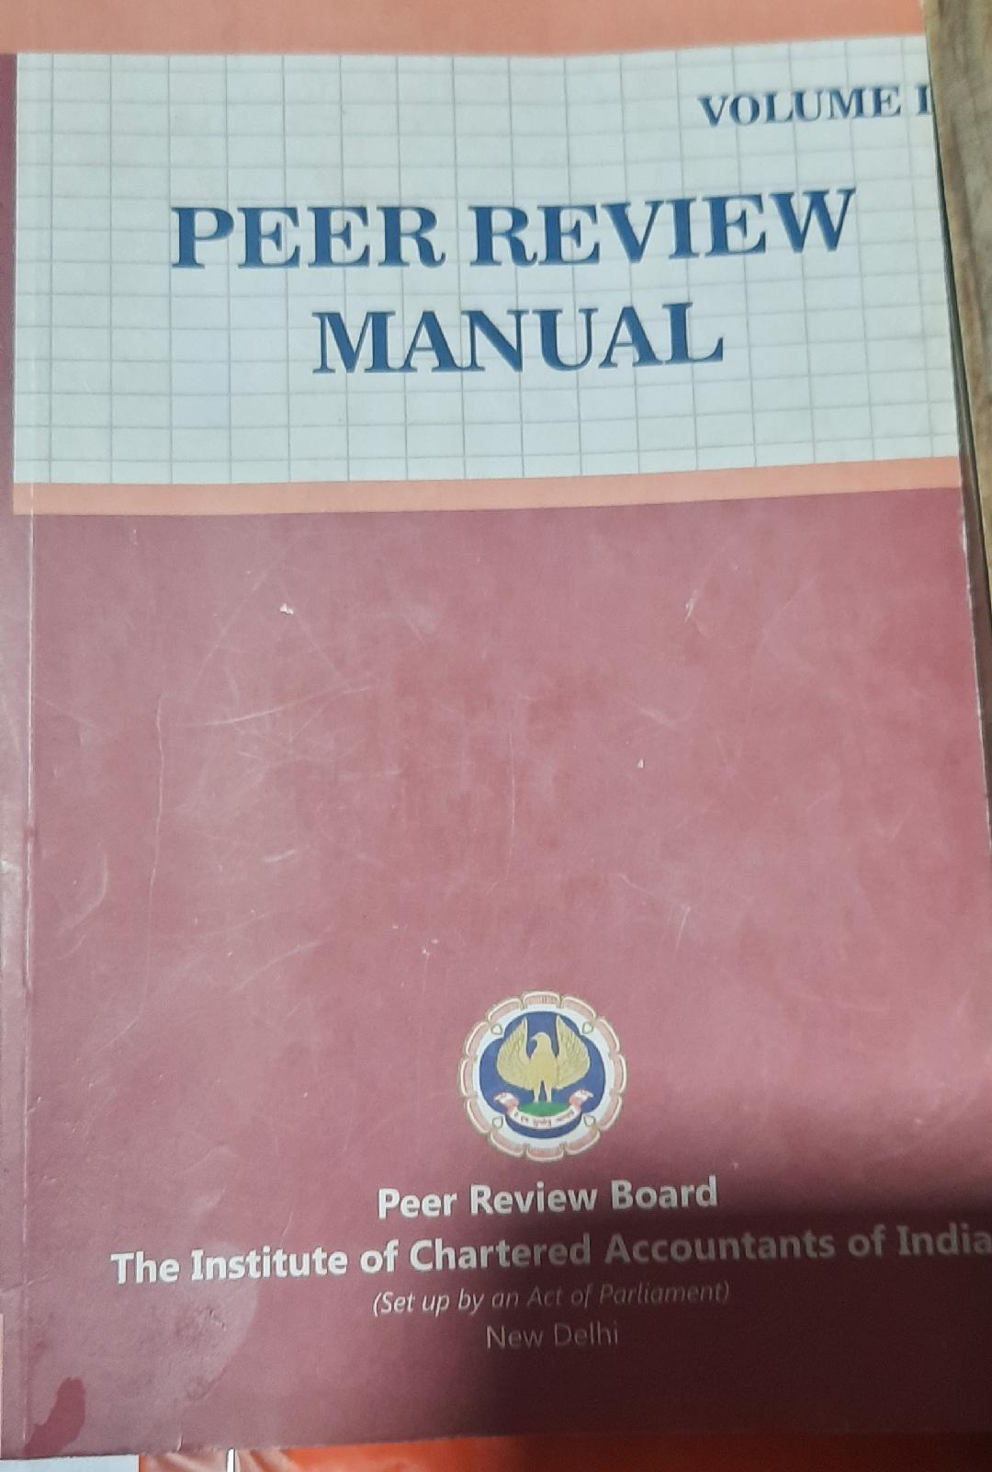
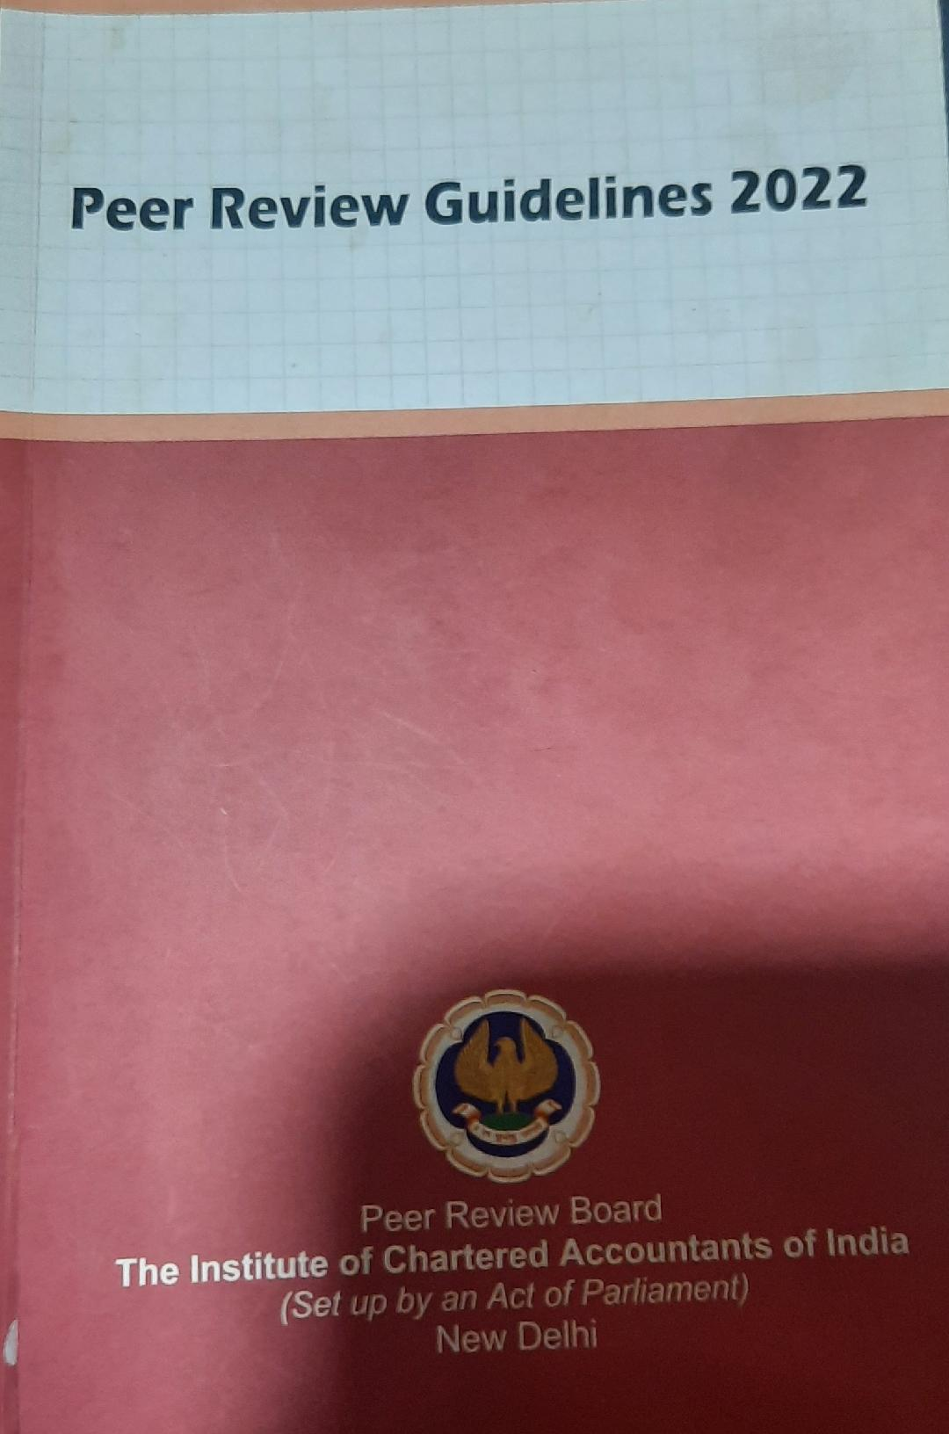
PUBLICATIONS-

Slide 4
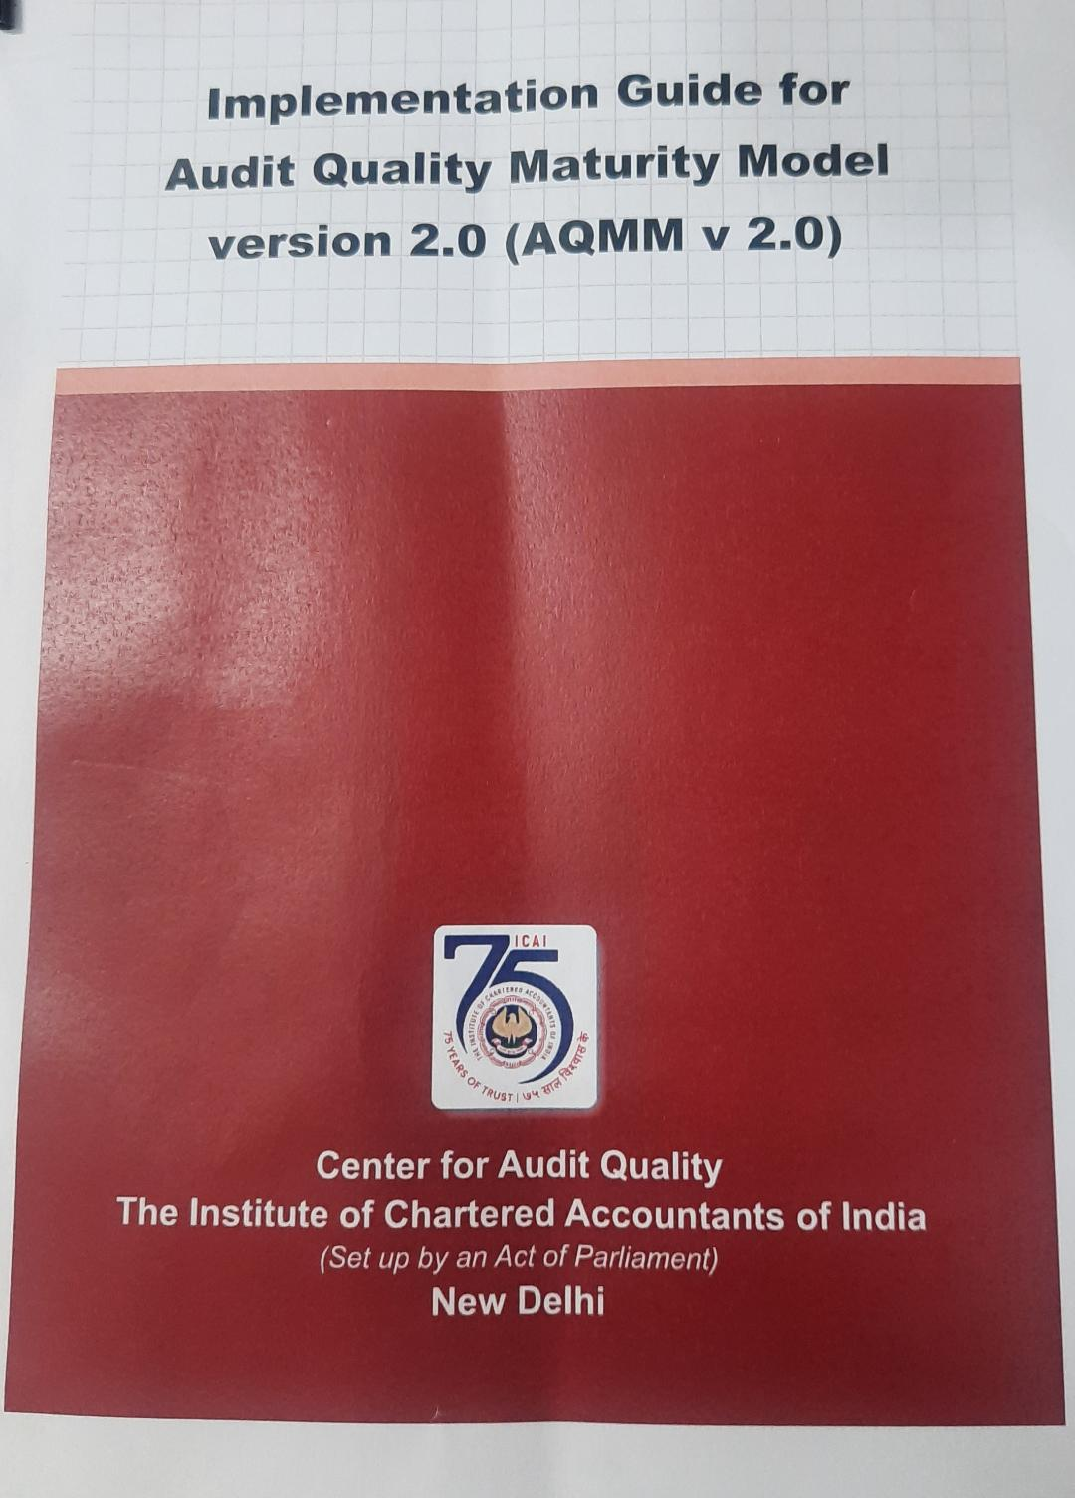
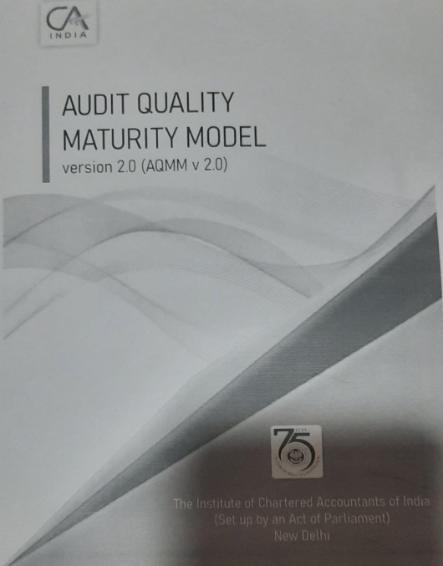
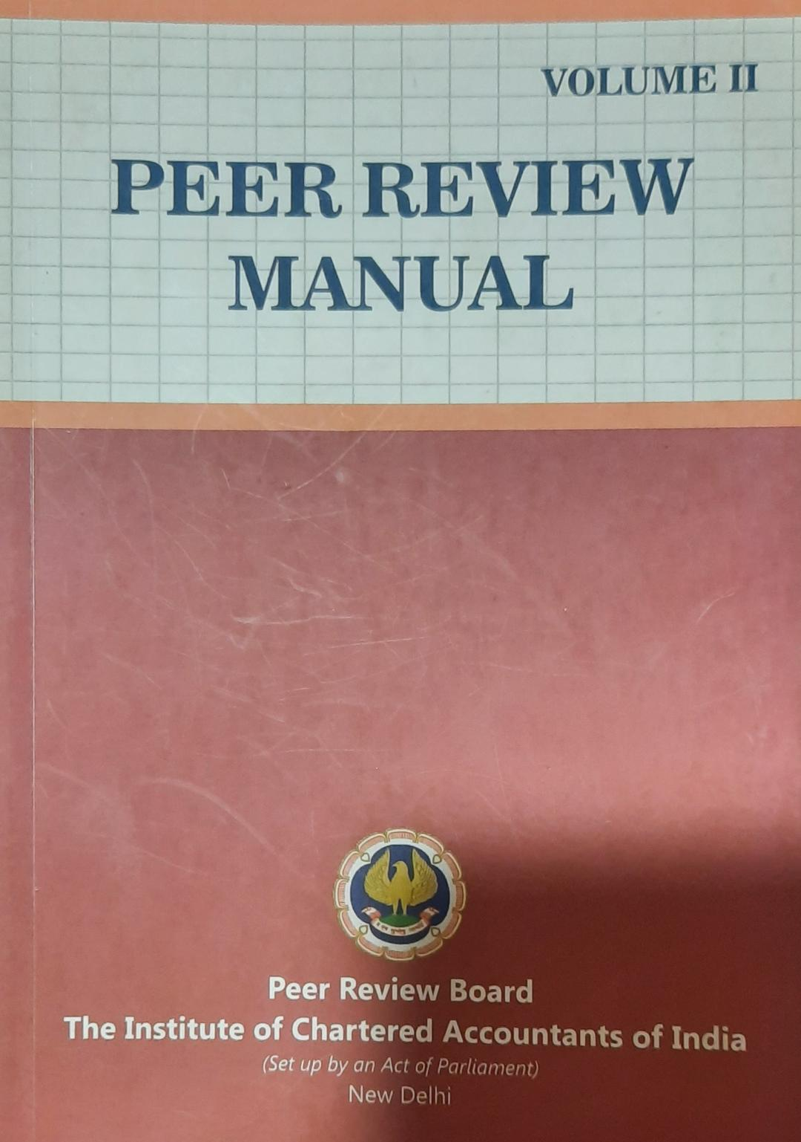
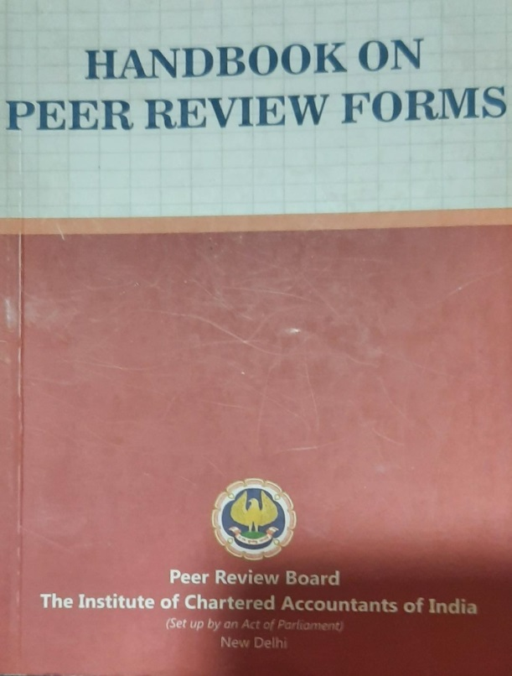
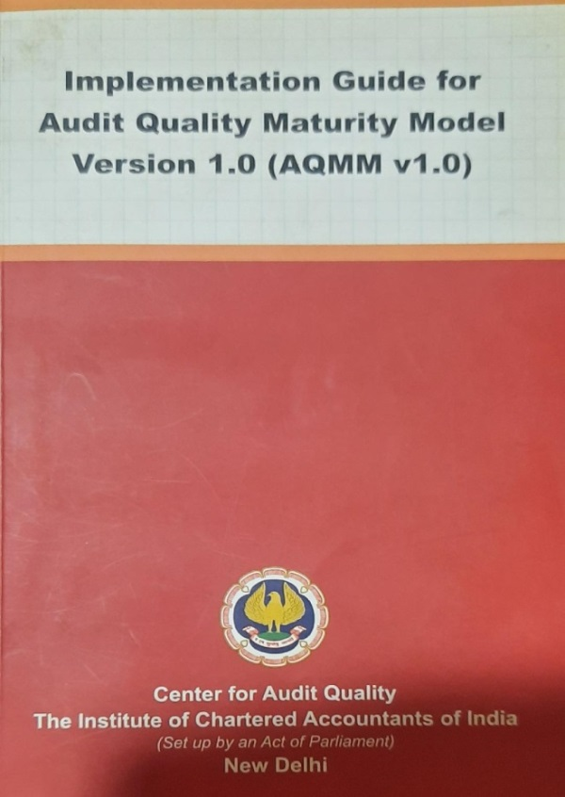

Slide 5

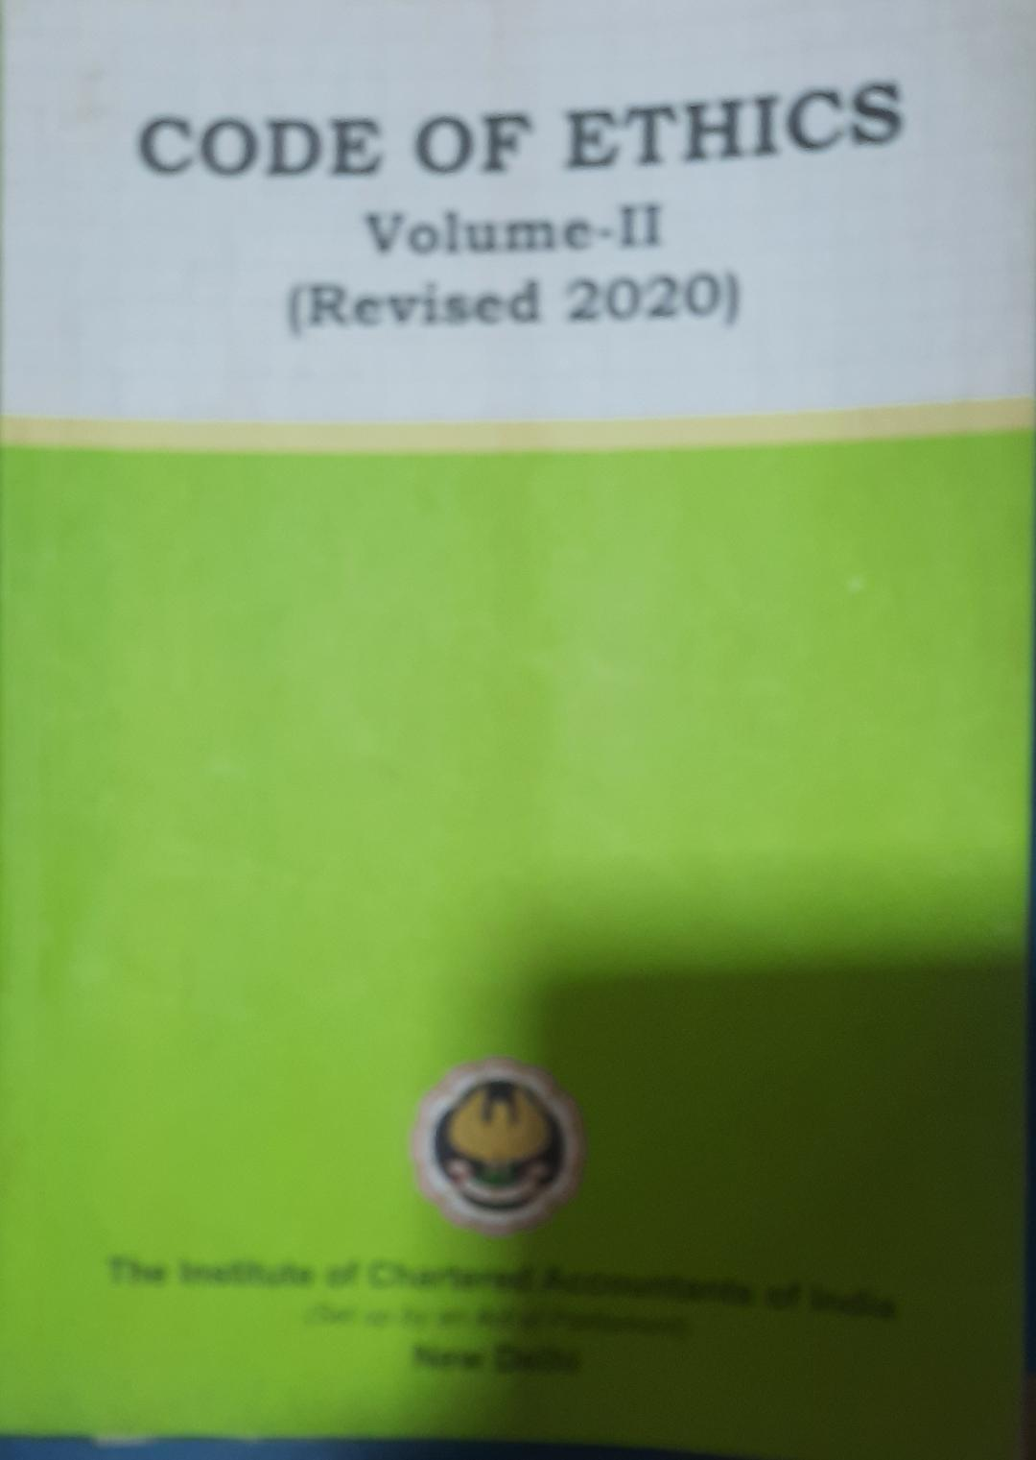

Slide 6
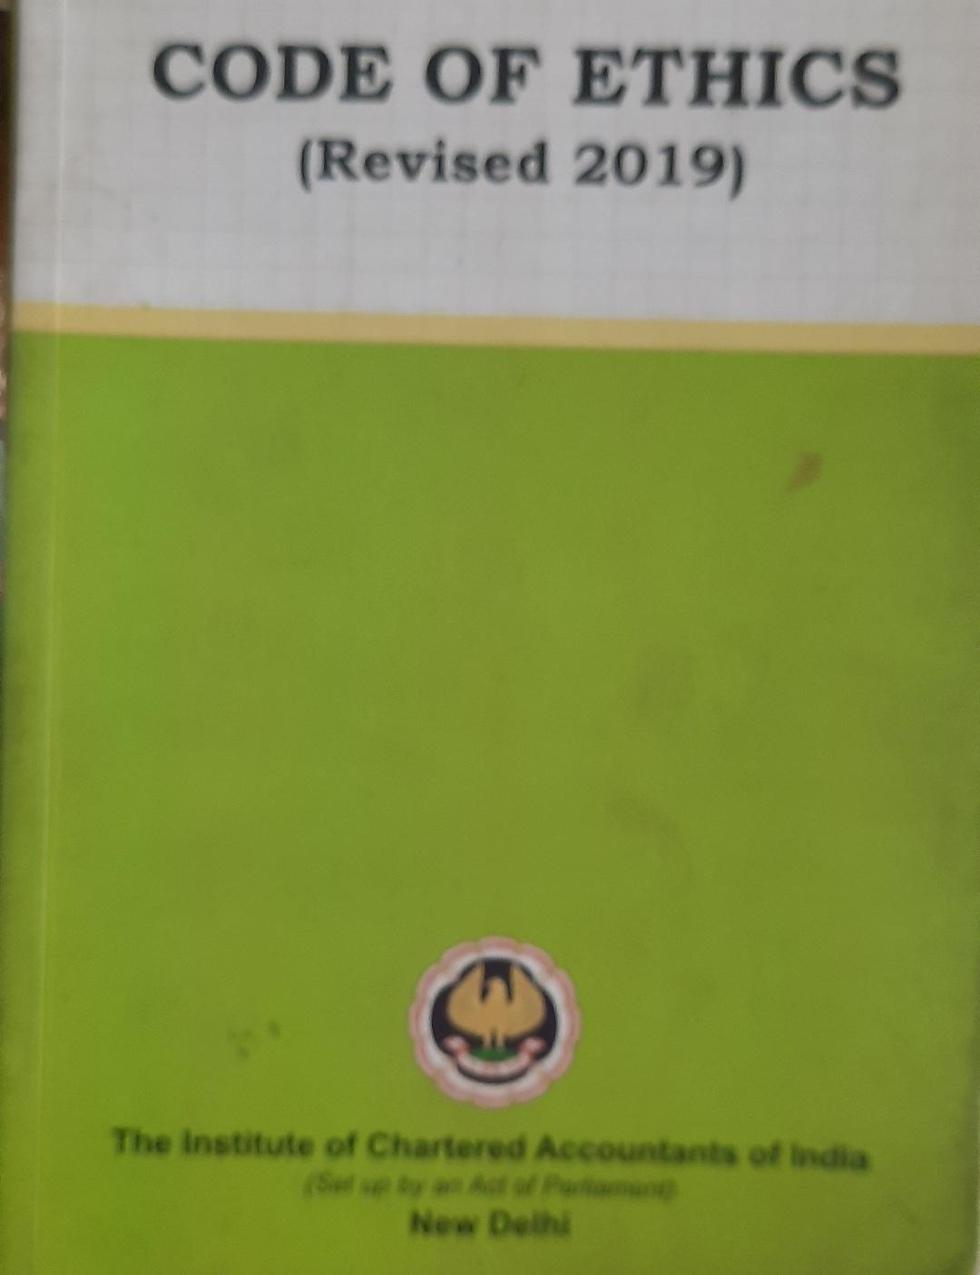

Slide 7

Moving forward-

Slide 8

FOCUSS

Slide 9
Important clause – Peer Review Guidelines 2022
Chapter II : Clause 4 - Coverage of Peer Review
 | (1) The Peer Review process shall apply to all the assurance engagements signed by a Practice Unit during the period under review. (2) Once a Practice Unit is subjected to Peer Review, its assurance engagement records pertaining to the Peer Review Period shall be subject to examination and review by the Peer Reviewer. (3) A Practice Unit having one or more branches at various locations in India may opt to get the Peer Review of any branch or branches conducted by a Branch Peer Reviewer. The Reviewer conducting the Peer Review of the Head Office shall consider the report of the Branch Peer Reviewer and shall issue a consolidated report for the Practice Unit. (4) The Peer Review shall cover: Compliance with Technical, Professional and Ethical Standards. (ii) Quality of reporting. (iii) Systems and procedures for carrying out assurance services. (iv) Self evaluation under Audit Quality Maturity Model or any other guideline issued by the Centre for Audit Quality. (v) Training programes for staff (including article and audit assistants) concerned with assurance functions, including availability of appropriate infrastructure. (vi) Compliance with directions and / or guidelines issued by the Council to its Members, including fees to be charged, number of audits undertaken, register for Assurance Engagements conducted during the year and such other related records. (vii) Compliance with directions and / or guidelines issued by the Council in relation to article assistants and / or audit assistants, including attendance register, work diaries, stipend payments, and such other related records.

Slide 10
Abbreviations: PRB - Peer Review Board, PU -Practice Unit, RE - Reviewer, HB - Hand book
Subject Heading | Peer Review procedures
Form 1 Contents: Application cum Questionnaire to be submitted by PU | 1.Application - (page 3 to 6 of HB) 2.Questionnaire -(page 7 to 50 of HB) PART A - Profile of PU - (with Annexure A for assurance details ) PART B - General controls based on SQC1 (not applicable for new units) Part B(I) - Leadership responsibilities for quality control , B(II) - Ethical requirements, B(III) - Acceptance and continuation of client relationship, B(IV) - Human resources , B(V) - Engagement performance B(VI)- Monitoring PART C - AQMM(Scores obtained ) Section 1-Practice management assurance( maximum score -370) Section 2-Human resources management ( maximum score -150) Section 3-Digital competency ( maximum score- 80) Total maximum score – 600

Slide 11
Guidance for checking Form 1 | General guidance points-Page no. 51 to 54 of Handbook on Peer Review Forms(HB)
i. Guidance for checking part A | Profile of PU and Annexure of assurances Page no. 54 to 61 of HB
ii. Guidance for checking part B | Based on SQC1 as submitted by PU-Page no. 62 to 78 of HB
iii. Guidance for checking part C | Scores obtained - Page no. 79 to 107 of HB—v1.0 AQMM-for v2.0 refer IG by CAQD
Form 2 -Acceptance cum Declaration of Confidentiality | RE to submit to PU on its email id once selection is intimated by PRB - Page no. 108 to 111 of HB (Note: breach of any condition in Form 2 to be treated Gross negligence)
Form 3,4 | Form 3 -application for RE empanelment page 112 –HB. Form 4-Not relevant for subject
Form 5 | Notice by RE for samples and visiting office of PU - Page no. 120,121 of HB
Form 6 | Form for seeking additional information from PU-Page no.122,123 of HB
Form 7 | Form for seeking additional time for completion of review-Page no.124,125 of HB
Form 8 | Not relevant for subject here
Form 9 | Letter for submission of Final Report by RE to PRB (along with checklist annexures for compliance)-Page no. 128,129,130 of HB
Form 10 | Not relevant for subject here

Slide 12
RREVIEW - OFF SITE PROCEDURES VIEW - OFF SITE PROCEDURES
 | 1. Design review strategy program, Evaluate Form 1, Application, Questionnaire A-Profile, Assurances list, B-SQC1, C-AQMM, form general opinion and note relevant points for further processing/enquiries or during review visits. Check if all forms are complete and duly filled, also assurances list, 2. Write to PU in Form 6 for further inputs/information required. 3. Intimate to PU in Form 5 for proposed dates of initial or review visits with SAMPLE SLECTION ,as per Board’s criteria intimated to RE. 4. Visit PU’s website and social media posts for review, if guidelines are followed and to know all about PU. 5. Go through ICAI/PRB/Other publications, books, download in your library.
REVIEW - ON SITE PROCEDURES
A. | First day visit - Suggested actions
 | i. Visit to PU’s office as fixed with full preparation, reference materials with a daily work note book. ii. Have introduction and conversations with PU team and do inspection of office, infrastructure deployed, computer systems, storage arrangement, overall professional culture, library etc.

Slide 13
 | First day visit- Suggested actions
 | iii. Obtain copy of SQC1 manual, compare with PU,s form 1, view audit manual, various checklists, inspection reports, system of assurance engagement from assurance strategy to final reporting and assembly of documents. Follow and notice compliance review system for independence, professional skills and standards, outside consultation, staff supervision and development, office administration. iv. Verify contents of Form 1, and questionnaire information with support and conversation with PU team. If any variance please record, Check profile part as per Annexure G. v. Check Article trainee records and compliance, member and firm records, training methodology and records, library, communications among PU firm staff and attendance system, talk to engagement staff, articles and proprietor / partner. (Base training guide by ICAI) vi. Talk and obtain about CPE compliance, Assurance registers, UDIN mapping , overall assess and frame in mind how and in what way PU is having culture for quality control and engagement performance. vii. Make PU aware about the reporting requirements in Annexure I, II, III. Also, note enquiry points in the Annexures. As RE you also have to keep in mind reporting objects as required in reporting Annexures. viii. Take up sample selection file one by one, make a check point sheet as documentation for every sample reviewed. (Sample selections as per criteria and details in form 5 as intimated to PU.) ix. By first day, RE to conclude about system and procedures, status of internal control at PU, frame Compliance / substantive procedures to apply and all about SQC1 applications at firm level.

Slide 14
B. | Second day visit- Suggested actions
 | Apply compliance and or/substantive approach to review files, use judgements and make a proper documentation sheet of your review, with date, time, who attended, explained, what reviewed, any deficiencies to note with highlighter. Special attention to pay if standards and guidance notes with applicable law and regulations followed. All deferment of review subject/files by PU to note in daily pending matters list, ( suggested review procedure- refer chapter 4,page 74 of manual volume 1,and peer review guidelines 2022 chapter 2,page 8 onwards), extract of flow chart attached here.
C. | Third, fourth and fifth day visit - Suggested actions
 | If additional samples to select-decide and inform PU in Form 5, copy to PRB. -check if branch records also to review at HO or to visit branches, -obtain billing details of all engagements, or ask for few highest revenue earning clients and take note during review of files, -obtain income/expenditure account of PU, validate assurance figures. -continue review of files as per guidance in manual, obtain from PU all information pending so far or remind every day.
D. | Sixth day visit - Suggested actions
 | Remind finally unsupported action by PU, list in your documentation on daily basis. Complete all sample files selected and check from form 5 again, also Annexure III score points to be decided seeing overall observations and review of files engagements applications. Note- suggested review days intermittently so that RE can further do back office exercise and refer . Total illustrated days visit prescribed are 6.

Slide 15
If review of files is not completed |  | Apply for extension in Form 7 to PRB, get jointly signed by PU too, specify reasons, either RE or PU to email to PRB.
Preliminary/initial finding |  | If RE finds any deficiencies in review system of quality control and procedures carried or any more inputs required , same should be communicated to PU, ask PU for response for your findings, else go for final reports.
REPORTING PROCEDURES
A. | Evaluate responses and conclude type of report to issue. | Evaluate responses and conclude type of report to issue.
 | RE to prepare satisfaction / verification report ( no format prescribed ) by evaluating every response by PU and conclude with note, how far as a RE you are satisfied or not, summarise the final points of deficiencies remained, evaluate if it is chronic, validate on certain standard key criteria as suggested in manual, conclude type of report to issue and finalise comments in Annexure I,II. Concluding what type of report is matter of judgement on facts reviewed and noted, one has to take overall view and not isolated, with keeping in mind the tag word “REASONABLE”,”SATISFACTION” As well criteria as listed in reporting section –vol.II
B. | Draft Final report
 | Prepare Draft final report, if any information missing obtain it, obtain MRL on points needed, if qualified report discuss with PU else finalise report. Format of model final report and contents specified in manual. (Page 228 to 250 of Peer Review Manual Volume I, Edition January 2023)

Slide 16
REPORTING PROCEDURES
C. | Ready to sign reports.
 | Sign and send one copy to PU with intimation to PRB, and eligible/agreed professional fee bill raised in PU name. Obtain form 9 signed by PU for acknowledgement of reports – Final report, Annexure I,II,III.
D. | Scheme of review –(optional as per best practice)
 | Draft scheme of review from beginning to end to be sent to PRB along with Form 9
E. | Ready all attachments for uploading
 | At the time of intimation for appointment, PRB annexes various links in e-mail with formats and checklists compliance to note and complete before sending on prb.reports@icai.in (note separate reporting email) Form 9 and checklist covering letter to send.(soft copies allowed)
F. | Note Suggested hints to RE
 | i. All reports and correspondence with PRB/PU should be on individual name/letter head of reviewer and not in firm name. ii. All forms emailed to PU suggested to make CC to PRB –e.g. form 2, 5,6, 7. iii. PRB advises both RE and PU to co-operate each other mutually and complete review as such both have to understand obligations of each other.

Slide 17
REPORTING PROCEDURES-continued
 | iv. Send engagement letter to PU after sending form 2, no specific format but mention of frame work of PRB guidelines, manual, circulars and updates desired. v. Your best friend is your library of books from PRB, ICAI audit assurance standards, publications, other relevant video/audio/print/PPT /DLH supports, as you have given Declaration of confidentiality. vi. For any guidance call to PRB Secretary /team on number specified, vii. Maintain documentation of review carried. viii. Only 20 working days allowed for whole process of review, yes extension possible on request in Form 7. ix. read advisories and guidance in Peer review manuals, hand book etc. and follow them as directed . x. Reference books for review procedures and reporting - Hand book on Peer Review Forms, Peer Review Guidelines 2022 , Peer Review Manual Volume I, II, AQMM v1.0,v2.0 implementation guide, code of ethics, training guide and non standing PRB ,ESB,AASB, ASB committee ,CAQD directorate at ICAI website.

Slide 18
PROCEDURE FOR PEER REVIEW OF NEW UNIT
 | Peer review of a new unit is to be conducted based on the antecedents of partners and policy parameters announced by the Practice Unit for conduct of attest function. The RE has to verify the same from Application cum Questionnaire submitted by the PU in Form 1 as well as on site visit to the PU which shall be restricted to 1 day. Entire review process to complete within 7 working days. RE shall thereafter submit a report to the board in formats as prescribed by it. Reporting format Page 233,234 of Peer Review Manual Volume I Edition January 2023
STUDY NOTE FROM REVIEW MANUAL VOLUME 1 page 6
 | “……Peer review is directed towards maintenance as well as enhancement of quality of assurances and provide guidance to members to improve their performance and adherence to various statutory and other regulatory requirements. Such an objective of peer review process makes it amply clear that the reviewer is not going to sit on judgement of the practice unit while rendering assurance services but to evaluate the procedure followed by practice unit in rendering such a service, Accordingly where a practice unit is not following prescribed standards the reviewer is expected to recommend measures to improve the procedures followed by practice units. Objective is to enhance quality of assurances by providing guidance rather than simply pointing out deficiencies of practice units, to elaborate further key objective of peer review is not to identify isolated cases of engagement failure but to identify weaknesses that are pervasive and chronic in nature….”

Slide 19
Review procedures off site- summary-page 75 of PR manual vol-1
1-EVALUATES FORM 1-APPLICATION CUM QUESTIONNAIRE
2-DETERMINE THE SAMPLES FROM LIST OF ASSURANCES SERVICE CLIENTS,
3-INTIMATE TO PU THE LIST OF SAMPLES SELECTED , PROPOSED DATES OF VISIT IN FORM 5
4- INTIMATE TO PU IN FORM 6 FOR SEEKING ANY ADDITIONAL INFORMATION IF REQUIRED.

Slide 20
Chart of flow of activities the reviewer follows for On site review-page 76 PR manual vol 1
1-RE. PLAN ONSITE VISIT IN CONSULTATION WITH PU
2-RE. TO GIVE AT LEAST 2 WORKING DAYS TO PU TO KEEP READY NECESSARY RECORDS
3-RE. MAY REVISE THE INITIAL SAMPLE SIZE, IF RE. DEEMS FIT
4-VISIT CAN BE CONDUCTED AT THE PU HO OR/AND BRANCHES OR ANY OTHER LOCATION
5-ON SITE REVIEW SHOULD NOT EXTEND BEYOND 6 WORKING DAYS AND 1 WORKING DAY IN CASE OF NEW UNIT
6-RE. TO ADOPT COMBINATION OF COMPLIANCE & SUBSTANTIVE APPROACH
7-AFTER COMPLETION OF ON SITE REVIEW RE. SHALL PREPARE AND SUBMIT PR REPORT TO THE BOARD ALONG WITH FORM 9

Slide 21
Comparision of audit program with work flow of SAMPLE selected-page 76 PRM vol-1
1-PLANNING-reviewer to collect audit program as devised and compare with actual flow,
2-EXECUTION
reviewer to check if the work of the executive and audit in charge are logged and time involved in line with audit program as devised,
3-CONCLUSION
RE to check if the final discussion are made by the partner of the PU with those charged with governance and such discussions are logged for documentation,

Slide 22
Methods to obtain sufficient appropriate review evidence on site- page 77 of PRM vol. 1
INSPECTION
Examination of documentations, other records, maintained by PU
ENQUIRY
Seeking informations from partner/prop, or other knowledgeable person with in PU
OBSERVATION
Witnessing a procedure or process being performed,

Slide 23
COMPLIANCE AND/OR SUBSTANTIVE PROCEDURES-HOW
Compliance procedure
Test design, implementation of controls
Check effectiveness of controls and form opinion
Substantive procedure
Compliance with Technical, Professional and Ethical standards- as defined
To the extent required in samples

Slide 24
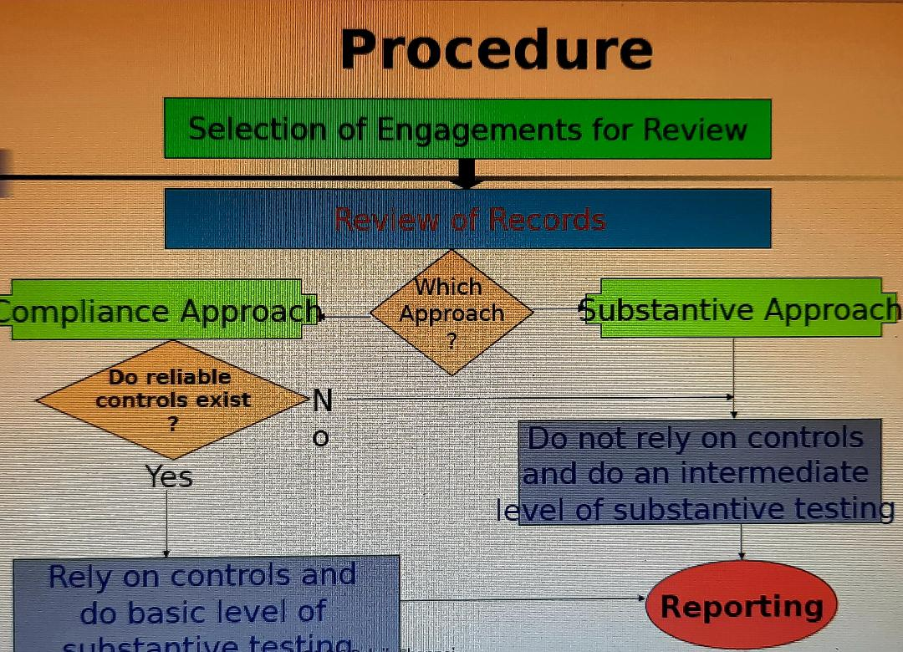
Final review procedure

Slide 25
Sr.no. | Review process | Time schedule | Cumulative Days
1. | Practice Unit (falling under clause 2(17) of Peer Review Guidelines 2022) shall make an Application cum Questionnaire to the Board in Form 1. OR Peer Review Board notifies the selection of Practice Unit (PU) (falling under clause 6(2) of the Peer Review Guidelines 2022) for Peer Review. The PU is requested to submit the duly filled Application cum Questionnaire to the Board in Form 1 | Counting starts after receipt of this document | Counting starts after receipt of this document Day 1
2. | Panel of three Reviewers is sent to PU, along with Notification of Peer Review fees (refer to clause 6(4) of the Peer Review Guidelines 2022). | Within 3 working days | Day 4
3. | PU to give the choice of the Reviewer. (refer to clause 6(5) of the Peer Review Guidelines 2022). | Within 1 working Day | Day 5
4. | As per the choice given by PU, the Board to notify the Reviewer to submit his Acceptance cum Declaration of Confidentiality in Form 2 to the PU. The Board would also mark a copy of the E-mail/ letter to Practice Unit confirming the appointment of reviewer. PU is also informed to send the Application cum Questionnaire (in Form 1) submitted by it to the Board to the Reviewer on receipt of Declaration of confidentiality in Form 2 from the Reviewer. | Within 2 working days | Day 7

Slide 26
Sr.no. | Review process | Time schedule | Cumulative Days
5. | Reviewer on receiving the Application cum Questionnaire in Form 1 from PU, shall intimate the PU and the Board, for proposed visit and proposed sample assurance services selected by him in Form 5. And accordingly, the Practice Unit to keep ready the necessary records of the selected assurance services for the purpose of review. | Within 2 days | Day 9
6. | Reviewer to seek further/ additional clarification in Form 6 from the Practice Unit on the information furnished/ not furnished by the PU in the Questionnaire. And PU to provide the additional information asked by the Reviewer. [Form 6] | Within 1 day | Day 10
7. | Reviewer to carry out the review by visiting the office of PU after fixing the date as per the mutual consent. | Within 6 Days After visiting PU’s Office | Day 16
8. | Reviewer to send the Preliminary report, if any, to the PU for comments | Within 1 day after completion of Review. | Day 17
9. | Practice Unit to submit representation on Preliminary report to the Reviewer. The Reviewer should be satisfied with PU response on Preliminary Report along with point wise justification and basis of arriving at Opinion/conclusion for issuing clean report | Within 2 days | Day- 19

Slide 27
Sr.no. | Review process | Time schedule | Cumulative Days
10. | On completion of the Review, the Reviewer has to submit the under mentioned documents duly signed in individual capacity along with Form 9 (to be signed by the PU and the Reviewer) a. along with Form 9 (to be signed by the PU and the Reviewer) b. Annexure I (https://resource.cdn.icai.org/66199prb5 3446-6.pdf ), c. Annexure II (Mandatory for all firms) (https://resource.cdn.icai.org/72012prb5 7960-annex2.pdf ) d. Annexure III (https://resource.cdn.icai.org/72013prb5 7960-annex3.pdf)- (Mandatory for firms carrying out audit of listed entity or Banks other than co-operative banks (except multi-state co-operative banks); or Insurance Companies. However firms doing only branch audit are not covered) e. List of sample selected and basis of sample selection and sample selection criteria as laid down by the Board.*( https://resource.cdn.icai.org/72066prb57 994.pdf ) f. Preliminary Report, if issued, PU’s submissions and Reviewers verification thereon g. Completed copy of PU Questionnaire received from Practice Unit. “Peer Review Board Reserves the right to ask for working papers as specified in the Peer Review Guidelines.” A copy of the Final Report along with Annexure I and Annexure II & Annexure III should be sent to the PU also. | Within 1 day | Day- 20

Slide 28
Sr.no. | Review process | Time schedule | Cumulative Days
11. | Board to consider issuance of Peer Review Certificate in case of clear Report. In case of Qualified Report submitted by reviewer, the report to be considered by the Board. Board to give the recommendation to PU for rectifying the deficiencies observed by Reviewer. Reviewer to submit proof of receipt of Peer Review Fees in individual capacity. | In the next Meeting of the Board.
The time period mentioned includes the transit time for mailing/ sending the reports/ communication etc
The Time schedule is illustrative as per the Guidelines and accordingly the Reviewer and Practice Unit shall mutually co-operate and ensure that the entire review process is completed within twenty working days from the date of receipt of application in Form 1 from the Practice Unit
In case of delay in the Peer Review process beyond the timeframe prescribed under the Peer Review Guidelines, the Practice Unit and the Reviewer, shall make an intimation to the Board in Form 7 seeking extension of time giving reasons for the delay in the process and submission of report to the Secretariat

Slide 29
Sample selection Criteria
The Board has laid down the following criterion for selecting the samples for reckoning the minimum number of samples for review:
Sample selected should be representative of total population of assurance services.
Sample chosen must include assurance engagement assignment which has the highest turnover among the statutory audit population.
At least 5 samples in total (in case less than 5 then 100% population) must be selected from the category ‘Statutory Audit’ of Listed entities, central/ State Public Sector Undertakings and Central Cooperative Societies.
At least 1 sample each from CSA audit of banks and Insurance Company, (if any). CSA will be substituted by SBAs in case PU does not undertake CSA.
Sample must include each ‘type of assurance engagement’ (viz. Statutory/Internal/concurrent/Tax/GST etc.) including services provided on tender.
Sample must be picked from the assurance clients which contribute 15% or more to the total revenue of the firm (as mentioned under the concentration Clause 17 of Part A of the Questionnaire)
Sample must be selected from each of the locations where the PU is rendering Assurance services. However, in case branch has a listed client, then that is mandatorily required to be included in the sample.
There must be at least one sample from assurance service rendered by each partner of the PU.
Sample must be picked from each year under review.
Sample must necessarily include those clients in respect of whom advisory has been issued by FRRB or any regulator. (as mentioned under Clause 14(ii) &14(iii) of Part B (II) of the Questionnaire).

Slide 30
Annexure I to the Final Peer Review Report of M/s./CA.__________for the peer review period_______Tick ‘Yes’ / ‘No’, appropriate option.
Sr. No. | Particulars | Observations
1. (a) | Date on which questionnaire received
(b) | Total number of assurance assignments handled by the PU during the peer review period
2. (a) | Number of initial samples selected for review
(b) | Was the completeness of the PU clients list verified from assignment register maintained by PU?
3.(a) | Was there any change made in initial sample selected by the Reviewer? | Yes | No
(b) | If ‘Yes’, please specify the number selected, after change
4. | Name of the Qualified Assistant of the reviewer, who helped in the Peer Review. (Please also attach declaration of confidentiality duly signed by the qualified assistant.)
5. | Whether following general controls are in existence and operating effectively during the period under review?
 | (i) Independence | Yes | No
 | (ii) Professional Skills and Standards | Yes | No
 | (iii) Outside Consultation | Yes | No
 | (iv) Staff Supervision and Development | Yes | No
 | (v) Office Administration | Yes | No
6. | Whether audit records/working papers administration is satisfactory? | Yes | No
7. | Whether the workings papers are maintained in soft copy or Hard copy?
8. | Whether review of internal control systems was carried out properly in performing assurance engagement? | Yes | No

Slide 31
9. | Whether proper systems and procedures exist within the PU to ensure compliance with technical, professional and ethical standards?
 | (i) Accounting Standards including Interpretations thereof | Yes |  |  | No
 | (ii) Standards on Auditing including General Clarifications thereof | Yes |  |  | No
 | (iii) Statements | Yes |  |  | No
 | (iv) Guidance Notes | Yes |  |  | No
 | (v) Institute’s Notifications/ Directions | Yes |  |  | No
 | (vi) Self-Regulatory Measures | Yes |  |  | No
10. | Whether overall presentation of financial statements conforms to statutory requirements of presentation under various Statutes? | Yes |  |  | No
11. | Whether audit conclusions drawn are duly supported by audit queries/observations? | Yes |  |  | No
12. | Whether the quality of audit reports in respect of format and content found proper? | Yes |  |  | No
13.(a) | Whether the Reviewer has issued preliminary report? | Yes |  |  | No
(b) | If ‘Yes’, please specify the areas of deficiencies
 | ……………………………………………………………………
14. (a) | Whether PU has responded to the preliminary report? | Yes | No |  |  | N.A.
(b) | Whether the Reviewer is satisfied with the response received from the PU? | Yes | No |  |  | N.A.
15. | If the Reviewer is not satisfied with the response of the PU, whether qualified report has been issued? | Yes | No |  |  | N.A.
16. (a) | Is the Final Report qualified? | Yes | No |  |  | N.A.
(b) | If ‘Yes’, specify the reasons …………………………….
17 | Whether the Reviewer received full co-operation from the PU during review? | Yes |  | No

Slide 32
18. | Is there any point which the Reviewer wants to bring to the notice of the Board?
 | If yes, please elaborate.
 | ……………………………………………………………………
19 (a). | Whether the PU obtained/Procured any professional work including attest functions through process of tendering? | Yes |  | No |  | N.A.
19 (b) | If yes, the Reviewer to confirm whether PU has maintained cost sheet for procuring work through tender. | Yes |  | No
20.(a) | Whether appointment letters are properly issued to staff recruited by the PU? | Yes |  | No
(b) | If not , whether the fact, with response of PU has been incorporated in Preliminary Report (Point 13(a) mentioned above)? | Yes |  | No |  | N.A.
21. | Whether Reviewer has selected the samples as per the criteria as mentioned for Sample selection by the Board. (as per direction given in ‘Reviewer selection letter’). | Yes |  |  | No
22.(a) | Whether PU has ever been reviewed by Quality Review Board? | Yes |  |  | No
(b) | If Yes, has the Reviewer verified for the necessary compliance as regards to the submission of Compliance Report to QRB by PU?
23 | Whether Reviewer has verified & satisfied himself with the quality of tax audit services rendered by partner/s, who have rendered in excess of limit prescribed by ICAI u/s 44AB of the Income-tax Act, 1961? | Yes | No |  |  | N.A.
24. (a) | Has the Practice Unit shared Quality Control Manual with Reviewer? | Yes |  |  |  | No
(b) | Is the Quality Control Manual in compliance with the responses submitted by Practice Unit under Part B of the Questionnaire (SQC1)? | Yes |  |  |  | No
Date: | Signature
M No. | Name
Email ID | Contact No.

Slide 33
-reviewer’s comments for annexure II subjects heading 6—(total 36 heads reporting comments)
1-Quality control, ethical requirements & independence,
2-Engagement documentation,
3-Audit planning and risk assessment,
4-Audit sampling and other selective testing procedures, materiality,
5-Audit documentations,
6-Audit evidence,

Slide 34
Model Final Report
To,
The Peer Review Board
As per your letter no. dated , I have carried out the peer review of {name of the practice unit} (FRN/MRN) having its registered Head Office/Branch Office at {address of the practice unit HO/ Branch Office as the case may be} for the period(s) {mention the periods reviewed}. The review was conducted from … to …. (dates visited) in accordance with the Peer Review Guidelines issued by the Institute of Chartered Accountants of India.
I have read and followed the guidance to review the information provided by the Practice Unit under various clauses of the Questionnaire. My report is based on my verification of these facts as per the Board’s guidelines. The Board may take such action in terms of power conferred to it under clause 21(6) of the Peer Review Guidelines 2022, in case if some discrepancies are noticed as per its records and the information furnished by the Practice Unit and verified by me.
Objective
The major focus of the review was on compliance with technical, professional and ethical Standards, Quality of Reporting, Office systems and procedures and the Training Program for staff (including Articled and Audit Clerks) concerned with assurance function including appropriate infrastructure engaged in assurance services. I am expressing an opinion on the implementation of quality control policies and procedures designed to ensure the compliance of technical, professional & ethical Standards and maintenance of quality of assurance services and its implementation.
Limitation
This review was limited primarily to inquiries of the Practice Unit’s personnel and an overall examination of the systems and procedures and a selection of engagement working papers and was therefore not intended to identify or discover all weaknesses. This review was also not intended to focus on isolated cases of control or engagement performance deficiencies but rather on weaknesses of a pervasive and chronic nature. As there are inherent limitations in the effectiveness of any system of quality control, departure from the system may occur and not be detected. Also, projection of any evaluation of system of quality control to future periods is subject to the risk that the system of quality controls may become inadequate because of changes in conditions, or that the degree of compliance with the policies and procedures may deteriorate.

Slide 35
Opinion
In my opinion the system of quality control for the assurance services of
{name of practice unit} for the period under review has been designed so as to carry out professional assurance services assignments in a manner that ensures compliance with technical, professional & ethical standards laid down by the Institute and Standards on Quality Controls mentioned by Practice Unit in Part B of the Questionnaire (SQC1) and maintenance of the quality of assurance service work they perform.
AQMM Level of Firm (As per Annexure III):
Name of the Reviewer:
Signature of the Reviewer:
Membership No.:
Place:
Date:
Encl. (1) Annexure – I
(2) Annexure - II
(3) Annexure – III – w.e.f. 01.04.2023 AQMM review is mandatory for the Practice Unit conducting statutory audits of Listed Entity or Banks other than co-operative banks (except multi-state co-operative banks); or Insurance Companies hence Practice Unit rendering assurance services to such clients should ensure to fill Part C of the Form-1.

Slide 36
HINTS FOR LISTED ENTITIES AUDIT REVIEW refer peer review manual -volume II
A-Listing obligations and disclosure requirements regulations 2015 provides applicability of regulations and same applies to all listed entities for securities specified,
B-required points minimum included in audit program
1-AudIt committee
2-Risk management committee
3-Vigil mechanism
4-Related party transactions
5-Disclosure of events or information

Slide 37
Refer peer review manual volume II
6-Holding of specified securities and share holding pattern
7-Conditions for reclassification of any person as promoter/public
8-Statement of deviation or variations
9-Financial results
10-Annual report
11-Annual information memorandum
12-Documents and information to shareholders
13-Draft scheme of arrangements and scheme of arrangements
14-Dividends
15-Accounting Standards,

Slide 38
RE to qualify/modify report due to one or more (illustrative qualifications refer appendix-XIX) …chapter 6
Non compliance with technical standards,
Non compliance with professional standards,
Non compliance with ethical standards,
Deficiency in quality control,
Non compliances with quality control policies and procedures,
Non existence of adequate training programs for staff,

Slide 39
KEY highlights of AQMM v2.0
AQMM v2.0
Audit quality maturity
model- highlights-
Presented by CA R.L.NOLAKHA

Slide 40
AUDIT QUALITY MATURITY MODEL (AQMM) IMPORTANCE in PEER REVIEW-
Tool for self evaluation for increase operational efficiency,
Amalgamation of well researched set of AQI,s
Model encourages proactive approach,
Leveraging technology and investing in the development of audit professionals,
Mitigate risk,
Cross functional evaluation model covering key areas of not only audit engagement but also audit practice at firm level,
Ultimately PR and AQMM have close interdependence making review process conclusive,

Slide 41
AQMM-importance continued..
PR can make qualitative recommendations for improvement for the benefit of the PU, in addition to rate scorings,
Mandatory applicable wef. April 2023 for PU conducting statutory audit of listed entities(other than branches of banks and insurance companies), recommendatory for all others,
Even small and medium firm’s can self review for further capacity building without requirement of Peer review,
Ultimately helping for peer review process and enhancing peer reviewed firm’s quality of assurances, infrastructures, human resources, adoption of technology and tools etc.

Slide 42
MANDATORY FOR FIRM,S (PU) AUDITING
Listed entities
Banks other than co-operative bank(Except multistate cooperative banks)or,
Insurance Companies
Note- Firm,s doing only branch audits are not covered, auditing means statutory audits)

Slide 43
Mandatory scope widened as per announcement -11/08/2025 by CAQD,
Scope widened for AQMMv2.0 in a phased manner for following-
1-firm,s auditing the holding/subsidiary/associates/joint ventures of the following entities
a- listed entity
b-banks other than cooperative banks(except multistate)
c-insurance companies,
however firms conducting only branch audits are not to be covered,
2-firm,s referred as practice units in PR guidelines 2022 which proposes to undertake statutory audits of unlisted public companies having paid up capital of not less than rupees 500 cr. or having annual TO, of not less than 1000 cr. in aggregate O/S loans, debentures and deposits of not less than rupees 500 cr. as on 31st march of immediately preceding FY.
WEF 01/04/2026
WEF 01/04/2026

Slide 44
Scope continued--
3- Firm’s referred as practice units in PR guidelines 2022 which proposes to undertake statutory audits of entities which have raised funds from public or banks or financial institutions of over 50 cr. during the period under review or of anybody corporate including trust which are covered under PIE,
4-LEVEL to mention on ICAI website along with validity and on Peer review certificate too,
WEF 01/04/2027
After 11/08/2025 as understood

Slide 45
CONTENTS ,SCORES IN AQMM V2.0 =600
Section-1 | P.M ASSURANCES | SCORES MAXIMUM
1.1 | PRACTICE AREAS OF FIRM | 7
1.2 | WORK FLOW MANNUAL | 12
1.3 | EFFORT MONITORING | 20
1.4 | QC –ENGAGEMENTS(NEGATIVES TOO) | 8
1.5 | CLIENT SANSITIZATION | 8
1.6 | REGULATORY COMPLIANCE | 55
1.7 | STRATEGIC-FUNCTIONAL | 12
1.8 | INFRASTRUCTURE PHYSICAL | 12
1.9 | PRACTICE CREDINTIALS | 6
1.10 | FORMAT/TEMPLATES | 230
 | TOTAL | 370
SECTION 2 | H R M | SCORES MAXIMUM
2.1 | POLICIES AND PRACTCIES | 21
2.2 | RESOURCES PLANNING, MONITORING,AS PER FIRMS POLICY | 12
2.3 | EMPLOYEE TRAINING AND DEVELOPMENT | 52
2.4 | RESOURCES TO AND COMPENSATION MGMT | 21
2.5 | QUALIFICATIONS SKILL SET OF EMPLOYEES | 28
2.6 | KPI,s | 16
 | Total | 150
3.1 DIGITAL COMPETANCY-15 SUBSECTIONS-80 SCORES

Slide 46
SCORING PATTERN –maximum scores that can be granted
SECTION | HEADS | MAXIMUM SCORES | % OF TOTAL SCORES | 30% MINIMUM SCORES
1 | PRACTICE MANAGEMENT | 370 | 61.67 | 111
2 | HUMAN RESOURCES MANAGEMENT | 150 | 25.00 | 45
3 | DIGITAL COMPETENCY | 80 | 13.33 | 24
TOTAL |  | 600 | 100 | 180

Slide 47
Small and medium firms…..V2.0
In v2.0 more weightage given to checklists, formats, and templates related to assurance function which will assist large number of small firms and medium firms to enhance the audit quality levels.(out of 370 maximum scores up to 230 is marked for checklist and templates under section 1)

Slide 48
REPORTINGS FOR AQMM - ANNEXURE III –
If PU,s application form 1 contain also self evaluation scores part C in v1.0 or v.2.0, its duty of reviewer to study publication IG. as applicable, available on PRB committee website, along scores awarded by PU and program.
Along with peer review relevant 3 sections of AQMM report points to be noted during peer review itself for evaluation of scores awarded by PU,
PU has to justify scores , and reviewer has to evaluate, if change, reviewer to put a note explanation for difference.
Determine level of firm as suggested in IG. Maintain documentations.

Slide 49
FIRM,S MATURITY LEVEL and interpretations
Firms maturity level-greater than | Firms, maturity level less than | Level to assign | Ranking judgment
30% or equal to 30% | Less than 50 % | I | Firm is very nascent take steps to upgrade
50% or equal to 50 % | Less than 70% | 2 | Some progress will have to fine tune
70% or equal to 70% | Less than 85% | 3 | Firm is in substantial progress
85% or equal to | Less than 100% | 4 | Firm is in significant adoption of standard and procedures should focus on optimizing further
Note- |  |  | Level I to 4 is in lower ranking to high rankings

Slide 50
What MIS to keep ready ? section 1.0 Practice Management – AQMM v2.0
Serial no. | Description of MIS to keep ready for reviewer and for self review too, | IG v2.0 Reference page no.
1 | Determine Revenue from Audit and assurances services to total revenue | IG page 1
2 | Top 20 assurances assignments budget vs actual time efforts spent | IG page 10
3 | Maximum negative scores that can be assigned | IG page 14 to 22
4 | Minimum fee charged criteria fulfilled -SA and tax audits together | IG page 31
5 | UDIN’s generated in two working days - | IG page 32
6 | Adequate experience of partner | IG page 37
7,8 | 7-Presence/implementation templates for 20 top assignments YES/NO/NA 8- communication TCWG from PR samples | IG page 43 IG page 26

Slide 51

SUMMARY OF ACTIONS FOR IMPLEMENTATION IN CA. FIRM- AQMM
A-Phase 1-
BENCHMARKING AND PLANNING,
B-phase 2-
IMPLEMENTATION,
All 3 sections
C-Phase 3-
MONITORING AND REVIEW,
Assess progress against parameters, Align with PR cycles, Documentation retention.
“KAAMYAAB BANO, KAMYABI KE PICHE MAT BHAGO….”
“AWAKE, ARISE AND DO NOT STOP TILL GOAL IS ACHIEVED”

Slide 52

CHALLANGES HANDLING-
CHALLANGES HANDLING-

Slide 53
Challenges in review process and resolutions-
Time constraints, user of AI practice and knowledge,
Judgmental issues, and knowledge must, little paid,
Reporting responsibility on reviewer, after report follow up,
Co- operation of PU team must and timely with proper record,
Emotional and friendly courtesy,
Influence by professionals and friends,
Maximum trust on personal enquiries,
Clean report or higher AQMM level do not mean all is well as there is limitations in reports, No immunity to firm-PU.

Slide 54
WHAT NEXT AFTER PEER REVIEW TRAINING AND PASSING OF TEST ?
STEPS
1- Review the notes of faculties, publications distributed during training day, apply in form 3 for empanelment,
2- Read PR Guidelines 2022, Hand Book, Manual, AQMM- IG,( all download free),
3- ICAI website–visit and read daily all updates, AASB,ASB, ESB, QRB,CAQD, PRB, FRRB, TAQRB and others,
4-Hand Book on PR contain hints to fill form 1 and Questionnaire and methods to check /review too with profile of PU firm,
5-Design review program-common points-based on PR manual-even if no allotment,
6- join sessions by ICAI,REGION, BRANCHES, or Study Circles,-physical or webinars,
7- Self review of preparations.
STAY FOCUSSED

Slide 55

FINALLY….

Slide 56

A high enthusiasm, willingness along action at speed of Bullet can make you achieve what you want- CA. RAMLAXMAN NOLAKHA

Slide 57

QUIZ-RUN UP…

Slide 58
COMPLEX SITUATIONS-
1. Peer reviewer found during review in one of sample assurance that CA firm(PU) signed tax audit but communication and acceptance of previous auditor was of later than sign date, later CA firm brought back dated communication letter from previous auditor and explained compliance-what reviewer should do?
a. Accept PU’s submission,
b. Do not accept and report in final report,
c. Since it was not chronic just make a documentation note and close the file,
d. Make to understand CA firm that such practices are unethical and does not fall for acceptance in any case,
e. All above or any other
2. After intimation of proposed 3 names for selection of reviewer by PRB , PU firm calls for meeting with one of reviewer, during meeting , PU request to complete pending documentations for engagements which they will pay separately, if yes, PU will intimate board for name confirmation.
if offer of PU is ethical?

Slide 59
Never forget…
You have to perform at a consistently higher level than others, that’s the mark of a true professional,
Do your best and leave the rest to God,

Slide 60

Thank you dear professionals of VASAI BRANCH AND OTHERS-WIRC –presentation by CA. Ram Laxman Nolakha- rlnolakha22@yahoo.com ,9322140998

