Slide 1
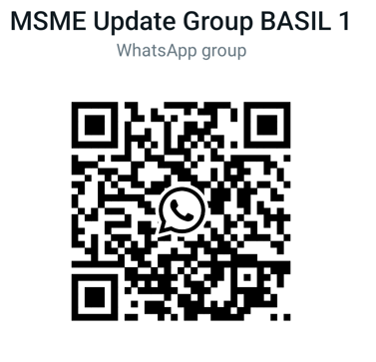
NAVIGATING MSMEs – PROFESSIONAL OPPORTUNITIES FOR CAs IN GOVT. INCENTIVES AND SUBSIDIES IN MSME SECTOR
Date: 27th June 2025, Friday
Venue: Vasai Branch of WIRC of ICAI
Presented By: CA Sachin Tulsyan
tulsyan.sachin@gmail.com
+91 99206 88003
Strictly Private & Confidential

Slide 2
Flow of Today’s Presentation
Definition of MSME
Various Subsidies & Incentives for MSMEs in Maharashtra
Various Subsidies & Incentives for MSMEs by Central Government
Fund Raising Opportunities for MSMEs
GEM Portal for MSMEs
TReDS Portal for MSMEs
MSME Samadhan

Slide 3
Universe of MSMEs in India
Total No. of MSMEs Enterprises in India – 7.00 Crores approx.
Total No. Registered MSMEs on Udyam Platform – 6.35 Crores
  Micro – 6.29 Crores
  Small – 4.72 Lacs
  Medium – 0.35 Lacs
MSME segment contribute 30% of GDP of India (India total GDP is approx. 3.5 Trillion USD)
MSMEs account for approx. 45% of overall exports and approx. 40% of the total manufacturing output in India
MSME sector Generates approx. 27 Crores Direct Employment Across Industries in India

Slide 4
Challenges of MSMEs in India
Lack of enough Finance in the absence of Collateral security
Timely recovery of dues from the customers
Competition from Large Businesses
Lack of skilled labours to operate new technologies
(Success of MSME sector is critical to the Success of Indian Economy and the Govt. is committed to Supporting and promoting MSMEs)

Slide 5
Major Announcements for MSME in Budget 2025
Four Pillars of Economy Agri, MSME, Investment, Exports
Broad Based the Definition of MSMEs
CGTMSE Cover for Micro and Small Enterprises Increased from Rs. 5 Crores to Rs. 10 Crores
Exporter MSMEs can get CGTMSE funding upto Rs. 20 Crores
New scheme for First Time Entrepreneurs by providing term loan upto Rs. 2 Crores
Customized Credit Card to Micro Enterprises with a Credit Limit of Rs. 5 Lakhs

Slide 6
Definition of MSME
Strictly Private & Confidential

Slide 7
New Definition of MSMEs
Revised Definition of MSME Enterprise (For Both Manufacturing & Service) (Revised in Year 2025)
Is Export turnover included????
Type of Enterprise | Investment in P&M | Total Turnover
Micro Enterprise | Upto Rs. 2.50 Crore (and) | Upto Rs. 10.00 Crores
Small Enterprise | Upto Rs. 25.00 Crores (and) | Upto Rs. 100.00 Crores
Medium Enterprise | Upto Rs. 125.00 Crores (and) | Upto Rs. 500.00 Crores

Slide 8
Some Important Definitions
Manufacturing Enterprises:
These are those enterprises which are engaged in the manufacture or production of goods relating to industry specified in the first schedule to the industries (Development and Regulation) Act, 1951 or employment of plant and machinery to add value to the final product.
Plant & Machinery:
The meaning of “plant and machinery or equipment”: This shall have the same meaning as assigned to the plant and Machinery in the Income Tax Rules, 1962, framed under the Income Tax Act, 1961. The investment shall include only all tangible assets. This excludes land and building, furniture & fittings.
(P&M cost Excluding GST and on Historical Cost).

Slide 9
Activities Excluded from Definition of MSME
Forest and Logging
Fishing and aquaculture
Wholesale, retail trade (Now covered only for Bank loan priority sector benefit purpose)
Activities of households as employees for domestic personnel
Undifferentiated goods and services producing activities of private households for own

Slide 10
Benefits of MSME Registration
Eligible for registration on GEM portal and its benefits
Eligible for TReDS Portal registration
Eligible for MSME Samadhan
Eligible for Various State and Central Government Subsidies
Eligible for classification under Priority sector for Banks and concessional rate of interest
Eligible for CGTMSE collateral free loan from Banks
Eligible for machinery finance under scheme of SIDBI at concessional rate of interest
Benefits under Income Tax Act Section 43B(h) (Payment within 45 days else disallowance)

Slide 11
About Subsidies and Incentives
Strictly Private & Confidential

Slide 12
Subsidies to MSMEs
Various Government Subsidies and Incentives for the MSMEs in Maharashtra :
Central Government and State Govt Focus on the MSME Development
Type of Subsidy i.e. Front Ended and Back Ended Subsidy and Credit Linked and Non Credit Linked Subsidies
Various Schemes of Subsidies of Central and State Government for MSMEs
Subsidies for MSMEs
State Government Subsidies
Central Government Subsidies

Slide 13
Various Subsidies for MSMEs in Maharashtra
Strictly Private & Confidential

Slide 14
WHY Maharashtra?
MH contribute to 14% of GDP of India
Various upcoming Industrial and Infra Projects In Maharashtra
State with One of the Best Road and Rail Connectivity in India
Mumbai being the Financial Capital of India

Slide 15
Upcoming New Infra In Maharashtra?
Wadhwan Port in Dahanu
New MIDC in Palghar District
Delhi Mumbai Expressway
Mumbai – Ahmedabad High Speed Rail Corridor (Bullet Train)
Mumbai – Nagpur High Speed Rail Corridor (Bullet Train)
Mumbai Nagpur Samruddhi Mahamarg Expressway
New MIDC in Aurangabad District (Bidkin Industrial Area)
PM Mega Integrated Textile Regions and Apparel (PM MITRA) Park - Amravati
Nagpur – Wardha National Mega Logistic Hub
Chhatrapati Sambhaji Nagar-Jalna, Thane-Bhiwandi, Ratnagiri-Sindhudurg, Pune-Purandar, and Palghar-Vadhavan State Logistic Hubs

Slide 16
Various State Govt Subsidies in Maharashtra
1. Package Scheme of Incentives 2019 | 9. Maharashtra IT/ITES Policy 2023
2. Scheme of Incentives for Women Entrepreneur - 2017 | 10. Maharashtra Defence Policy 2018
3. Maharashtra Electric Vehicle Policy – 2018 | 11. Maharashtra Maritime Development Policy 2023
4. Maharashtra Export Policy – 2023 | 12. Maharashtra Green Hydrogen Policy 2024
5. Chief Minister Food Processing Policy | 13. Chief Minister Employment Generation Programme (CMEGP)
6. Maharashtra Textile Policy – 2023 | 14. Maharashtra Electronics Policy – 2016
7. Maharashtra Tourism Policy 2024 | 15. Maharashtra Renewable Energy Policy 2020
8. Maharashtra Logistics Park Policy - 2024

Slide 17
Central Govt. Subsidies for MSMEs
National Agri Infra Fund (3% Interest Subsidy)
PM Kisan SAMPADA Yojana
NABARD Subsidy for Agri Infra
APEDA Subsidy For Food Processing Sector
NHB / NHM Subsidy for Horticulture sector
National Subsidy for Cold Storages

Slide 18
Package Scheme of Incentives 2019 for MSMEs in Maharashtra
Strictly Private & Confidential

Slide 19
Overview of PSI 2019 for MSMEs
Procedural Rules Under PSI 2019 were laid down Vide G.R. I.E. & L.D. No. IDL-7079/(2540) /IND-8, dated 11/8/1980 which were later amended vide G.R., I.E. & L.D. No. IDL-1088 / (6564) / IND-8 dated 20/7/1989 and G.R., I.E. & L.D. No. IDL-1089 / (7186) / IND-8 dated 27/3/1991
TOTAL BEDGET ALLOCATION FOR PSI-2019 IS RS. 3000 Crores

Slide 20
Objective and Purpose of PSI 2019
PSI Scheme Started in the Year 1964 and got renewed every 5 years thereafter
Objective:
Policy Envisages grant of fiscal and non fiscal incentives to MSMEs to ensure higher and sustainable economic growth of the state
Purpose:
Dispersal of Industries to lesser developed areas of the state
Local Employment Generation
Higher and inclusive industrial growth
Further improve the conducive industrial climate

Slide 21
Highlights of MH. State Schemes
MH. State Govt Schemes | Benefits | Applicability (New and Expansion Both)
Package Scheme of Incentives 2019 | Upto 100% of FCI – Revenue Linked | All Manufacturing Industries, Food Processing, Bio- Technology, Information Technology
Special Policy for Women Entrepreneur - 2017 | Fixed + Upto 100% of FCI – Revenue Linked | All Manufacturing Industries, Food Processing, Bio- Technology, Information Technology

Slide 22
Highlights of MH. State Schemes
MH. State Govt Schemes | Benefits | Applicability (New and Expansion Both)
Maharashtra State Electronics Policy - 2016 | Upto 100% of FCI – Revenue Linked | All types of electronics manufacturing units, Semi Conductors etc.
Maharashtra Electric Vehicles Policy - 2018 | Upto 100% of FCI – Revenue Linked | Manufacturing of Electric Vehicles, EV Components, EV Battery, EV Battery Components, Charging Stations etc.

Slide 23
PSI 2019 for MSMEs
Key Features of PSI 2019 for MSMEs:
Available on Investment in Land, Building, Plant & Machinery
Available for New as well as expansion Projects
Entire Maharashtra is Distributed under 7 Zones i.e. A, B, C, D, D+, No Industry Area and Aspirational Districts
Capital Subsidy from 30% to 100% of FCI (Fixed Capital Investment) based on Area Classification
Subsidy Available for a period of 7 to 10 Years period based on Location and Zone
Back End Subsidy and not Credit Linked

Slide 24
PSI 2019 for MSMEs
Key Definitions Under PSI 2019:
1. Definition of MSME (Old Definition)
Note: PSI subsidy as Medium Enterprise also available for units having Gross FCI upto Rs. 50 Crores (New Category)
Manufacturing Enterprise | Investment In Plant & Machinery
Micro | Upto Rs. 25 Lacs
Small | > Rs. 25 Lacs and upto Rs. 5 Crores
Medium | > Rs. 5 Crores and Upto Rs. 10 Crores

Slide 25
PSI 2019 for MSMEs
Key Definitions Under PSI 2019:
2. New Unit:
A New Unit shall mean a Unit which is set up for the first time by an entity in the Private Sector / Co-operative Sector / State / Joint Sector in any Taluka where there is no Existing Unit set up by the said entity, provided that such Unit satisfies the following conditions:
a) It is not an Existing Unit.
b) At least one of the Effective Steps is completed on or after the 1st April, 2019 for setting up the Unit.
c) It is not formed as a result of re-establishment, mere change of ownership, change in the constitution, reconstruction or revival of an Existing Unit.

Slide 26
Effective Steps under PSI 2019
Following Effective steps (atleast one) to be completed on or after 1.4.2019 by New unit to claim Subsidy under PSI 2019:
Constitution of Firm / Company / LLP
Effective Possession of Land
Effective Steps
Udyam Registration
MPCB Consent to Establish

Slide 27
PSI 2019 for MSMEs
Key Definitions Under PSI 2019:
3. Fixed Capital Investment:
The term Fixed Assets (FCI) shall mean and include:
(i) Land
(ii) Building
(iii) Plant and Machinery
(iv) Land development cost
(v) Installation Charges & Pre Operative Expenses
(vi) R&D Expenses

Slide 28
Applicability & Coverage of PSI 2019
The PSI 2019, as may be amended from time to time is applicable from 1.4.2019 to 31.3.2024.
Coverage of PSI 2019:
Industries Listed in the First Schedule of the Industries (Development & Regulation) Act, 1951
Manufacturing Enterprise as Defined in MSMED Act 2006
Bio Technology Manufacturing Units as specified by Govt from Time to Time
IT Manufacturing Unit registered with DIC
Mechanised Food & Agro Processing Units including Dairy, Grain Processing, Poultry, Non Alcoholic Beverages from Fruits & Vegetables

Slide 29
Thrust Sectors Under PSI 2019
Electric Vehicles
Aerospace & Defense Manufacturing
Textile Machinery Manufacturing
Sports & Gym Equipment Manufacturing
Bio Technology & Medical Devices Manufacturing
Agro & Food Processing
IT Products Manufacturing
Mineral Based Manufacturing Industries
Bio Fuel Production
Electronic System & Semi Conductor Manufacturing
Nuclear Power Plant Equipment Manufacturing

Slide 30
Basket of Incentives for MSMEs
Taluka Classification | Incentive % | Eligibility Period (In Years)
A | - | -
B | 30% | 7
C | 40% | 7
D | 50% | 10
D+ | 60% | 10
Vidharba, Marathwada, Ratnagiri, Sindhudurg & Dhule | 80% | 10
No Industry Districts, Naxalism Affected Areas and aspirational areas like Nandurbar | 100% | 10

Slide 31
PSI 2019 for MSMEs
For Food / Agro Processing units, additional subsidy of 20% and additional period of 2 years

Slide 32
Area Classification Near Mumbai
District | Group A | Group B | Group C | Group D | Group D+
Greater Mumbai | Greater Mumbai
Thane | Thane, Kalyan, Ullhasnagar, Ambarnath, Bhivandi@ | Murbad | Bhivandi $ Shahpur
Nashik |  | Nashik | Niphad Sinnar | Dindori Yeola Igatpuri | Velhe

Slide 33
Area Classification Near Mumbai
District | Group A | Group B | Group C | Group D | Group D+
Palghar | Vasai Palghar | Dahanu |  |  | Jawhar Mokhada Talasari Wada Vikramghad
Raigad | Alibaug@ Uran Panvel Karjat@ Khalapur Pen Roha | Alibaug$ Sudhagad | Karjat$ Mahad Mangaon Murud | Shrivardhan | Poladpur Mhasala Tala

Slide 34
Area Classification Near Mumbai
District | Group A | Group B | Group C | Group D | Group D+
Ratnagiri |  |  | Ratnagiri Chiplun | Khed | Guhagar Dapoli Lanja Mandangad Rajapur Sangameshwar
Sindhudurg |  |  |  | Vengurla | Kankavali Kudal Sawantwadi Malvan Deogad

Slide 35
Area Classification Near Nagpur
District | Group A | Group B | Group C | Group D | Group D+ (Vidharbha)
Nagpur |  |  |  | Nagpur City | Nagpur (R) Kamptee Hingana Katol Narkhed Savner Kalmeshwar Ramtek Parseoni Mauda Umred Bhiwapur Kuhi

Slide 36
Area Classification Near Pune
District | Group A | Group B | Group C | Group D | Group D+
Pune | Pune City Maval Haveli@ Bhor@ Daund@ Shirur@ khed@ Mulshi@ Purandar@ Velhe@ |  | Bhor$ Daund$ Shirur$ khed$ Purandar$ Indapur Baramati | Ambegaon Junnar | Velhe$

Slide 37
Area Classification Near Pune
District | Group A | Group B | Group C | Group D | Group D+
Satara |  |  |  | Satara Khandala Koregaon Phaltan Khatav Mahabaleshwar | Wai Man Patan Jaoli
Solapur |  |  |  | Solapur (North) Pandarpur Malshiras | Barshi Akkalkot Solapur (South) Mohol Mangalwedhe Sangole Karmala madha

Slide 38
Basket of Incentives for MSMEs under PSI
Stamp Duty Exemption on Purchase of Land
SGST Payable on Total Sales
Interest Subsidy on Term Loan
Electricity Tariff
Electricity Duty Exemption
Under 4.8 Clause
5% TUFS subsidy for units in A Zone (for Expansion P&M)
Other subsidies on Installation of Power Saving Equipments, Electric Audit, Installation of Effluent Treatment Plant (ETP) etc.

Slide 39
Subsidy for Expansion Units
What is an Expansion Unit:
A Unit in Production prior to 1.4.2019
A unit which has been granted EC or has availed any incentive under earlier Schemes

Slide 40
Subsidy for Expansion Units
Conditions for Expansion:
Additional Investment should be more than 25% of the Gross FCI of immediate Previous year
Increase in capacity by atleast 25%
Increase in employment by atleast 10%

Slide 41
Implementing Agencies
For: Micro and Small Enterprises: District Industries Centre (DIC)
For Medium Enterprises: Regional Joint Director of Industries (JDI)

Slide 42
Basic Requirements to claim PSI Subsidy
Land Should be NA
Building Plan Approved by Town Planning
Udyam Registration
MPCB Consent to Establish
MPCB Consent To Operate
Project to be Appraised by a Bank / SICOM

Slide 43
Process of Obtaining PSI Subsidy
Acquisition of Project Land (NA Land must)
Take Stamp Duty Exemption on Land Purchase (If Applicable)
Town Planning Approved Building Plan Must
Preparation of Project Report
Project Finance Term Loan Approval From Bank (If Needed)
MPCB Consent To Establish
Complete Project
Obtain MPCB Consent to Operate
Apply for PSI Subsidy application within 30 days of 1st Billing
Obtain Eligibility Certificate
Submission of Yearly Claims of SGST, Bank Interest, Electricity Tariff etc.

Slide 44
State Govt Subsidy
Chief Minister Food Processing Policy - 2017
Strictly Private & Confidential

Slide 45
CM Food Processing Policy Key Features
Eligible Products:
Processing of Food Products like Manufacturing of Spices, Floor, Ketchup, Dal Mill, Rice Mill, Oil Mill, Dairy Products, Cold Chain, Cold Storages, Fruits & Vegetables Processing, Pulses Processing, etc.
Project anywhere in Maharashtra
It is a Credit Linked Subsidy
Back Ended Subsidy (subsidy amt kept with bank)
Subsidy Available on Investment in Land, Building, P&M
Max. Subsidy is Rs. 50 Lacs or 30% of Project cost, whichever is less

Slide 46
State Govt Subsidy
Chief Minister Employment Generation Programme (CMEGP Subsidy)
Strictly Private & Confidential

Slide 47
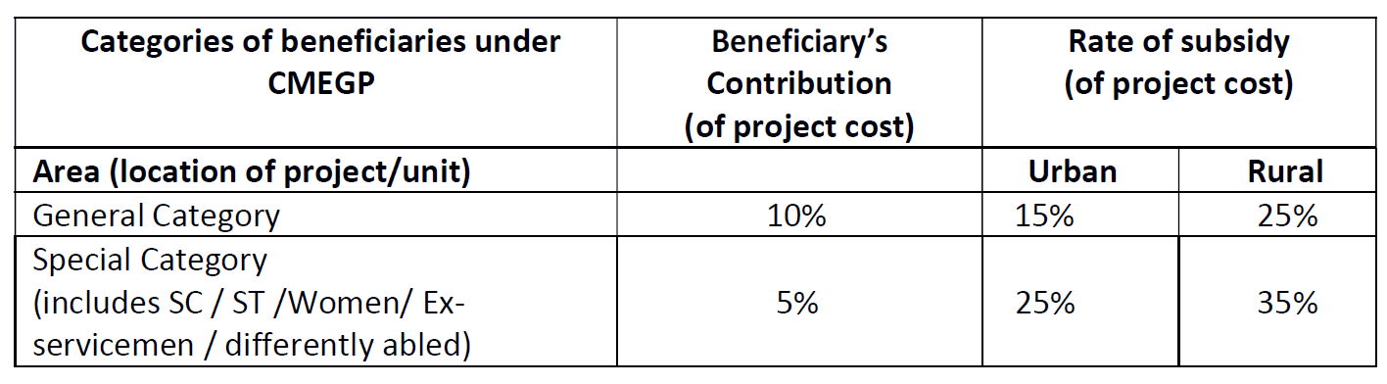
CMEGP Subsidy Key Features
Project Cost Eligibility Criteria
For MSME Manufacturing Projects – Project Cost Max. Rs. 100 Lakhs
Quantum of Financial Assistance Subsidy and Bank Funding Under CMEGP:

Slide 48
CMEGP Subsidy Key Features
It is a Credit Linked Subsidy
All manufacturing units (any sector) are eligible for this subsidy
Back Ended Subsidy (subsidy amt. kept with bank for 3 years)
Subsidy Available on Investment in Land, Building, P&M, Furniture & Fixture, Computers, etc.
Implementing and Approving Agency for CMEGP Subsidy are District level DICs
Age Limit of Owner Max. 45 Years. For women extra 5 years i.e. upto 50 Years.

Slide 49
Central Govt Subsidy
National Agri Infra Fund Scheme
Strictly Private & Confidential

Slide 50
National Agri Infra Fund - Key Features
Eligible Products:
Cold Storages
Agri Warehouses
Nursery
Tissue Culture
Seed Processing
Organic Input Production
Cold Chains, Refer Vans etc.
Primary Processing Units (Cleaning, Grading, Sorting etc.)
Secondary Food Processing Units (newly added) (like Spices, Biscuits, Ketchup unit, Syrups etc.)
Project anywhere in India
Credit linked subsidy

Slide 51
National Agri Infra Fund - Key Features
Subsidy is Interest Subsidy of 3% on Term Loan (upto Rs. 2 Crores)
Project Can be of more than Rs. 2 Crores
Period upto the Term Loan period (Max 7 years)
Credited after end of Year Directly in Bank Account
Eligible Banks are Nationalised Banks, Private Banks, Scheduled Co Operative Banks
Can apply for this subsidy even after disbursement from Bank

Slide 52
Central Govt Subsidy
NHB Subsidy For Cold Storages
Strictly Private & Confidential

Slide 53
NHB Subsidy for Cold Storages - Key Features
Eligible Products:
Construction of Agri Product Cold Storage
Expansion of Cold Storages
Project anywhere in India
Credit linked subsidy
Back Ended Subsidy
Subsidy @35% of Project Cost
Max Capacity of Subsidy 10,000 MT
Minimum Capacity 5,000 MT
Capital Cost Per Tonne of Cold Storage capped to Rs. 8000 Per MT

Slide 54
Central Govt Subsidy
PM Kisan SAMPADA Yojana – Creation / Expansion of Food Processing Units
Strictly Private & Confidential

Slide 55
Creation / Expansion Food Processing Unit Subsidy:
Eligible Products:
Fruits & Vegetable Processing
Milk Processing
Meat / Poultry / Fish Processing
Ready to Eat / Ready to Cook / Breakfast Cereals / Snacks / Bakery / products
Grains / Pulses Processing
Oil Seed Milling
Rice Milling
Natural Food Flavours / Food Colours manufacturing
Project anywhere in India
Credit linked subsidy
Front Ended Subsidy (release in 2 installments)

Slide 56
Creation / Expansion Food Processing Unit Subsidy:
Subsidy is 35% of Project Cost
Max Subsidy Rs. 5 Crores
Available on Investment on Building Civil Cost, Plant & Machinery (Not on Land investment)

Slide 57
Bank Funding Options for MSMEs
Strictly Private & Confidential

Slide 58
Bank Funding for MSMEs
CGTMSE Scheme Collateral Free Loans
Currently Upto Rs. 10 Crores
For Both Term Loan and Working Capital
Insurance Premium currently around 1%
Some nationalized banks are aggressive in this Scheme
Stand Up India Scheme
Loan upto Rs. 50 Lacs
For Term Loan and Working Capital Both
Interest rate concession for Women Entrepreneur
Fast Processing
Separate Department in some Nationalised Banks for this Scheme

Slide 59
Bank Funding for MSMEs
MSME dedicated branches of PSU banks across country
PSU Banks recently opened Startup dedicated branches also (BOB SME Loan Factory, SBI SME Cell,, Central Bank of India, Bank of India etc.)
SIDBI branches across countries catering to needs of MSMEs
SIDBI loans at very concessional rates and lesser collateral security

Slide 60
GEM Portal for MSMEs
Strictly Private & Confidential

Slide 61
Benefits of GEM Portal Registration
What is GEM Portal:
The Government e-Marketplace (GeM) is basically an e-commerce portal operated by the Government of India. It is an online platform where sellers and government buyers meet to facilitate the procurement of Goods & Services that are required by different Government Departments, Organizations, and Public Sector Undertakings.
- GEM Portal was launched in August 2016
- It took pace of registrations in the year 2020 onwards

Slide 62
Who Can Be Seller on GEM Portal
Who can be seller on GEM Portal ? ? ?
Any OEM Manufacturer
Authorised Channel Partners of OEMs
Authorisesd Dealers of OEMs
In Case of Imported Goods, Authorised Importers of OEMs
Can CA Firms register themselves on GEM portal as service Providers???

Slide 63
ICAI Clarification on GEM portal
The ICAI vide Announcement dated March 04, 2022 issued clarification with regard to chartered accountants in Practice/Firms of chartered accountants registering themselves on Government e-marketplace (“GeM”) Portal.
It is hereby clarified that the Chartered Accountants in Practice/Firms of chartered accountants are permitted to register on GeM Portal for rendering professional services. The information being published on the portal should be in compliance with the provisions of Code of Ethics.

Slide 64
Who Can Be Buyers on GEM Portal
Who can be Buyers on GEM Portal ? ? ?
Central and State Govt Ministries (Railway, Defence)
Public Sector Enterprises
Public Sector Banks
Public Sector Finance Companies
Public Sector Insurance Companies
Local Bodies like BMC, PMC etc. in Maharashtra

Slide 65
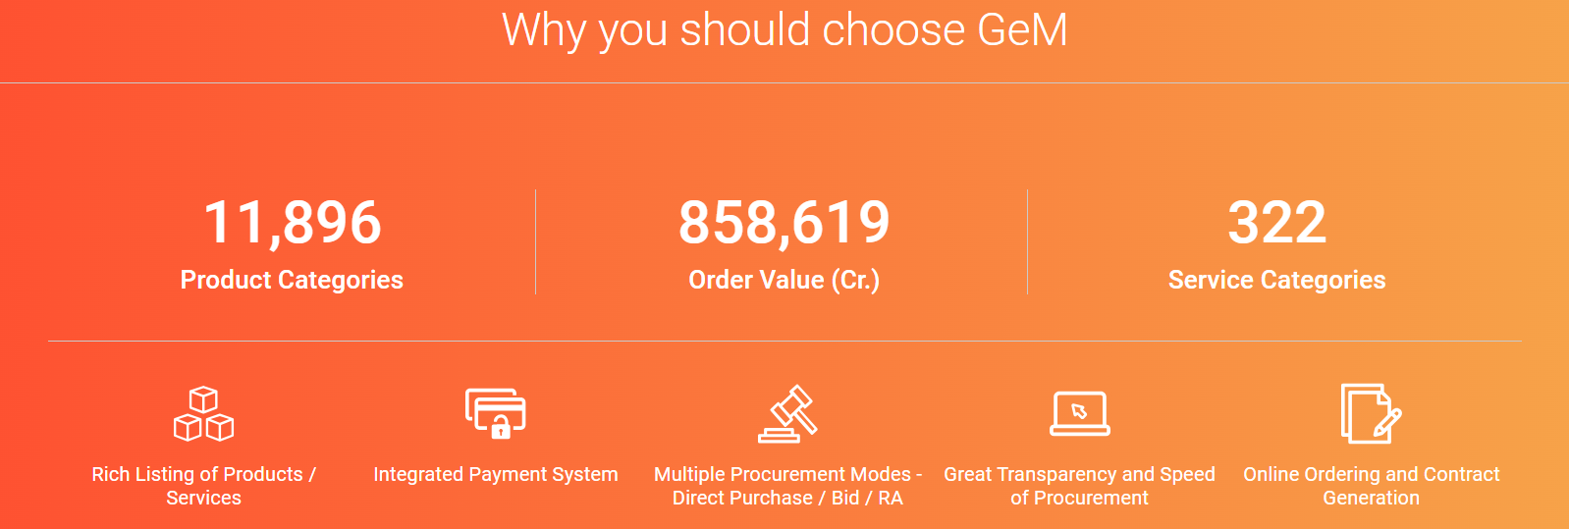
Why to Use GEM Portal

Slide 66
Some Date Points of GEM Portal
Till Date approx. 9.00 Lacs sellers registered on GEM portal
Processed orders worth Rs. 2.50 Lakh Crores in FY 2023-24
Processed orders worth Rs. 1.52 Lakh Crores in FY 2022-23
In FY 2021-22 it was Rs. 1.06 Lakh crores orders processed on GEM portal

Slide 67
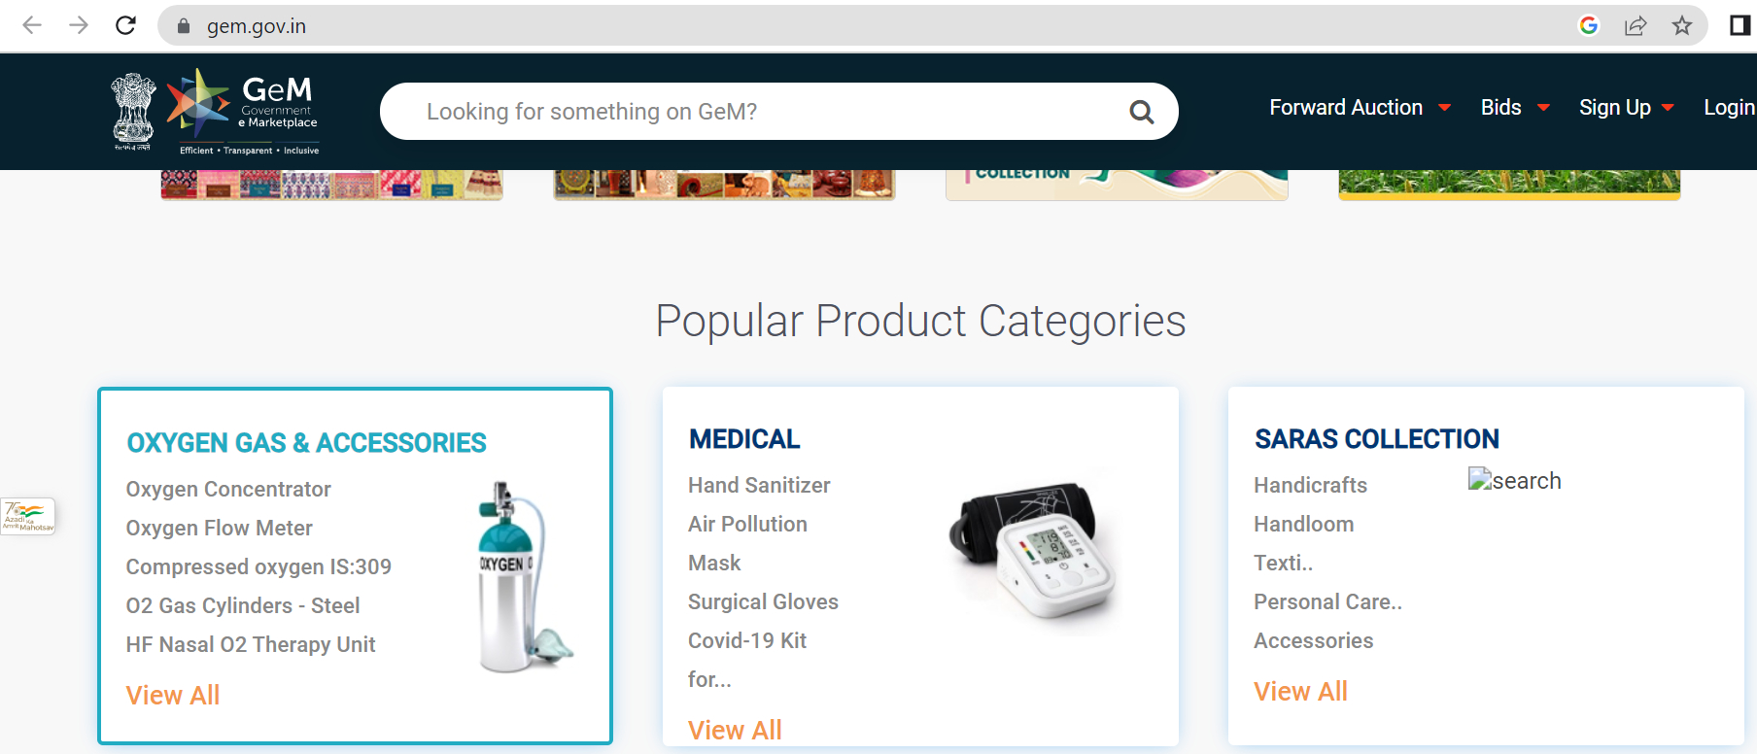
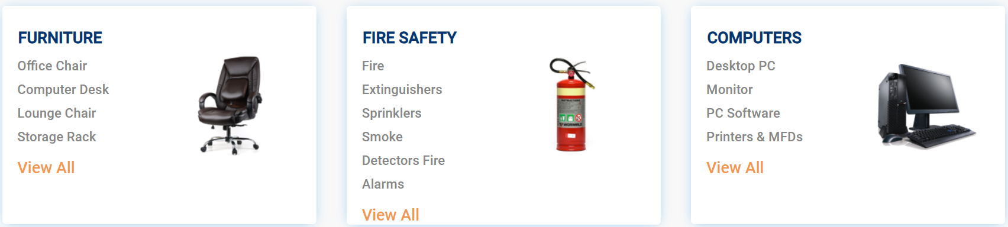
Benefits of GEM Portal Registration
Some Popular Product Categories:

Slide 68
Benefits of GEM Portal Registration
GeM Portal Advantages for Sellers
Sellers get access to the National Public Procurement market.
There is no fee or charge for registration.
The sellers will be able to view the reasons for rejection if the consignee rejects goods.
Direct access to government organizations and departments.
Price can be changed based on the market conditions.

Slide 69
TReDS Portal for MSMEs
Strictly Private & Confidential

Slide 70
Benefits of TReDS Portal Registration
What is TReDS Portal:
Trade Receivables Discounting System is a step by the RBI to regulate the trade receivables between MSMEs, Large Corporates and Financiers.
TReDS is an institutional mechanism set up in order to facilitate the discounting of trade receivables of MSMEs from corporate buyers through invoice discounting by multiple financiers.
This step is deemed to augment the trade account receivable management of the micro small & medium enterprises.
3 portals available for TReDS:
www.rxil.in
www.m1exchange.com
www.invoicemart.com

Slide 71
Benefits of TReDS Portal Registration
Benefits of TReDS Portal:
Easy Access to Working Capital
Collateral Free Funding
Get Funds in 24Hrs
Seamless & Secure Digital Platform
Faster Business Expansion & Growth
Off Balance Sheet Bill Discounting
Competitive Discount Rates

Slide 72
MSME SAMADHAAN
Strictly Private & Confidential

Slide 73
MSME Samadhaan and Its Benefits
What is MSME Samadhaan:
MSME SAMADHAAN- Mechanism to resolve Delayed Payments to Micro and Small Enterprises under Micro, Small and Medium Enterprise Development (MSMED) Act, 2006
It falls under MSMED Act 2006
The Micro, Small and Medium Enterprise Development (MSMED) Act, 2006 contains provisions of Delayed Payment to Micro and Small Enterprise (MSEs). (Section 15- 24).
State Governments to establish Micro and Small Enterprise Facilitation Council (MSEFC) for settlement of disputes on getting references/filing on Delayed payments. (Section 20 and 21)

Slide 74
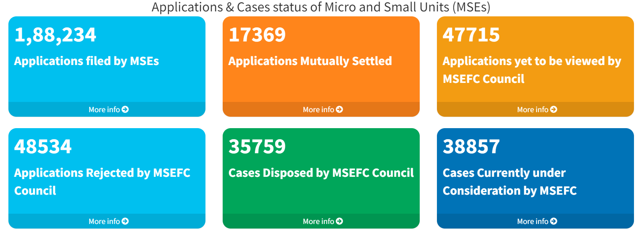
Some Key Data of MSME Samadhaan

Slide 75
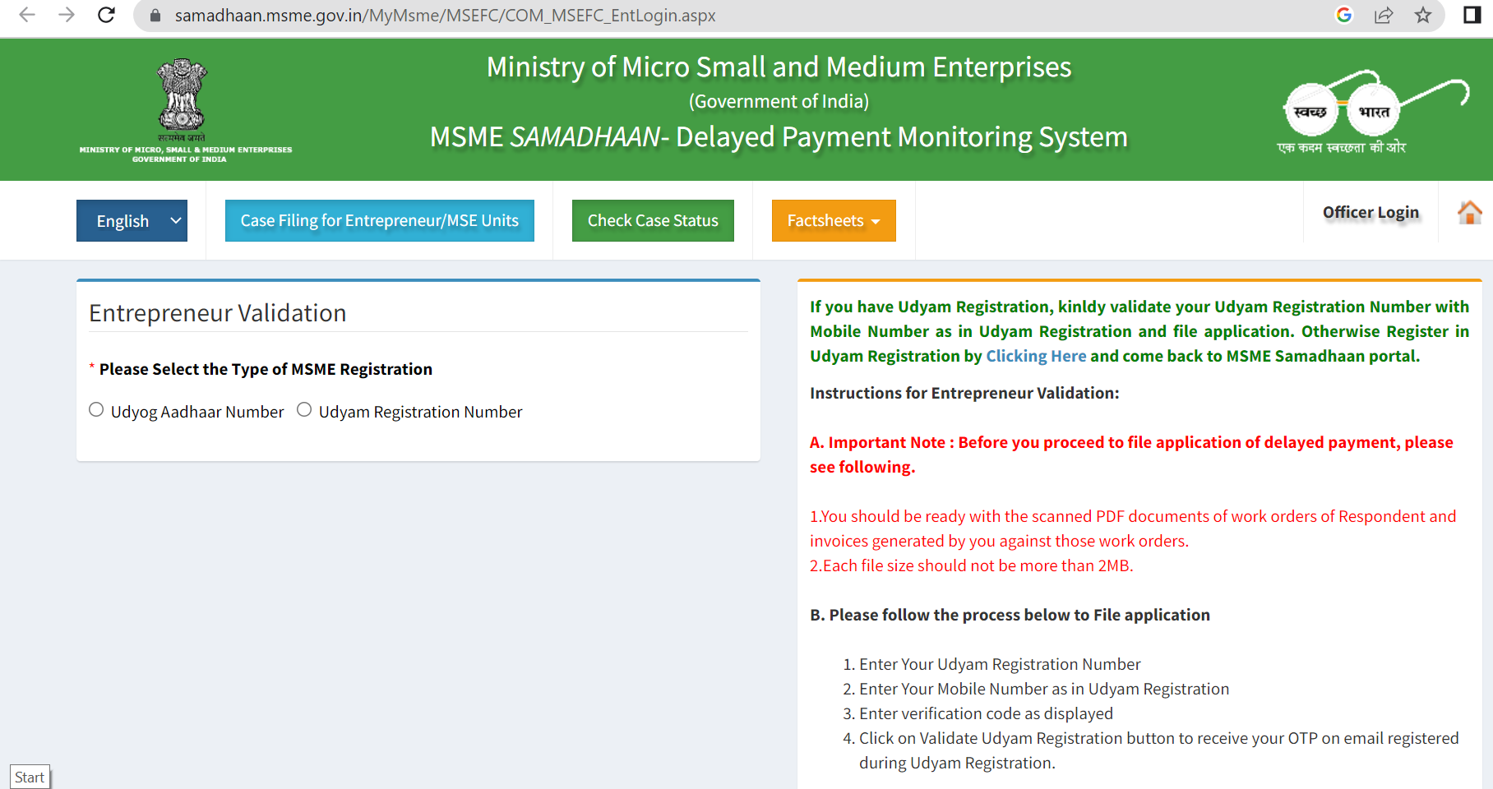
View of MSME Samadhaan Website

Slide 76
MSME Samadhaan and Its Benefits
Nature of assistance:
MSEFC of the State after examining the case filed by MSE unit will issue directions to the buyer unit for payment of due amount along with interest as per the provisions under the MSMED Act 2006.
Who can apply
Any Micro or small enterprise (Not Medium) having valid Udyam Registration can apply.
Registration of case on MSME Samadhaan website is free of cost
A professional like CA can assist in filing of application on portal
MSME Samadhaan is available only for Manufacturers and Service Providers. (Not for Wholesale and retail Traders)
Can a CA firm also file case under MSME Samadhan to recover its dues????

Slide 77
MSME Samadhaan and Its Benefits
Key Documents Required:
PDF documents of work orders of Respondent and invoices generated against those orders
In case the purchase order is oral an affidavit to that effect is to be submitted

Slide 78
MSME Samadhaan and Its Benefits
Salient Features:
The buyer is liable to pay compound interest with the monthly rests to the supplier on the amount at the three times of the bank rate notified by RBI in case he does not make payment to the supplier for his supplies of goods or services within 15days / 45 days of the acceptance of the goods/service rendered. (Section 16)

Slide 79
MSME Samadhaan and Its Benefits
Salient Features:
State Governments to notify (i) Authority for filing Entrepreneur Memorandum (ii) Rules of MSEFC and (iii) Constitution of MSEFC.
All States/UTs have notified Authority for Filing Entrepreneur's Memorandum, have Notified rules of MSEFC and all the 37 States/UTs have constituted MSEFCs, as per provisions laid down under MSMED Act 2006.

Slide 80
MSME Samadhaan and Its Benefits
Salient Features:
Every reference made to MSEFC shall be decided within a period of ninety days from the date of making such a reference as per provisions laid in the Act.
MSEFC gives a chance of 3 hearings to both the parties and thereafter within 90 days, decide the case.
If the Appellant (buyer of goods) wants to file an appeal, no application for setting aside any decree or award by the MSEFC shall be entertained by any court unless the appellant (buyer of goods) has deposited with it, the 75% of the award amount. (Section 19)

Slide 81
MSME Samadhaan and Its Benefits
Salient Features of MSME Samadhaan Online Portal:
The portal facilitates the entrepreneurs in monitoring the delayed payments effectively.
The information on the portal will be available in the public domain.
The MSMEs will also be empowered to access the portal and monitor their cases.
The CEOs of PSEs and the secretary of the Ministries concerned will also monitor the delayed payment of MSEs and issues quickly.
Enterprises can register the cases if they do not get the amount within 15 days / 45 days from PSUs or government agencies.

Slide 82

Contact Details
CA Sachin Tulsyan
tulsyan.sachin@gmail.com
+91 99206 88003
Offices in Mumbai, Pune, Delhi
(For regular Updates on various schemes for MSMEs You May like to join our WhatsApp group: https://chat.whatsapp.com/ERlkMEEsqRK7mHnObcKEWy
Can also Scan below QR Code to join WhatsApp MSME Updates Group:
Thank You

