Slide 1
Peer Review Procedures and reporting procedure and AQMM Reporting
A comprehensive guide to understanding the peer review process for assurance engagements, including coverage requirements, procedures, reporting standards, and the importance of Audit Quality Maturity Model (AQMM) compliance.

Slide 2
Table of contents
1.Coverage of peer Review
2.Various forms
3.Peer Review Process
4.Advisories for Peer Process
5.Illustrative Qualifications
6.Critifical points
7.AQMM
8.Cotents of final report
9.Common queries from PRB

Slide 3
Coverage of Peer Review
assurance engagements
(2) A Practice Unit having one or more branches- Consolidated report
(3) The Peer Review shall cover:
(i) Compliance with Technical, Professional and Ethical Standards.
(ii) Quality of reporting.
(iii) Systems and procedures for carrying out assurance services.
(iv) Self evaluation under AQMM or any other guideline issued by the Centre for Audit Quality.
(v) Training programmes for staff (including article and audit assistants) concerned with assurance functions,
including availability of appropriate infrastructure.
(vi) Compliance with directions and / or guidelines issued by the Council to its Members, including fees to be charged, number of audits undertaken, register for Assurance Engagements conducted during the year and such other related records.
(vii) Compliance with directions and / or guidelines issued by the Council in relation to article assistants and / or audit assistants, including attendance register, work diaries, stipend payments, and such other related records.

Slide 4

Various Forms
Various forms -Word/ Excel/ PDF along with clarification
https://www.icai.org/post/prb-applicable-forms

Slide 5
Peer Review Process
The peer review follows a structured approach from planning through execution to final reporting. Reviewers must follow specific procedures while examining the Practice Unit's compliance with professional standards.
Planning
Initial assessment, questionnaire review, and sample selection
Execution
On-site procedures, evidence gathering, and compliance verification
Reporting
Preliminary findings, Practice Unit response, and final report submission

Slide 6
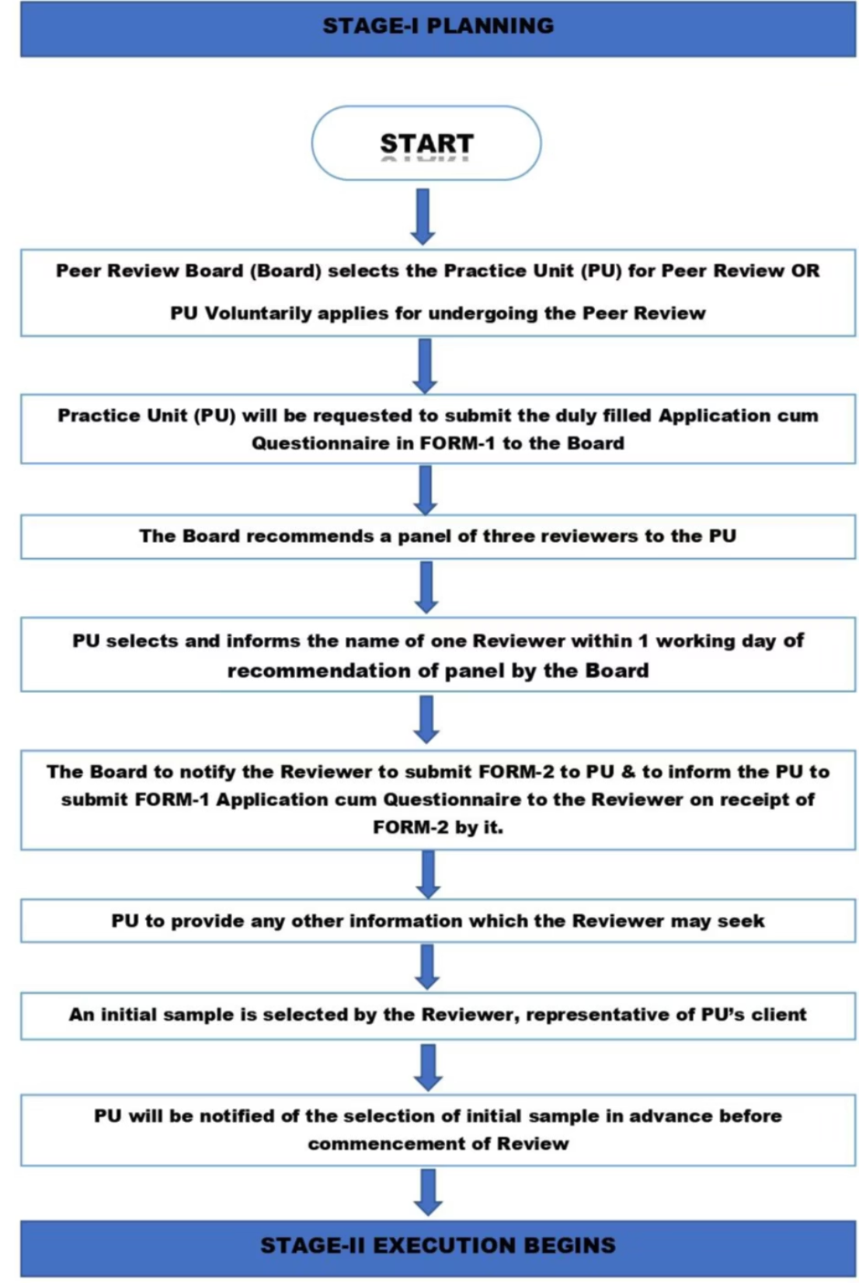
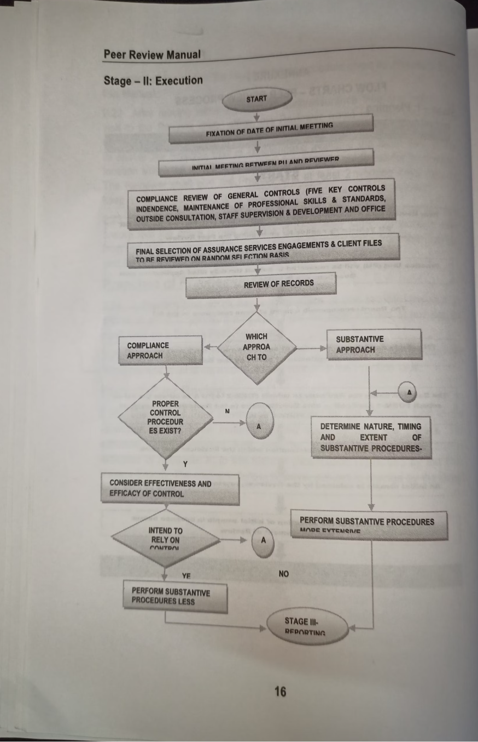
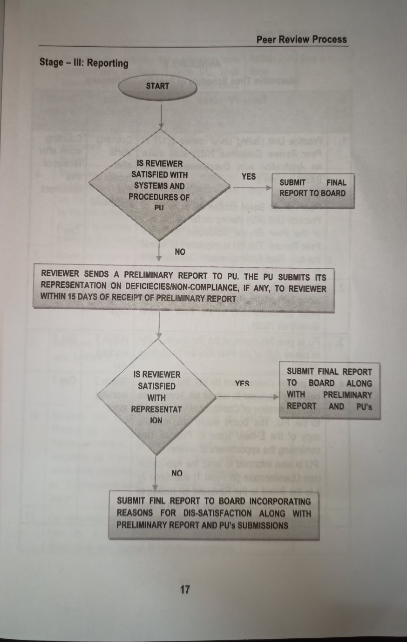
`

Slide 7
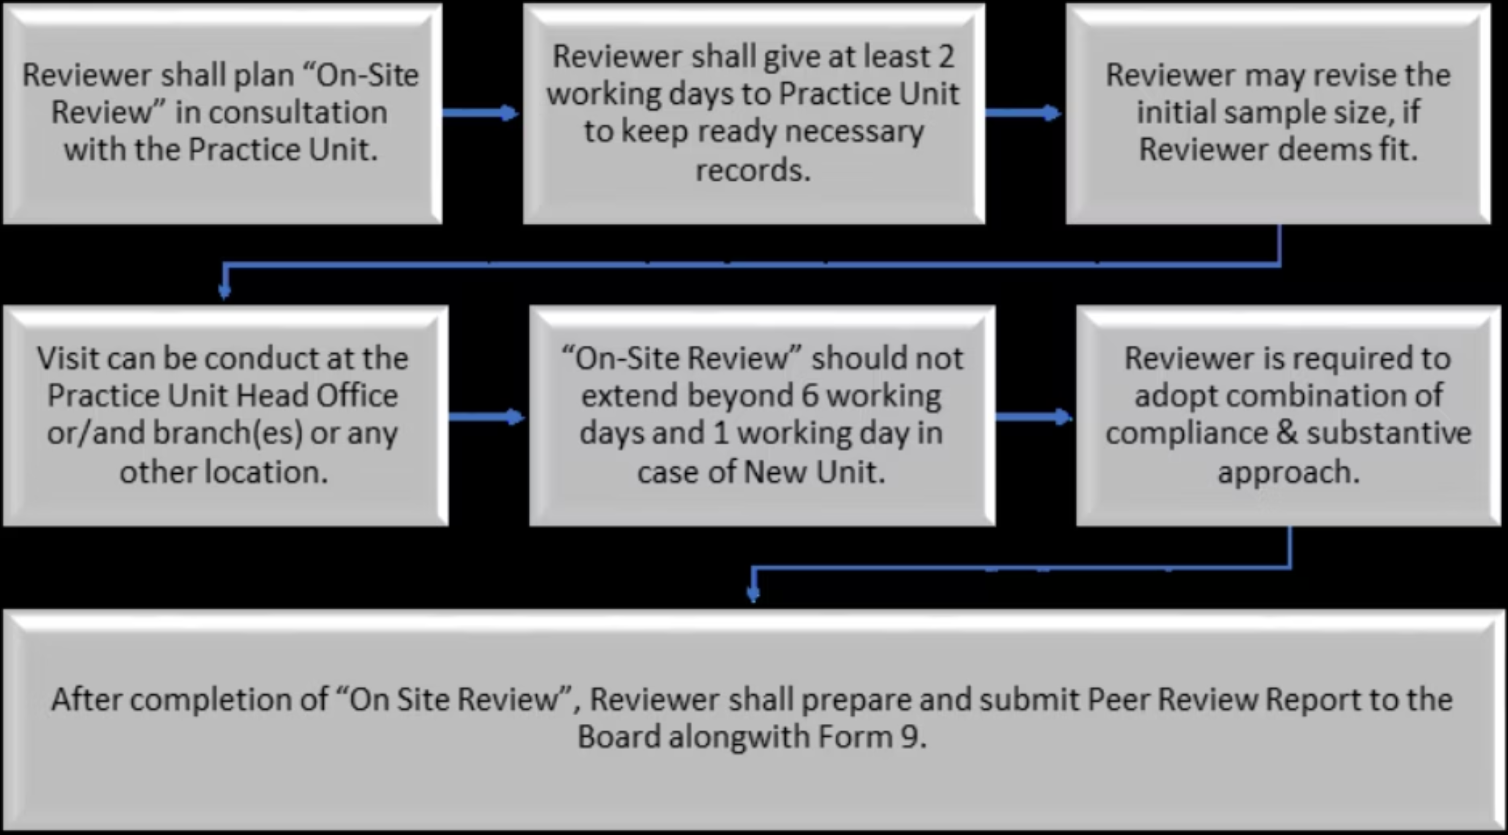
On-site Procedure:-

Slide 8
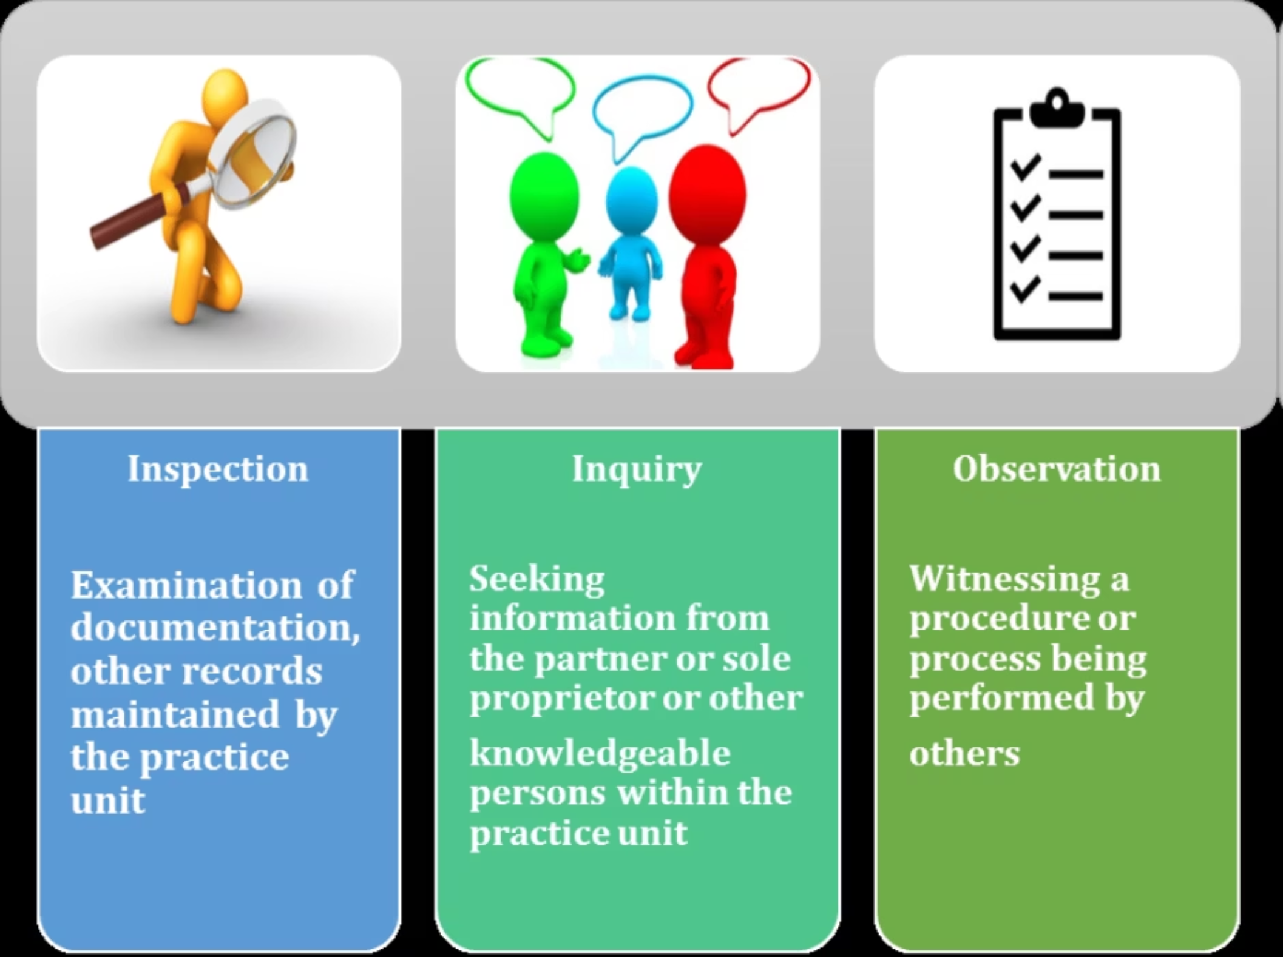
METHODS TO OBTAIN SUFFICIENT APPROPRIATE AUDIT EVIDENCE:-

Slide 9
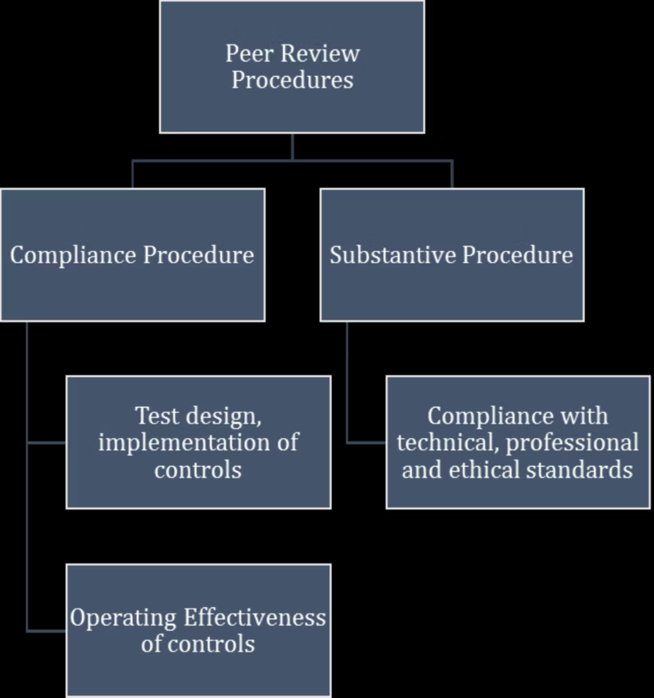
PEER REVIEW PROCEDURES:-

Slide 10
Compliance Review procedure
Independence
Outside consultation
Maintenance of professional skills and standards
Staff supervision and development
Office Administration

Slide 11
Illustrative checklist of the PU
Preliminary review procedures
Audit Planning
Performance
Senior review checklist
Partner Review checklist
Final audit file and check point

Slide 12
Checklist for Reviewer regarding PU
Technical standards
Ethical standards
Accounting Standards
INDs As
Standards on Auditing
Working Papers

Slide 13
Advisories for Peer Reviewers
Professional Conduct
Never use firm letterhead for Board or PU correspondence
Adhere to applicable Standards on Auditing
Document working papers thoroughly (SA 230)
Obtain written representations when required (SA 580)
Send engagement letter to Practice Unit (SA 210)
UDIN Reco , Peer review period , Document date and not UDIN date
Customised checklist
An unqualified report may be issued only if there is reasonable compliance with the four focus areas: 1.Technical standards, 2.Reporting quality, 3.Office systems, and 4.Training programs.

Slide 14
findings of last peer review have been implemented by PU
Reviewer can give recommendation for on the best practices followed by other peer review firms

Slide 15
SOME ILLUSTRATIVE QUALIFICATIONS
Staff Expertise Issues
Internal Control Evaluation
Deployment of inexperienced staff lacking industry expertise, with no evidence of review by senior resources
No evaluation of control environment or testing of internal controls over financial reporting per SA 315 and SA 330
Sampling Methodology
Going Concern Assessment
No stated methodology for sample design, size, or selection; samples not free from bias; no projection of misstatements
Failure to evaluate management's going concern assessment despite significant financial distress indicators
These qualification examples highlight common deficiencies found during peer
reviews that may lead to qualified reports.

Slide 16
Critical Points for Successful Peer Review
SQC 1 policy implementation is crucial, tailored to the size and operating characteristics of the Practice Unit
Sample selection methodology must be appropriate and well-documented
Comprehensive documentation is essential throughout the review process
Utilize standard checklists for Standards on Auditing and Accounting Standards-(Refer Peer Manual Manual I )
Special attention required for listed companies (refer to Peer Review Manual II)-Note on applicability of listing agreement, checking records
Mutual co-operation
Peer Review Board Reserves right to ask for working papers

Slide 17
AQMM
Mandatory for firms carrying out audit of :
listed entity or
Banks other than co operative banks (except multi-state co opbanks) branch audit are
not covered.;
or Insurance Companies.
Recommendatory for others
New AQMM 2.0 is applicable w.e.f. 1st April 2025 (Practice mngt, HR, Digital competency).Score criteria , score basis, Presence , Implementation , Negative marking
Minimum Ratings for each section is required and on aggregate basis.
AQMM level is to be mentioned in final report . Level 1 lower, 4 highest
AQMM level is printed in the certificates and displayed on Peer Review website
Statistical point counting is imp
Provide Qualitative suggestions to PU

Slide 18
Form 1
Part A –Application cum questionnaire
Part B -GENERAL CONTROLS (Based on SQC 1) -(Not applicable for New Units)
Broadly, PU system of quality control should include policies and procedures addressing leadership responsibility, ethical requirements, acceptance and continuance of client relationship, Human Resources, Engagement Performance and Monitoring etc.
Part C –AQMM
Quality control Manual on accordance with SQC 1 policy

Slide 19
Contents of final reports to be sent to Peer Review Board:-
1.Checklist -Annexure A
2.Form 9 ( signed by Peer Reviewer and PU)
3.Final Report
4.Annexure I
5.Annexure II
6.Annexure III (AQMM)
7.List of samples selected
8.Fees receipt / confirmation
9.Preliminary report ( if any), PU’s response, Reviewers confirmation about satisfaction
10.Application form cum questionnaire

Slide 20
Common queries (clarificatory ) received from PRB:-
1. Internal Mismatch –Application form, Annexure I, II, III and final report
2. Mismatch-ICAI records and application form, final report
3. AQMM –Point scoring scoring – calculation and rewarding points basis.
Scores awarded by Reviewer is to be considered.
Diff. to be explained by Reviwer
4. Sr no 22-Annexure A- client in specified format
5. Sample section –in specified format

Slide 21
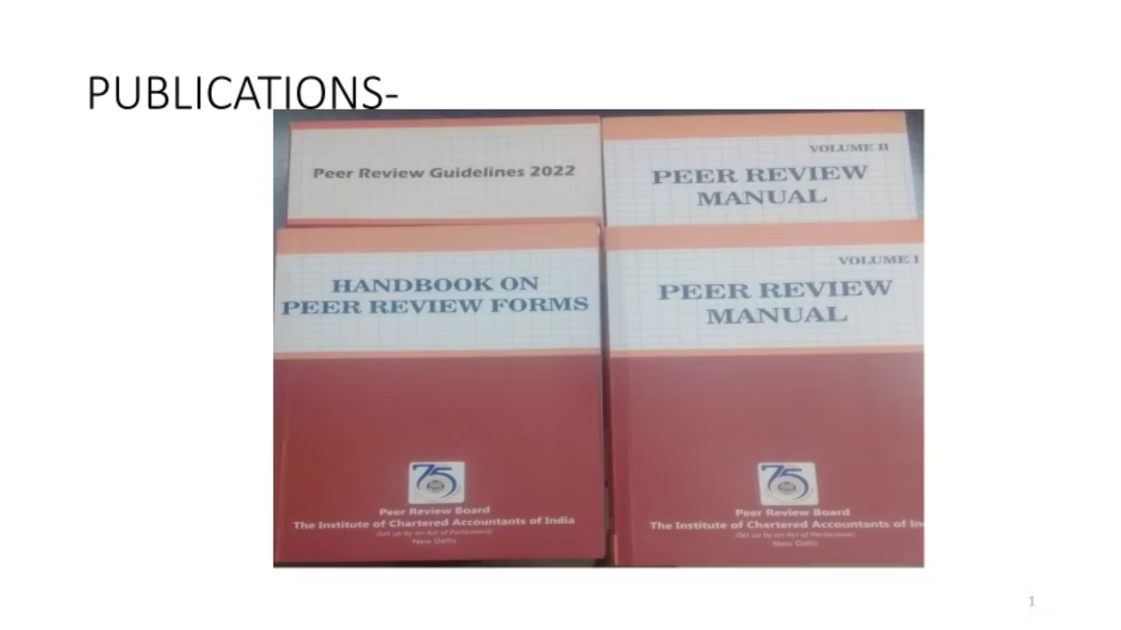
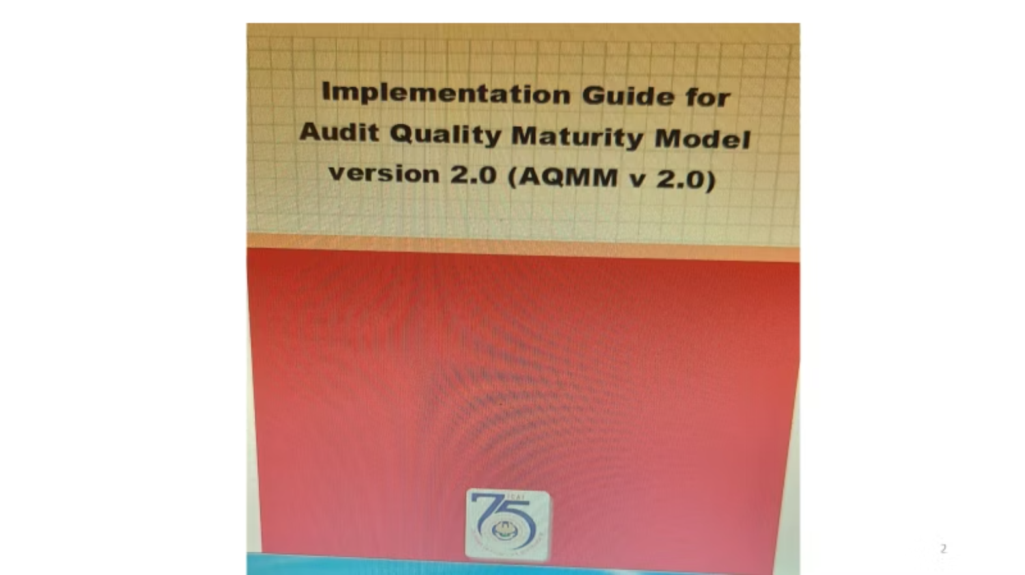

Peer Review Board website
Implementation guide on SQC1

Slide 22
Thank you
CA Samir Kasvala
Mob : 9833222524
Email : samir@kasvalaassociates.com

