Slide 1
Peer Review :
Rationale and significance of Peer Review

Slide 2
Table of contents
1. Objectives
2. Key Definitions
3. Coverage of peer review
4. Implementation Timeline
5. Peer Reviewer : Eligibility, obligations, fees
6. Various forms
7. Critical points

Slide 3
Objectives
proper systems and procedures , including documentation, for quality assurance.
Technical, Professional, and Ethical Standards. AQMM ,and other regulatory requirements by council / committee . Implemented and Consistently applied throughout the samples selected .
Transparency in technical standards used , techniques used to get desirable audit result. No relationship with disciplinary or other regulatory mechanism.
all the practicing members rendering service -highest standards.
status of ICAI as regulator and PU
To Build credibility and trust among clients and public
To Identify areas for professional development.
To Recognition by regulators like SEBI & CAG.
Voluntarily Client may prefer

Slide 4
Key Definitions
Assurance Engagement – as defined in the Framework for Assurance Engagements issued by the Institute of Chartered Accountants of India and as may be amended from time to time means an engagement in which a practitioner expresses a conclusion designed to enhance the degree of confidence of the intended users other than the responsible party about the outcome of the evaluation or measurement of a subject matter against criteria but does not include:
(i) Management Consultancy Engagements;
(ii) Representation before various Authorities;
(iii) Engagements to prepare tax returns or advising clients in taxation matters;
(iv)Engagements for the compilation of financial statements;
(v) Engagements solely to assist the client in preparing, compiling or collating information other than financial statements;
(vi) Testifying as an expert witness;
(vii) Providing expert opinion on points of principle, such as Accounting Standards or the applicability of certain laws, on the basis of facts provided by the client;
(viii) Engagement for Due diligence and
(ix) other service not prescribed by the Council to be ‘Assurance Engagement’.
Audit Services / Attestation Functions /Audit Functions

Slide 5
Branch Peer Reviewer – means a Reviewer appointed to conduct the Peer Review of the Branch of a Practice Unit. The qualifications and other obligations and duties of the Branch Peer Reviewer shall be the same as that of the Reviewer;
New Unit - means a firm whose date of establishment is less than 12 months immediately preceding the date of receipt of application of Peer Review and which may or may not have rendered any assurance service during the said period or a Practice Unit in existence for a period exceeding 12 months but not rendering any assurance services;
Peer Review - means an examination and review of the systems and procedures to determine whether the same have been put in place by the Practice Unit for ensuring the quality of assurance services as envisaged by the Technical, Professional and Ethical Standards as applicable including Audit Quality Maturity Model wherever applicable or any other regulatory requirements as may be prescribed by the Council or any Committee and whether the same were consistently applied during the period under review;
Peer Review period – means three financial years preceding the year in which the Practice Unit is selected or such other period or any period as may be prescribed by the Peer Review Board for conducting a Peer Review in a specific case;
Practice Unit - means a firm of Chartered Accountants or a member in Practice, practicing whether in an individual name or a trade name or such other entity as recognized by the Institute of Chartered Accountants of India from time to time;
Reviewer - means a member duly approved and empanelled by the Board on fulfilling the qualifications prescribed for a Reviewer as per Guideline 26 of these Guidelines;

Slide 6
Technical, Professional and Ethical Standards - mean
(i) AS issued by ICAI that are applicable for entities other than companies under the Companies Act, 2013;
(ii) AS prescribed under section 133 of the Companies Act, 2013
(iii) IND AS prescribed under section 133 of the Companies Act, 2013
(iv) Standards issued by the Institute of Chartered Accountants of India including
(a) Engagement and Quality Control Standards
(b) Statements
(c) Guidance notes
(d) Standards on Internal Audit
(e) Guidelines/ Notifications / Directions / Announcements / Pronouncements / Professional Standards by the Council or any of its Committees;
(v) Framework for the preparation and presentation of financial statements, Preface to the Standards on Quality Control, Auditing, Review, Other Assurance and Related Services and Framework for Assurance engagements;
(vi) Provisions of the relevant statutes and / or rules or regulations which are applicable in the context of the specific engagements being reviewed including instructions, guidelines, notifications, directions issued by regulatory bodies as covered in the scope of assurance engagements;
(vii) Any other Technical, Professional, Ethical Standards and other Standards issued by any authority governing the profession of Chartered Accountancy.

Slide 7
Coverage of Peer Review
assurance engagements
(2) A Practice Unit having one or more branches- Consolidated report
(3) The Peer Review shall cover:
(i) Compliance with Technical, Professional and Ethical Standards.
(ii) Quality of reporting.
(iii) Systems and procedures for carrying out assurance services.
(iv) Self evaluation under AQMM or any other guideline issued by the Centre for Audit Quality.
(v) Training programmes for staff (including article and audit assistants) concerned with assurance functions,
including availability of appropriate infrastructure.
(vi) Compliance with directions and / or guidelines issued by the Council to its Members, including fees to be charged, number of audits undertaken, register for Assurance Engagements conducted during the year and such other related records.
(vii) Compliance with directions and / or guidelines issued by the Council in relation to article assistants and / or audit assistants, including attendance register, work diaries, stipend payments, and such other related records.

Slide 8
Phased wise Implementation Timeline
Phase 1 | 1st Apr , 2023 | Company – Statutory Audit of enterprises whose equity or debt securities are listed in India or abroad as defined under SEBI (LODR,2015)
Phase 2 | 1st July , 2024 | unlisted public companies with paid-up capital ≥₹500 crores (OR) annual turnover ≥₹1000 crores (OR) outstanding loans/debentures/ deposits ≥₹500 crores as on 31st march of immediately preceeding FY | 5+partners
Phase 3 | 1st July, 2025 | Entities -raising funds >₹50 crores Or any body corporate /Trust which are covered under public Interest entity | 4+partners
Phase 4 | 31st Dec , 2026 | branches of Public Sector banks (statutory audit) | 3+partners
Applicability : Mandatory, Voluntary ,Special case, New Units

Slide 9
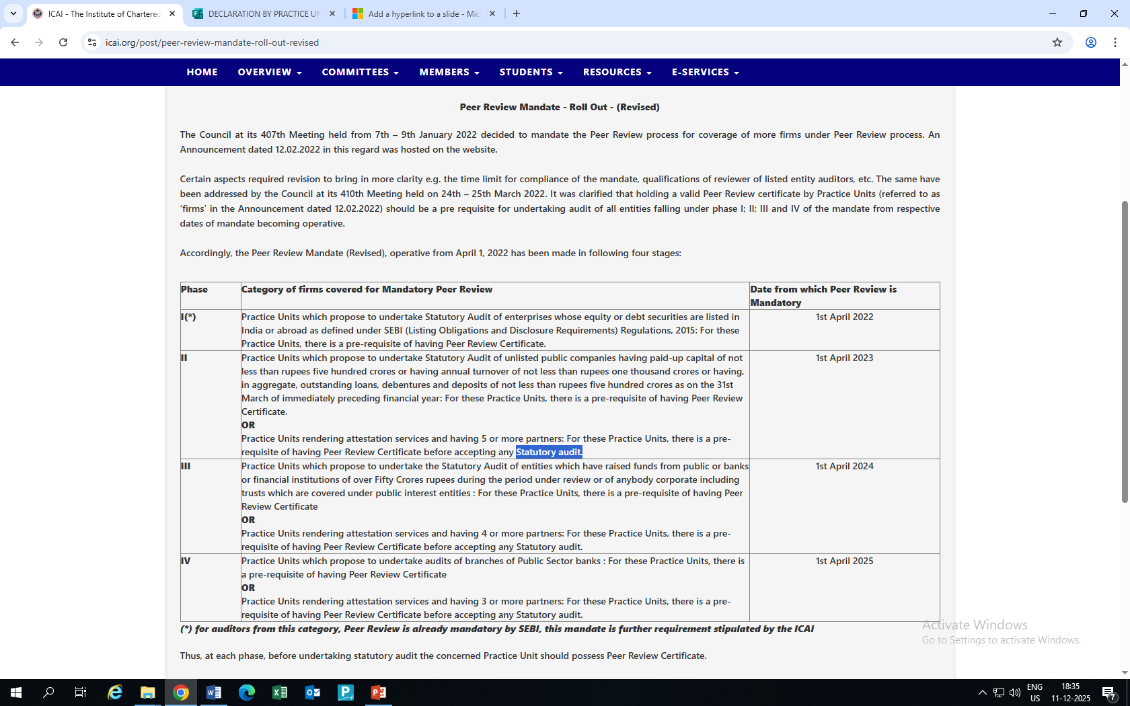
Meaning of statutory audit
Company

Slide 10
Clarifications / FAQs on the issues arising out of the Peer Review Mandate
1. At which stage
2. Meaning of ‘’raised funds ‘’ for phase III
CC/ Working capital
Term loan
from all sources
‘any body Corporate including trusts which are covered under public interest entities’ – Limit of Rs 50 cr is not applicable
3. Audit of branches of public sector Bank – Only statutory branch audit is covered .
4. Meaning of Statutory Audit?--mandated by law or statute.
5. As on which date should the number of having 5 or 4 or 3 or more Partners be reckoned ---on the date of mandate applicability

Slide 11
Peer Reviewer: Eligibility
Eligibility
Ineligibility
practice with at least 7 years of assurance (signing capacity) OR
Pending disciplinary action/proceeding
Found guilty of professional misconduct
10+ years employment experience and 3+ years audit in practice experience ( signing capacity) and is in whole-time practice at the time of enrolment and appointment as Peer Reviewer.
Not to accept the assignment before or after 2 years
Training and Test
Form 3 -Application
Valid for 3 years
Renewal 6 months before
Convicted of offense involving moral turpitude
Conflict of interest with Practice Unit
Prior association with Practice Unit (partner, training , article )

Slide 12
Peer Reviewer : Obligations & Fees
Reviewer Obligations
Fees Structure
Peer Review Guidelines
Mutually agreed upon by both parties
confidentiality
Minimum recommendatory fees notified by Board.
Not to take extracts of Practice Unit's client files
Board notified fees based on fees charged for
attest function (or ) gross turnover by PU
Complete review within prescribed timeframe
Submit report to Board within allowed time
Payable within 7 working days of invoice
Document all working papers-18 months
Appoint assistant
Non-payment may result in withholding certificate

Slide 13
Various Forms
Form 1- Application cum Questionnaire to be submitted by the Practice Unit.
Form 2- Acceptance cum Declaration of Confidentiality to be Submitted to the Practice Unit.
Form 6- Format for seeking additional information from the Practice Unit by the Reviewer.
Form 5- Notice by Peer Reviewer for visiting the office of the Practice Unit
Form 7- Joint application to be made by PU and RE for seeking additional time For completion of Peer Review process.
Form 9- Letter for submission of report by the Peer Reviewer to the Peer Review Board
Form 3- Application cum Declaration for Empanelment as a Peer Reviewer.
Form 8- Letter seeking extension to the validity of Peer Review Certificate.
Form 10- Notice to be given to the Practice Unit by the Board in case of revocation of Peer Review Certificate

Slide 14
Critical Points to Remember
Peer reviewer is appointed in individual capacity
UDIN is not required
  Cannot communicate with or visit clients of the Practice Unit under any circumstances
Documentation and sample selection are critical aspects
Peer Review is not a fault-finding exercise but a capacity-building tool

Slide 15
Benefits
Benefits for Practice Units
Ensures compliance with established Standards, such as SQC-1.
Enhances efficiency and consistency in audit engagements.
Provides structured feedback for continuous improvement.
Acts as a vital tool for preparation for regulatory scrutiny.
Documents preparation including and more specifically MSME and SMP.
Advisory services
Implementation began in April 2023 for firms auditing listed companies and will extend to smaller practices by January 2026, progressing through four distinct phases.

Slide 16
Conclusion
"Peer Review does not seek to redefine the scope and authority of any Technical, Professional and Ethical Standards but only seeks to ensure they are implemented, both in letter and spirit."
Focus Area
Primary Objective and end goal
To maintain and improve the quality of assurance services
Value added suggestions
not to judge or simply identify deficiencies but to evaluate procedures followed by the Practice Unit and provide appropriate guidance
To identify weaknesses that are pervasive and chronic in nature, not isolated cases of engagement failure.

Slide 17
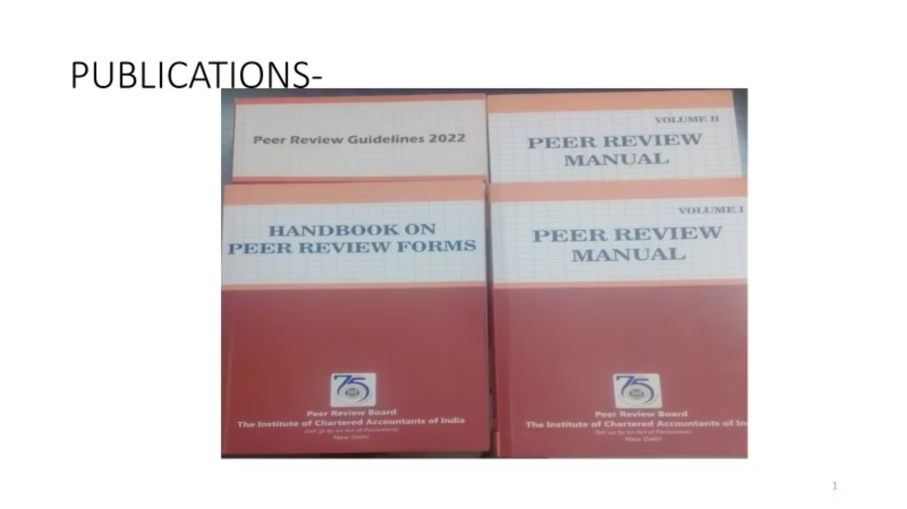
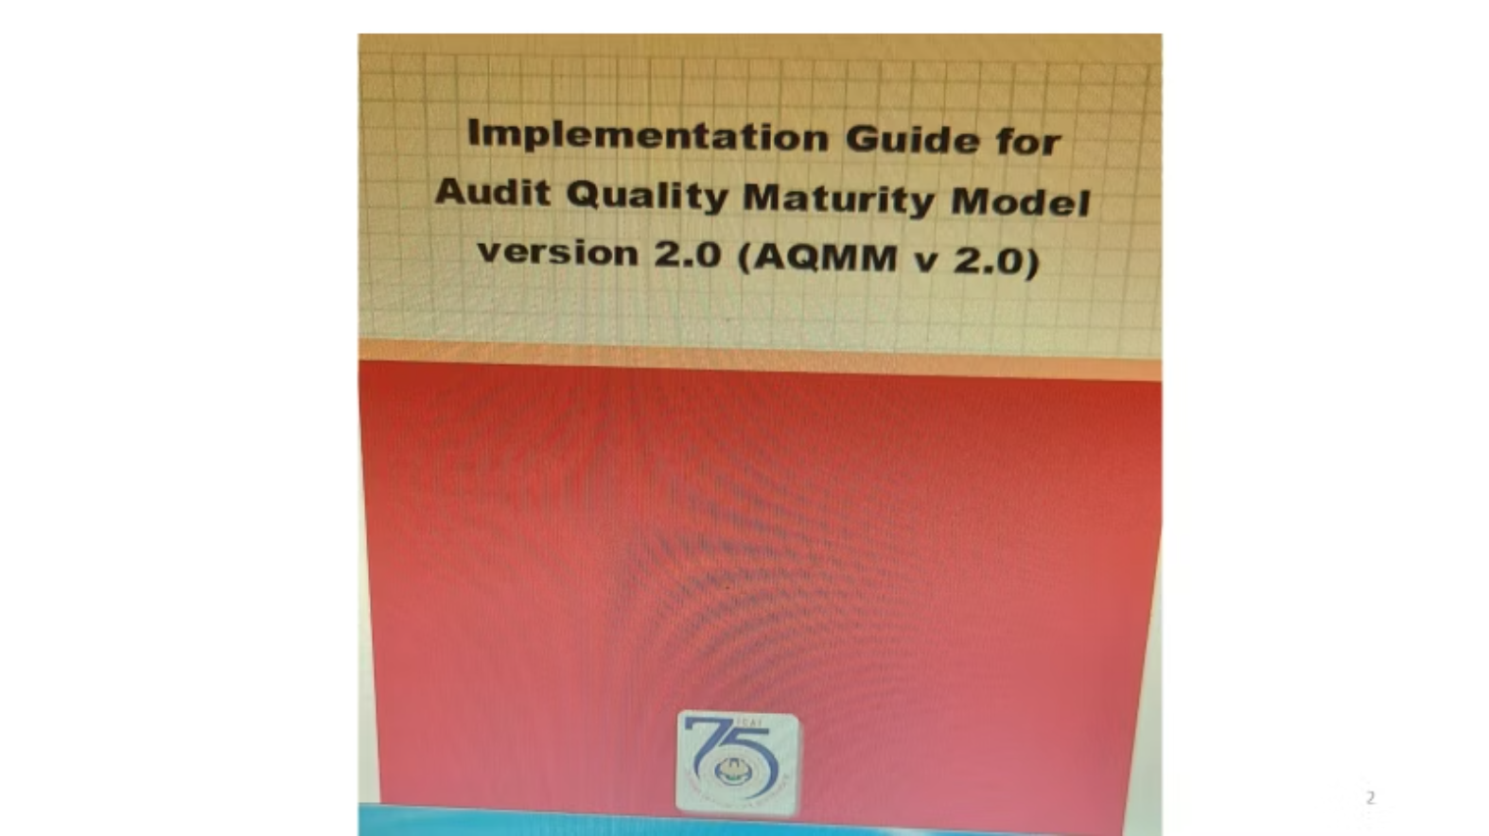
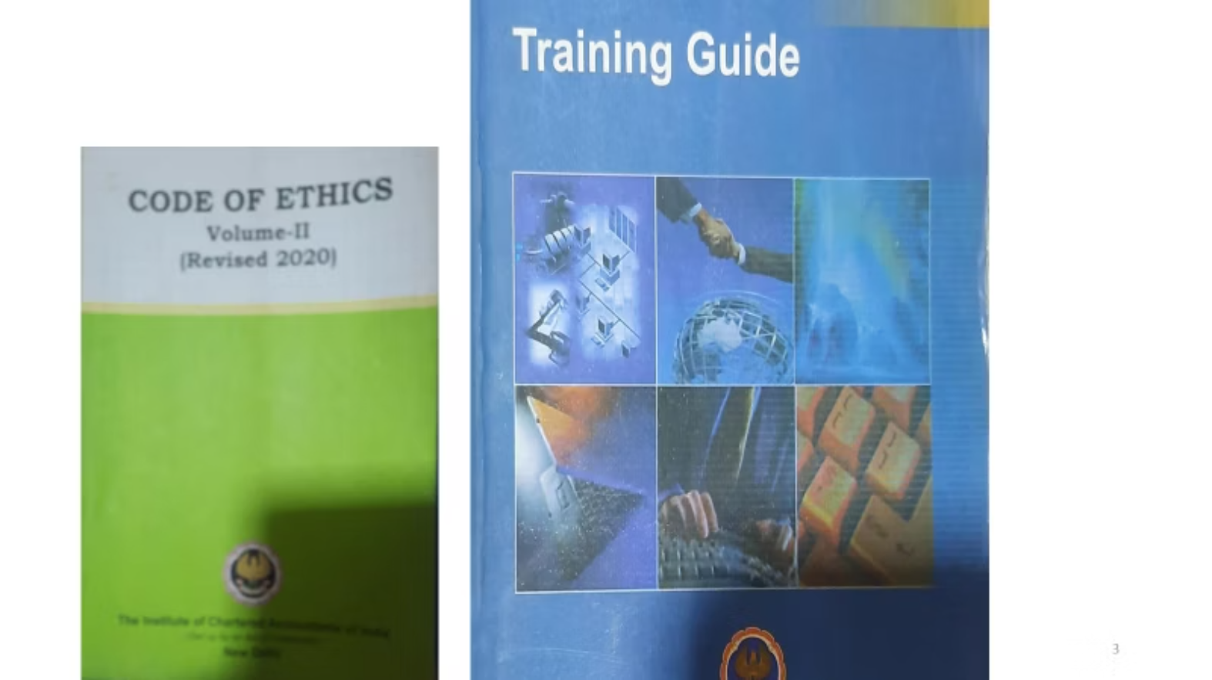
Peer Review Board website
Implementation guide on SQC1

Slide 18
Thank you
CA Samir Kasvala
Mob : 9833222524
Email : samir@kasvalaassociates.com

