Slide 1
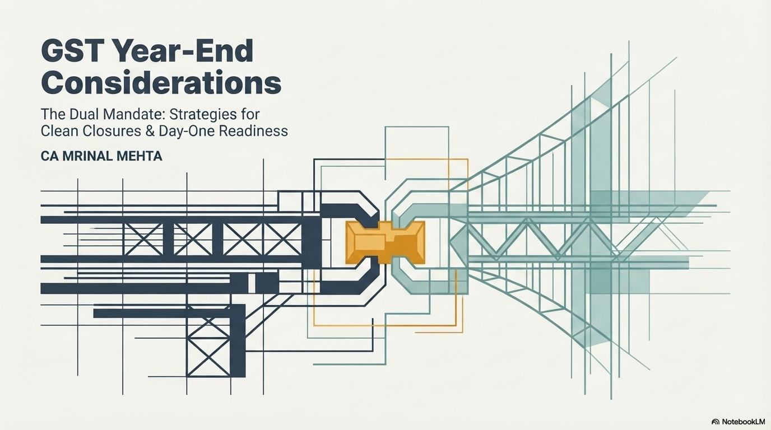

Slide 2
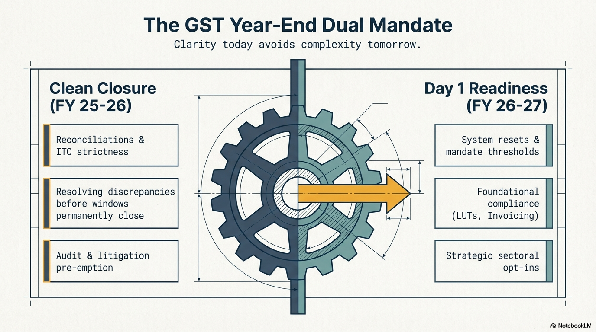

Slide 3


Slide 4
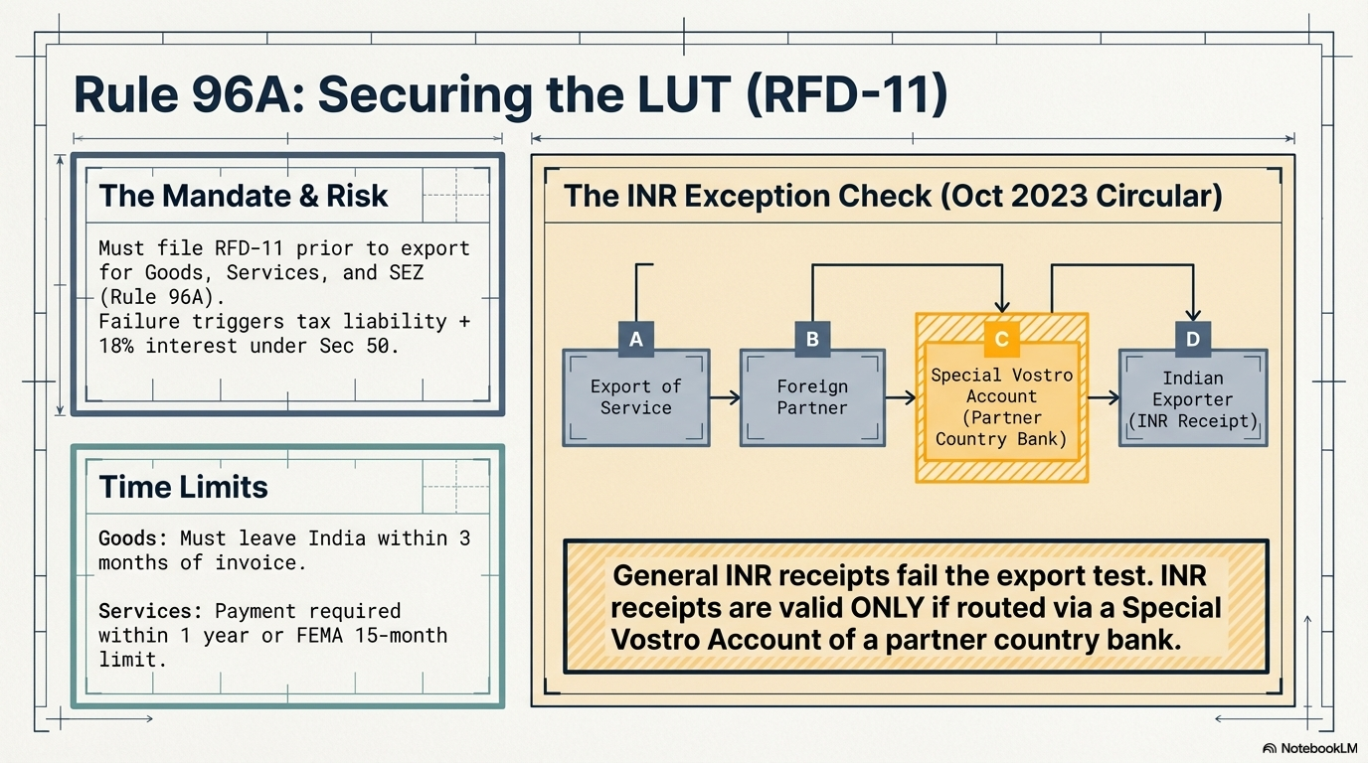

Slide 5
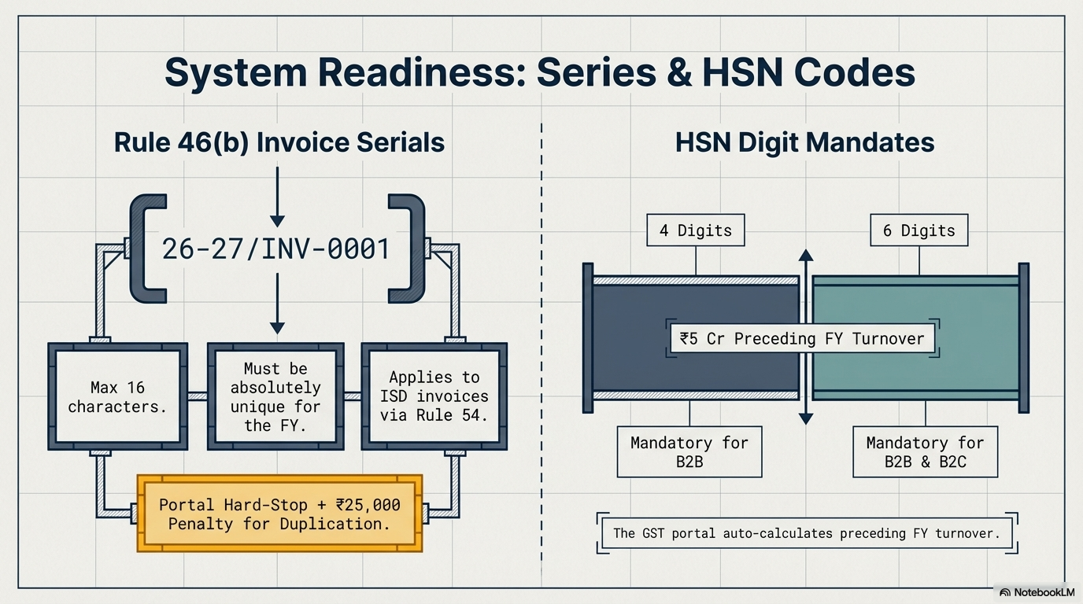

Slide 6
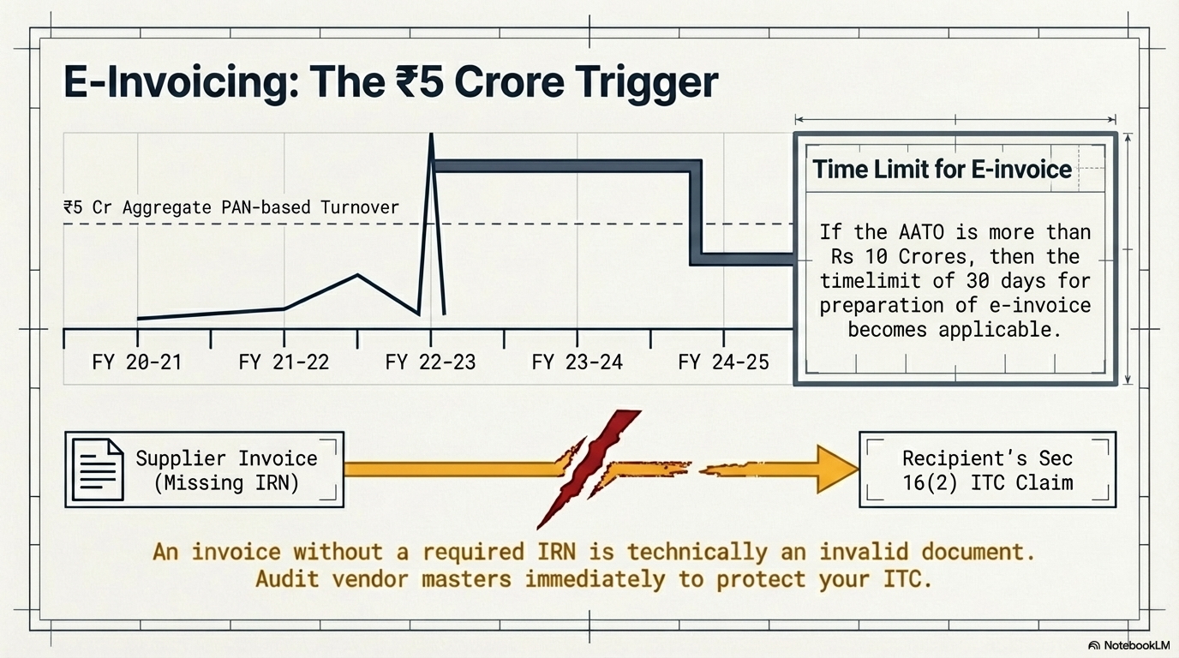

Slide 7
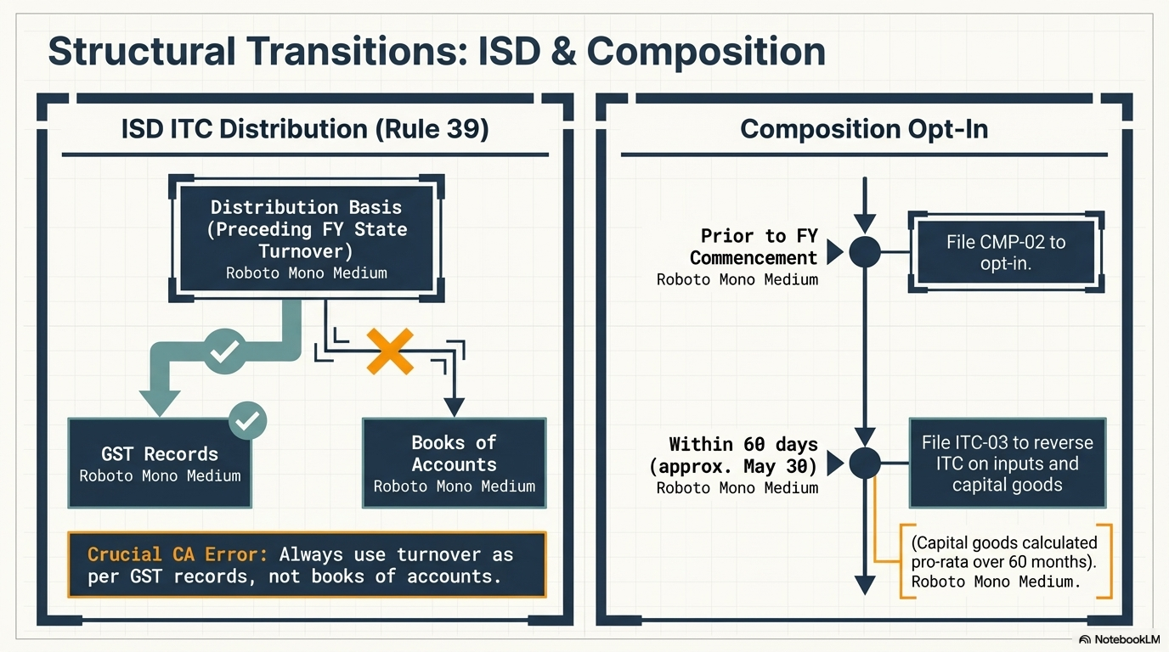

Slide 8
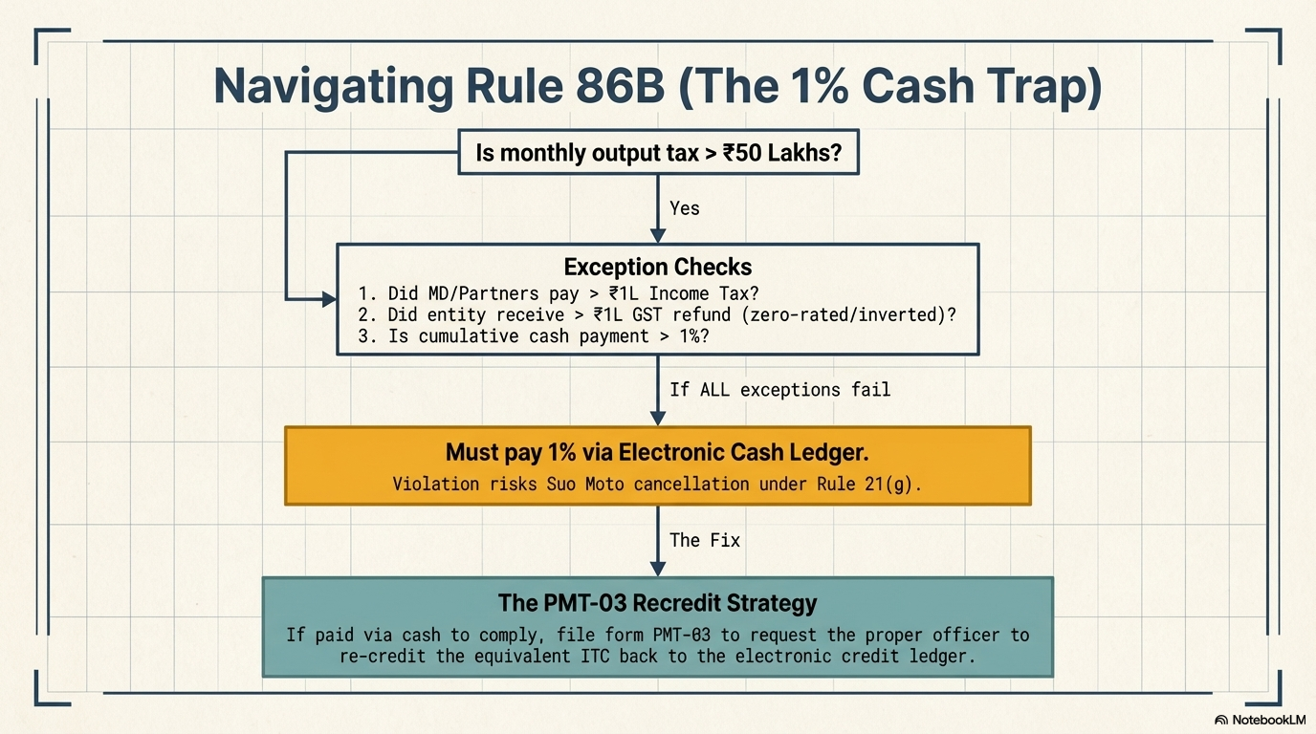

Slide 9
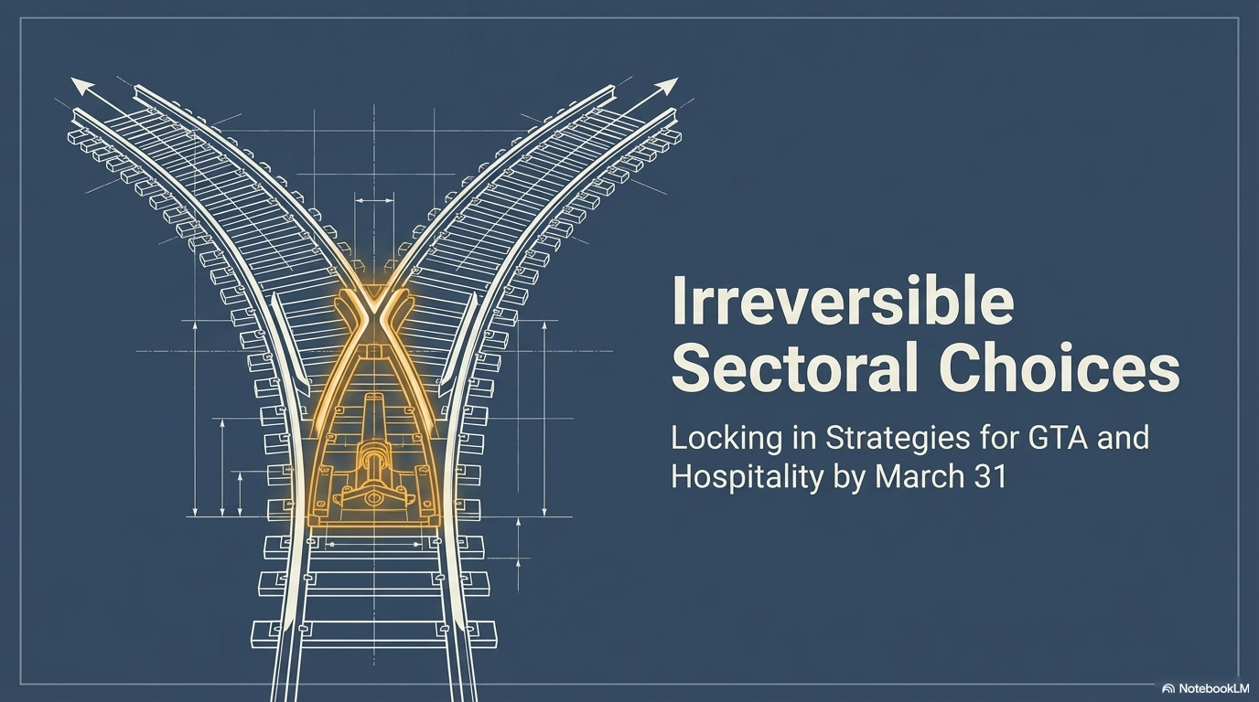

Slide 10
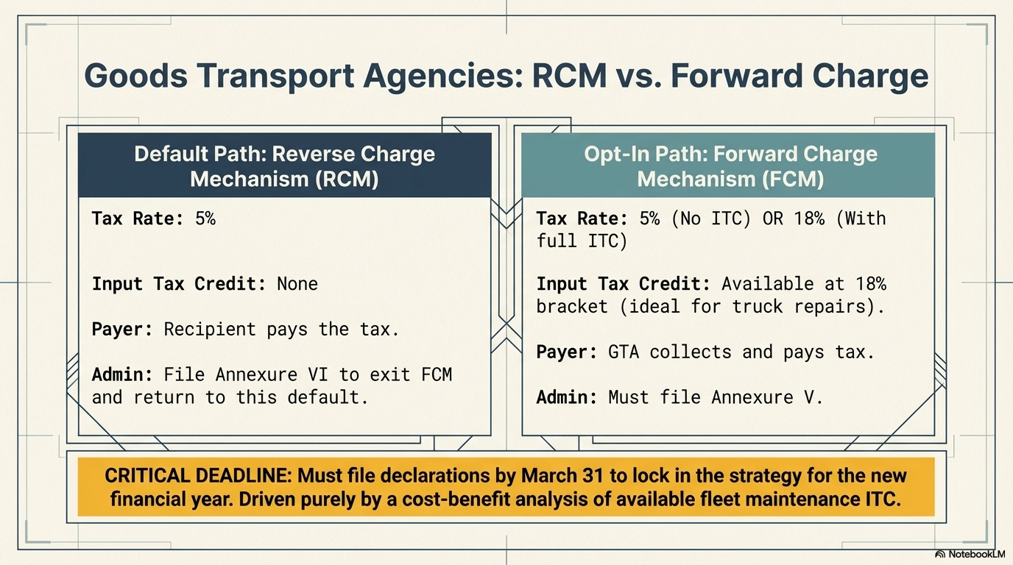

Slide 11
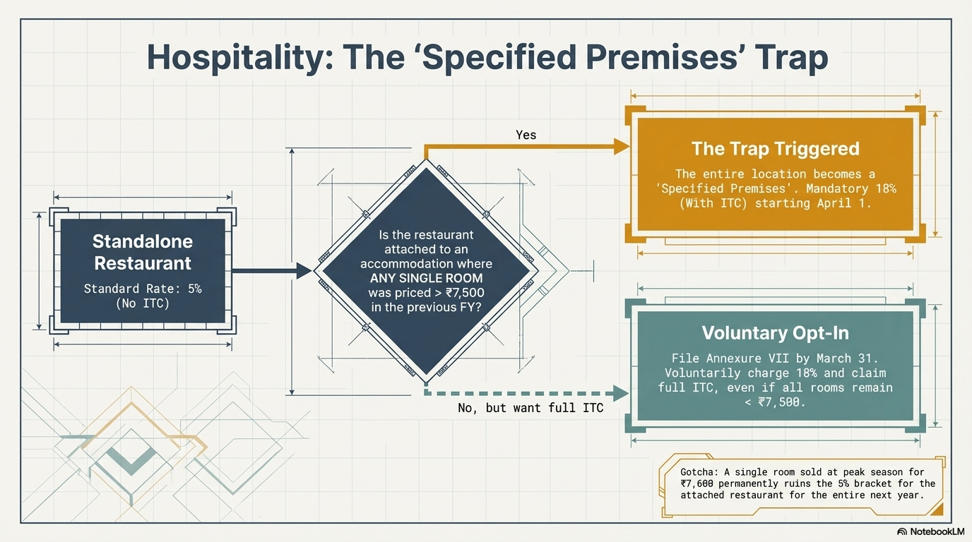

Slide 12
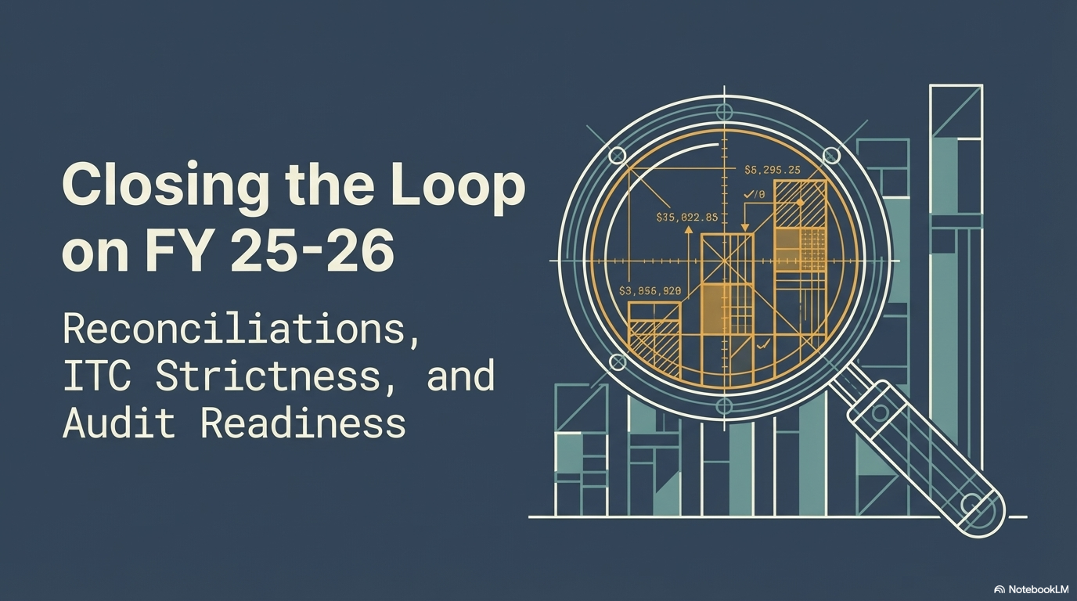

Slide 13
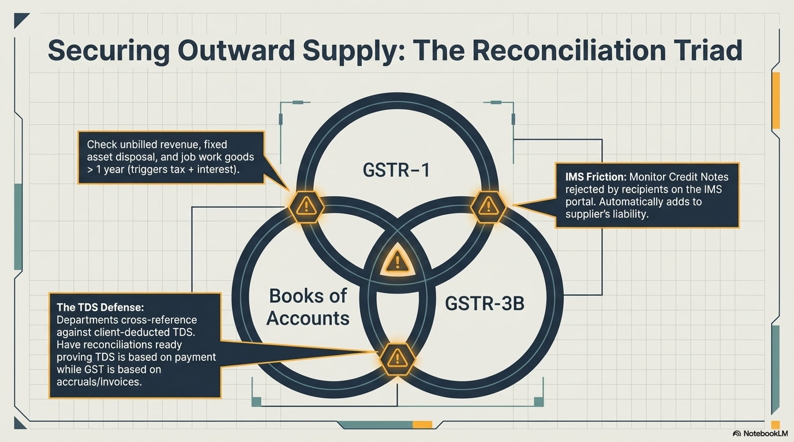

Slide 14
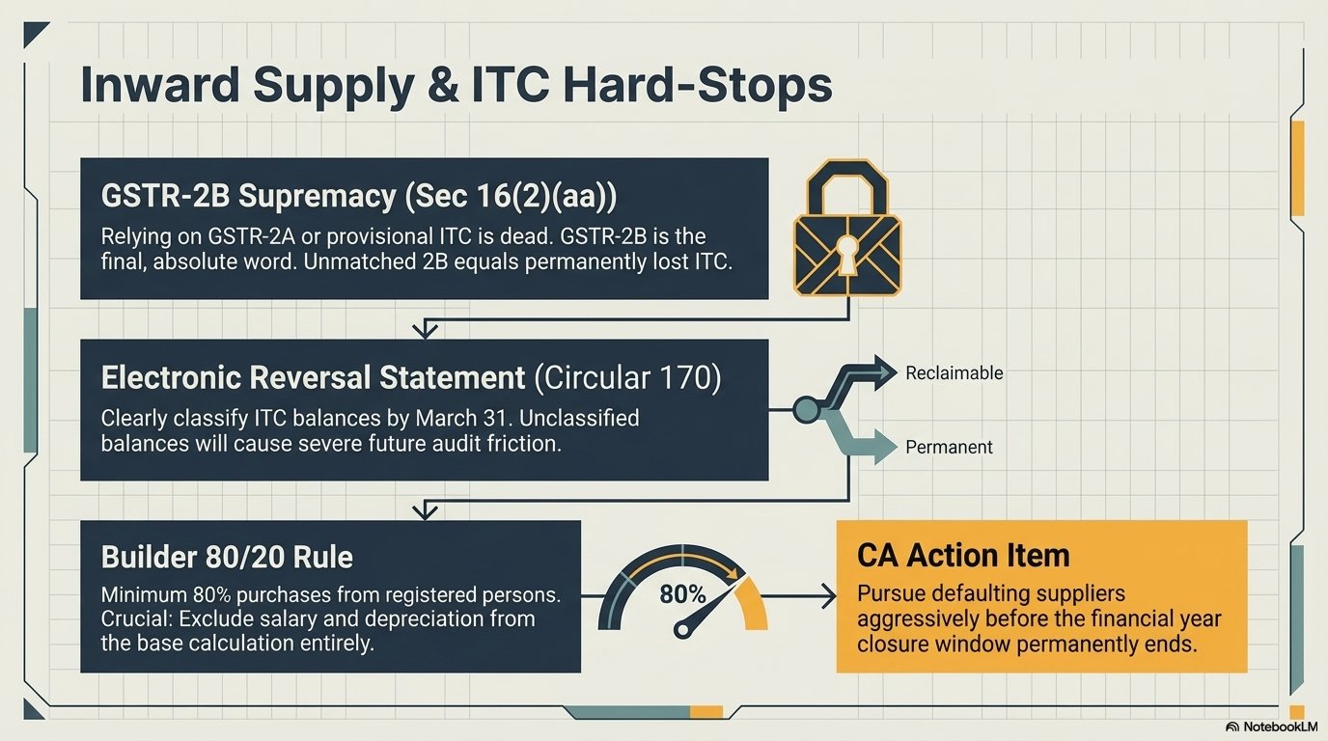

Slide 15
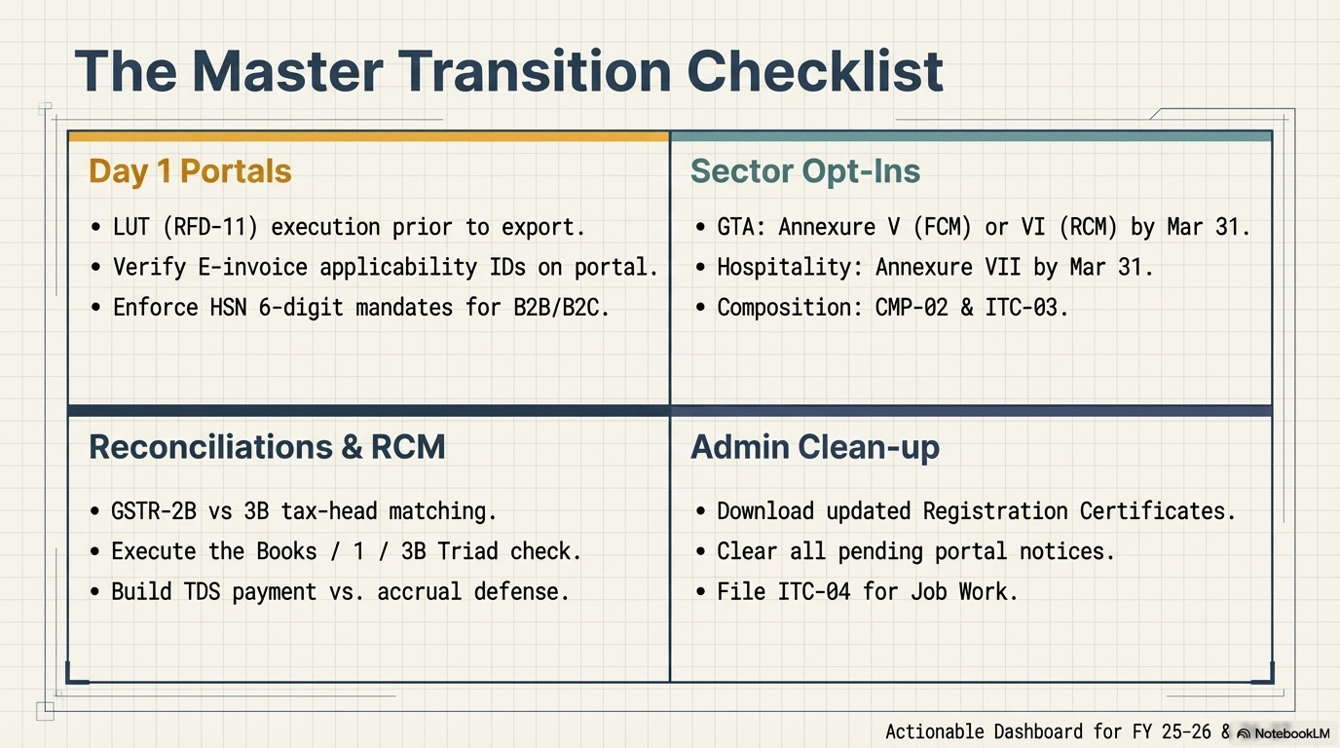

Slide 16
Additional Points
Change of periodicity of returns filing from Quarterly to Monthly and vice versa.
Taxpayers with AATO < Rs 5 Crores can opt for Quarterly Return Monthly Payment Scheme (QRMP)
The QRMP scheme can be opted in or out at any time during the year, but the window is restricted to the first month of the quarter
Verify B2C sales reported in GSTR1 due to temporary suspension of Customer GSTIN’s. In case the GSTIN are now active, the amendment to be filed as B2B and revised B2C turnover
Re-computation of Reversal of ITC under Rule 42 & 43 and adjustment thereof

Slide 17
Additional Points
Refund Application – Time Barring of 2 years
Refund for April 2024 gets time barred on 31/3/2026
Accounting Entries for Utilisation and Reversal of ITC and reconciliation of ITC balance as per books of accounts with the Electronic Credit Ledger
Review of amounts payables to the vendors and reversal of ITC if outstanding for more than 180 days
Billing Compliances for Unbilled Revenue and Advances Received

Slide 18
QUESTIONS ??
CA MRINAL ASHOK MEHTA
Email: mrinal.vmc@gmail.com
Mobile: 9820792762

